Slide 1


Cursed Tomorrow
A DSA project by :
Ahmed Hassan 221775
Faraz Ashraf 221847

Slide 2
Why we Choose this Project
Passion Fusion: Blend of love for game development and data structures.
Learning Through Play: Game integrates data structures for hands-on learning.
Real-world Application: Showcases practical use of data structures in games.
Graphical Function Flow: Creating a Mesh among Classes, Linking different levels to "goto" among each process.
DSA Concepts in Gaming Field: Aside Problem Solving, but Now Renouncing DSA in the Gaming Field.
Efficient FPS: Demonstrates coding and data structure concepts, enhancing game frame-rate per second, thus enabling smooth gameplay.

Slide 3
TABLE OF CONTENTS
01
02
03
04
Introduction
Topics covered
Libraries
Classes

Slide 4
01
Introduction
Cursed Tomorrow" a magnificent 2D platformer that transcends the boundaries of traditional gaming. This masterpiece has been meticulously crafted using C++ and the complex principles of OOP and Data Structures.

Slide 5
Topics covered
Stack
Queue
Dequeue
Iterators
Linked list

Slide 6


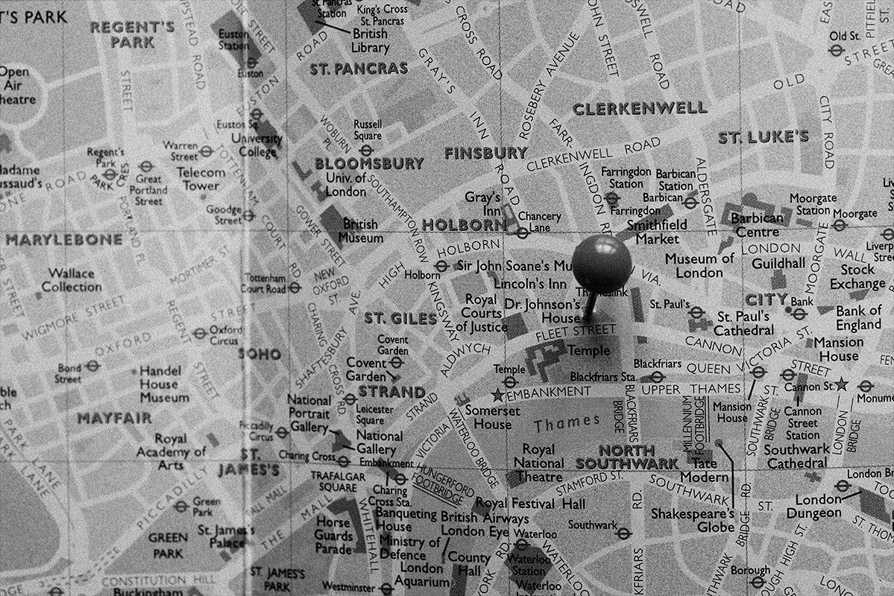
Stack
Stack is used in the code as a screen changer. It works like as the game starts, pushes the main screen in the stack and pops the screen before entering the second screen

Slide 7
Queue
Queue used in end screen animation when user completes all levels and animations start. Queue provides a simple sequence of animation screen making it easy to add and remove

Slide 8
Dequeue
Dequeue switches level from one to next. Dequeue updated after the completion of each level

Slide 9

Iterators
Iterator is a pointer that is used to represent the position of an object. Iterators update and manage the position of an object. As the game starts, the iterator starts checking the position with the help of the position properties of an object, checking the location or position, continues updating with the object movement so that object work properly as the game progress

Slide 10
Libraries
Stack
Queue
Raylib.h
Dequeue
Vector

Slide 11
Classes
Class Audio
Class character
Class PNG’S
Class stages
Class Levels

Slide 12
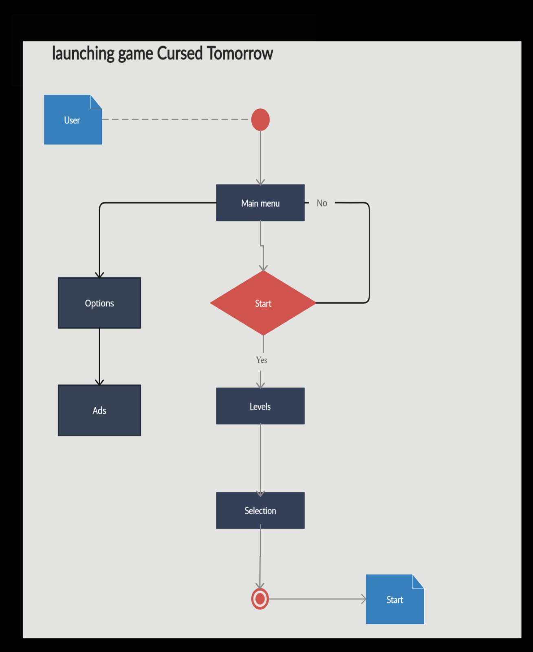
Game step

Slide 13
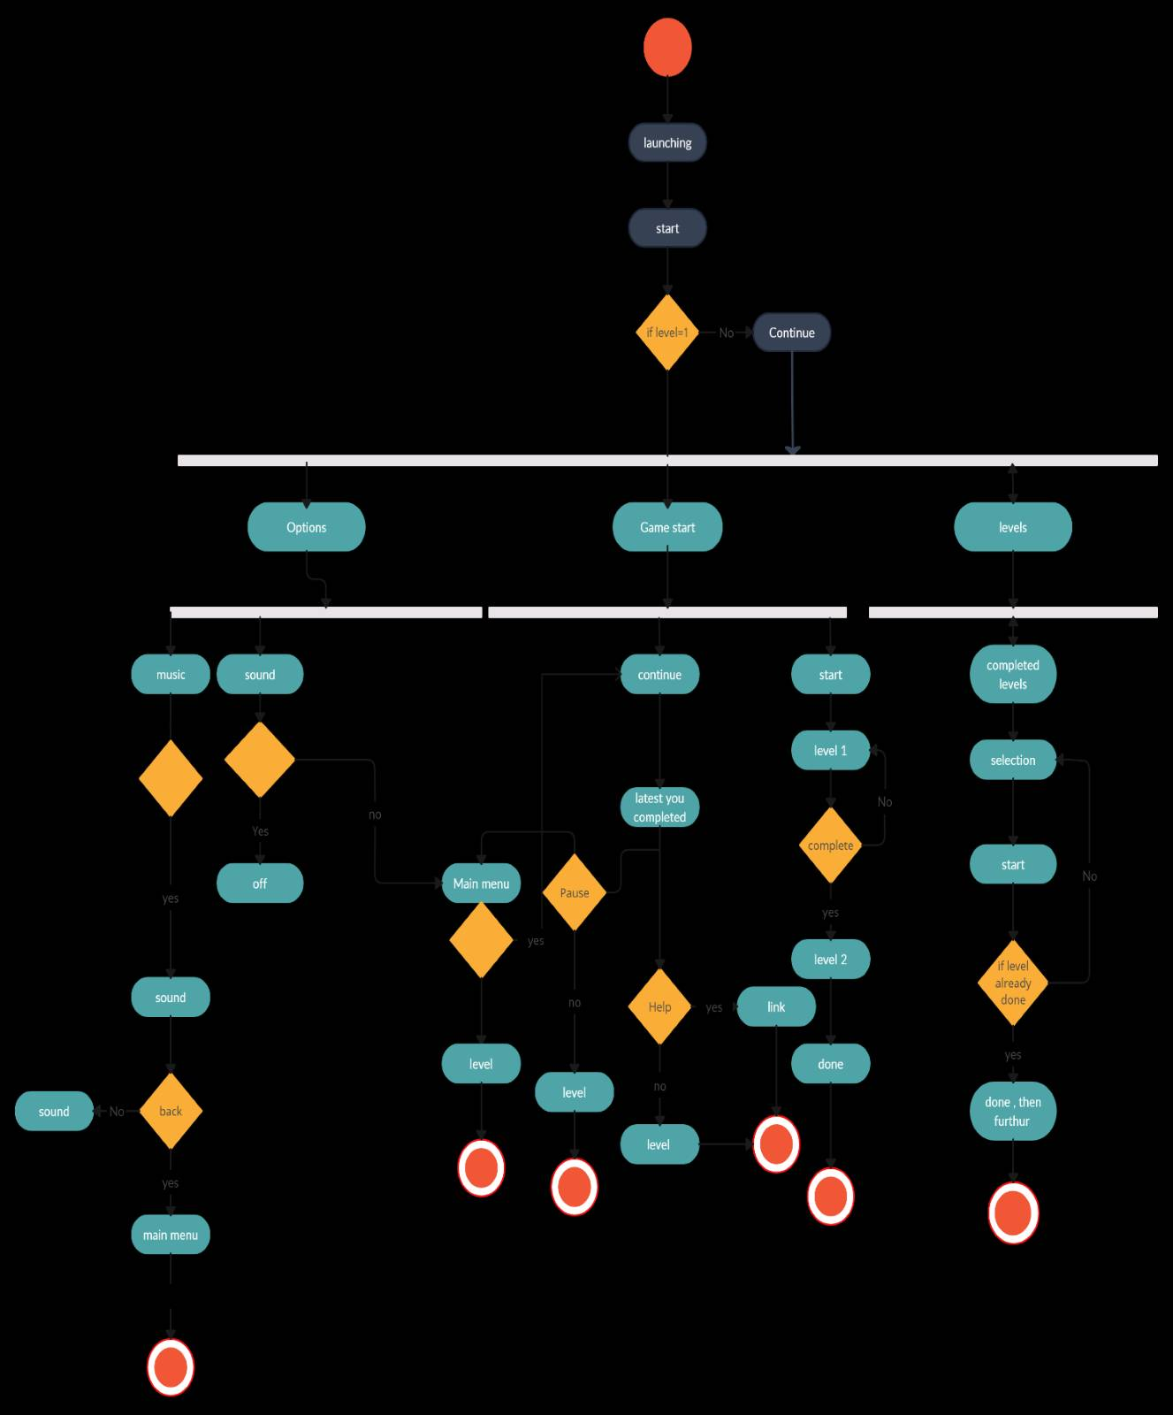

Logical Flow
MEN
Mercury is the smallest planet
WOMEN
Venus has a beautiful name

Slide 14
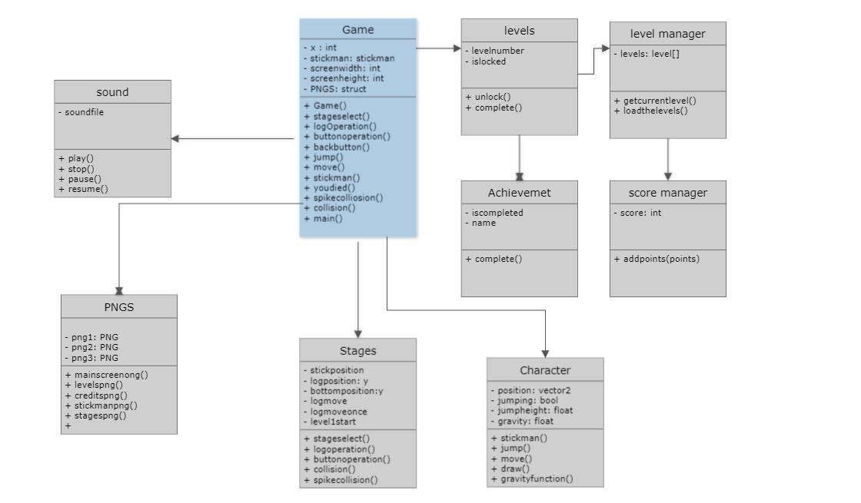
Class Diagram

Slide 15

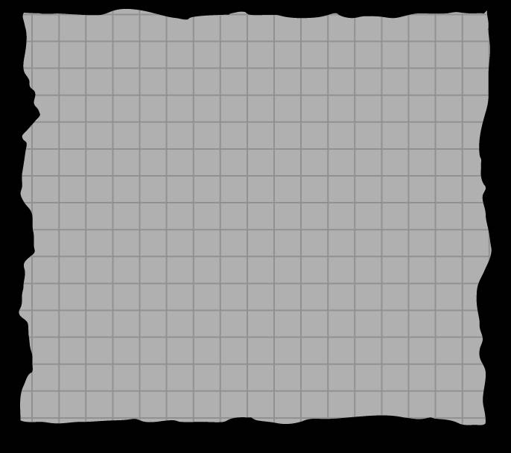
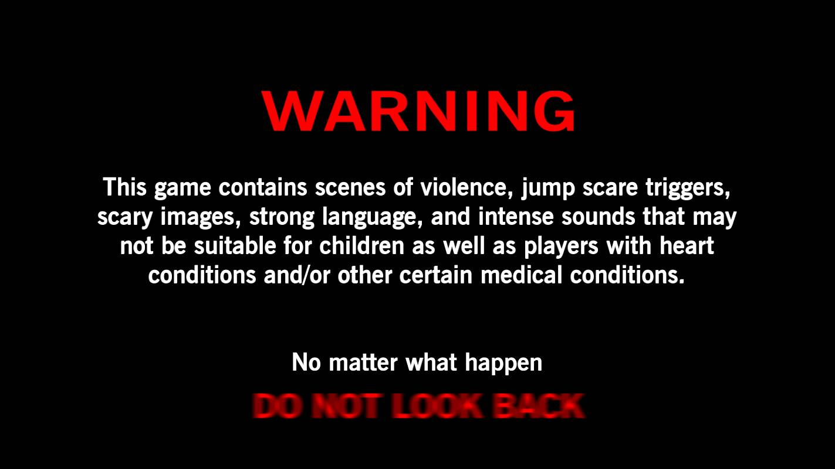


Starting screen
Have you see the truth?
DATE | TIME | PLACE | COURSE
02/22/23 | 9:00 am | Saturn has several rings | Neptune is far away from us
04/15/23 | 2:00 pm | Jupiter is the biggest planet | Mercury is a small planet
06/30/23 | 11:00 am | Venus has a beautiful name | Mars is a very cold planet
Who was...?
Where…?

Slide 16

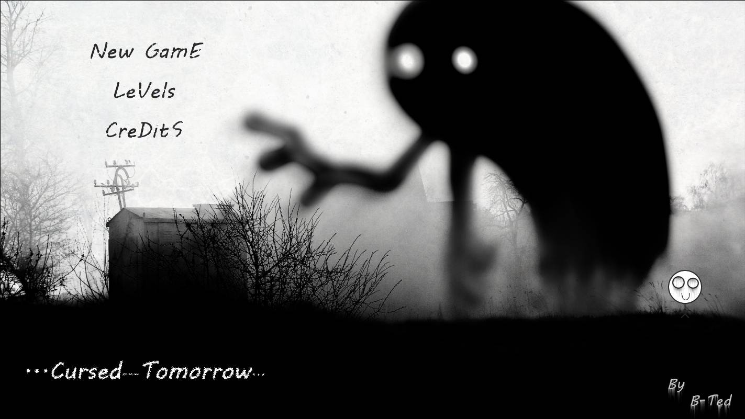
Main screen`

Slide 17
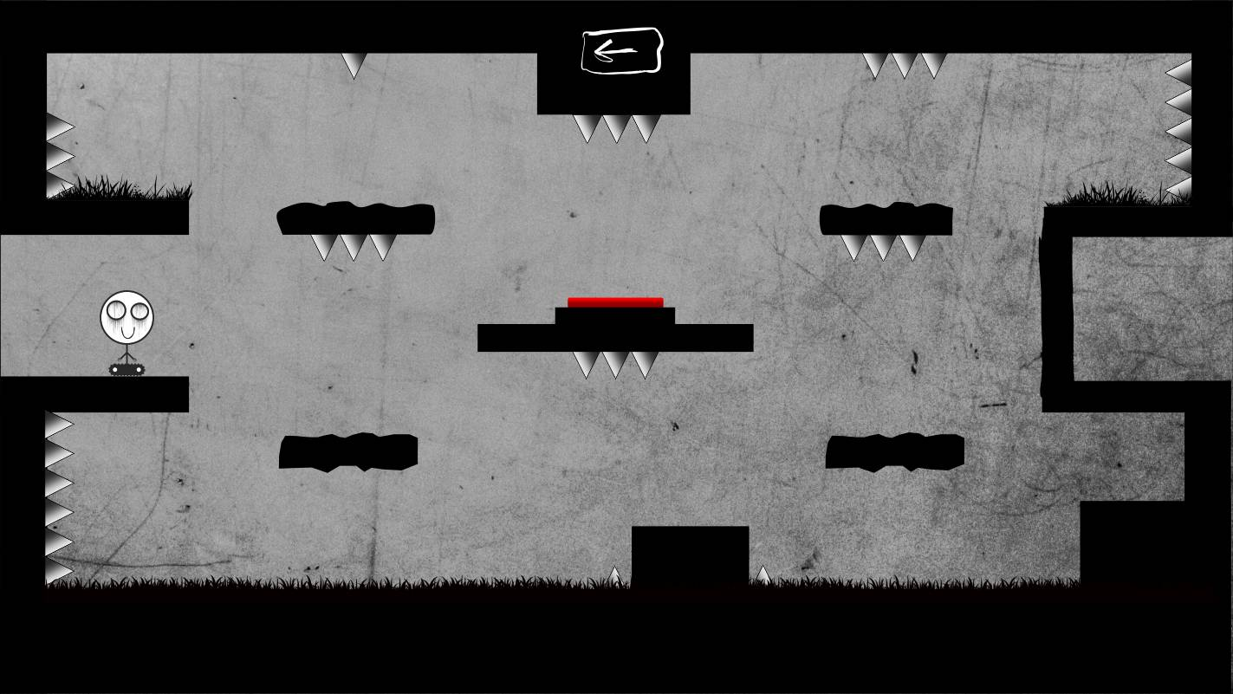
Game screen

Slide 18
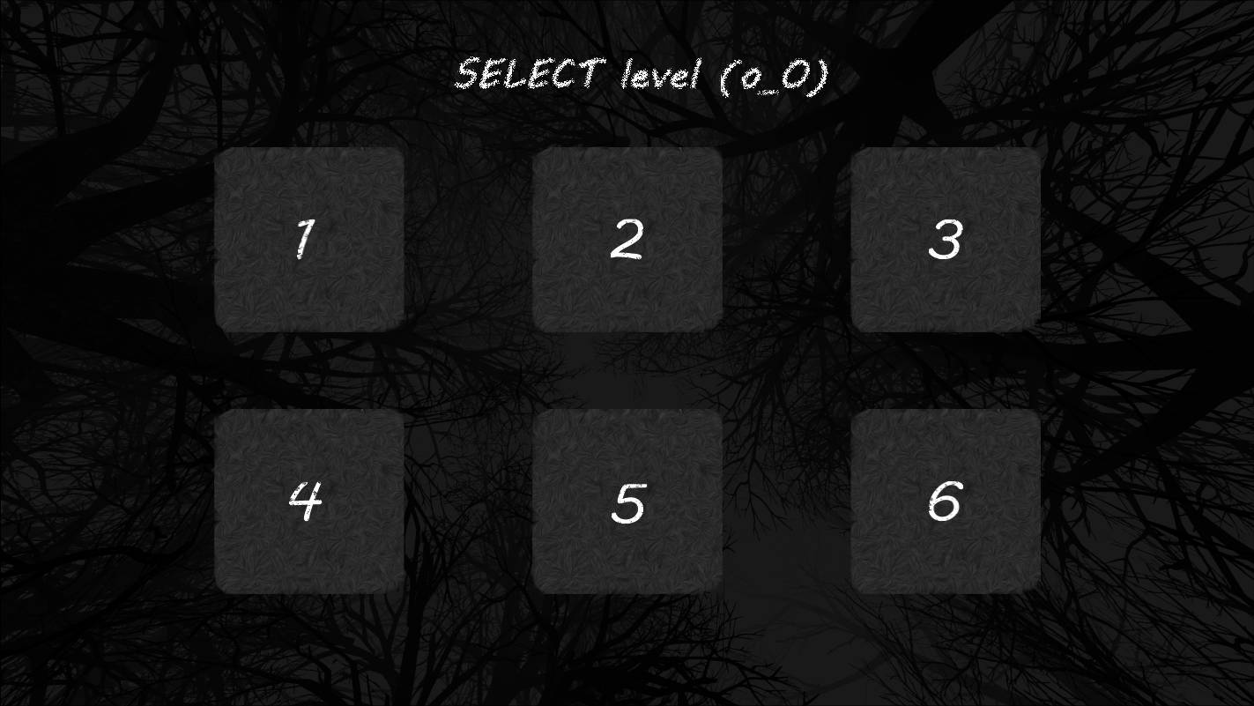
Level screen

Slide 19
THANK YOU!

