Slide 1
Investigating Pixel 3
Android 10
Notes:
https://digitalcorpora.s3.amazonaws.com/corpora/mobile/android_10/Non-Cellebrite%20Extraction/Pixel%203.zip

Slide 2
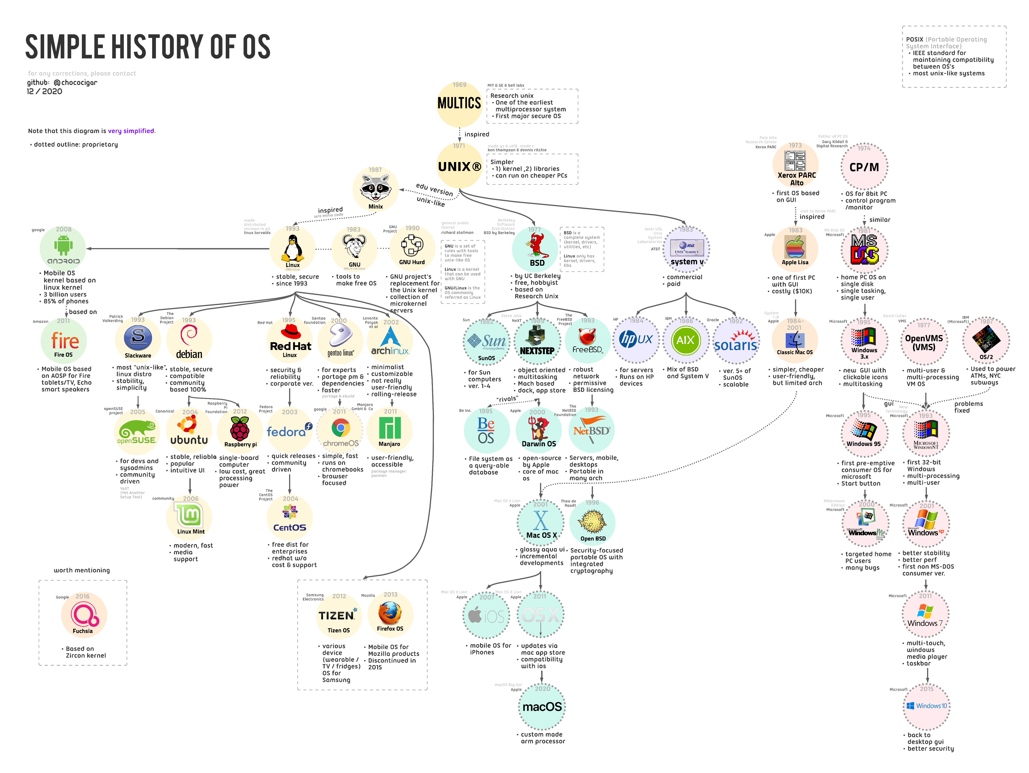

Slide 3
Introduction to Android

Slide 4
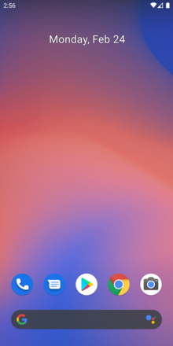
What is Android?
Android is a mobile operating system
  based on a modified version of the Linux kernel
  was unveiled in November 2007
Android is open-source software
  its source code is known as Android Open-Source Project (AOSP)
Most Android devices ship with additional proprietary software pre-installed, including
  Google Mobile Services: Google Chrome, YouTube, Google Maps
  Google Play Service: Backup, Contacts Sync, Account Manager
Notes:
https://en.wikipedia.org/wiki/Android_(operating_system)
https://en.wikipedia.org/wiki/Google_mobile_services

Slide 5
Google controls AOSP
Google controls and maintains AOSP
  Core Development by Google
  Open Source Contribution
  Apache License 2.0
  Google manages the release schedule, documentation, and feature roadmap for AOSP
Examples of AOSP-derived projects
  Amazon Fire OS,
  LineageOS: completely open-source and community-driven
  Huawei HarmonyOS

Slide 6
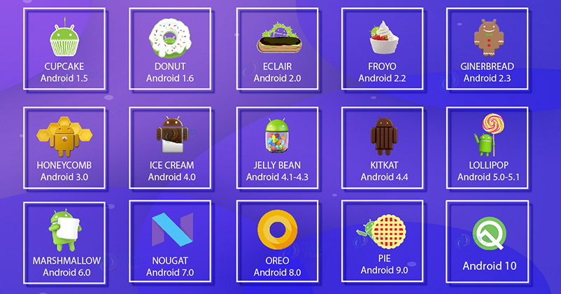
History of Android (1-10)
Code Name
Version Name

Slide 7
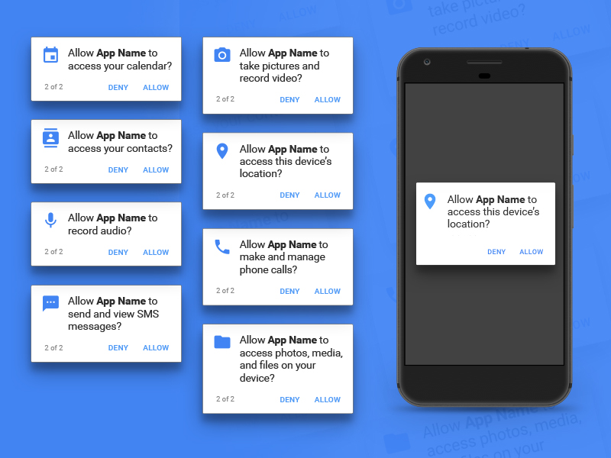
History of Android (11)
Launched in September 2020
The most significant changes revolve around privacy
Pushes the background location permission even deeper into the system
  makes it more difficult for apps to request
Removes an app's ability to see what other apps are installed on your phone
Android permission prompts to ensure privacy
https://www.sketchappsources.com/resources/source-image/android-permission-groups-prompts.jpg

Slide 8
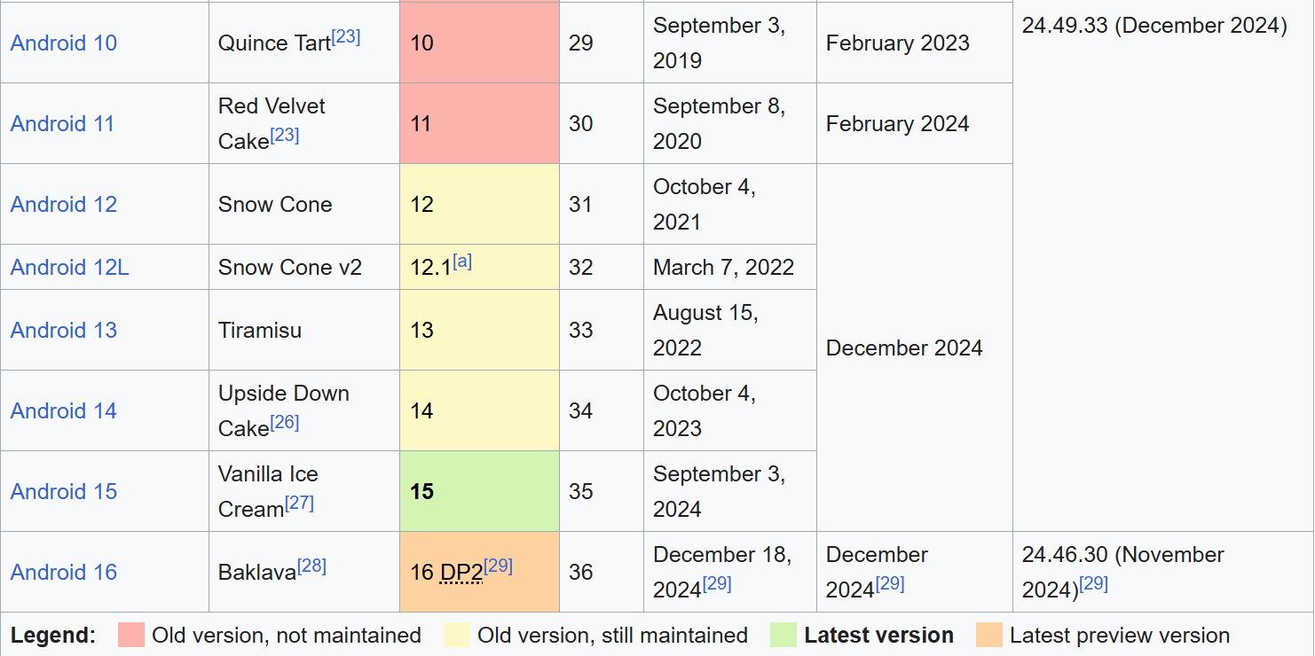
History of Android (11-16)
https://en.wikipedia.org/wiki/Android_version_history

Slide 9
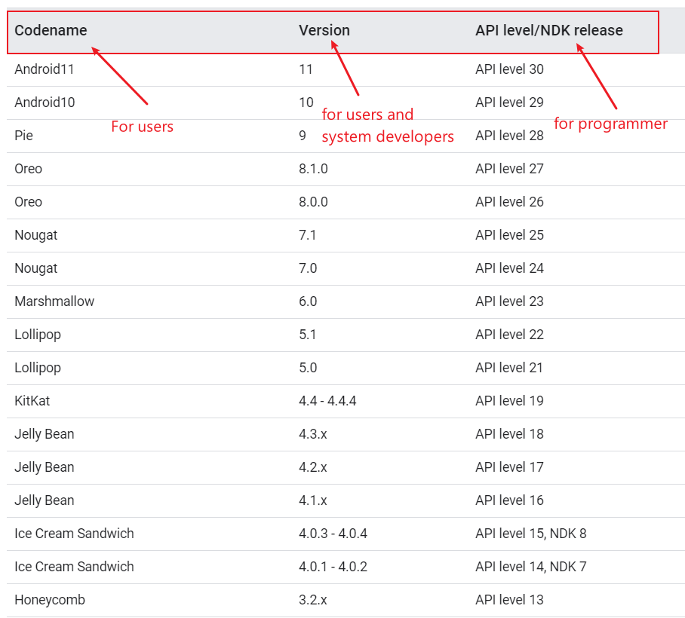
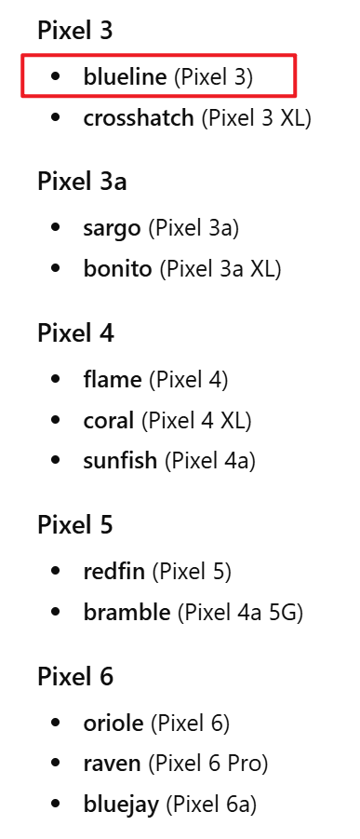
Codename, Version, API, hardware codename
The Android NDK is a toolset that lets you implement parts of your app in native code, using languages such as C and C++.
hardware codename
Notes:
https://source.android.com/setup/start/build-numbers

Slide 10
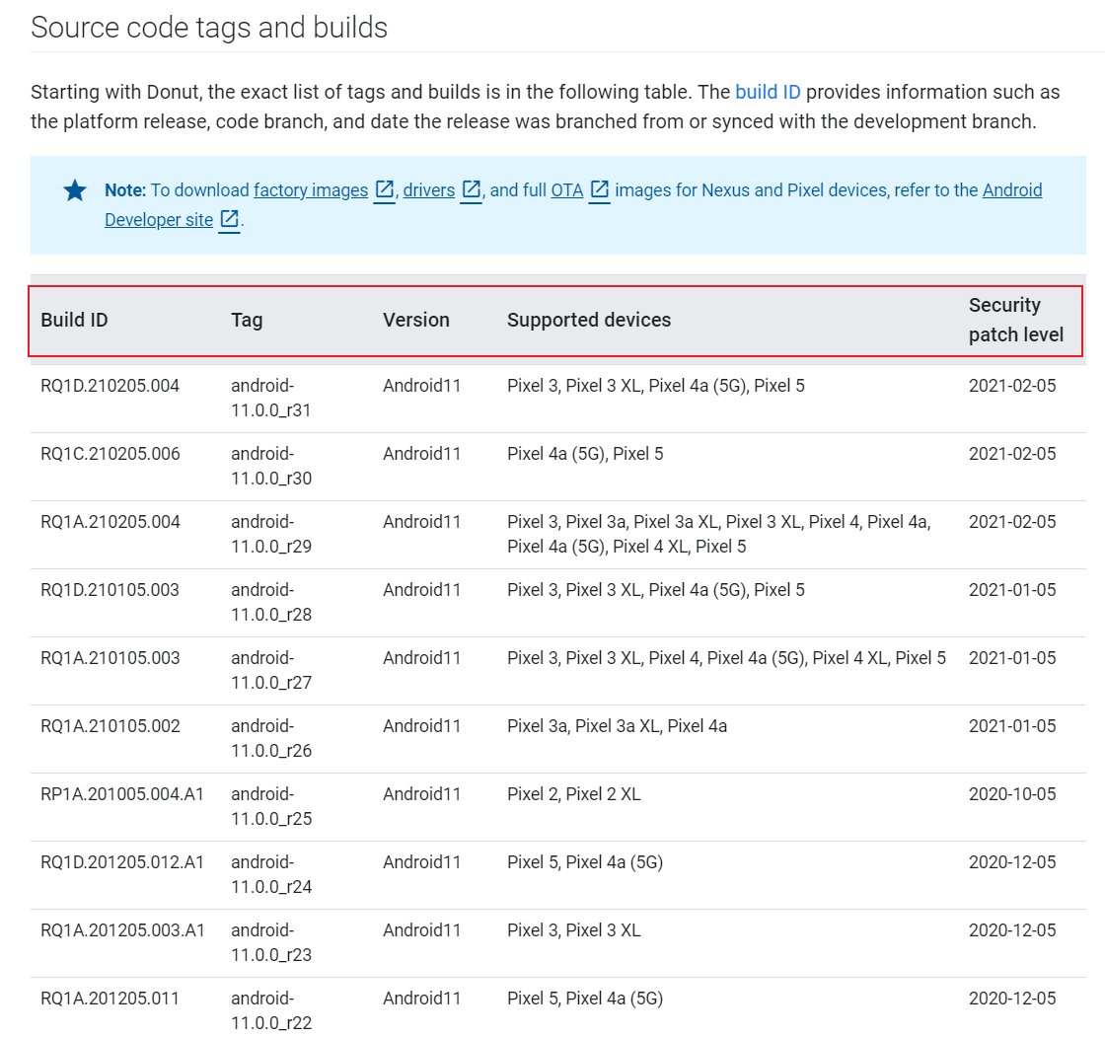
Source code tags and builds
build ID provides information such as the platform release, code branch, and date the release was branched from or synced with the development branch.
Notes:
https://source.android.com/setup/start/build-numbers
Each stage of the Android boot process involves completing specific tasks, preparing for the next stage, and then handing over control to the subsequent stage. Here's a breakdown of how this works across the key stages:
---
### **1. Boot ROM (Read-Only Memory)**
- **Tasks Completed**:
- Executes when the device is powered on.
- Detects the boot media (e.g., internal storage or external memory) to locate the bootloader.
- Loads the first-stage bootloader into RAM.
- **Preparation for Next Stage**:
- Initializes minimal hardware components (e.g., CPU, clocks).
- Ensures external RAM is ready for use.
- **Control Transfer**:
- Hands control to the **bootloader**.
---
### **2. Bootloader**
- **Tasks Completed**:
- Sets up initial memory configurations.
- Loads the Linux kernel and its associated RAM disk (temporary file system) into memory.
- Handles security checks (e.g., locked/unlocked bootloader).
- **Preparation for Next Stage**:
- Configures file systems, additional memory, and low-level security options.
- Prepares the environment for the kernel to execute.
- **Control Transfer**:
- Jumps to the **Linux kernel** after decompressing it in memory.
---
### **3. Linux Kernel**
- **Tasks Completed**:
- Initializes hardware drivers (e.g., interrupt controllers, memory management units, caches).
- Sets up virtual memory and scheduling mechanisms.
- **Preparation for Next Stage**:
- Mounts the root file system.
- Locates the `init` process (found in `/system/core/init`) to serve as the first user-space process.
- **Control Transfer**:
- Passes control to the **init process**.
---
### **4. Init Process**
- **Tasks Completed**:
- Parses initialization scripts (`init.rc` or `init<machine name>.rc`).
- Sets up system services, file systems, and other parameters defined in the script.
- **Preparation for Next Stage**:
- Launches core system services and processes.
- Starts the **Zygote process**, which preloads common application classes and initializes the Dalvik/ART runtime.
- **Control Transfer**:
- Hands control to the **Zygote process**.
---
### **5. Zygote and Dalvik/ART**
- **Tasks Completed**:
- Preloads common application classes and resources into memory.
- Initializes the Android Runtime (ART) or Dalvik Virtual Machine (DVM).
- **Preparation for Next Stage**:
- Speeds up app launches by sharing preloaded code across all apps.
- Prepares the environment for launching the **System Server**.
- **Control Transfer**:
- Passes control to the **System Server**.
---
### **6. System Server**
- **Tasks Completed**:
- Starts core Android services:
- Activity Manager, Package Manager, Window Manager, etc.
- Telephony registry, alarm manager, sensor service, Bluetooth service, etc.
- Manages system-wide functionalities like notifications, location services, and audio settings.
- **Preparation for Next Stage**:
- Completes the initialization of the Android framework.
- Broadcasts the `ACTION_BOOT_COMPLETED` intent to signal that the boot process is complete.
- **Control Transfer**:
- Allows third-party apps and services to start running by responding to the `ACTION_BOOT_COMPLETED` broadcast.
---
### **7. User-Space Services and Apps**
- **Tasks Completed**:
- Third-party apps and services register to receive the `ACTION_BOOT_COMPLETED` broadcast.
- Custom services or apps can perform actions (e.g., setting alarms, initializing background tasks).
- **Preparation for Next Stage**:
- The system is now fully operational, and the user interface is ready for interaction.
- **Control Transfer**:
- Control is handed over to the user, who can interact with the device.
---
### Summary Table of Boot Process Stages
| **Stage** | **Tasks Completed** | **Preparation for Next Stage** | **Control Transfer** |
|-----------------------|-------------------------------------------------------------------------------------|------------------------------------------------------------------|---------------------------------|
| **Boot ROM** | Detects boot media, loads bootloader | Initializes minimal hardware | Bootloader |
| **Bootloader** | Loads kernel and RAM disk, handles security | Configures memory, file systems, and low-level settings | Linux Kernel |
| **Linux Kernel** | Initializes hardware drivers, sets up memory management | Mounts root file system, locates `init` process | Init Process |
| **Init Process** | Parses `init.rc`, starts core services | Launches Zygote process | Zygote |
| **Zygote** | Preloads app classes, initializes ART/Dalvik | Prepares environment for System Server | System Server |
| **System Server** | Starts core Android services (Activity Manager, etc.) | Broadcasts `ACTION_BOOT_COMPLETED` | User-space apps/services |
| **User-Space Apps** | Responds to `ACTION_BOOT_COMPLETED`, performs custom actions | Fully operational system | User Interaction |
---
This sequential flow ensures that each stage builds upon the previous one, creating a stable and functional Android environment by the time the user gains control.

Slide 11
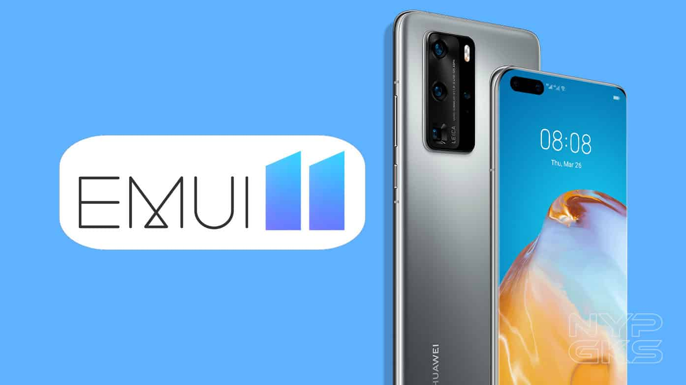
What is Stock Android and Android Skins?
Unmodified version of Android
  known as vanilla or pure Android
Companies can modify Android
  adding a custom skin
  new features.
Popular skins
  Samsung Experience,
  HTC Sense,
  EMUI (Huawei), and
  OxygenOS (OnePlus)

Slide 12
Stock Android
Advantages
  Fast updates
  Bloatware-free: pre-installed software can’t be deleted from a device, unless you root it.
Popular stock Android smartphones are those made by Google
  older Nexus devices
  Pixel, Pixel 2, and Pixel 3 handsets
Android holds over 71% of the global mobile OS market share
  as of November 2020 (StatCounter)

Slide 13
Android Architecture

Slide 14
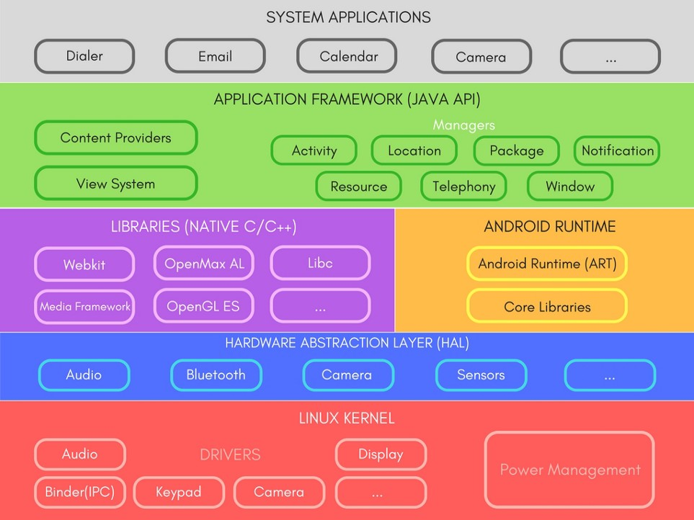
Layers
Apps we use every day
Java APIs for developer
A set of Libraries and Android Runtime.
defines a standard interface for hardware vendors to implement
Security, Process management, Memory management, Device management
Multitasking
Notes:
https://medium.com/@deepamgoel/understanding-android-architecture-1f0fb4b52f90
https://source.android.com/devices/architecture

Slide 15


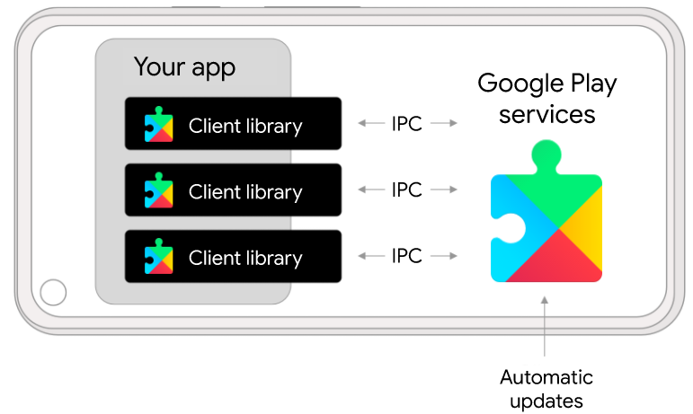
Layers containing evidence
google mobile services (GMS)
Pre-installed by OEM
Elevated Privilege
Non-Removable
Background Services
Google Play Services
(Google Service Framework, GFS)
1.Google Backup
2.Play Store Services
3.Contacts Sync
4.Account Manager
Google Play services receives regular updates that contain improvements and bug fixes.
Notes:
https://developers.google.com/android/guides/overview

Slide 16
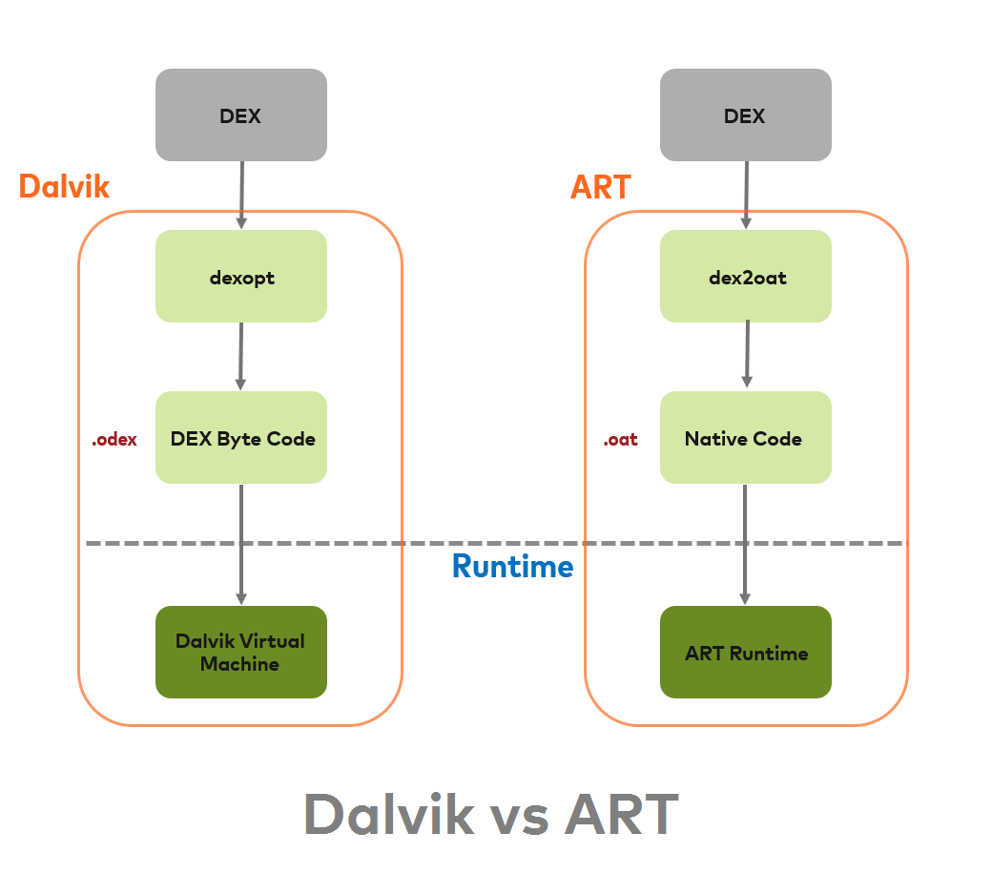
Android RunTime (ART)
.Java
.dex
Source code
DEX
Resource and Native code
zip
.APK
install
install
ART is the system within the Android operating system that executes applications
  by translating their bytecode (DEX/Dalvik Executable) into machine code that the device's processor can understand
  old: Dalvik Virtual Machine(DVM) till Kitkat
ART is faster than DVM
  ART does ahead-of-time (AOT) compiles higher-level program languages to machine code
  .oat: : optimized version of a Dalvik Executable (.dex) file used in ART
  .odex: After Android 8.0: optimize Android apps' compilation and loading process.
Resource and Native code
Optimized Dalvik EXcutable
.oat: Of Ahead Time, a reordering of Ahead Of Time
Do not trust extensions: .dex can be DEX or OAT, .odex are OAT, .oat are OAT, …
Notes:
https://medium.com/android-news/closer-look-at-android-runtime-dvm-vs-art-1dc5240c3924
https://stackoverflow.com/questions/28435860/what-does-oat-mean
The Dalvik Virtual Machine (DVM) was named after the Dalvik village in Iceland, which is the hometown of Dan Bornstein, the Google engineer who led the development of Dalvik.

Slide 17
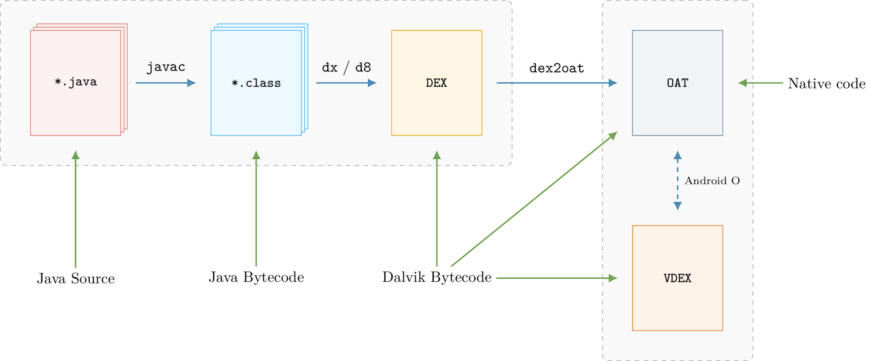
The process of converting Java sources into the OAT
Dalvik Executable
Verified DEX
https://lief.quarkslab.com/doc/latest/tutorials/10_android_formats.html
Notes:
https://lief.quarkslab.com/doc/latest/tutorials/10_android_formats.html

Slide 18
Android Booting Process

Slide 19
Android booting process needs multiple stages
Start from users press the power button
  to a fully functional user interface
Perform a series of checks and configurations to properly launch the OS on the diverse hardware of different Android devices
  initialize various hardware components
  load the necessary software components like the kernel
  prepare the system environment by setting up services and processes

Slide 20
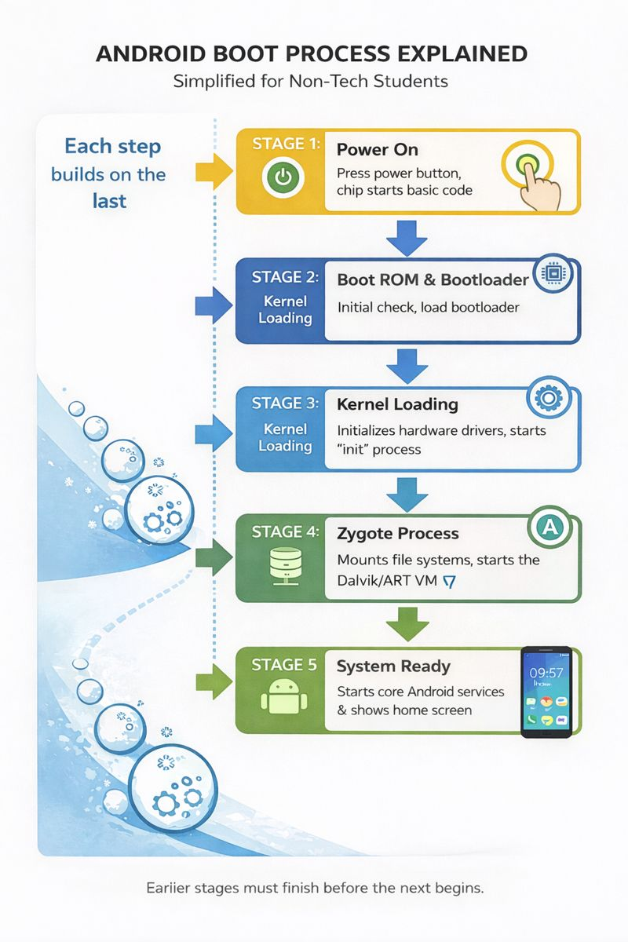
The "Snowball Effect" Strategy
Each stage is designed to be just "smart" enough to find and start the next, more complex stage. This happens for two main reasons:
Hardware Constraints: When you first press the power button, the phone’s brain (CPU) is "blank." It doesn't know what a screen or a battery is yet. It only knows how to execute one tiny piece of code stored in a permanent spot (the Boot ROM).
Efficiency: Small code is fast and reliable. By starting small, the system ensures the foundation is solid before loading the heavy, "hungry" parts of the software like the camera drivers or your wallpaper.

Slide 21
Key Android boot process stages
Boot ROM: The initial stage, where the basic hardware is initialized, and the bootloader is loaded
Bootloader: Loads the Linux kernel into memory and sets up necessary configurations for the system to run
Kernel: Initializes the hardware drivers and starts the "init" process
Init process: Responsible for mounting file systems, starting core services, and launching the "Zygote" process
Zygote process: Preloads common application classes into memory, significantly speeding up app launch times, and inits Dalvik VM
System Server: Starts various Android system services, e.g., the Activity Manager, Package Manager, and Window Manager.
User-space Apps: Provide service to customers
prepare hardware
prepare service

Slide 22
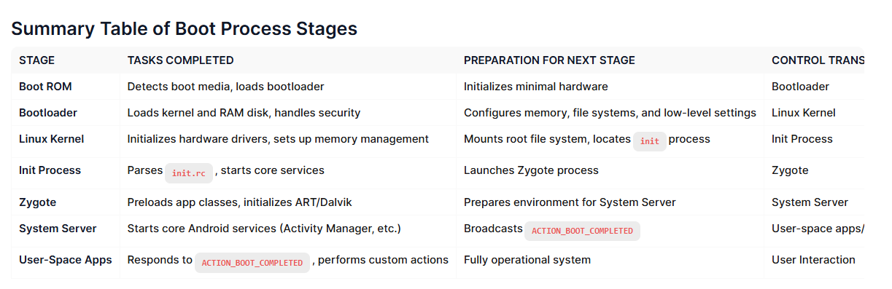
Each stage of the Android boot process involves completing specific tasks, preparing for the next stage, and then handing over control to the subsequent stage.

Slide 23
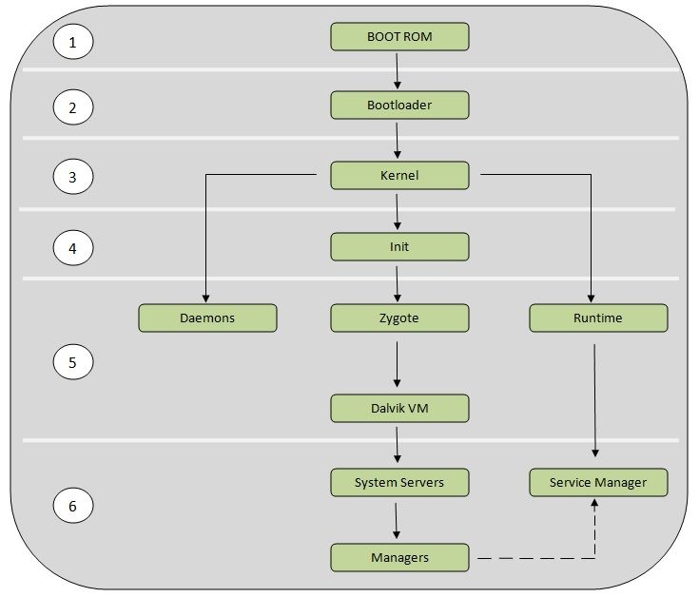
Android Booting Process
Boot ROM (Read-only Memory)
The bootloader
The Linux kernel
The init process
Zygote and Dalvik
The System server
Android ROM is a specific version of the Android operating system that runs on a phone

Slide 24
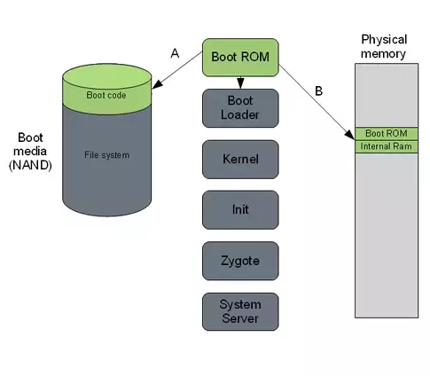
1. Boot ROM (Read-only Memory)
Power On and Boot ROM code starts executing
  A: ROM Code detects the boot media to determine where to find the boot loader.
  B: ROM Code loads the first stage Bootloader into RAM, and the Bootloader starts executing in RAM.
Notes:
https://community.nxp.com/t5/i-MX-Processors-Knowledge-Base/The-Android-Booting-process/ta-p/1129182
https://www.quora.com/How-does-Android-boot-process-work

Slide 25
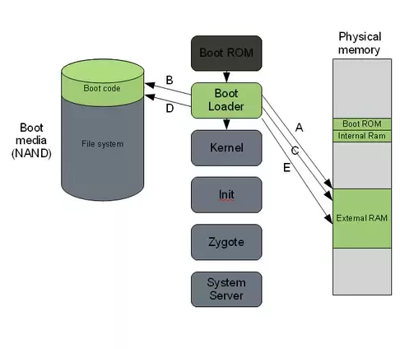
2. Bootloader
A special program to set up initial memories and load the kernel to RAM.
  Kernel and Ramdisk (a temporary filesystem to assist in loading the real root filesystem) are flashed to /root partition
  locked by manufacturers
Must unlock bootloader to root Android devices
  get system permission to acquire data for forensic investigations
Notes:
https://community.nxp.com/t5/i-MX-Processors-Knowledge-Base/The-Android-Booting-process/ta-p/1129182
https://www.quora.com/How-does-Android-boot-process-work
GNU GRand Unified Bootloader

Slide 26
A. The first boot loader stage will detect and set up external RAM (Initialize minimal hardware, e.g., CPU, clocks).
B. Once external RAM is available and the system is ready to run something more significant, the first stage will load the main bootloader and place it in external RAM.
C. The second stage of the bootloader is the first major program that will run.
This may contain code to set up file systems, additional memory, network support, and other things.
On a mobile phone, it may also be responsible for loading code for the modem CPU and setting up low-level memory protections and security options.

Slide 27
D. Once the bootloader is done with any special tasks it will look for a Linux kernel to boot.
It will load this from the boot media (or some other source depending on system configuration) and place it in the RAM.
It will also place some boot parameters in memory for the kernel to read when it starts up.
E. Once the boot loader is done it will perform a jump to the Linux kernel
usually some decompression routine, and the kernel assumes system responsibility.

Slide 28
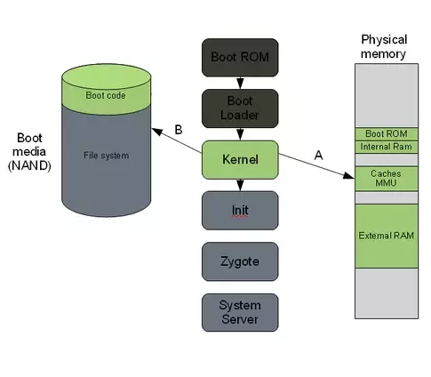
3. The Linux kernel
Set up everything that is needed for the system to run.
  Initialize interrupt controllers
  Set up memory protections, caches and scheduling.
A. Once the memory management units and caches have been initialized, the system will be able to use virtual memory and launch user space processes.
B. The kernel will look in the root file system for the init process (found under system/core/initial the Android open-source tree) and launch it as the initial user space process.

Slide 29
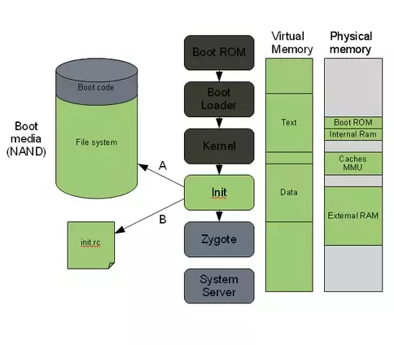
4. The init process
.rc. Early Unix used run commands(rc) for the name of the operating system's boot script
The "grandmother" of all system processes.
Every other process in the system will be launched from this process or one of its descendants.
A. The init process in Android will look for a file called init.rc. or init<machine name>.rc
  This is a script that describes the system services, file system and other parameters that need to be set up.
  The script is placed in system/core/rootdir in the Android open-source project.
B. The init process will parse the init script and launch the system service processes.

Slide 30
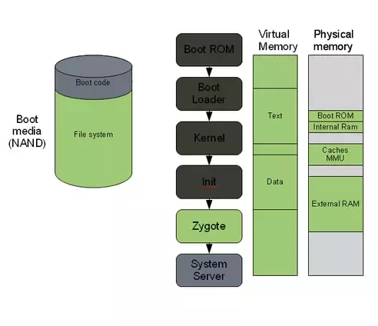
5. Zygote and Dalvik
A process of Android Runtime
The Zygote is launched by the init process and will basically just start executing and initializing the Dalvik VM.
Zygote enables library sharing across the Dalvik VM, achieving a lower memory footprint and minimal startup time.

Slide 31
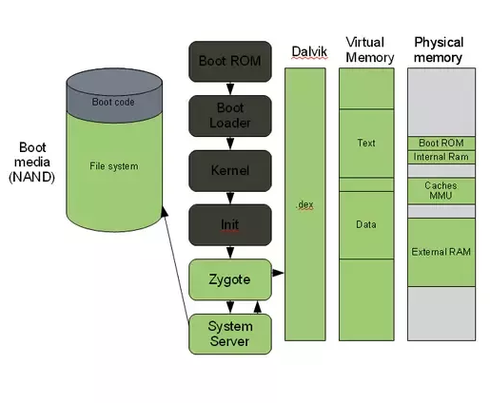
6. The system server
The system server is the first java component to run in the system.
Core services: Creating the Activity Manager, Starting telephony registry, context manager, system contact providers Starting alarm manager, sensor service, window manager, Bluetooth service, mount service
Other services: Starting hardware service, Starting NetStat service, connectivity service, Notification Manager, Device Storage Monitor service, Location Manager, Search Service, Clipboard Service, checkin service, Wallpaper service, Audio Service, Headset Observer, AdbSettings Observer

Slide 32
7. Start your own service
Once the System Server is up and running and the system boot has completed
  there is a standard broadcast action called ACTION_BOOT_COMPLETED.
To start your own service
  register an alarm or otherwise make your application perform some action after boot
  register to receive this broadcast intent.

Slide 33
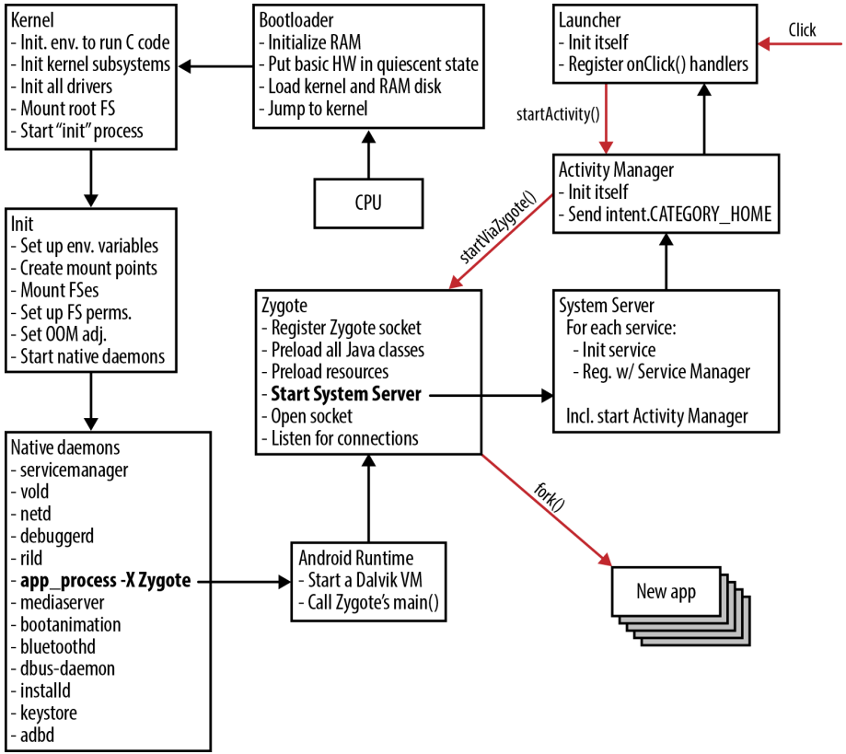
Booting process with focus on Zygote
Notes:
https://medium.com/@voodoomio/what-the-zygote-76f852d887d9

Slide 34
Android partition layout
mapping booting process to partitions

Slide 35
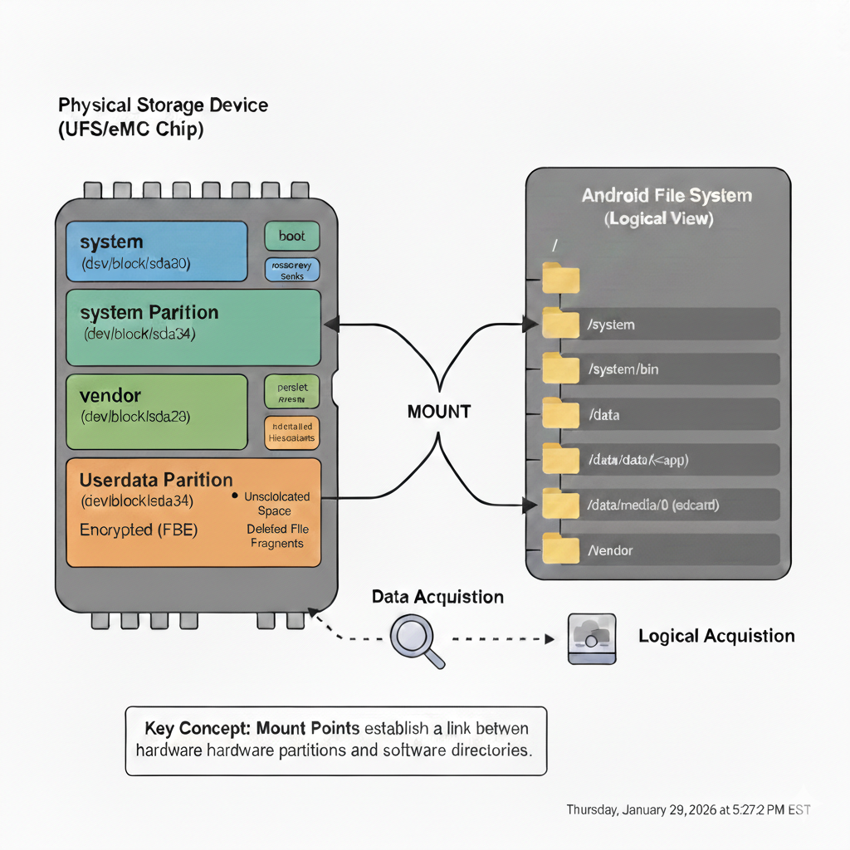
Android partition
Android partitions are logical storage units made inside the device's persistent storage
  logically divide the available space into sections that can be accessed independently of each other
  each partition has a distinct role in the functionality of the device
The Relationship between partitions and folders
  partitions are "mounted" to specific folders. This process makes the contents of a separate storage area appear as if they are just another directory in the system
Partitioning is a fundamental design choice in Android that provides security, stability, and efficiency that standard folders simply cannot offer.
  Malware attack: Can delete or overwrite the Kernel/OS? Folder (yes), Partition (no)
Notes:
https://forum.xda-developers.com/t/android-partitions-explained.3657183/
https://forum.xda-developers.com/t/info-android-device-partitions-and-filesystems.3586565/

Slide 36
Android Partition List
Partition | Description | Forensic Value
/data | Userdata. The primary target. Including /data/data/, /data/user/, /data/media/ Contains app databases (SQLite), media, and PII. | Critical
/system | The OS itself (GUI, core apps). Usually read-only to the user. | Low
/boot | Contains the Kernel and Ramdisk (config files). Crucial for understanding device integrity. | Medium
/recovery | An alternate boot image used for updates or factory resets. | Medium
/cache | Stores frequently accessed data and OTA update logs. | Low/Medium
/vendor | Proprietary files from the manufacturer (e.g., Samsung or Qualcomm drivers). | Low
/misc | Stores hardware settings (CID, region) and USB/carrier-specific flags. | Low
/metadata | Used for File-Based Encryption (FBE) to store encryption keys. | High (for decryption)

Slide 37
iOS Partition List
Volume / Path | Description | Forensic Value
System (/) | Contains the core iOS binaries. This partition is cryptographically signed and read-only. | Low
Data (/private/var) | The Data Partition. This is where all user content, messages, and third-party app data live. | Critical
Preboot | Contains files needed to boot the OS (Apple Logo, login screen). | Low
Recovery | The environment used for "Find My iPhone" wipes or system repairs. | Low
VM | Virtual Memory / Swap space. (Temporary data). | Low

Slide 38
Acquisition

Slide 39
Mobile Forensics Steps
Preparation
Seizure
Acquisition
Analysis
Report

Slide 40
Acquisition
Physical acquisition
  bit-by-bit copy or disk imaging, tricky
Logical acquisition
  extracting the logical storage objects, such as files and directories
  data may be modified
Evidence only (Logical acquisition)
  message, call log, contacts, social apps, GPS, images, videos, and
  other common activities, browser history

