Slide 1
A Pixel 3 image
File system overview

Slide 2
Overview
Pixel 3 Image Description
File System Structure
Understand the Apps/Package

Slide 3
Pixel 3 Image Description
How was the device image acquired?

Slide 4
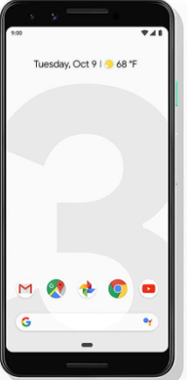

About the Pixel 3 Image
Created by Joshua Hickman
The Pixel device is first rooted
  using the Team Win Recovery Project (TWRP)
  TWRP enables users to install custom ROMs, root devices, and restore backups easily
Not a real “dd image”
  is a logic copy
The image acquisition process
Cellebrite .z and .zip file
Non-Cellebrrite .zip
Rooted by TWRP
Notes:
https://twrp.me/site/update/2019/10/23/twrp-and-android-10.html
https://thebinaryhick.blog/2020/02/15/android-10-image-now-available/
https://digitalcorpora.org/corpora/cell-phones/android-10/
https://thebinaryhick.blog/public_images/

Slide 5
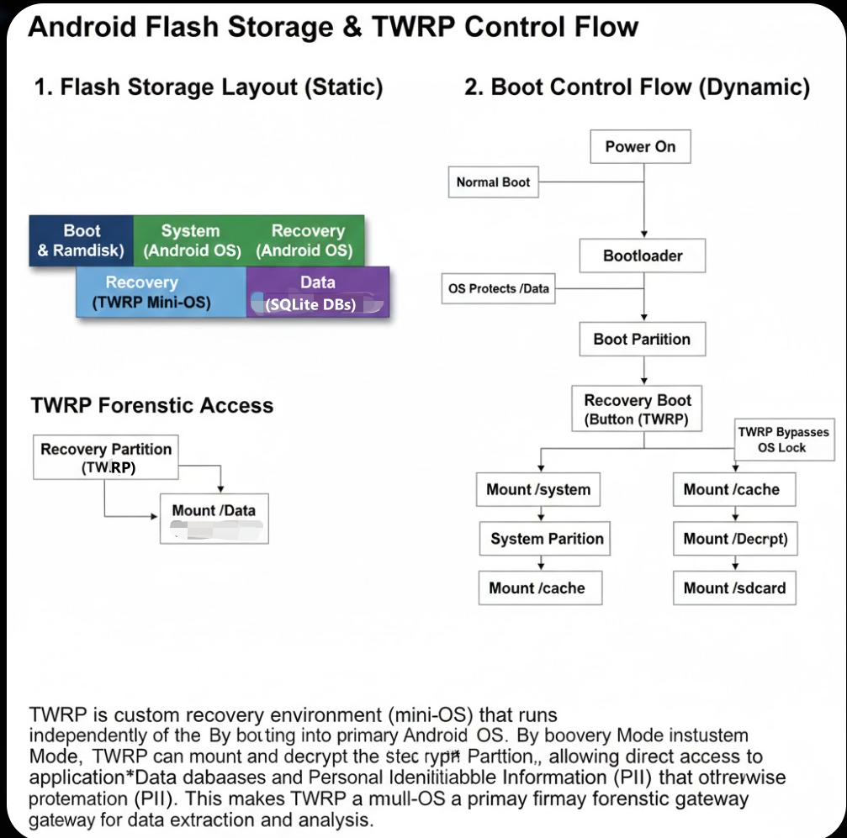
Notes:
Recall: Android devices have separate partitions for different parts of the system:
Boot partition: Contains the kernel and ramdisk for normal booting.
System partition: Holds the main OS files.
Recovery partition: A small, independent mini-OS that loads when you boot into recovery mode (usually via button combos like Volume Up + Power).
Data partition: User data, apps, settings.
TWRP is essentially a standalone, lightweight operating environment (based on a minimal Linux system) that gets flashed (installed) into the recovery partition. When you boot into recovery:
The device loads TWRP instead of the stock recovery.
It runs completely separate from your main Android OS — it doesn't touch or depend on your installed ROM unless you tell it to.
It mounts (makes accessible) partitions like /system, /data, /cache, and often /sdcard (internal storage or external SD).
On many devices, it can even decrypt the /data partition if it's encrypted (with your PIN/pattern), allowing full backups/restores.

Slide 6
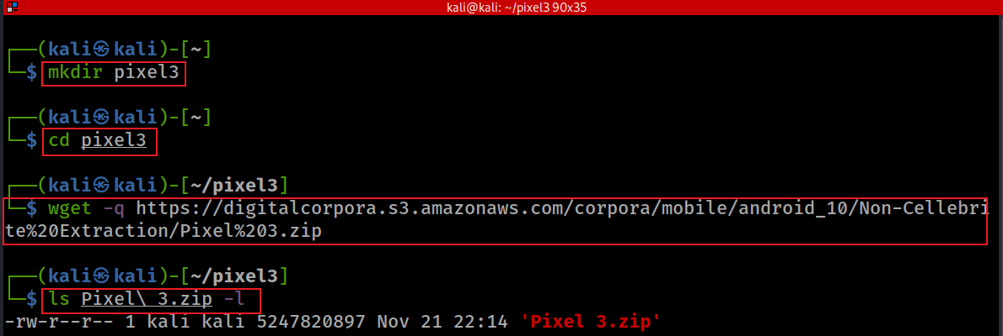
Download Pixel 3 image
A stock image of Android 10
The “%20" in the http link presents a space
The “\" in file name as an Escape Character
https://corp.digitalcorpora.org/corpora/mobile/android_10
https://corp.digitalcorpora.org/corpora/mobile/android_13/
https://corp.digitalcorpora.org/corpora/mobile/android_14/
https://thebinaryhick.blog/public_images/
Notes:
mkdir pixel3
cd pixel3
wget -q https://digitalcorpora.s3.amazonaws.com/corpora/mobile/android_10/Non-Cellebrite%20Extraction/Pixel%203.zip
ls Pixel\ 3.zip -l
https://linuxhint.com/kali_linux_top_forensic_tools/#:~:text=The%20hashdeep%20tool%20is%20a,are%20generated%20with%20every%20output.
https://digitalcorpora.org/corpora/cell-phones/

Slide 7
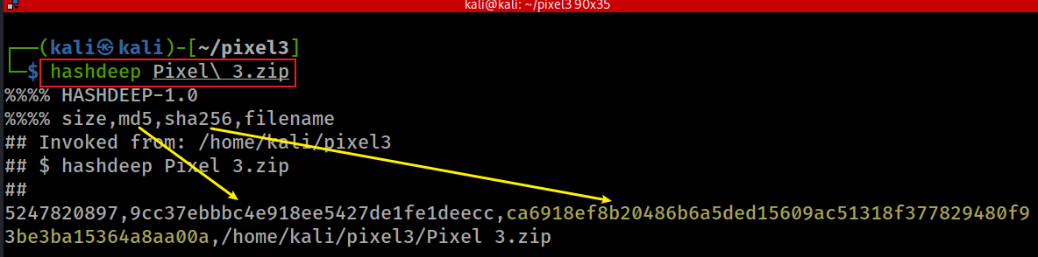
Verify hashes
SHA2-256: ca6918ef8b20486b6a5ded15609ac51318f377829480f93be3ba15364a8aa00a
Notes:
hashdeep Pixel\ 3.zip
5247820897,9cc37ebbbc4e918ee5427de1fe1deecc,ca6918ef8b20486b6a5ded15609ac51318f377829480f93be3ba15364a8aa00a,/home/kali/pixel3/Pixel 3.zip

Slide 8
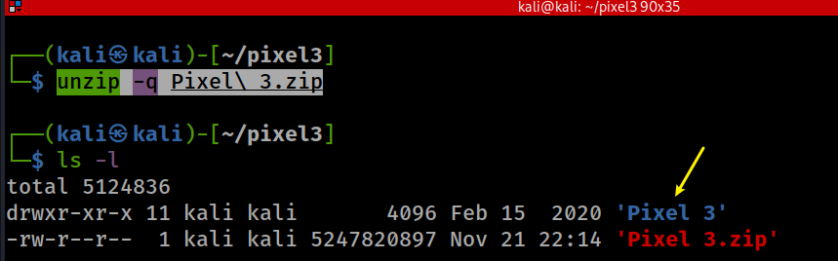
unzip to get Pixel 3 image
Notes:
unzip -q Pixel\ 3.zip

Slide 9
unzip to get Pixel 3 image
Notes:
unzip -q Pixel\ 3.zip

Slide 10
System Software, Application Software and Users
Understand the locations may contain forensics data

Slide 11

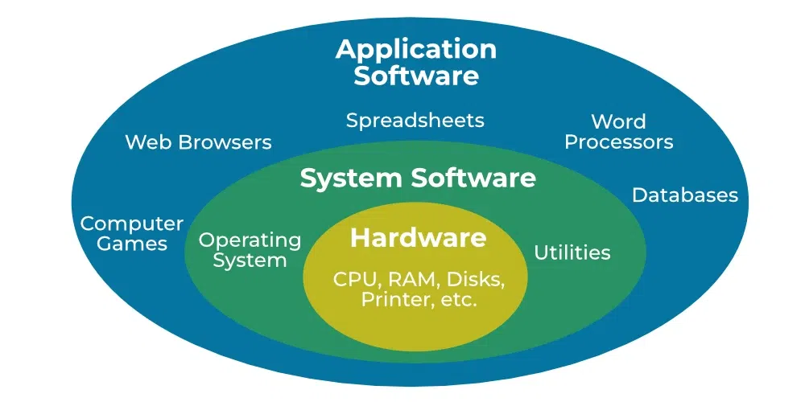
OS, System Software, Application Software, and Users
Forensics value decreases
A mount of evidence decreases
Evidence extraction difficulty increases
Notes:
https://www.geeksforgeeks.org/operating-systems/difference-between-system-software-and-application-software/

Slide 12
System Software and Application Software
OS: the core software that manages a device's hardware, resources, and provides a platform for applications to run.
Utilities: pre-installed applications that come bundled with the operating system. They are designed to provide core functionalities or enhance the user experience within the OS
Notes:
https://www.geeksforgeeks.org/operating-systems/difference-between-system-software-and-application-software/

Slide 13
Aspect | Operating System (OS) | Utilities (System Apps)
Role | Core software that manages hardware and software. | Pre-installed apps for specific functionalities.
Necessity | Essential for device operation. | Not essential; provide convenience/features.
Scope | Controls the entire system. | Runs on top of the OS, limited to app tasks.
Examples | Windows, Linux, Android. | Calculator, File Browser, File Manager.
Modifiability | Cannot be removed without breaking the device. | Can often be disabled or removed (varies).
Access Level | Full control over hardware and software. | Limited access, but often privileged.

Slide 14
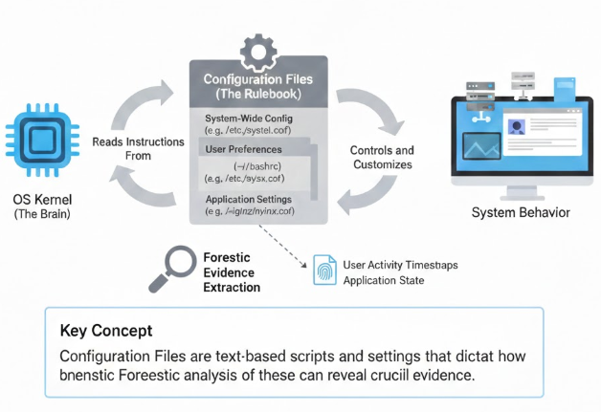
Android configuration
Android configuration: the settings, parameters, and files that define how the Android operating system (OS) and its system apps function, interact with hardware, and adapt to user preferences.
Configuration files: configurations that are typically stored in configuration files or databases that control system-wide behavior, app-specific settings, and device capabilities.

Slide 15
Why Configurations Matter
Customization: Allow Android to adapt to different devices, manufacturers, and user needs.
Functionality: Ensure the OS and apps work correctly with the device’s hardware and software.
Stability: Misconfigured files (especially OS-level) can cause crashes, boot loops, or app malfunctions.
Security: Configurations enforce permissions and sandboxing to protect the system and user data.

Slide 16
Android OS Configuration
Purpose:
  Initialize hardware and services during boot.
  Define network settings (e.g., Wi-Fi, DNS).
  Set security policies and permissions.
  Specify global settings like locale or time zone.
Examples:
  /system/build.prop: Defines device properties (e.g., model, OS version, screen density)
  ./init.rc: Manages boot processes and system services.
  /system/etc/wifi/wpa_supplicant.conf: Configures Wi-Fi networks.
  /system/etc/permissions/platform.xml: Sets system-level permissions.
Location: Primarily in /system/etc/, /vendor/etc/, or /data/system/.
Access: Read-only on non-rooted devices; requires root privileges to modify.

Slide 17
System App Configuration
Governs the behavior of pre-installed apps (e.g., Settings, Contacts, Browser) and their interaction with the OS.
Purpose:
  Store user preferences (e.g., notification settings, email accounts).
  Define app permissions and capabilities.
  Enable integration with OS resources (e.g., camera hardware, GPS).
  Provide default or reset settings for apps.
Location:
  /system/app/<app_name>/AndroidManifest.xml : Declares app permissions and features.
  /data/data/com.android.settings/...xml: Store Settings app preferences (e.g., display brightness).
  /system/etc/gps.conf: Configures location settings for apps like Maps.
Access: Sandboxed per app; modifiable via app UI or root access.

Slide 18
Summary Table
Aspect | Android OS Configuration | System App Configuration
Role | Manages boot, hardware, networking, security, settings. | Controls app behavior, user preferences, OS integration.
Examples | build.prop, init.rc, wpa_supplicant.conf. | AndroidManifest.xml, app-specific XML in /data/data/.
Location | /system/etc/, /vendor/etc/, /data/system/. | /system/app/, /data/data/<package_name>/.
Criticality | Essential; errors can crash the system. | Affects only the app; less critical.
Access | Read-only; needs root to modify. | Sandboxed; modifiable via UI or root.

Slide 19
Examples of Configuration Files and Their Forensic Association
File/Artifact | Location | Description | Forensic Value in Evidence Extraction
settings_global.xml | /data/system/users/0/ | Stores global settings like device name, airplane mode, auto-time sync, boot count. | Identifies device, verifies timestamps, analyzes network activity (e.g., airplane_mode_on for offline periods).
settings_secure.xml | /data/system/users/0/ | Contains secure settings like Android ID, Bluetooth address/name. | Links device to user (e.g., android_id for unique identification), traces connectivity history.
settings_system.xml | /data/system/users/0/ | Manages system preferences like volume, brightness. | Provides context on user interface behavior, less critical but useful for patterns.
packages.xml | /data/system/ | Lists installed apps, versions, and permissions. | Reveals app ecosystem, permissions (e.g., camera access), detects sideloaded/malicious apps.
frosting.db | /data/data/com.android.vending/databases/ | Records app installations and updates with timestamps. | Builds installation timelines, identifies suspicious apps.
app_usage_stats.xml | /data/user/0/com.google.android.apps.turbo/shared_prefs/ | Logs recent app activity timestamps. | Establishes short-term usage patterns and timelines.
accounts_ce.db / accounts_de.db | /data/system_ce/0/accounts_ce.db etc. | Stores app account details, logins, tokens. | Uncovers logged-in accounts, last logon times, authentication data.

Slide 20
Labs

Slide 21
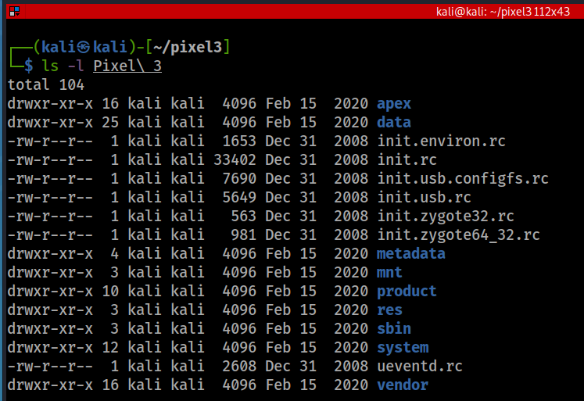
list root directory
To speed up security updates
  Android Pony EXpress (APEX) is a container format introduced in Android 10 that is used in the install flow for lower-level system modules.
  This format facilitates the updates of system components that don’t fit into the standard Android application model.
device
run commands(rc): OS boot script
mount point for other file systems
Resource, e.g., layout, color
binaries for several important daemons.
Android OS (AOSP), exclude Google services
Notes:
https://www.cnblogs.com/shangdawei/p/4513604.html
https://saketupadhyay.medium.com/apex-androids-new-file-format-187e21b8261

Slide 22
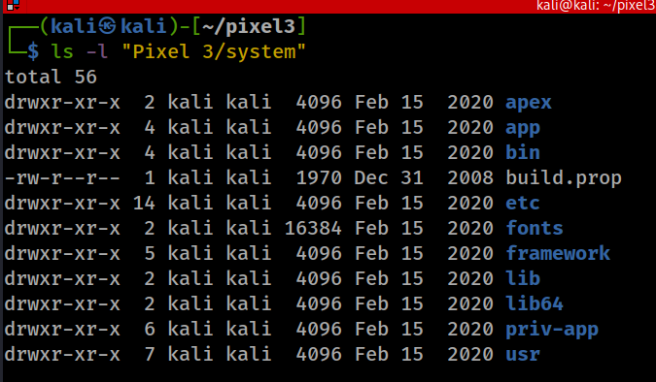
/System: Android OS Project (AOSP)
Android OS pre-installed bloatware apps, often can’t uninstall
"rooting" is required to modify the contents of this partition.
executable binaries, daemons or bash
App Framework
native libraries (C/C++; DLL)
Privileged apps, apps that are eligible for system permissions
all system-wide, read-only files installed by (or provided by) the OS
It is less likely that you need to investigate the folder

Slide 23
Pre-installed/downloaded apps
Pre-installed bloatware with ROM
  /system/app: camera, settings, messages, Google Play Store, etc.
  /system/priv-app: implicitly granted system privilege
  /custpack/app
If moving apps to an SD card
  Apps will be encrypted in /mnt/sdcard/.android_secure.
  Android decrypts them at runtime and stores a decrypted copy on in /mnt/asec/tmpfs
  Need to use a card reader and attach the SD card to a PC to see the files
    .asec (Android Secure External Cache) instead of .apk -- from which you will get the connection to the name /mnt/asec
Notes:
https://android.stackexchange.com/questions/3002/where-in-the-file-system-are-applications-installed

Slide 24
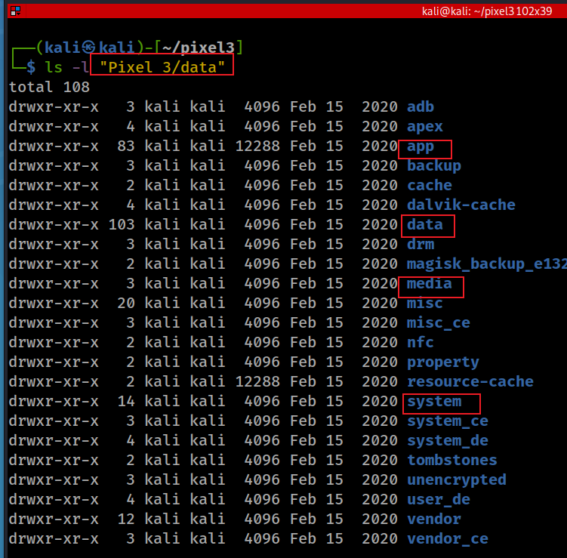
/data
downloaded .apk from Google Play Store
installed apps/generated data
Contains subfolders with forensic data
all installed Android apps
  native apps or
  3rd party
all system config/log
all app-generated data
system config/ logs

Slide 25
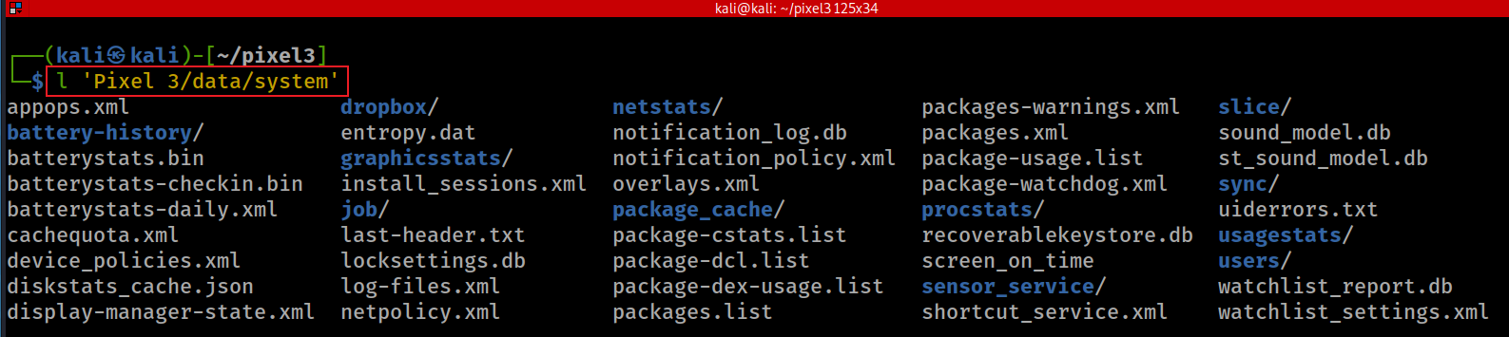
data/system settings (don’t confuse with /system)
Contains system configuration files critical to maintaining device's state.
Contains system state logs
Access to the directory is restricted by the system (utility) apps only, so if the device is not rooted the folder content can't be seen.
for newer devices: /data/system_xx/<userID>
Notes:
https://android.stackexchange.com/questions/157691/what-does-the-data-system-folder-store-and-its-significance/157862

Slide 26
Configurations File Formats
Plain text (e.g., .conf files like wpa_supplicant.conf).
  txt
Key-value pairs (e.g., build.prop).
XML files (e.g., AndroidManifest.xml, app preference files).
  .json
Databases (e.g., settings in /data/system/xxx.db).
Special format (.plist)

Slide 27
System (utility) apps’ configuration files may contain evidence
appops.xml - a configuration file used by the AppOps service, which controls application permissions;
batterystats.bin - a binary used by the BatteryStats service to keep power statistics of applications installed;
gesture.key - lockscreen pattern;
inputmethod/ - a directory used to store IME configuration. Contains subtypes.xml with IME locales, keyboard layout sets, etc.
locksettings.db - an SQLite database containing the lock screen settings;
netpolicy.xml - a configuration file used by the NetworkPolicyManagerService;
netstats/ - a directory used to hold NetworkStatsService statistics;
Notes:
http://newandroidbook.com/
https://android.stackexchange.com/questions/157691/what-does-the-data-system-folder-store-and-its-significance/157862
https://github.com/lywschxd/Understanding-Android-Internals-Volume-One

Slide 28
packages.list - a file used by the PackageManager service containing the list of all packages (apks) installed in the system (same as executing pm list packages within shell);
packages.xml - a file used by the PackageManager service to hold metadata of all installed packages, like UIDs, requested permissions etc;
profiles.xml - a configuration file to keep metadata of device profiles including sound mode, airplane mode, vibration etc.;
password.key - password hash;
usagestats/ - a directory used to store files for the UsageStats service. Contains usage-history.xml that holds info on all apps and its components with the last time a user used them;
users/ - a directory used for multi-user support. Contains userlist.xml which keeps info on all users in the system (0 - is a device owner/primary user); e.g. a sub-directory users/0/ holds info on the user account (accounts.db), widgets (appwidgets.xml), wallpaper (wallpaper_info.xml) etc.

Slide 29
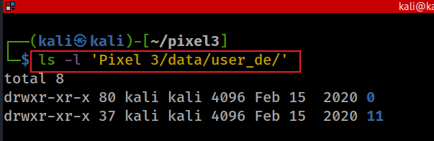
/data/data/ Store app-specific/generated data
not tight to specific users: /data/data/<package_name>
associate with specific users:
  /data/user/<userid> (is a symlink to /data/data)
  /data/user_de/<userid> for newer devices
External storage for user app-generated data
  /mnt/sdcard/Android/data/<package_name>

Slide 30
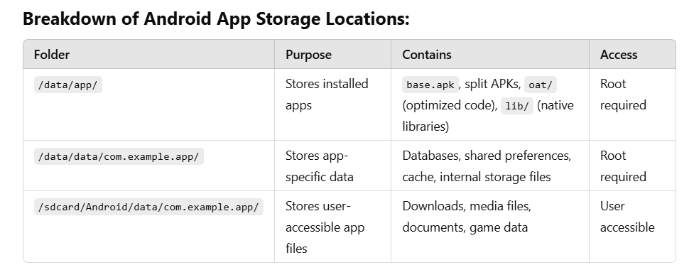
Notes:
Breakdown of Android App Storage Locations:
FolderPurposeContainsAccess/data/app/Stores installed appsbase.apk, split APKs, oat/ (optimized code), lib/ (native libraries)Root required/data/data/com.example.app/Stores app-specific dataDatabases, shared preferences, cache, internal storage filesRoot required/sdcard/Android/data/com.example.app/Stores user-accessible app filesDownloads, media files, documents, game dataUser accessibleSo, /data/app/ is for applications, not user data. If you want to access user-generated files, you'd need to look in /data/data/ (for internal storage) or /sdcard/Android/data/ (for external storage).
Would you like help navigating these directories?

Slide 31
Understand the Apps/Package
Know where to extract forensic data

Slide 32
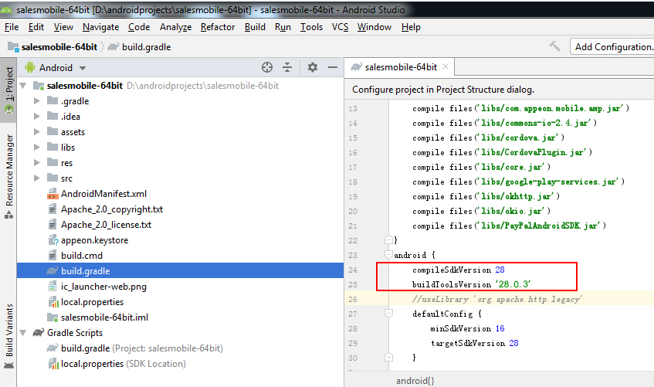
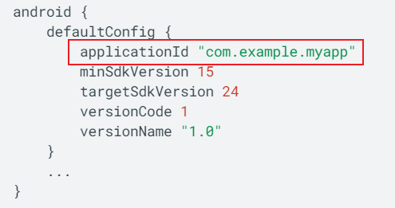
What is Android (application) package .APK?
Android Package (APK) is the package file format
  used by the Android OS
  zip + pre-defined specific structure
  compiled to .dex format
application ID is defined with the applicationId property in build.gradle
  Use the ID to identify apps and the generated data
exactly matches the Java-style package name
As a developer, you should never change the application ID.
Notes:
https://docs.appeon.com/pb2019r2/appeon_mobile_tutorials/ch04s03s02.html

Slide 33
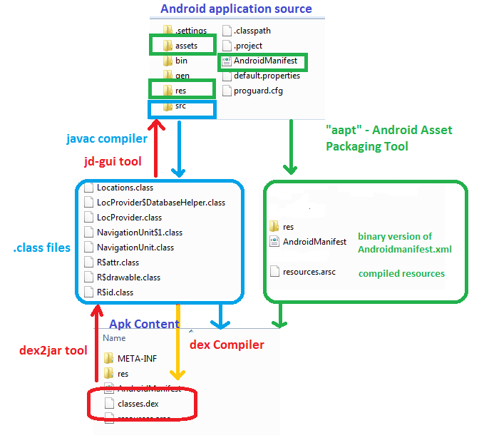
APK compilation and de-compilation
https://www.dunebook.com/apk-decompiler/
DEX (Dalvik Executable):
translates JVM bytecode to DVM bytecode and put all class files to one dex file.

Slide 34
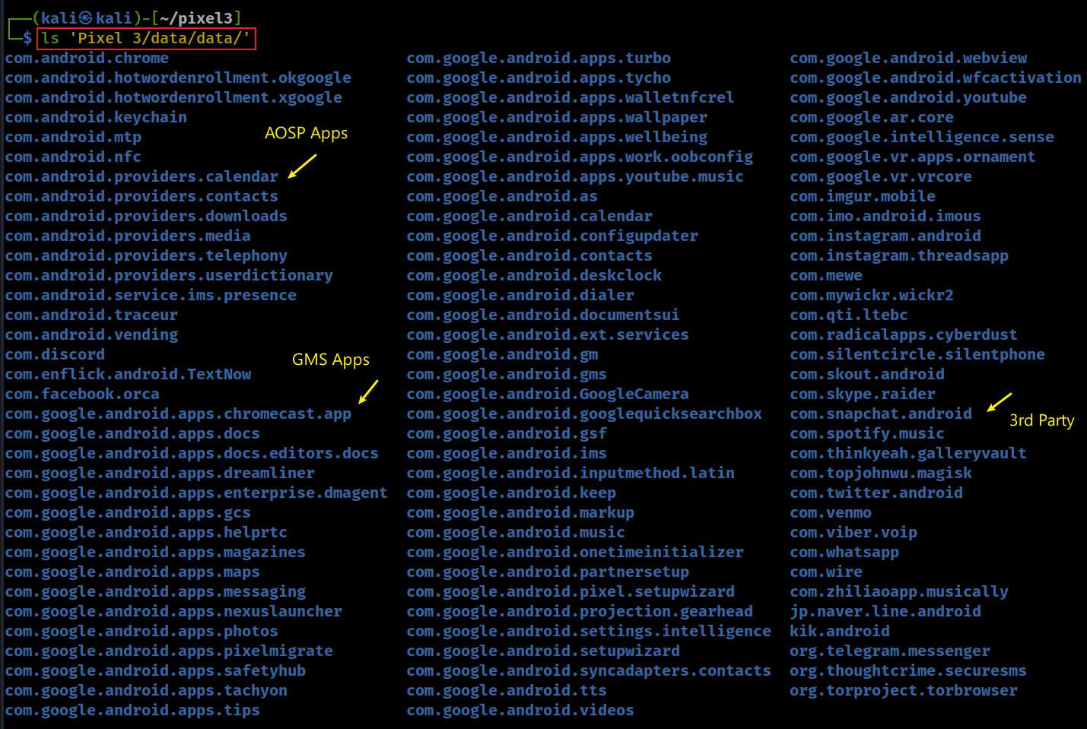
Use ApplicationID as a folder to save application data
Notes:
ls 'Pixel 3/data/data/'

Slide 35
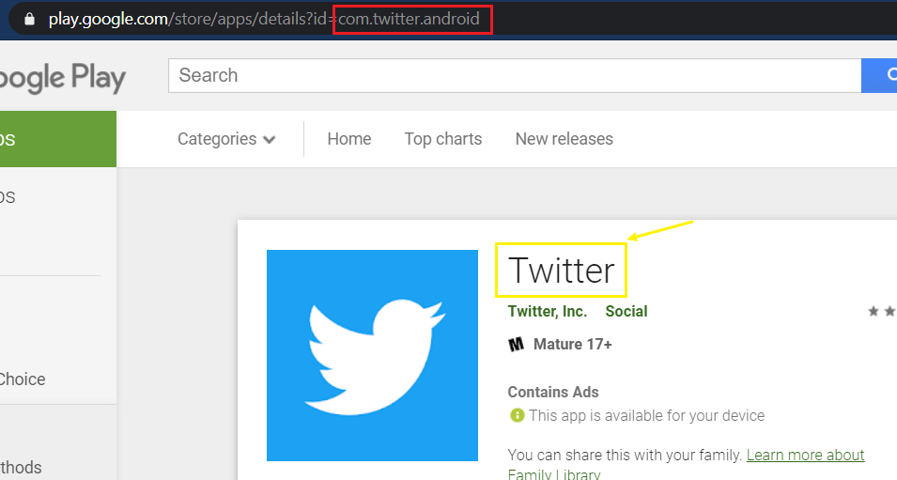
What is the name of Application for a given applicationID? (Twitter vs. com.twitter.android)
https://play.google.com/store/apps/details?id=com.twitter.android

Slide 36
How to find the name of the application automatically? (com.twitter.android)
Steps
Send a http request to https://play.google.com/store/apps/details?id=com.twitter.android
Parse the html
Search for a string (name of the application) from a specific location
How to identify the location? (next slice)

Slide 37
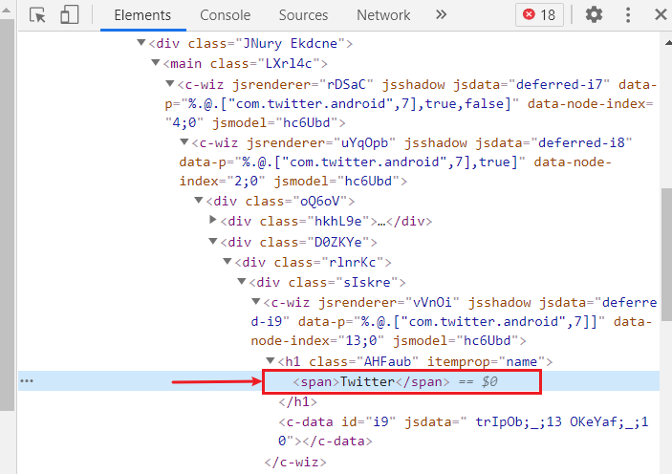
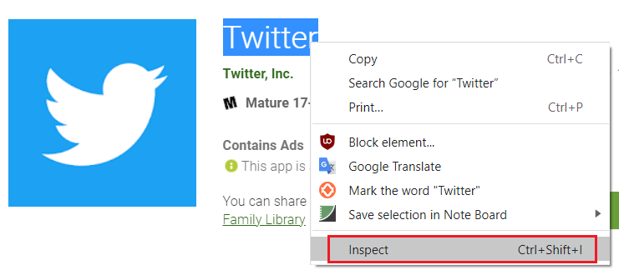
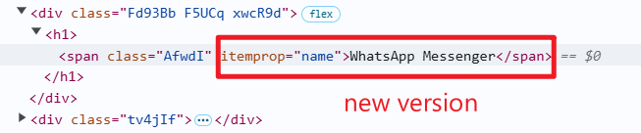
Find inspect the Twitter name location in Chrome
Warming: this is the old version of HTML
Warming: this is the new version

Slide 38

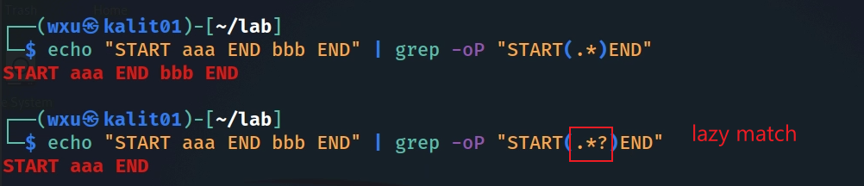
Notes:
echo "START aaa END bbb END" | grep -oP "START(.*)END“
echo "START aaa END bbb END" | grep -oP "START(.*?)END"

Slide 39
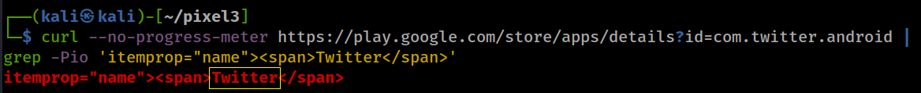
Show the location of Twitter name
Warming: this is the old version, use new version for your lab
-P, --perl-regexp PATTERNS are Perl regular expressions
-o, --only-matching show only nonempty parts of lines that match
-i, --ignore-case ignore case distinctions in patterns and data
Only show the name Twitter name (only match the word between 'itemprop="name"><span> and </span> )
? : lazy match
\K : Keep text matched so far out of the return match (discard previous match)
(?=pattern) : used as a zero-width look-ahead assertion after the text you want to output
Notes:
curl --no-progress-meter https://play.google.com/store/apps/details?id=com.twitter.android | grep -Pio 'itemprop="name"><span>Twitter</span>’
curl --no-progress-meter https://play.google.com/store/apps/details?id=com.twitter.android | grep -Pio 'itemprop="name"><span>\K.*?(?=</span>)’
echo "START aaa END START bbb END" | grep -oP 'START(.*)END’
echo "START aaa END START bbb END" | grep -oP 'START(.*?)END'

Slide 40
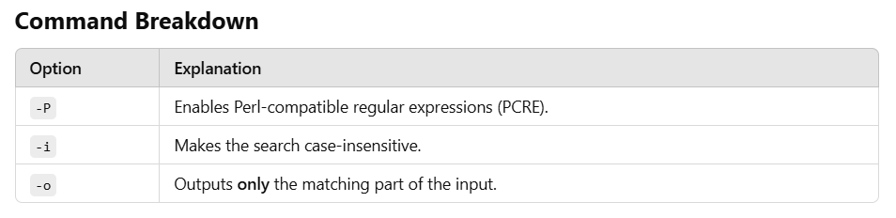
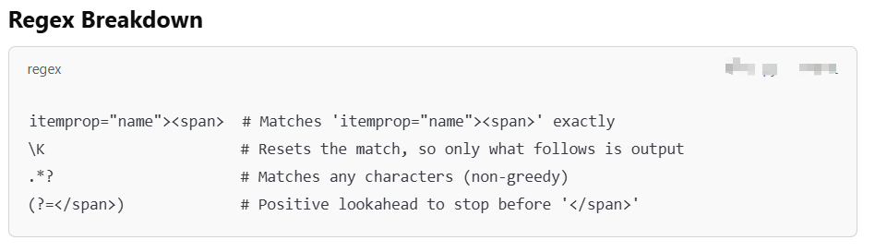

Slide 41
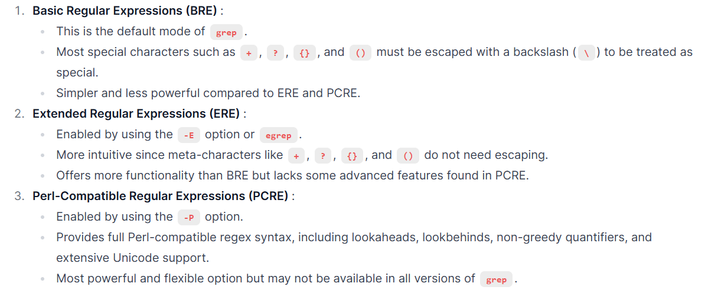
Grep supports multiple regular expression (regex) syntaxes

Slide 42
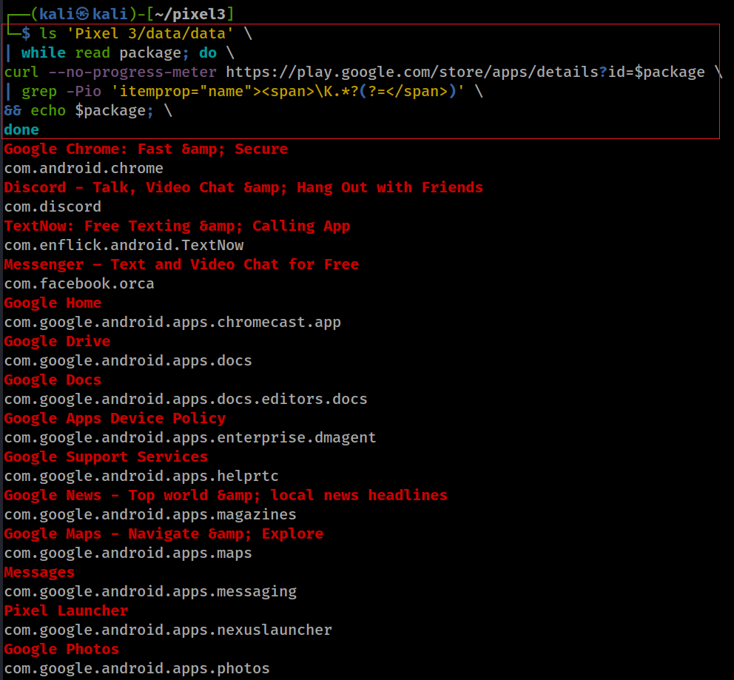
List all app names and package ID
ls 'Pixel 3/data/data' \
| while read package; do \
curl --no-progress-meter https://play.google.com/store/apps/details?id=$package \
| grep -Pio 'itemprop="name"><span>\K.*?(?=</span>)' \
&& echo $package; \
done
Notes:
ls 'Pixel 3/data/data' \
| while read package; do \
curl --no-progress-meter https://play.google.com/store/apps/details?id=$package \
| grep -Pio 'itemprop="name"><span>\K.*?(?=</span>)' \
&& echo $package; \
done
Google Chrome: Fast &amp; Secure
com.android.chrome
Discord - Talk, Video Chat &amp; Hang Out with Friends
com.discord
TextNow: Free Texting &amp; Calling App
com.enflick.android.TextNow
Messenger – Text and Video Chat for Free
com.facebook.orca
Google Home
com.google.android.apps.chromecast.app
Google Drive
com.google.android.apps.docs
Google Docs
com.google.android.apps.docs.editors.docs
Google Apps Device Policy
com.google.android.apps.enterprise.dmagent
Google Support Services
com.google.android.apps.helprtc
Google News - Top world &amp; local news headlines
com.google.android.apps.magazines
Google Maps - Navigate &amp; Explore
com.google.android.apps.maps
Messages
com.google.android.apps.messaging
Pixel Launcher
com.google.android.apps.nexuslauncher
Google Photos
com.google.android.apps.photos
Data Transfer Tool
com.google.android.apps.pixelmigrate
Personal Safety
com.google.android.apps.safetyhub
Google Duo - High Quality Video Calls
com.google.android.apps.tachyon
Google Fi
com.google.android.apps.tycho
Google Pay (old app)
com.google.android.apps.walletnfcrel
Wallpapers
com.google.android.apps.wallpaper
Digital Wellbeing
com.google.android.apps.wellbeing
YouTube Music - Stream Songs &amp; Music Videos
com.google.android.apps.youtube.music
Google Calendar
com.google.android.calendar
Contacts
com.google.android.contacts
Clock
com.google.android.deskclock
Phone by Google - Caller ID &amp; Spam Protection
com.google.android.dialer
Gmail
com.google.android.gm
Google Play services
com.google.android.gms
Google Camera
com.google.android.GoogleCamera
Google
com.google.android.googlequicksearchbox
Carrier Services
com.google.android.ims
Gboard - the Google Keyboard
com.google.android.inputmethod.latin
Google Keep - Notes and Lists
com.google.android.keep
Google Play Music
com.google.android.music
Android Auto - Google Maps, Media &amp; Messaging
com.google.android.projection.gearhead
Google Text-to-Speech
com.google.android.tts
Google TV (previously Play Movies &amp; TV)
com.google.android.videos
Android System WebView
com.google.android.webview
YouTube
com.google.android.youtube
Google Play Services for AR
com.google.ar.core
Pixel Ambient Services
com.google.intelligence.sense
Playground (was AR Stickers)
com.google.vr.apps.ornament
Google VR Services
com.google.vr.vrcore
Imgur: Find funny GIFs, memes &amp; watch viral videos
com.imgur.mobile
imo free HD video calls and chat
com.imo.android.imous
Instagram
com.instagram.android
Threads from Instagram
com.instagram.threadsapp
MeWe
com.mewe
Wickr Me – Private Messenger
com.mywickr.wickr2
Dust - a safer place to text
com.radicalapps.cyberdust
Silent Phone - Secure Calling &amp; Messaging
com.silentcircle.silentphone
SKOUT - Meet, Chat, Go Live
com.skout.android
Skype - free IM &amp; video calls
com.skype.raider
Snapchat
com.snapchat.android
Spotify: Listen to podcasts &amp; find music you love
com.spotify.music
Gallery Vault - Hide Pictures And Videos
com.thinkyeah.galleryvault
Twitter
com.twitter.android
Venmo
com.venmo
Viber Messenger - Free Video Calls &amp; Group Chats
com.viber.voip
WhatsApp Messenger
com.whatsapp
Wire • Secure Messenger
com.wire
TikTok
com.zhiliaoapp.musically
LINE: Free Calls &amp; Messages
jp.naver.line.android
Kik
kik.android
Telegram
org.telegram.messenger
Signal Private Messenger
org.thoughtcrime.securesms
Tor Browser: Official, Private, &amp; Secure
org.torproject.torbrowser

Slide 43
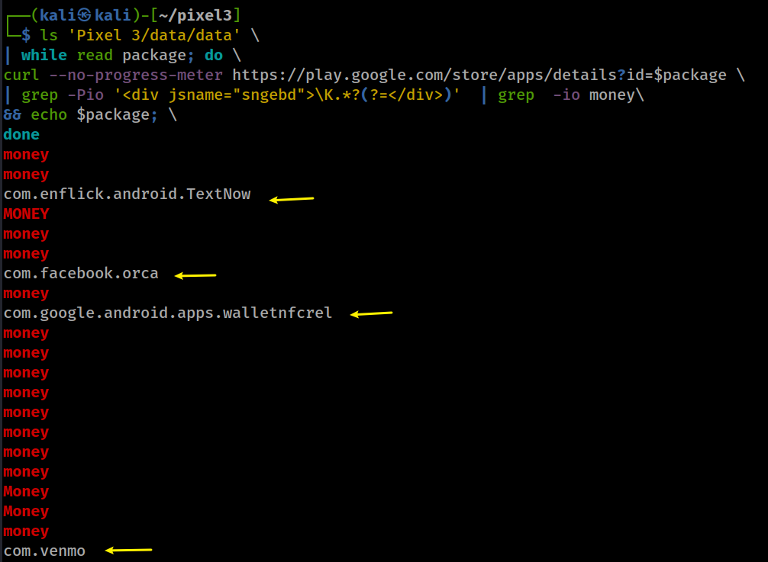
Are there any apps with money transfer function?
Interesting: It seems vemo mentioned money 10 times
Notes:
ls 'Pixel 3/data/data' \
| while read package; do \
curl --no-progress-meter https://play.google.com/store/apps/details?id=$package \
| grep -Pio '<div jsname="sngebd">\K.*?(?=</div>)' | grep -io money\
&& echo $package; \
money
money
com.enflick.android.TextNow
MONEY
money
money
com.facebook.orca
money
com.google.android.apps.walletnfcrel
money
money
money
money
money
money
money
money
Money
Money
money
com.venmo

Slide 44
Python version (List all app names and package ID/ works for new Playstore HTTP response)
import os
import requests
import re
def get_android_apps():
package = "com.twitter.android"
# Base URL for Google Play Store app details
base_url = "https://play.google.com/store/apps/details?id="
try:
# Fetch the app details page
url = base_url + package
print(url)
response = requests.get(url)
if response.status_code != 200:
print(f"Failed to fetch details for package: {package}")
else:
# Extract the app name using a regular expression
match = re.search(r'itemprop="name">(.*?)</span>', response.text)
app_name = match.group(1) if match else "Unknown"
# Print the app name and package ID
print(f"App Name: {app_name}, Package ID: {package}")
except Exception as e:
print(f"Error processing package {package}: {str(e)}")
if __name__ == "__main__":
get_android_apps()
"""
Explanation of the Code
Listing Package IDs :
- The script uses os.listdir() to list all directories in the Pixel 3/data/data folder. Each directory corresponds to an installed app's package ID.
Fetching App Details :
- For each package ID, the script constructs the Google Play Store URL (https://play.google.com/store/apps/details?id=<package>).
- It uses the requests library to fetch the HTML content of the app's details page.
Parsing the HTML :
- The script uses BeautifulSoup from the bs4 module to parse the HTML response.
- It looks for the <h1> tag with the attribute itemprop="name" to extract the app name.
Output :
- The script prints the app name and its corresponding package ID.
"""
Notes:
"""
Explanation of the Code
Listing Package IDs :
- The script uses os.listdir() to list all directories in the Pixel 3/data/data folder. Each directory corresponds to an installed app's package ID.
Fetching App Details :
- For each package ID, the script constructs the Google Play Store URL (https://play.google.com/store/apps/details?id=<package>).
- It uses the requests library to fetch the HTML content of the app's details page.
Parsing the HTML :
- The script uses BeautifulSoup from the bs4 module to parse the HTML response.
- It looks for the <h1> tag with the attribute itemprop="name" to extract the app name.
Output :
- The script prints the app name and its corresponding package ID.
"""
import os
import requests
import re
def get_android_apps():
package = "com.twitter.android"
# Base URL for Google Play Store app details
base_url = "https://play.google.com/store/apps/details?id="
try:
# Fetch the app details page
url = base_url + package
print(url)
response = requests.get(url)
if response.status_code != 200:
print(f"Failed to fetch details for package: {package}")
else:
# Extract the app name using a regular expression
match = re.search(r'itemprop="name">(.*?)</span>', response.text)
app_name = match.group(1) if match else "Unknown"
# Print the app name and package ID
print(f"App Name: {app_name}, Package ID: {package}")
except Exception as e:
print(f"Error processing package {package}: {str(e)}")
if __name__ == "__main__":
get_android_apps()

Slide 45
Homework
Complete the lab by following screenshots
  including Linux commands and Python code
Pay special attention to slide 34 because the Google Play Store encodes app names differently in HTML pages
Need to show Python execution results

