Slide 1
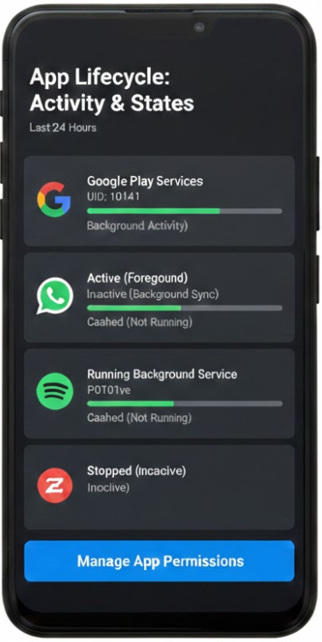
Tracking Apps through Their Life Cycle
Installed, Running, Background, Deleted

Slide 2
Track apps on the phone
Track installed Apps via vending machine
1
Find Purchased Apps via the vending machine
2
Find Installed Apps through App Folders
3
Exam App Properties
4
Exam Basic App Usages
5
Find Deleted Apps
6
Notes:
find 'Pixel 3' -iname 'package*'

Slide 3
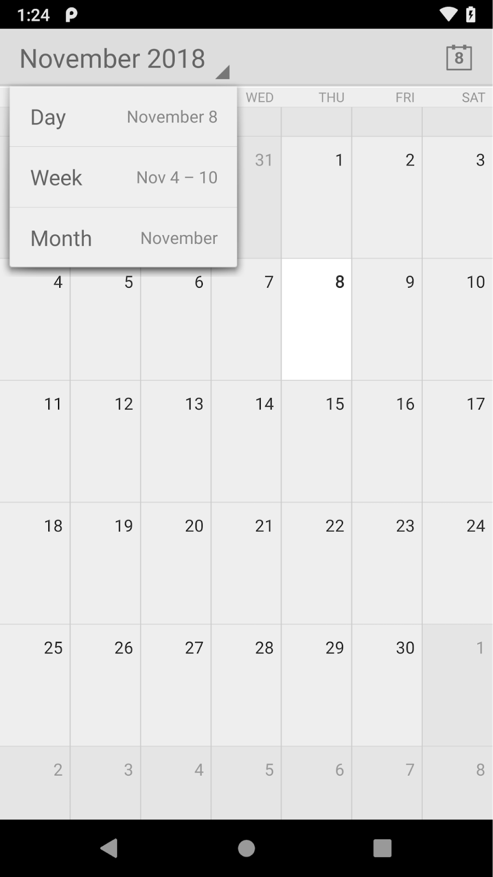
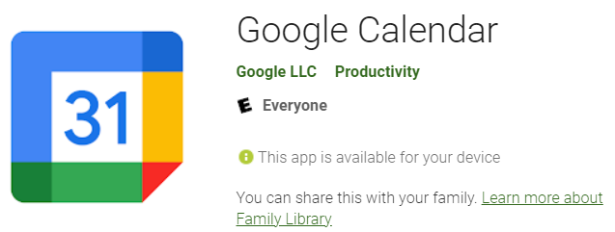
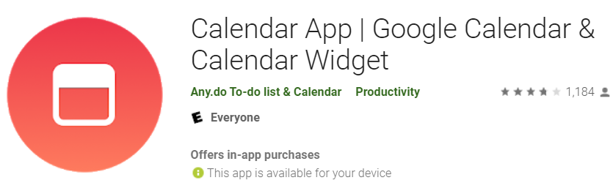
Three types of Android Apps
AOSP Applications
  com.android.calendar
Proprietary Application (Play store)
  Google GMS: com.google.android.calculator
  3rd Party Apps: com.sec.android.app.popupcalculator
Notes:
https://android.googlesource.com/platform/packages/apps/
https://android-developers.googleblog.com/2019/03/aosp-application-updates.html

Slide 4
1: Track Installed Apps
vending machine

Slide 5
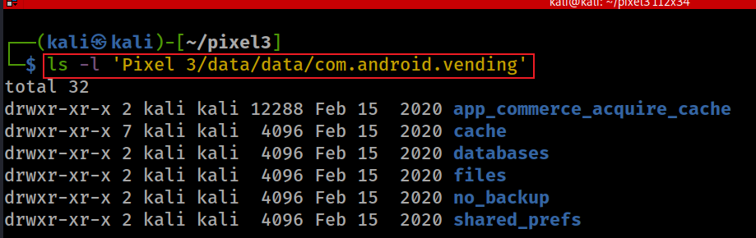
What is the package name of App installer?
/data/data/com.android.vending
App installer maintains the application installation process information in databases
Notes:
ls -l 'Pixel 3/data/data/com.android.vending’
https://gossipfunda.com/com-android-vending/

Slide 6
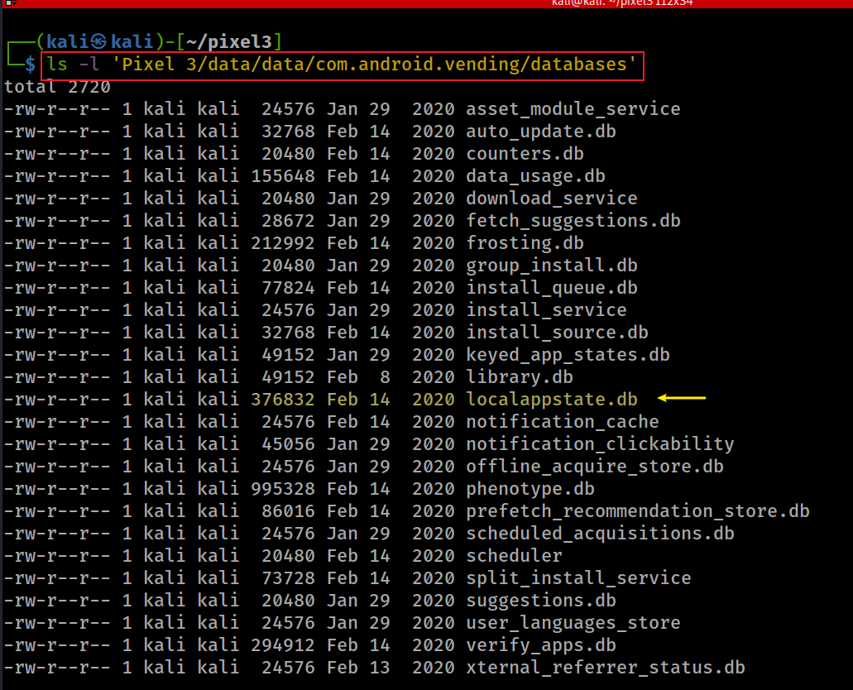
Show installer database
It is part of Google Play Store app's data.
Notes:
ls -l 'Pixel 3/data/data/com.android.vending/databases'

Slide 7
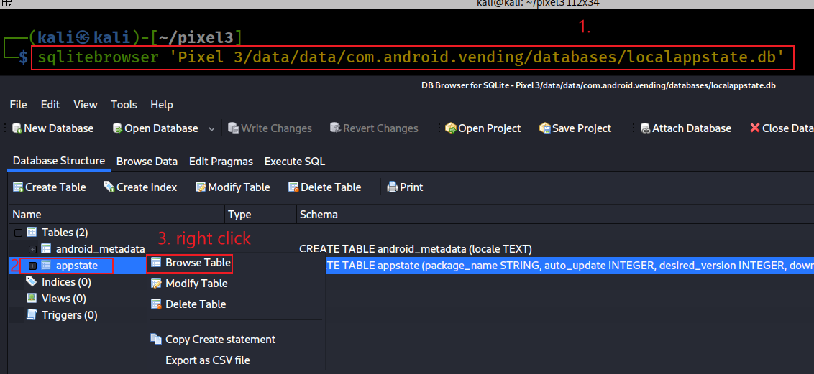
Browse localappstate.db
Notes:
sqlitebrowser 'Pixel 3/data/data/com.android.vending/databases/localappstate.db'

Slide 8
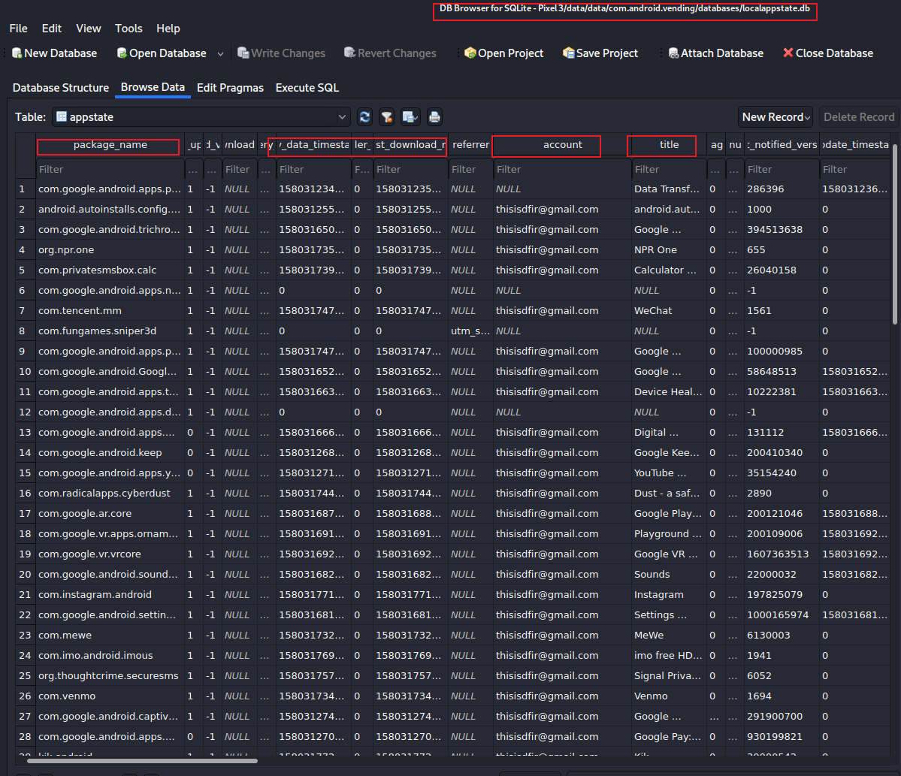

Slide 9
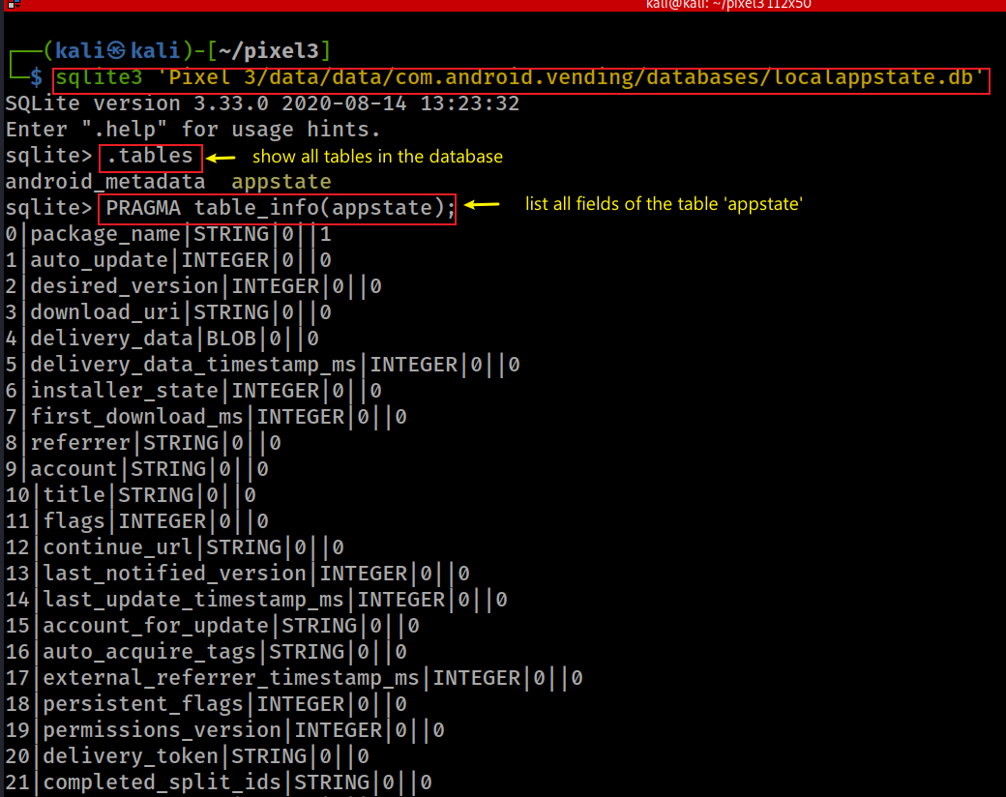
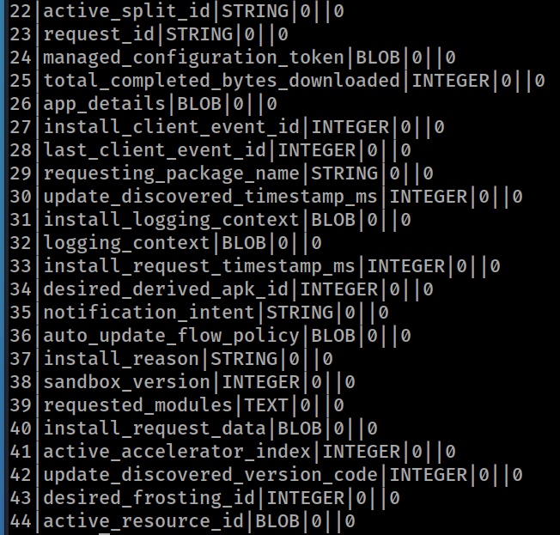
Exam appstate fields
.open anotherdatabase.db
Notes:
sqlite3 'Pixel 3/data/data/com.android.vending/databases/localappstate.db’
.tables
PRAGMA table_info(appstate);

Slide 10
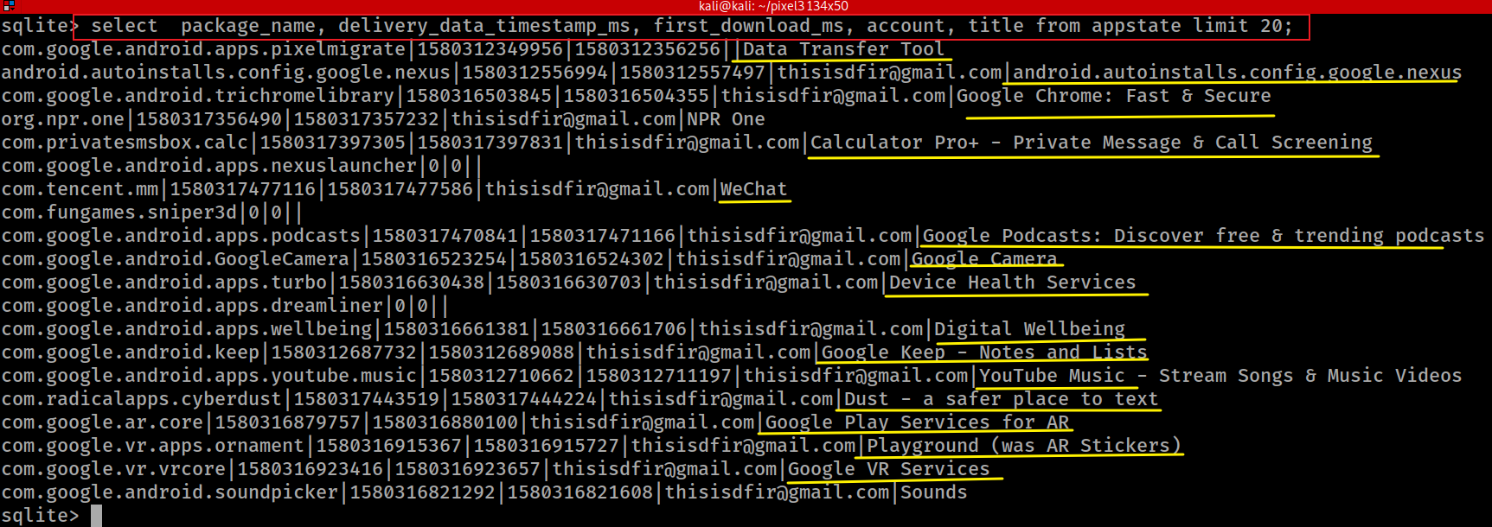
List 20 installed apps
Notes:
select package_name, delivery_data_timestamp_ms, first_download_ms, account, title from appstate limit 20;

Slide 11

Has the user downloaded WeChat?
WeChat is a Chinese multi-purpose messaging, social media and mobile payment app
  Developed by Tencent
  First released in 2011
The world's largest standalone mobile app in 2018
  over 1 billion monthly active users.
WeChat has been described as China's "app for everything"
  because of its wide range of functions.
Key functions
  text messaging, hold-to-talk voice messaging, broadcast (one-to-many) messaging, video conferencing, video games, sharing of photographs and videos, and location sharing.

Slide 12
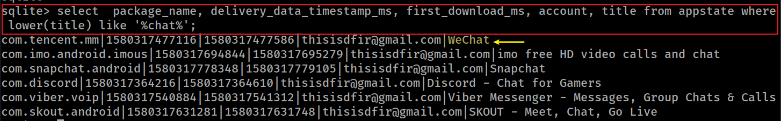
Approach 1: Search app using SQL statement
lower(title): convert title string to lower case
%chat%: match any title with ‘chat’ keyword
Search title with like
Notes:
select package_name, delivery_data_timestamp_ms, first_download_ms, account, title from appstate where lower(title) like '%chat%';

Slide 13
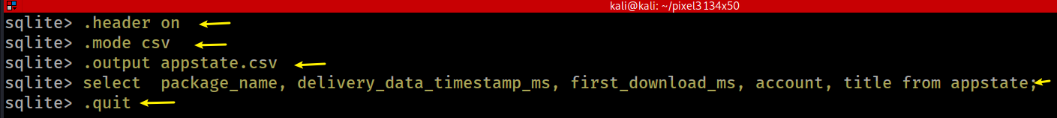
Approach 2: Search app in .csv
keep output column name when export to .csv
change to .cvs mode
ready to export to appstate.csv
export specified columns
quit sqlite3
Notes:
sqlite> .header on
sqlite> .mode csv
sqlite> .output appstate.csv
sqlite> select package_name, delivery_data_timestamp_ms, first_download_ms, account, title from appstate;
sqlite> .quit

Slide 14
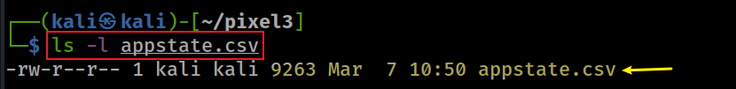
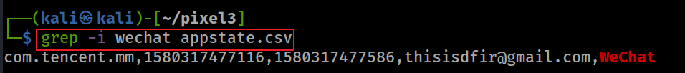
verify the output file
Search for wechat app
Notes:
sqlite> .header on
sqlite> .mode csv
sqlite> .output appstate.csv
sqlite> select package_name, delivery_data_timestamp_ms, first_download_ms, account, title from appstate;
sqlite> .quit

Slide 15
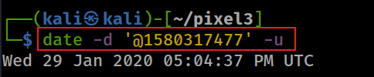
Which email is associated with WeChat?
Found that thisisdfir@gmail.com is associated with WeChat
Convert integer to downloaded time
Notes:
date -d '@1580317477' -u

Slide 16
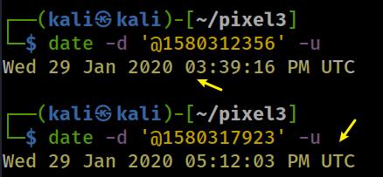
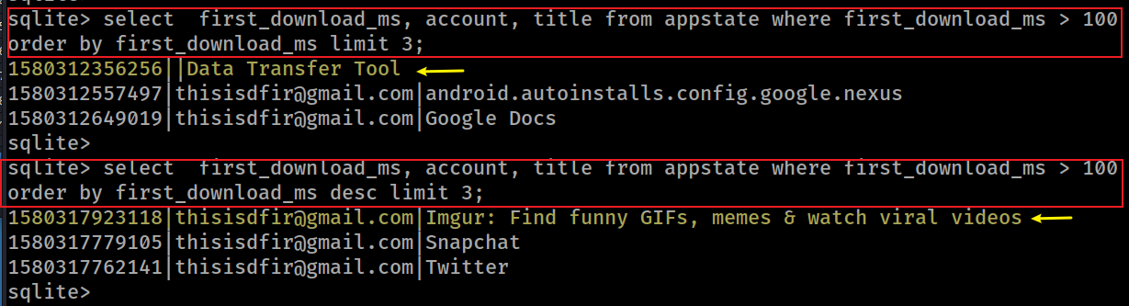
What is the time between the first and last app downloaded (less than 2 hours)?
Find the time of the app downloaded and the last app downloaded
Millisecond (ms):One millisecond is equal to one-thousandth (1/1000) of a second.
Microsecond (µs):One microsecond is equal to one-millionth (1/1,000,000) of a second
Notes:
sqlite> select first_download_ms, account, title from appstate where first_download_ms > 100 order by first_download_ms limit 3;
1580312356256||Data Transfer Tool
1580312557497|thisisdfir@gmail.com|android.autoinstalls.config.google.nexus
1580312649019|thisisdfir@gmail.com|Google Docs
sqlite>
sqlite> select first_download_ms, account, title from appstate where first_download_ms > 100 order by first_download_ms desc limit 3;
1580317923118|thisisdfir@gmail.com|Imgur: Find funny GIFs, memes & watch viral videos
1580317779105|thisisdfir@gmail.com|Snapchat
1580317762141|thisisdfir@gmail.com|Twitter

Slide 17
2. Find Purchased Apps

Slide 18
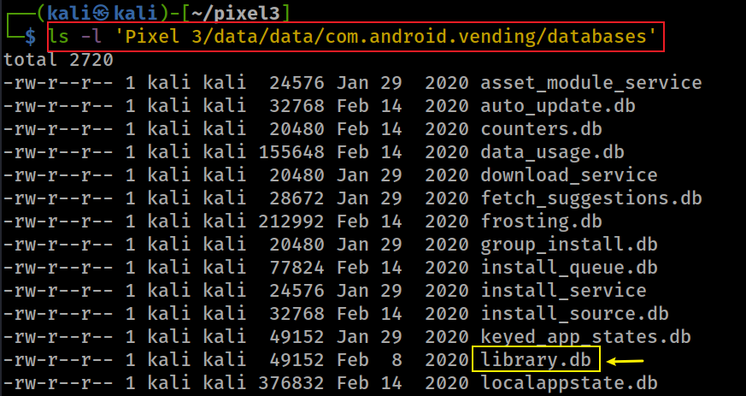
Which database stores purchased time?
Show location of database (library.db)
2. Find purchase time in the ownership table based on app name:
account
doc-id (package name)
doc hash
purchase time
1. find app name

Slide 19
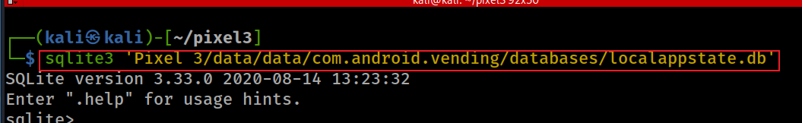
When was WhatsApp purchased?
1. Show location of database (localappstate.db) where we can find package name of whatsapp
2. Find package name of whatsapp
first_download_ms Wed 29 Jan 2020 05:09:04 PM UTC
Notes:
sqlite3 'Pixel 3/data/data/com.android.vending/databases/localappstate.db’
select package_name, delivery_data_timestamp_ms, first_download_ms, account, title from appstate where lower(title) like '%whatsapp%';

Slide 20
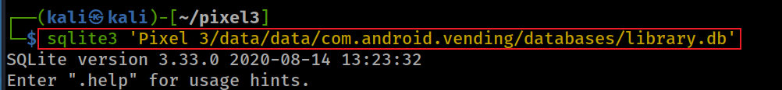

3. Open the database where whatsapp purchase time is stored
4. Find the purchase time
5. Convert the purchase time to a human readable format
Notes:
sqlite3 'Pixel 3/data/data/com.android.vending/databases/library.db’
select doc_id, document_hash, purchase_time from ownership where doc_id like '%whatsapp%';
com.whatsapp|-2208265135048976340| 1543518467665
Thu 29 Nov 2018 07:07:47 PM UTC

Slide 21
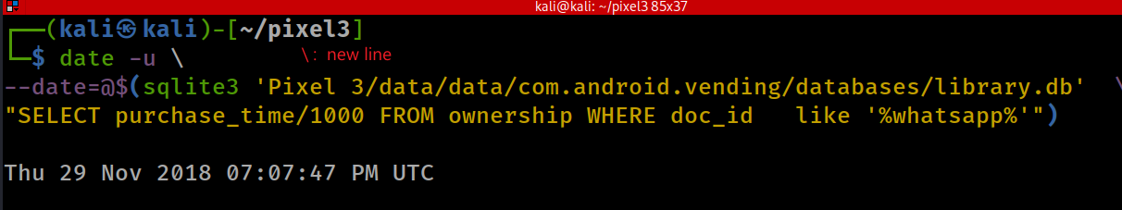
Combine step 1 – 5 in one command
The command in the braces of $() is executed in a subshell and the output is then placed in the original command.
Notes:
date -u \
--date=@$(sqlite3 'Pixel 3/data/data/com.android.vending/databases/library.db' \
"SELECT purchase_time/1000 FROM ownership WHERE doc_id like '%whatsapp%'")

Slide 22
notes about purchased time
A free app is also considered purchased
WhatsApp time
  purchased: Thu 29 Nov 2018 07:07:47 PM UTC
  downloaded: Wed 29 Jan 2020 05:09:04 PM UTC
Why there is over one year gap?
  the phone has been reset
    the purchased time is the last time that a removed/un-installed app was installed
  the phone is the user’s second Android device.
    the purchased time is the user’s previous Android device

Slide 23
3: Find Installed Apps
through apps/packages’ Folders

Slide 24
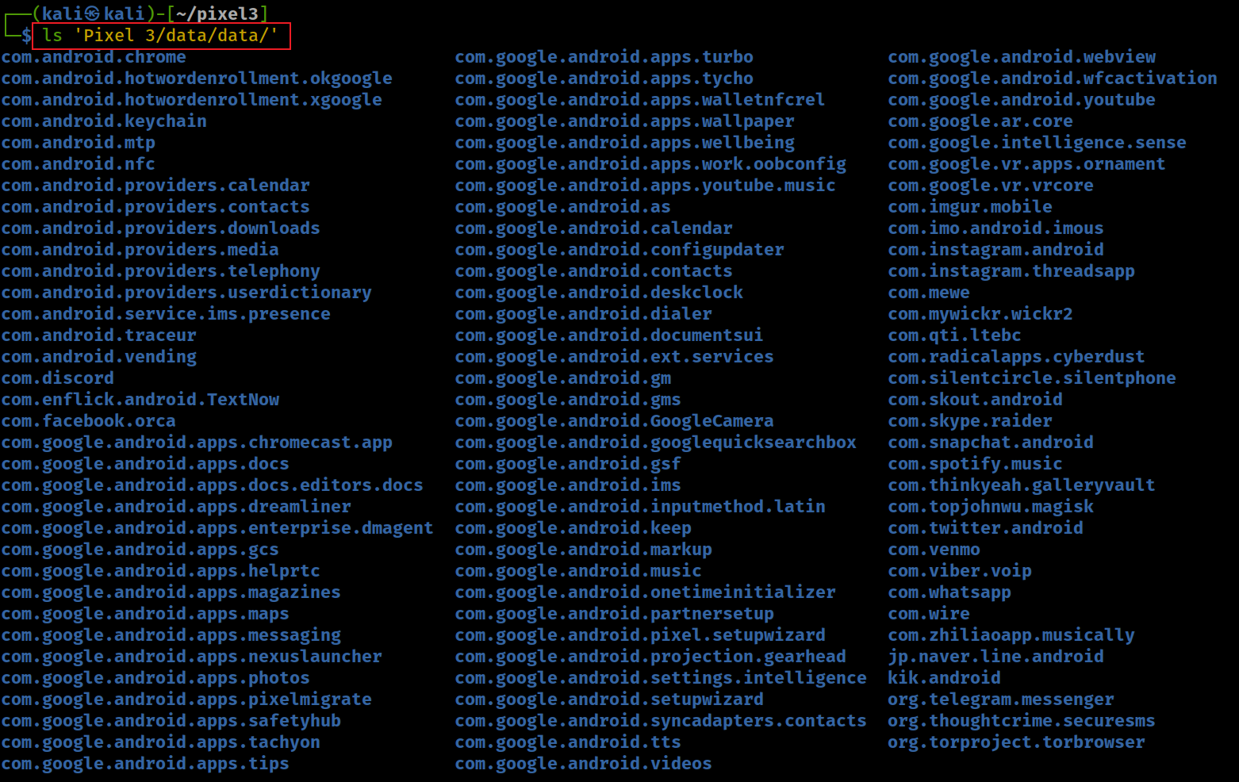
Show all packages under the folder /data/data/<package-name>
We will categorize them into groups:
google apps: com.google.*
android apps: com.andriod.*
3rd-party apps
Notes:
ls 'Pixel 3/data/data/'

Slide 25
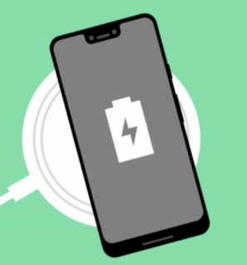
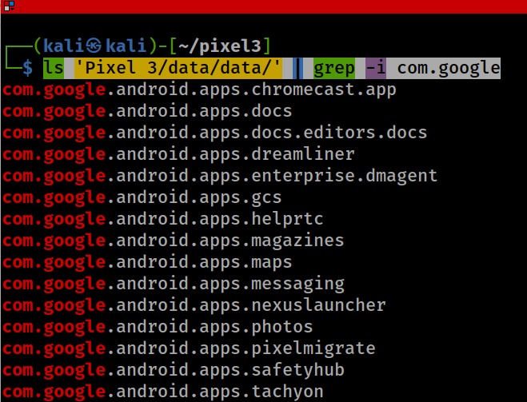
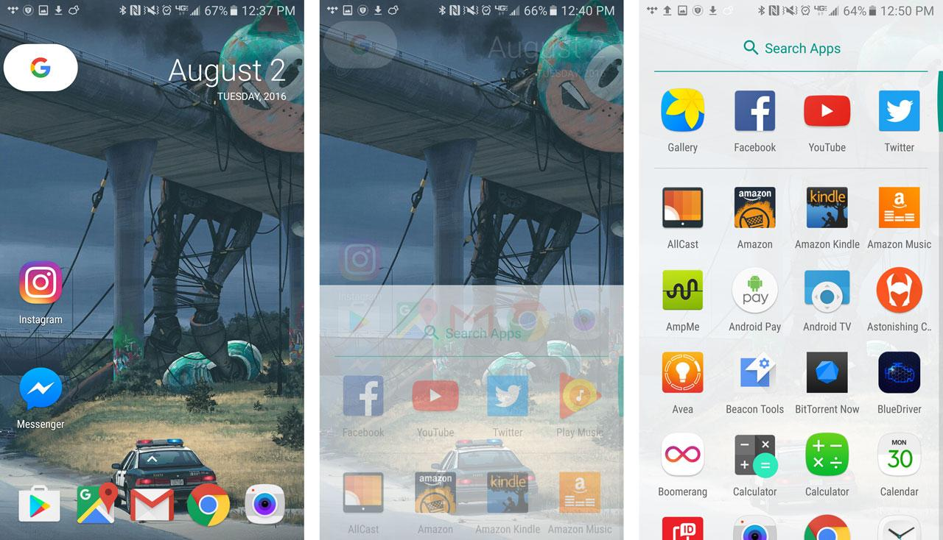
Group 1 (Google GMS Apps): com.google.*
‘dreamliner’ wireless charging widget support
Notes:
ls 'Pixel 3/data/data/' | grep -i com.google

Slide 26
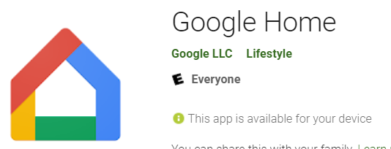

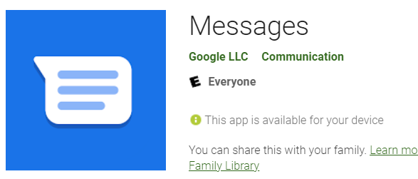
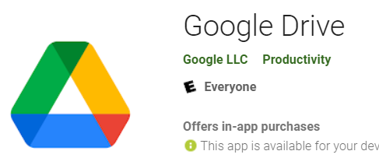
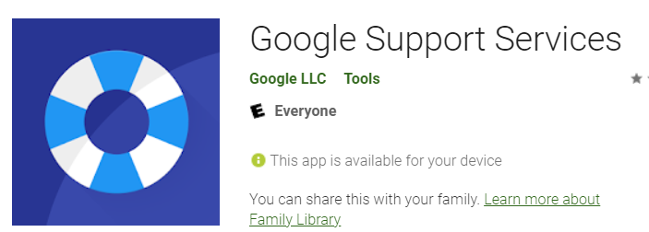
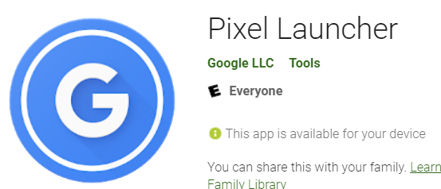
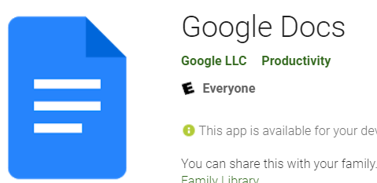
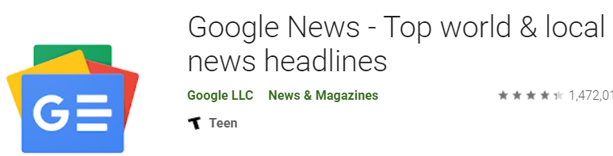
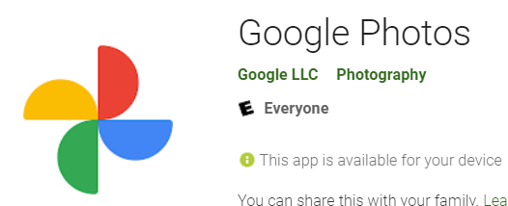
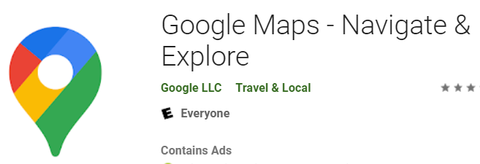
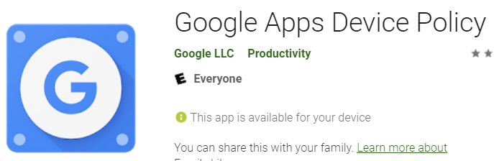
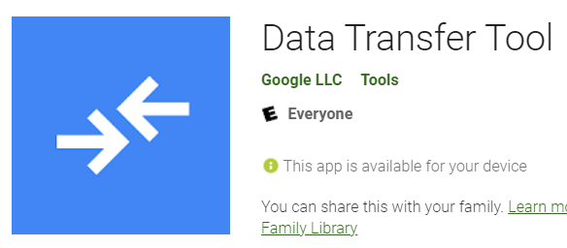
Notes:
com.google.android.apps.chromecast.app
com.google.android.apps.docs
com.google.android.apps.docs.editors.docs
com.google.android.apps.dreamliner
com.google.android.apps.enterprise.dmagent
com.google.android.apps.gcs
com.google.android.apps.helprtc
com.google.android.apps.magazines
com.google.android.apps.maps
com.google.android.apps.messaging
com.google.android.apps.nexuslauncher
com.google.android.apps.photos
com.google.android.apps.pixelmigrate

Slide 27
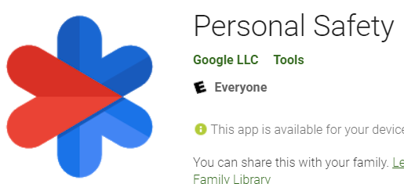
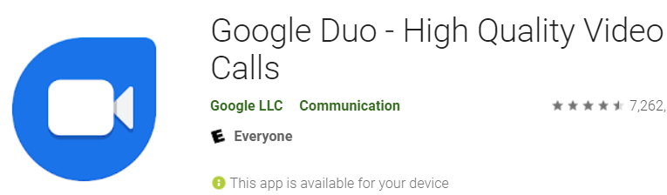
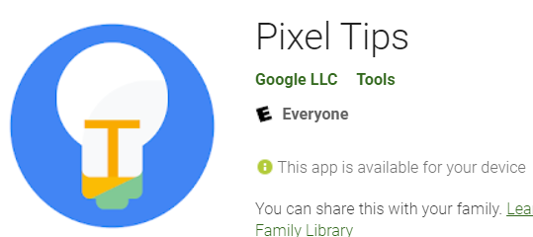
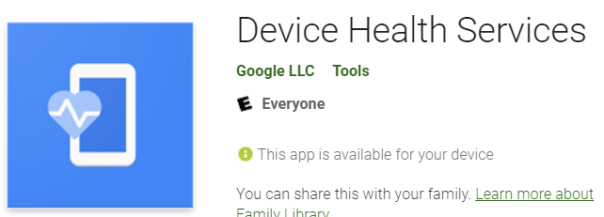
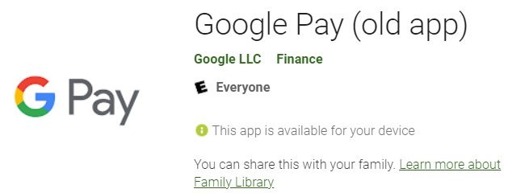
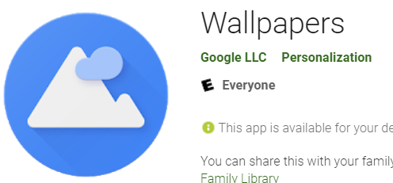
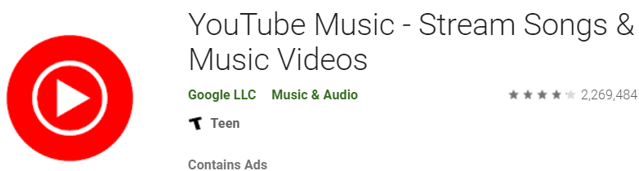
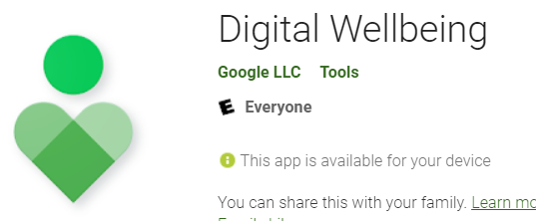
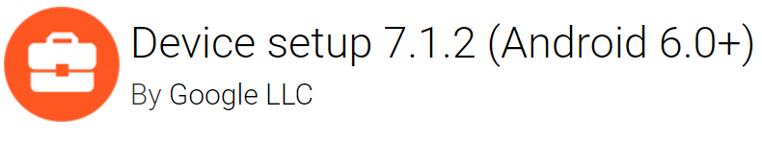
Notes:
com.google.android.apps.safetyhub
com.google.android.apps.tachyon
com.google.android.apps.tips
com.google.android.apps.turbo
com.google.android.apps.tycho
com.google.android.apps.walletnfcrel
com.google.android.apps.wallpaper
com.google.android.apps.wellbeing
com.google.android.apps.work.oobconfig
com.google.android.apps.youtube.music

Slide 28

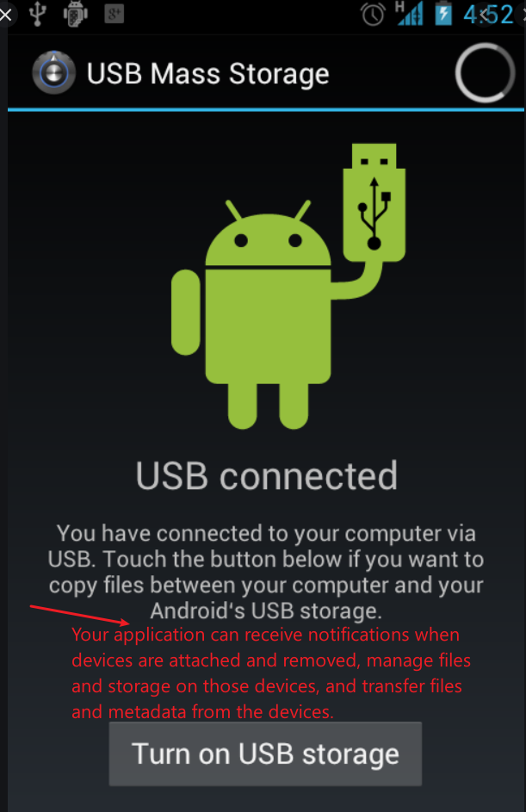
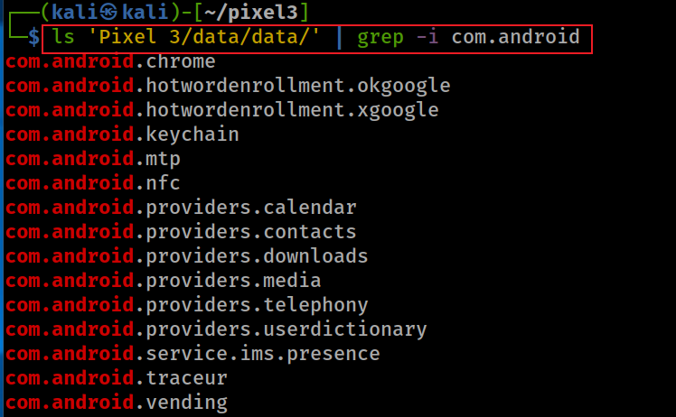
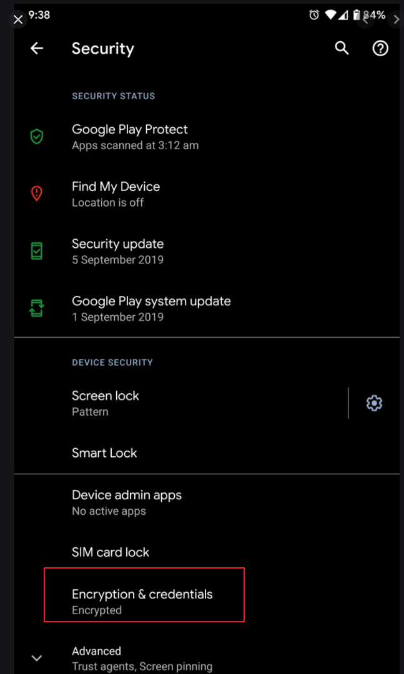
Group 2 (AOSP Apps): com.andriod.*
Show apps start with com.android
you have an email app and a browser app which talk to the same backend server with the same set of credentials.
contains data related to phone operation, specifically SMS and MMS messages, access to the APN list, including the MMSC to use, and the service state.
delivering IP multimedia services (text, video..)
Recording device activity over a short period of time is known as system tracing (research project?)
Notes:
ls 'Pixel 3/data/data/' | grep -i com.android
https://developer.android.com/reference/android/provider/UserDictionary
https://developer.android.com/reference/android/mtp/package-summary
https://developer.android.com/topic/performance/tracing
com.android.chrome
com.android.hotwordenrollment.okgoogle
com.android.hotwordenrollment.xgoogle
com.android.keychain
com.android.mtp
com.android.nfc
com.android.providers.calendar
com.android.providers.contacts
com.android.providers.downloads
com.android.providers.media
com.android.providers.telephony
com.android.providers.userdictionary
com.android.service.ims.presence
com.android.traceur
com.android.vending

Slide 29
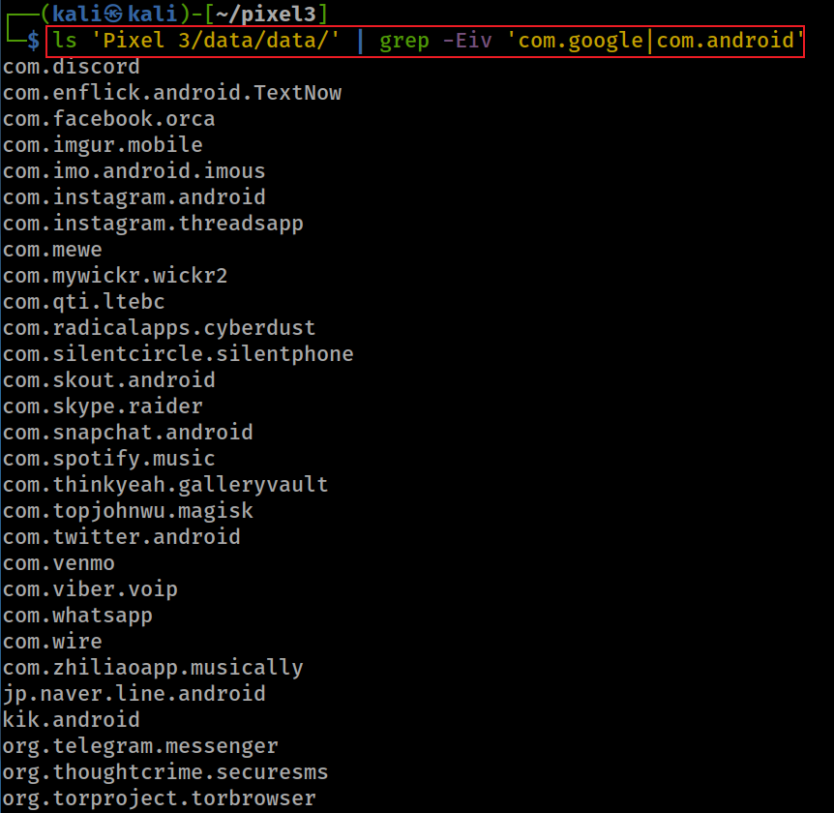
Group 3: 3rd-party apps
Show group 3 apps (all apps except groups 1 and 2)
-v, --invert-match select non-matching lines
Notes:
ls 'Pixel 3/data/data/' | grep -Eiv 'com.google|com.android’
com.discord
com.enflick.android.TextNow
com.facebook.orca
com.imgur.mobile
com.imo.android.imous
com.instagram.android
com.instagram.threadsapp
com.mewe
com.mywickr.wickr2
com.qti.ltebc
com.radicalapps.cyberdust
com.silentcircle.silentphone
com.skout.android
com.skype.raider
com.snapchat.android
com.spotify.music
com.thinkyeah.galleryvault
com.topjohnwu.magisk
com.twitter.android
com.venmo
com.viber.voip
com.whatsapp
com.wire
com.zhiliaoapp.musically
jp.naver.line.android
kik.android
org.telegram.messenger
org.thoughtcrime.securesms
org.torproject.torbrowser

Slide 30
















Slide 31














Slide 32
4: Exam App Properties
think about the metadata of a file system

Slide 33
Overview
System needs to manage Apps through App’s Property info (metadata)
Metadata is saved in data/system
  UID of apps/packages
  When the apps/packages are downloaded and updated
  Library required by apps/packages
  Name of the installer (e.g., com.android.vending)
  Usages
  …

Slide 34

What is the location of App Property (metadata) info?
data/system/package*
Notes:
find 'Pixel 3' -iname 'package*'

Slide 35

App property in system/packges.list?
Android assigns a unique user ID (UID) to each Android application and runs it in its own process.
  UID: Linux user ID
The UID isolates apps from each other and protects apps and the system from malicious apps.
Only list .gm packages (Gmail and gms) in system/packages.list
Notes:
cat 'Pixel 3/data/system/packages.list' | grep -Ei '\.gm’
https://source.android.com/security/app-sandbox#:~:text=This%20isolates%20apps%20from%20each,a%20kernel%2Dlevel%20Application%20Sandbox.

Slide 36
App property (metadata) in system/packages.xml?
Metadata of all installed apps includes
  code path
  library path
  installation and update timestamp
  installer
Metadata saved in
  system/packages.xml
Used by the PackageManager
  backup & restore, analytics, app management, system integrity
Notes:
grep -in 'package name="com.google.android.gm' 'Pixel 3/data/system/packages.xml’
3962: <package name="com.google.android.gm" codePath="/data/app/com.google.android.gm--QTglY_VBwLxA5dDcCqrCw==" nativeLibraryPath="/data/app/com.google.android.gm--QTglY_VBwLxA5dDcCqrCw==/lib" publicFlags="944488133" privateFlags="524288" ft="16ff237b230" it="11e8f7d4c00" ut="16ff237b83e" version="62049238" userId="10187" installer="com.android.vending" isOrphaned="true" categoryHint="4">
6405: <package name="com.google.android.gms" codePath="/data/app/com.google.android.gms-ZpkWIkavN2y4dNnqJLme0g==" nativeLibraryPath="/data/app/com.google.android.gms-ZpkWIkavN2y4dNnqJLme0g==/lib" primaryCpuAbi="arm64-v8a" secondaryCpuAbi="armeabi-v7a" publicFlags="-1605714235" privateFlags="524296" ft="17043c42548" it="11e8f7d4c00" ut="17043c42752" version="200414037" sharedUserId="10141" installer="com.android.vending" isOrphaned="true" categoryHint="7">
9310: <package name="com.google.android.gms.location.history" codePath="/product/app/LocationHistoryPrebuilt" nativeLibraryPath="/product/app/LocationHistoryPrebuilt/lib" publicFlags="810040901" privateFlags="524288" ft="11e8f7d4c00" it="11e8f7d4c00" ut="11e8f7d4c00" version="1" userId="10191" isOrphaned="true">
10408: <updated-package name="com.google.android.gm" codePath="/product/app/PrebuiltGmail" ft="11e8f7d4c00" it="11e8f7d4c00" ut="11e8f7d4c00" version="61499782" nativeLibraryPath="/product/app/PrebuiltGmail/lib" userId="10187">
10733: <updated-package name="com.google.android.gms" codePath="/product/priv-app/PrebuiltGmsCore" ft="11e8f7d4c00" it="11e8f7d4c00" ut="11e8f7d4c00" version="17786048" nativeLibraryPath="/product/priv-app/PrebuiltGmsCore/lib" primaryCpuAbi="arm64-v8a" secondaryCpuAbi="armeabi-v7a" sharedUserId="10141" />

Slide 37

it: initial download
ft: first installation
up: update time
Only list .gm packages (Gmail and gms), show metadata
Notes:
grep -in 'package name="com.google.android.gm' 'Pixel 3/data/system/packages.xml’
3962: <package name="com.google.android.gm" codePath="/data/app/com.google.android.gm--QTglY_VBwLxA5dDcCqrCw==" nativeLibraryPath="/data/app/com.google.android.gm--QTglY_VBwLxA5dDcCqrCw==/lib" publicFlags="944488133" privateFlags="524288" ft="16ff237b230" it="11e8f7d4c00" ut="16ff237b83e" version="62049238" userId="10187" installer="com.android.vending" isOrphaned="true" categoryHint="4">
6405: <package name="com.google.android.gms" codePath="/data/app/com.google.android.gms-ZpkWIkavN2y4dNnqJLme0g==" nativeLibraryPath="/data/app/com.google.android.gms-ZpkWIkavN2y4dNnqJLme0g==/lib" primaryCpuAbi="arm64-v8a" secondaryCpuAbi="armeabi-v7a" publicFlags="-1605714235" privateFlags="524296" ft="17043c42548" it="11e8f7d4c00" ut="17043c42752" version="200414037" sharedUserId="10141" installer="com.android.vending" isOrphaned="true" categoryHint="7">
9310: <package name="com.google.android.gms.location.history" codePath="/product/app/LocationHistoryPrebuilt" nativeLibraryPath="/product/app/LocationHistoryPrebuilt/lib" publicFlags="810040901" privateFlags="524288" ft="11e8f7d4c00" it="11e8f7d4c00" ut="11e8f7d4c00" version="1" userId="10191" isOrphaned="true">
10408: <updated-package name="com.google.android.gm" codePath="/product/app/PrebuiltGmail" ft="11e8f7d4c00" it="11e8f7d4c00" ut="11e8f7d4c00" version="61499782" nativeLibraryPath="/product/app/PrebuiltGmail/lib" userId="10187">
10733: <updated-package name="com.google.android.gms" codePath="/product/priv-app/PrebuiltGmsCore" ft="11e8f7d4c00" it="11e8f7d4c00" ut="11e8f7d4c00" version="17786048" nativeLibraryPath="/product/priv-app/PrebuiltGmsCore/lib" primaryCpuAbi="arm64-v8a" secondaryCpuAbi="armeabi-v7a" sharedUserId="10141" />

Slide 38
 | Attribute Name | Description
1 | name | package name
2 | codePath | APK file installation location (/system/app/ or /data/app/)
3 | nativeLibraryPath | native library (*.so file) default path is /data/data/<package name>/lib/
4 | flag | Store ApplicationInfo Flags [http://developer.android.com/reference/android/content/pm/ApplicationInfo.html]
5 | ft | timestamp in hex format of first time installation (milliseconds Unix epoch time)
6 | it | timestamp in hex format of initial download? (online notes are conflict with ft)
7 | ut | timestamp in hex format of last update
8 | version | Version Code from AndroidManifest.xml file [http://developer.android.com/guide/topics/manifest/manifest-element.html#vcode]
9 | sharedUserId | The name of Linux user ID that will be shared with other applications, It is same parameter which we define in AndroidManifest.xml [http://developer.android.com/guide/topics/manifest/manifest-element.html#uid]
10 | userId | The name of a Linux user ID (important to find the owner of apps)
Notes:
https://dzone.com/articles/depth-android-package-manager

Slide 39

Exam timestamps of .gm
Type | Hex | Integer | Epoch
ft | 16ff237b230 | 1580316734000 | Wednesday, January 29, 2020 4:52:14 PM
it | 11e8f7d4c00 | 1230768000000 | Thursday, January 1, 2009 12:00:00 AM
ut | 16ff237b83e | 1580316735550 | Wednesday, January 29, 2020 4:52:15.550 PM
https://www.epochconverter.com/

Slide 40
5. Exam Basic App Usage Events
data/system/package-usage.list
data/system/usagestats/

Slide 41
Overview
What was the last time that package (or application) used?
What are usage events generated by apps?
What is Android activity lifecycle?
How are usage events associated with Android activity lifecycle?
What user behaviors can be discovered from usage event logs?

Slide 42
package usages in system/package-usage.list
app last execution time
Saturday, February 1, 2020 1:07:29.465 AM
Saturday, February 1, 2020 2:19:40.618 AM
Friday, January 31, 2020 7:08:52.035 PM
Saturday, February 1, 2020 2:19:40.614 AM
Saturday, February 1, 2020 2:19:34.402 AM
the last 8 execution timestamps? need to verify
Notes:
grep -Ei '\.gm' 'Pixel 3’/data/system/package-usage.list
com.google.android.gm 1580519249465 1580523580618 1580497732035 1580523580614 1580523574402 0 0 0
com.google.android.gms 1580523599326 1580529895520 1580395544983 1580529394178 1580526326157 0 1580529874202 0
http://freeandroidforensics.blogspot.com/2014/11/some-artifacts-in-datasystem-directory.html

Slide 43
Usage events in system/usagestats
Device startup/shutdown
Keyguard Show/off
Move to background/foreground
Screen interactive screen turned on for full user interaction, not ambient display or other non-interactive state
Screen not interactive
completely turned off or turned on only in a non-interactive state like ambient display
Activity paused/resumed/stopped
User interaction
An event type denoting that a package was interacted with in some way by the user
Configuration Change
https://developer.android.com/reference/android/app/usage/UsageEvents.Event#SCREEN_INTERACTIVE
Notes:
https://abrignoni.blogspot.com/2019/02/android-usagestats-xml-parser.html
https://developer.android.com/reference/android/app/usage/UsageEvents.Event
https://www.youtube.com/watch?v=ZI_vzeKA_Zg&list=PLfouvuAjspTo6pWGP7otkE6SZ3QQ0b-RD

Slide 44


Android activity lifecycle
An activity is a single, focused thing that the user can do.
Almost all activities interact with the user
  generate events and save event info in system/usagestats
Activities are often presented to the user as
  full-screen windows,
  floating windows
  Multi-Window mode
Different activities generate
  different events

Slide 45

Android activity lifecycle.

Slide 46

Screen visibility and Android activity
move to foreground
move to background
Activity stopped
Notes:
https://www.codevoila.com/post/58/android-tutorial-activity-lifecycle

Slide 47



system/usagestats are saved in different folders
Show usagestats folder structure
Fri 14 Feb 2020 04:00:01 PM UTC
interval Type: system collects and aggregates the data over 4 different intervals
Only can retrieve app usage data for up to 7 days for interval daily, up to 4 weeks for interval weekly, up to 6 months for monthly and finally up to 2 years for yearly.
Notes:
tree 'Pixel 3/data/system/usagestats/' -L 2
tree 'Pixel 3/data/system/usagestats/0' -L 2
date -d '@1580917965671' -u
1580917965671
1581004373881
1581090879070
1581177279272
1581263873464
1581350284755
1581436707859
1581523178051
1581609587089
1581696001773
https://medium.com/@quiro91/show-app-usage-with-usagestatsmanager-d47294537dab

Slide 48
How to read activity event log files?
Activity event logs are saved in /usagestats folder
  in Protocol Buffers format
    Protocol buffers are for serializing structured data
    Google's language-neutral, platform-neutral, extensible mechanism
    like XML, but smaller, faster, and simpler.
Parse information in /usagestats folder
Analyze parsed results
Notes:
https://abrignoni.blogspot.com/2019/02/android-usagestats-xml-parser.html
https://www.swiftforensics.com/2020/01/usagestats-on-android-10-q.html
https://developers.google.com/protocol-buffers

Slide 49



1. Protocol Buffers example
Notes:
https://martin.kleppmann.com/2012/12/05/schema-evolution-in-avro-protocol-buffers-thrift.html

Slide 50


2. Prepare tool and data
Download usagestates parsing tool
works with both old android (before 10) XML based usagestats as well as the newer (10+) Protocol buffer
Copy the whole usagestats folder to the tool folder (required by tool)
cp -avr <source_folder> <destination_folder>
-a: preserve all
-r: copy directories recursively
-v: explain what is being done
Notes:
git clone https://github.com/abrignoni/Android-Usagestats-XML-Protobuf.git
cp -avr 'Pixel 3/data/system/usagestats/' Android-Usagestats-XML-Protobuf
https://github.com/abrignoni/Android-Usagestats-XML-Protobuf

Slide 51


3. Parse the usagestats folder
parsing and results are saved in usagestates.db
Verify the parsed results are saved in usagestates.db
Notes:
python3 Android-Usagestats-XML-Protobuf/usagestats_conv.py

Slide 52

4. Show usage table column names
Fullatt example
font_scale: 1.0
mcc: 310
mnc: 120
screen_layout: 268435810
color_mode: 10
touchscreen: 3
keyboard: 1
keyboard_hidden: 1
hard_keyboard_hidden: 2
navigation: 1
navigation_hidden: 2
orientation: 1
ui_mode: 19
screen_width_dp: 392
screen_height_dp: 713
smallest_screen_width_dp: 392
density_dpi: 440
window_configuration {
app_bounds {
right: 1080
bottom: 2028
}
windowing_mode: 1
bounds {
right: 1080
bottom: 2160
}
}
locale_list: "en-US"
Usage_type: Can be event-log, configuration, and packages.
Lastime: last active or a configuration took place.
Time_active: Certain events keep track of their length in milliseconds.
Types: Activity types as integer values. These represent activity like move to background or move to foreground.
Classs: Application name and corresponding modules in use.
Source: daily, weekly, monthly, and yearly.
Fullatt: Contains the full attributes for the XML event /all the data for the event in JSON format. With the data in this field the analyst can easily select any key:value pair and make it its own column in a SQL query by the use of JSON_Extract. see example
https://abrignoni.blogspot.com/2018/09/finding-slack-messages-in-android-and.html
https://abrignoni.blogspot.com/2019/02/android-usagestats-xml-parser.html
Notes:
sqlite3 'usagestats.db’
.tables
pragma table_info(data);

Slide 53
5. Show parsed table
SELECT
usage_type,
datetime(lastime/1000, 'UNIXEPOCH', 'localtime') as lasttimeactive,
timeactive as time_Active_in_msecs,
timeactive/1000 as timeactive_in_secs,
package,
CASE types
WHEN '1' THEN 'MOVE_TO_FOREGROUND'
WHEN '2' THEN 'MOVE_TO_BACKGROUND'
WHEN '5' THEN 'CONFIGURATION_CHANGE'
WHEN '7' THEN 'USER_INTERACTION'
WHEN '8' THEN 'SHORTCUT_INVOCATION’
WHEN ‘23' THEN 'ACTIVITY_STOPPED'
ELSE types
END types,
classs,
source,
fullatt
FROM data
ORDER BY lasttimeactive DESC
Note:
data is the table in usagestats.db
the timestamp is converted from UTC to 'localtime’ of your computer
You can remove it or change it to UTC
https://abrignoni.blogspot.com/2019/02/android-usagestats-xml-parser.html

Slide 54


6. Show generated data in html

Slide 55
When did the user shared his/her location in Line?
What is the package name of Line?
  search 'Pixel 3/data/data/com.android.vending/databases/localappstate.db’
  one of the methods to find the package name
What is the event that is associated with the sharing location activity?
  selectLocationActivity
Find the timestamp of the generated events
  search the usage data table based on a Line and selectLocationActivity

Slide 56

Find the package name of Line?
Notes:
sqlite3
.open 'Pixel 3/data/data/com.android.vending/databases/localappstate.db'
select package_name, first_download_ms, account, title from appstate where package_name like '%line%' ;

Slide 57

Find events associated with the sharing location
Notes:
.open 'usagestats.db'
SELECT
usage_type,
datetime(lastime/1000, 'UNIXEPOCH') as lasttimeactive,
timeactive as time_Active_in_msecs,
timeactive/1000 as timeactive_in_secs,
package,
CASE types
WHEN '1' THEN 'MOVE_TO_FOREGROUND'
WHEN '2' THEN 'MOVE_TO_BACKGROUND'
WHEN '5' THEN 'CONFIGURATION_CHANGE'
WHEN '7' THEN 'USER_INTERACTION'
WHEN '8' THEN 'SHORTCUT_INVOCATION'
WHEN '23' THEN 'ACTIVITY_STOPPED'
ELSE types
END types,
classs,
source
FROM data
where package = 'jp.naver.line.android' and usage_type ='event-log'
ORDER BY lasttimeactive ;

Slide 58

location service
MOVE_TO_FOREGROUND: the user was using the app and in a specific activity
MOVE_TO_BACKGROUND: the user moved away from the activity

Slide 59

What is specific time period the user uses Line in Feb 9, 2020?
Show all events of Line usage
Notes:
SELECT
usage_type,
lastime,
datetime(lastime/1000, 'UNIXEPOCH') as lasttimeactive,
timeactive as time_Active_in_msecs,
timeactive/1000 as timeactive_in_secs,
package,
CASE types
WHEN '1' THEN 'MOVE_TO_FOREGROUND'
WHEN '2' THEN 'MOVE_TO_BACKGROUND'
WHEN '5' THEN 'CONFIGURATION_CHANGE'
WHEN '7' THEN 'USER_INTERACTION'
WHEN '8' THEN 'SHORTCUT_INVOCATION'
WHEN '23' THEN 'ACTIVITY_STOPPED'
ELSE types
END types,
classs,
source
FROM data
where package = 'jp.naver.line.android' and usage_type ='event-log'
ORDER BY lasttimeactive ;

Slide 60

timestamp of sharing location

Slide 61

What was the next activity after the user shared his/her location?
Show all events after 1581271520730, which is the timestamp of sharing location
Notes:
SELECT
usage_type,
lastime,
datetime(lastime/1000, 'UNIXEPOCH') as lasttimeactive,
timeactive as time_Active_in_msecs,
timeactive/1000 as timeactive_in_secs,
package,
CASE types
WHEN '1' THEN 'MOVE_TO_FOREGROUND'
WHEN '2' THEN 'MOVE_TO_BACKGROUND'
WHEN '5' THEN 'CONFIGURATION_CHANGE'
WHEN '7' THEN 'USER_INTERACTION'
WHEN '8' THEN 'SHORTCUT_INVOCATION'
WHEN '23' THEN 'ACTIVITY_STOPPED'
ELSE types
END types,
classs,
source
FROM data
where usage_type ='event-log' and lastime > 1581271520730
ORDER BY lasttimeactive limit 20;

Slide 62

what is com.google.android.apps.nexuslauncher?
what is com.viber.voip?

Slide 63

Key features:
• Swipe right from your home screen to see personalized Google cards that bring you news and personalized information, at just the right time.
• Quick access to Google Search on your primary home screen.
• Swipe up on the bottom Favorites row to find your apps from A-Z.
• App Suggestions bring the app you’re looking for to the top of your A-Z list.
• Long-press on apps that support shortcuts to jump right into where you need to go or long-press on the shortcuts to drag them to the home screen.

Slide 64


