Slide 1
Investigating the 3rd Party Android Apps
Part 3: whatsapp
Notes:
https://digitalcorpora.s3.amazonaws.com/corpora/mobile/android_10/Non-Cellebrite%20Extraction/Pixel%203.zip

Slide 2
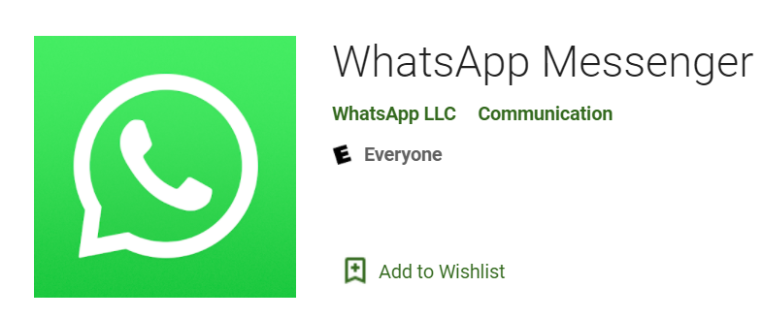
What is whatsapp?

Slide 3
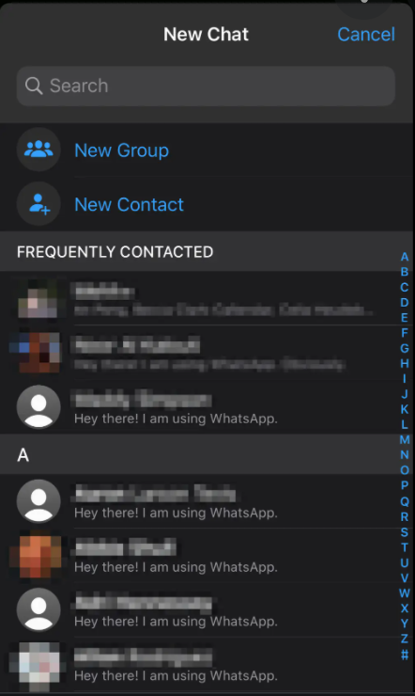
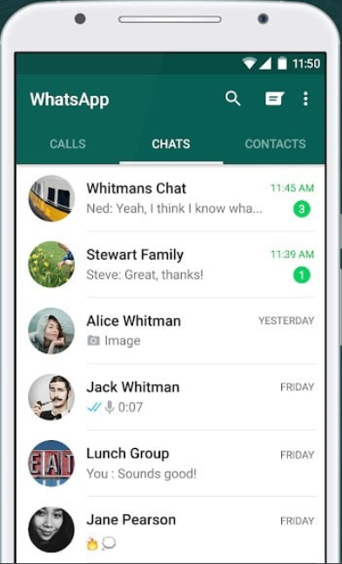
WhatsApp features
WhatsApp is a free, multiplatform messaging app
  Video and voice calls
  Send images and text messages
Evidence types
  Messages
  Contacts
  Phone numbers

Slide 4
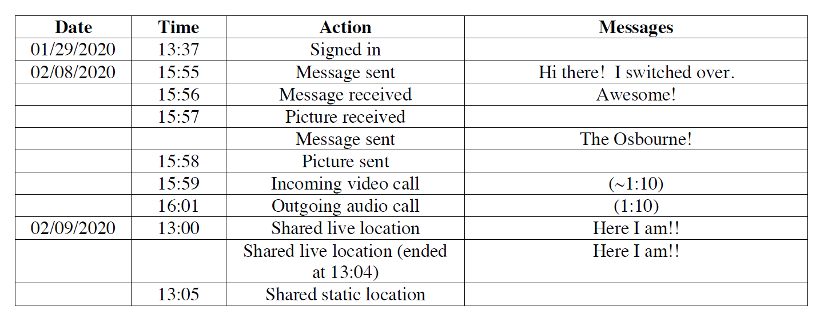
Sample questions
Which phone number is associated with WhatsApp?
How many contacts are stored on WhatsApp?
Are there any conversations stored in the device?
Are we able to construct a timeline of the suspect’s behaviors?

Slide 5
Investigate whatsApp

Slide 6
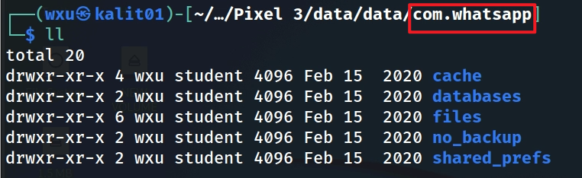
whatsApp folder structure
Notes:
tree -L 1 'Pixel 3/data/data/com.whatsapp/'

Slide 7
Shared preference

Slide 8
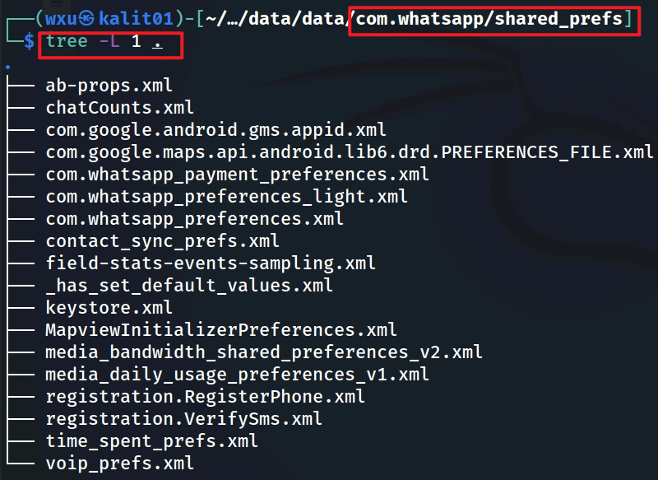
shared_prefs folder
registration.registerPhone.xml (phone number registration details)
com.whatsapp_preferences.xml (core user settings and metadata)
com.whatsapp.preferences_light.xml (additional user settings)
contact_sync_prefs.xml (contact synchronization data)
register.VerifySms.xml (SMS verification details)
com.whatsapp_payment_preferences.xml (payment-related data, if applicable)
keystore.xml (potential cryptographic keys, though difficult to exploit)
time_spent_prefs.xml (usage patterns)
voip_prefs.xml (call-related metadata)
Notes:
In the context of digital forensics, the image shows a directory listing of files in the `/data/data/com.whatsapp/shared_prefs` directory on a device running Kali Linux, likely extracted from a Pixel 3 device. The `shared_prefs` directory typically contains XML files that store application preferences and user data for the WhatsApp app. Some of these files can be highly valuable for forensic analysis because they may contain user activity, settings, or metadata that can provide insights into the user's behavior, communications, or app usage.
Here’s an analysis of the files listed and their potential forensic value:
1. **com.whatsapp_preferences.xml**
- **Value: High**
- This file likely contains core preferences for the WhatsApp app, such as user settings, account information, notification preferences, and possibly timestamps of last activity. It could reveal user behavior, such as whether they enabled features like end-to-end encryption or two-step verification.
2. **com.whatsapp.preferences_light.xml**
- **Value: High**
- This file might store lightweight preferences, potentially related to UI settings or simplified user data. It could still contain valuable metadata, such as theme preferences or last-used settings, which might help establish a timeline of user activity.
3. **contact_sync_prefs.xml**
- **Value: High**
- This file likely contains data about contact synchronization, such as which contacts were synced with WhatsApp and when. It could reveal the user’s network of contacts and the frequency of sync operations, which is useful for mapping relationships and communication patterns.
4. **registerPhone.xml**
- **Value: High**
- This file probably contains data related to the phone number registration process, such as the registered phone number, timestamps of registration, or verification attempts. This can be critical for linking the device to a specific user or phone number.
5. **register.VerifySms.xml**
- **Value: High**
- This file likely stores information about SMS verification during the registration process, such as verification codes, timestamps, or attempts. It can help confirm the user’s identity and establish a timeline of when the app was set up or re-registered.
6. **time_spent_prefs.xml**
- **Value: Moderate to High**
- This file might track the amount of time the user spent on WhatsApp, potentially broken down by activity (e.g., chatting, calls). This can be useful for behavioral analysis and establishing usage patterns.
7. **ab-props.xml**
- **Value: Moderate**
- This file likely contains A/B testing properties, which WhatsApp uses to test new features on subsets of users. While not directly tied to user data, it might reveal which experimental features the user was exposed to, potentially indicating their app version or participation in beta testing.
8. **chatCounts.xml**
- **Value: Moderate**
- This file might store counts of chats or messages, such as the number of conversations or unread messages. It can provide a high-level overview of the user’s activity but may lack detailed content.
9. **com.google.android.gms.appid.xml**
- **Value: Moderate**
- This file is related to Google Play Services and may contain an app ID or push notification tokens for WhatsApp. It can help identify the device and its connection to Google services, which might be useful for cross-referencing with other data.
10. **com.google.maps.api.android.lib6.drd.PREFERENCES_FILE.xml**
- **Value: Low to Moderate**
- This file is related to Google Maps API preferences, possibly used by WhatsApp for location-sharing features. It might contain location-related settings or cached data, which could be useful if the user shared locations frequently.
11. **com.whatsapp_payment_preferences.xml**
- **Value: High**
- If WhatsApp Payments is enabled, this file could contain payment-related preferences, such as linked bank accounts, transaction settings, or timestamps of payment activity. This is highly valuable for financial investigations.
12. **field-stats-events-sampling.xml**
- **Value: Low to Moderate**
- This file likely contains data about event sampling for analytics (e.g., how often certain events are logged). It might provide some insight into app usage but is less likely to contain direct user data.
13. **has_set_default_values.xml**
- **Value: Low**
- This file probably indicates whether default values for certain settings have been set. It’s more technical and less likely to contain forensically significant user data.
14. **keystore.xml**
- **Value: High**
- This file might store cryptographic keys or tokens used by WhatsApp for encryption or secure storage. If accessible, it could potentially help decrypt other data, though WhatsApp’s end-to-end encryption makes this challenging.
15. **MapviewInitializerPreferences.xml**
- **Value: Low to Moderate**
- Similar to the Google Maps API file, this might contain map-related preferences, potentially tied to location-sharing features. Its forensic value depends on whether the user frequently shared locations.
16. **media_bandwidth_shared_preferences_v2.xml**
- **Value: Moderate**
- This file likely stores settings related to media bandwidth usage, such as preferences for downloading media over mobile data or Wi-Fi. It can provide insight into the user’s data usage habits.
17. **media_daily_usage_preferences_v1.xml**
- **Value: Moderate**
- This file might track daily media usage, such as the amount of data used for photos, videos, or voice messages. It can help establish usage patterns but may not contain specific content.
18. **voip_prefs.xml**
- **Value: Moderate to High**
- This file likely contains preferences for WhatsApp’s VoIP (voice over IP) features, such as call settings, audio quality preferences, or call-related metadata. It could reveal patterns of voice or video call usage.
### Most Valuable Files for Digital Forensics
Based on the analysis, the most valuable files for digital forensics in this directory are likely:
- **com.whatsapp_preferences.xml** (core user settings and metadata)
- **com.whatsapp.preferences_light.xml** (additional user settings)
- **contact_sync_prefs.xml** (contact synchronization data)
- **registerPhone.xml** (phone number registration details)
- **register.VerifySms.xml** (SMS verification details)
- **com.whatsapp_payment_preferences.xml** (payment-related data, if applicable)
- **keystore.xml** (potential cryptographic keys, though difficult to exploit)
- **time_spent_prefs.xml** (usage patterns)
- **voip_prefs.xml** (call-related metadata)
These files are likely to contain user-specific data, metadata, or behavioral patterns that can help reconstruct the user’s activities, relationships, and interactions on WhatsApp.

Slide 9
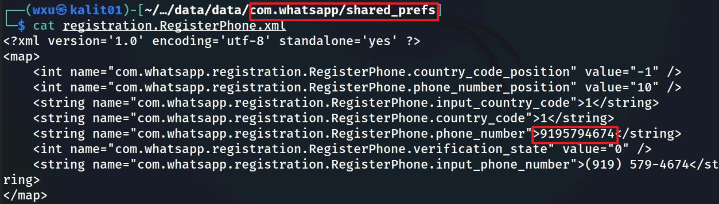
registration.registerPhone.xml
Notes:
cat 'Pixel 3/data/data/com.whatsapp/shared_prefs/registration.RegisterPhone.xml'

Slide 10
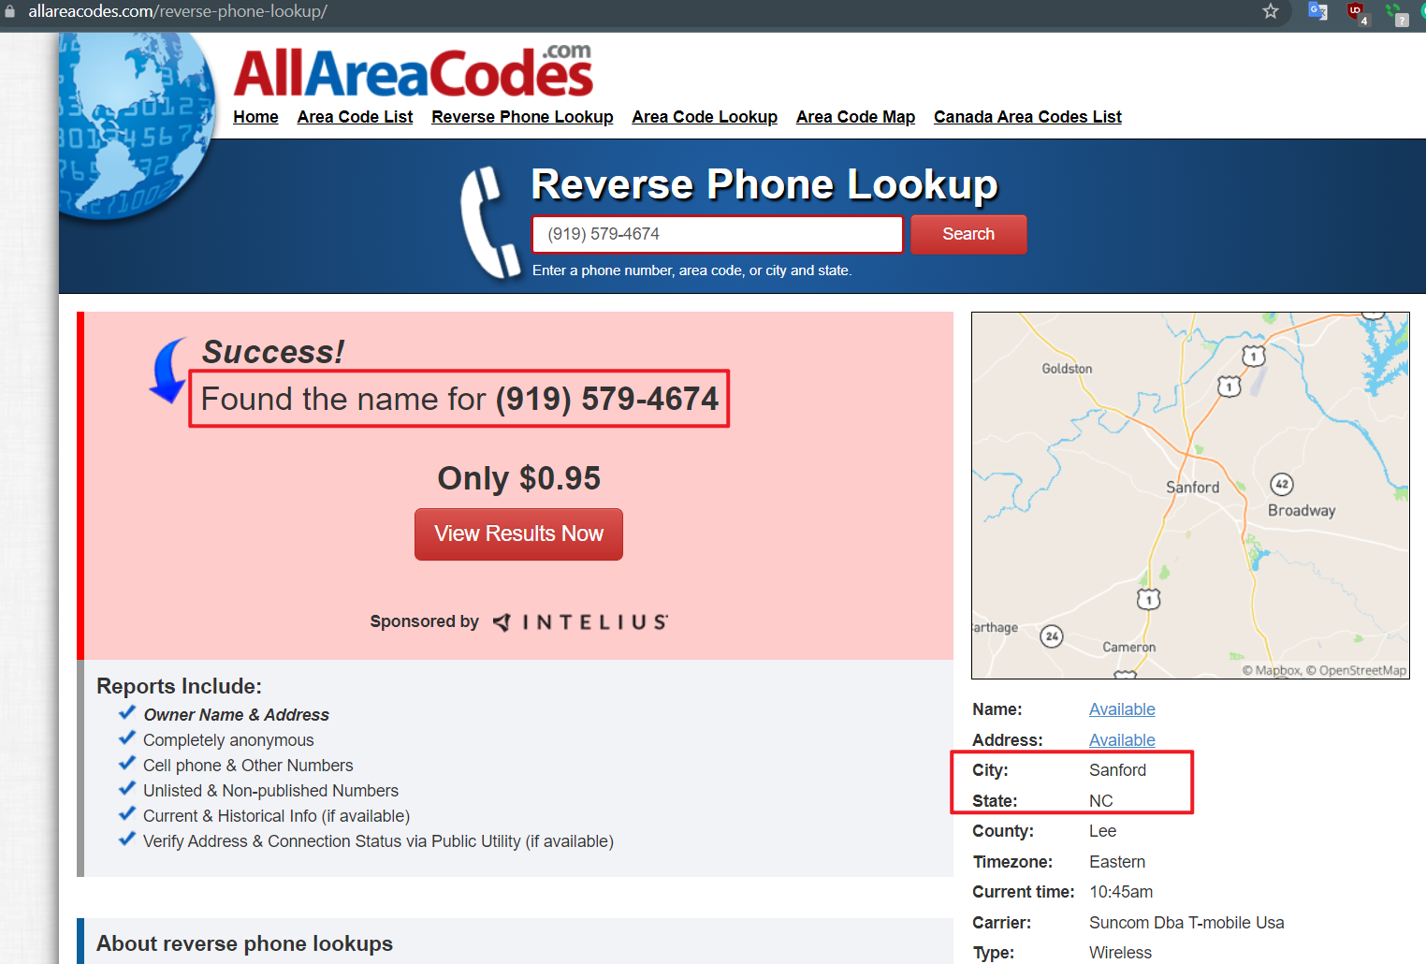

Slide 11
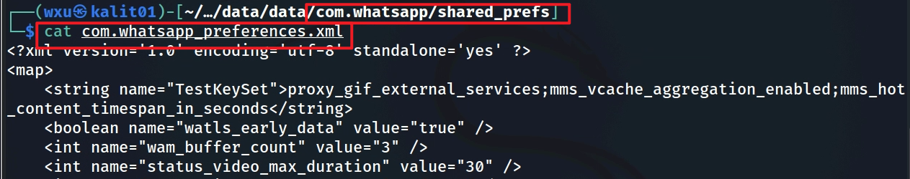
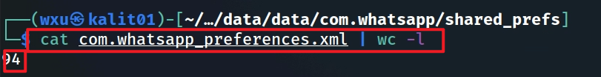
com.whatsapp_preferences.xml
the problem is that there are 94 lines and difficult to read

Slide 12
Most valuable information in com.whatsapp_preferences.xml
Location Data (share_location_lat, share_location_lon)
  Coordinates (35.65854, -78.861786) near Raleigh, NC, USA, can help pinpoint the user’s location at a specific time, especially if correlated with timestamps.
Timestamps (groups_server_props_last_refresh_time, file_date)
  The timestamp (February 14, 2020, 15:40:36 UTC) and date (February 8, 2020) provide a timeline of app activity, which is critical for reconstructing events.
Payment Settings (payments_web_enabled, payments_upi_transaction_limit)
  Indicates the user had WhatsApp Payments enabled with a UPI transaction limit of 5000, suggesting potential financial activity that could be investigated further.
Group and Communication Settings (group_invite_sending, frequently_forwarded_max_chats)
  Provides insight into the user’s group interactions and message-forwarding behavior, which can be relevant for social network analysis or investigating the spread of content.
Security Settings (two_factor_auth_email_set)
  Suggests two-factor authentication was configured, which might lead to identifying the user’s email address in other data sources.
Notes:
The file `com.whatsapp_preferences.xml` you provided contains configuration settings and preferences for the WhatsApp application, stored in the `/data/data/com.whatsapp/shared_prefs` directory. In a digital forensics context, this file can be highly valuable because it includes metadata, user settings, and behavioral indicators that can help reconstruct a user’s activity, preferences, and interactions within the app. Below is an analysis of the contents to identify the most valuable information for forensic purposes:
---
### Key Forensic Value from `com.whatsapp_preferences.xml`
1. **Location Data**
- **Entries:**
- `share_location_lat` = `35.65854` (latitude)
- `share_location_lon` = `-78.861786` (longitude)
- `share_location_zoom` = `12.513967` (zoom level)
- **Forensic Value: High**
These coordinates (35.65854, -78.861786) point to a specific location, which, when mapped, corresponds to an area near Raleigh, North Carolina, USA. This could indicate a location the user shared or a default location set in the app. The zoom level might provide context about the granularity of the shared location (e.g., a specific building or a broader area). This is critical for geolocation analysis and establishing the user’s physical presence or activity at a specific time.
2. **Timestamps**
- **Entries:**
- `groups_server_props_last_refresh_time` = `1581692436133` (Unix timestamp in milliseconds)
- `file_date` = `20200208` (likely a date in YYYYMMDD format)
- **Forensic Value: High**
- The `groups_server_props_last_refresh_time` (1581692436133) converts to **February 14, 2020, 15:40:36 UTC**. This indicates the last time the app refreshed group-related server properties, which can help establish a timeline of app usage or group activity.
- The `file_date` (20200208) corresponds to **February 8, 2020**, which might indicate when a specific file or setting was last modified or created. Timestamps are crucial for building a timeline of events in a forensic investigation.
3. **Payment-Related Settings**
- **Entries:**
- `payments_disable_switch_psp` = `true`
- `payments_web_enabled` = `true`
- `payments_upi_transaction_limit` = `5000`
- **Forensic Value: High**
These settings indicate that WhatsApp Payments was enabled (`payments_web_enabled = true`) and configured for UPI (Unified Payments Interface), with a transaction limit of 5000 (likely in INR, as UPI is primarily used in India). The `payments_disable_switch_psp` being `true` might mean the user cannot switch payment service providers, which could indicate a specific payment setup. This is valuable for financial investigations, as it suggests the user may have engaged in payment activities, and further investigation into transaction logs could reveal financial interactions.
4. **User Behavior and Preferences**
- **Entries:**
- `input_enter_send` = `true` (send message on pressing Enter)
- `voip_low_data_usage` = `false` (not using low data mode for VoIP calls)
- `status_collapse_muted` = `true` (collapse muted statuses)
- `camera_is_front` = `false` (default camera is rear-facing)
- `interface_font_size` = `0` (default font size)
- `settings_language` = `0` (default language, likely English or device default)
- **Forensic Value: Moderate**
These settings provide insight into the user’s interaction with the app, such as their preferred way of sending messages, camera usage, and UI preferences. While not directly incriminating, they can help build a behavioral profile of the user, which might be useful for attribution or understanding their habits.
5. **Media and File Limits**
- **Entries:**
- `media_limit_mb` = `64` (media size limit in MB)
- `media_limit_auto_download_mb` = `32` (auto-download limit in MB)
- `document_limit_mb` = `100` (document size limit in MB)
- `image_max_kbytes` = `1024` (image size limit in KB)
- `image_max_edge` = `1600` (max image resolution edge in pixels)
- `status_image_max_edge` = `1280` (max status image edge in pixels)
- `status_image_quality` = `50` (status image quality)
- `video_max_bitrate` = `5000` (max video bitrate in kbps)
- `status_video_max_duration` = `30` (max status video duration in seconds)
- **Forensic Value: Moderate**
These settings define the limits for media sharing and downloads, which can help investigators understand the types of files the user was likely to share or receive. For example, the `status_video_max_duration` of 30 seconds indicates the maximum length of status videos, and the `image_max_edge` of 1600 pixels suggests the resolution of shared images. This can assist in analyzing media files found elsewhere on the device.
6. **Group and Communication Settings**
- **Entries:**
- `group_invite_sending` = `true` (group invite sending enabled)
- `group_join_permissions` = `true` (group join permissions enabled)
- `groups_privacy_blacklist` = `true` (privacy blacklist for groups enabled)
- `group_description_length` = `512` (max group description length in characters)
- `participants_size_limit` = `257` (max number of participants in a group)
- `multicast_limit_global` = `5` (max recipients for multicast messages)
- `frequently_forwarded_messages` = `true` (frequently forwarded messages feature enabled)
- `frequently_forwarded_max_chats` = `5` (max chats for frequently forwarded messages)
- **Forensic Value: Moderate to High**
These settings provide insight into the user’s group interactions. For example, the `participants_size_limit` of 257 indicates the maximum size of groups the user could participate in, and `frequently_forwarded_max_chats` of 5 suggests limits on message forwarding, which could be relevant for investigating the spread of misinformation or viral content. The `groups_privacy_blacklist` being enabled might indicate the user restricted certain contacts from adding them to groups, which could be relevant for social network analysis.
7. **Security and Privacy Settings**
- **Entries:**
- `two_factor_auth_email_set` = `2` (likely indicates two-factor authentication email status)
- `suspicious_links` = `true` (suspicious link detection enabled)
- `instrument_spam_report_enabled` = `true` (spam reporting enabled)
- **Forensic Value: Moderate**
The `two_factor_auth_email_set` value of 2 might indicate that two-factor authentication was configured with an email, which could be a lead for identifying the user’s email address (though the email itself isn’t stored here). The `suspicious_links` and `instrument_spam_report_enabled` settings suggest the user had security features enabled, which might indicate their awareness of privacy or security risks.
8. **App Configuration and Features**
- **Entries:**
- `watls_enabled` = `true` (WATLS protocol enabled)
- `watls_early_data` = `true` (WATLS early data enabled)
- `watls_prefer_ip6` = `true` (prefer IPv6 for WATLS)
- `watls_no_dns` = `true` (no DNS for WATLS)
- `gif_provider` = `2` (GIF provider setting)
- `third_party_sticker_web_sync` = `true` (third-party sticker sync enabled)
- `third_party_sticker_caching` = `true` (third-party sticker caching enabled)
- `sticker_notification_preview` = `true` (sticker notification previews enabled)
- **Forensic Value: Low to Moderate**
These settings are more technical and relate to app functionality, such as the use of WATLS (WhatsApp’s TLS implementation) for secure communication, GIF providers, and sticker features. While they don’t directly reveal user activity, they can help investigators understand the app’s configuration and potential data sources (e.g., third-party sticker data might be cached elsewhere).
9. **Server and Network Settings**
- **Entries:**
- `server_props:config_hash` = `4u2az` (server config hash)
- `server_props:last_version` = `26` (last server props version)
- `server_props:refresh` = `86400000` (server props refresh interval in milliseconds, 24 hours)
- `heartbeat_interval_seconds` = `86400` (heartbeat interval, 24 hours)
- **Forensic Value: Low to Moderate**
These settings provide insight into the app’s communication with WhatsApp servers. The `server_props:refresh` and `heartbeat_interval_seconds` both being 86400 seconds (24 hours) indicate how often the app syncs with the server, which can help establish a timeline of network activity.
---
### Most Valuable Information for Digital Forensics
The following entries stand out as the most valuable for forensic analysis:
1. **Location Data (`share_location_lat`, `share_location_lon`)**
- Coordinates (35.65854, -78.861786) near Raleigh, NC, USA, can help pinpoint the user’s location at a specific time, especially if correlated with timestamps.
2. **Timestamps (`groups_server_props_last_refresh_time`, `file_date`)**
- The timestamp (February 14, 2020, 15:40:36 UTC) and date (February 8, 2020) provide a timeline of app activity, which is critical for reconstructing events.
3. **Payment Settings (`payments_web_enabled`, `payments_upi_transaction_limit`)**
- Indicates the user had WhatsApp Payments enabled with a UPI transaction limit of 5000, suggesting potential financial activity that could be investigated further.
4. **Group and Communication Settings (`group_invite_sending`, `frequently_forwarded_max_chats`)**
- Provides insight into the user’s group interactions and message-forwarding behavior, which can be relevant for social network analysis or investigating the spread of content.
5. **Security Settings (`two_factor_auth_email_set`)**
- Suggests two-factor authentication was configured, which might lead to identifying the user’s email address in other data sources.
---
### Additional Notes on File Size
Since the `cat` command doesn’t provide the file size, you can use a command like `ls -lh com.whatsapp_preferences.xml` to check the size of the file. In this case, the file appears to be relatively small (likely a few KB), as it contains only configuration data in XML format. However, its forensic value lies in the content rather than the size.
If you need to explore further, you might want to examine other files in the `shared_prefs` directory (e.g., `registerPhone.xml` or `com.whatsapp_payment_preferences.xml`) for more user-specific data, such as phone numbers or payment transaction details.

Slide 13
databases

Slide 14
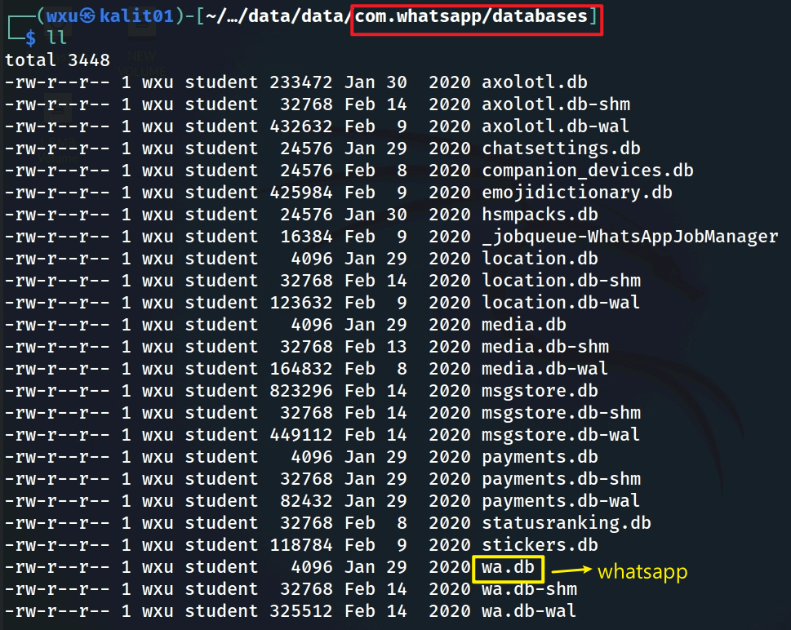
Notes:
tree -L 1 'Pixel 3/data/data/com.whatsapp/databases'

Slide 15
Most valuable databases for digital forensics (1)
msgstore.db
  Contains the user’s chat history, including messages, group chats, and metadata. This is the most critical database for reconstructing communication history and identifying contacts.
wa.db
  Stores contact information, which is essential for mapping the user’s social network and identifying communication partners.
payments.db
  Contains payment-related data, which is critical for financial investigations, especially given the payment settings found in com.whatsapp_preferences.xml (e.g., UPI transaction limit of 5000).
Notes:
The image shows a directory listing of the `/data/data/com.whatsapp/databases` directory on a device running Kali Linux, likely extracted from a WhatsApp installation. This directory contains SQLite database files (`.db` files) and their associated shared memory (`.db-shm`) and write-ahead log (`.db-wal`) files. In a digital forensics context, these databases are critical because they store user data, messages, metadata, and other app-related information that can provide deep insights into a user’s activities, communications, and interactions on WhatsApp.
Below is an analysis of the databases listed in the figure, focusing on their potential forensic value, along with their sizes as shown in the output.
---
### Analysis of Databases and Their Forensic Value
1. **wa.db (Size: 4096 bytes, Last Modified: Jan 29, 2020)**
- **Description:** The `wa.db` database typically stores WhatsApp contact information, such as the user's contact list, phone numbers, and associated metadata (e.g., display names, profile pictures). It may also include information about WhatsApp-specific contacts (e.g., those who have WhatsApp installed).
- **Forensic Value: High**
This database is valuable for mapping the user’s social network. It can reveal the user’s contacts, their phone numbers, and potentially their WhatsApp IDs, which can be used to identify communication partners. It may also contain timestamps of when contacts were added or last updated.
2. **msgstore.db (Size: 823296 bytes, Last Modified: Feb 14, 2020)**
- **Description:** The `msgstore.db` database is the primary database for storing WhatsApp messages, including chat conversations, group chats, and message metadata (e.g., timestamps, sender/receiver IDs, message status). It typically contains the actual content of messages, unless they are end-to-end encrypted and the decryption key is unavailable.
- **Forensic Value: Very High**
This is one of the most critical databases for forensic analysis. It can reveal the user’s entire chat history, including text messages, group conversations, and metadata like timestamps and read receipts. Even if message content is encrypted, metadata (e.g., who the user communicated with and when) can still be extracted, which is invaluable for establishing communication patterns and timelines.
3. **chatsettings.db (Size: 24576 bytes, Last Modified: Jan 29, 2020)**
- **Description:** This database stores chat-specific settings, such as mute status, notification preferences, and pinned chats. It may also include group chat settings, like group names, descriptions, and admin details.
- **Forensic Value: Moderate to High**
This database can provide insights into the user’s chat preferences and priorities (e.g., which chats were muted or pinned). For group chats, it might reveal group metadata, such as the group’s creation date, admin list, and member list, which can help map social relationships.
4. **payments.db (Size: 4096 bytes, Last Modified: Jan 29, 2020)**
- **Description:** The `payments.db` database stores information related to WhatsApp Payments, such as transaction history, linked bank accounts, and payment settings. This is relevant if the user has enabled WhatsApp’s payment feature (e.g., UPI in India).
- **Forensic Value: High**
If the user has used WhatsApp Payments, this database could contain financial transaction details, such as amounts, recipient details, and timestamps. This is critical for financial investigations, especially if linked to fraudulent or illicit activities.
5. **location.db (Size: 4096 bytes, Last Modified: Jan 29, 2020)**
- **Description:** This database likely stores location-sharing data, such as coordinates, timestamps, and details of shared locations within chats.
- **Forensic Value: High**
Location data is crucial for geolocation analysis. This database might reveal specific locations the user shared in chats, along with timestamps, which can help establish their physical presence at a given time. It can also corroborate the location data found in `com.whatsapp_preferences.xml` (e.g., the coordinates 35.65854, -78.861786).
6. **media.db (Size: 4096 bytes, Last Modified: Jan 29, 2020)**
- **Description:** The `media.db` database typically stores metadata about media files shared or received in WhatsApp, such as file paths, types (e.g., image, video), and timestamps. It does not store the media files themselves (those are usually in the `/data/data/com.whatsapp/files` directory) but links to them.
- **Forensic Value: Moderate to High**
This database can help identify media files shared or received by the user, including their metadata (e.g., when a photo was sent or received). This can be cross-referenced with the actual media files to reconstruct the user’s media activity.
7. **stickers.db (Size: 118784 bytes, Last Modified: Feb 9, 2020)**
- **Description:** This database stores information about stickers used in WhatsApp, such as sticker packs, usage history, and metadata (e.g., timestamps of when stickers were sent).
- **Forensic Value: Moderate**
While stickers themselves are not typically critical, this database can provide behavioral insights, such as the user’s sticker usage patterns. It might also contain timestamps of when stickers were sent, which can contribute to a timeline of activity.
8. **statusranking.db (Size: 32768 bytes, Last Modified: Feb 8, 2020)**
- **Description:** This database likely stores data related to WhatsApp Status updates, such as which statuses were viewed, posted, or ranked (e.g., based on user interaction).
- **Forensic Value: Moderate**
This can reveal the user’s Status activity, including who they interacted with via Status updates and when. It might also show which contacts’ statuses the user viewed, providing insight into their social interactions.
9. **hsm.db (Size: 24576 bytes, Last Modified: Jan 30, 2020)**
- **Description:** The `hsm.db` database is likely related to WhatsApp’s Highly Structured Messages (HSM), which are template messages often used by businesses for notifications or customer service.
- **Forensic Value: Low to Moderate**
If the user interacted with businesses via WhatsApp, this database might contain templates or metadata about those interactions. It’s less likely to contain personal user data but could be relevant for investigating business communications.
10. **emojidictionary.db (Size: 425984 bytes, Last Modified: Feb 9, 2020)**
- **Description:** This database stores emoji-related data, such as emoji mappings, search indexes, or frequently used emojis.
- **Forensic Value: Low**
This database is primarily for app functionality (e.g., emoji search) and is unlikely to contain significant user-specific data. However, it might reveal frequently used emojis, which could provide minor behavioral insights.
11. **companion_devices.db (Size: 24576 bytes, Last Modified: Feb 8, 2020)**
- **Description:** This database likely stores information about companion devices linked to the user’s WhatsApp account, such as devices used for multi-device support (e.g., WhatsApp on a desktop or tablet).
- **Forensic Value: High**
This can reveal other devices the user has linked to their WhatsApp account, including device IDs, IP addresses, or timestamps of when the devices were linked. This is critical for identifying additional devices that might contain relevant data.
12. **jobqueue-WhatsAppJobManager (Size: 16384 bytes, Last Modified: Feb 9, 2020)**
- **Description:** This database is likely used by WhatsApp’s job queue system to manage background tasks, such as message sending, media uploads, or notifications.
- **Forensic Value: Low to Moderate**
While it may not contain direct user data, it could include metadata about queued tasks, such as timestamps of when certain actions (e.g., message sending) were scheduled. This can contribute to a timeline of activity.
13. **axolotl.db (Size: 233472 bytes, Last Modified: Jan 30, 2020)**
- **Description:** The `axolotl.db` database is related to WhatsApp’s implementation of the Axolotl (Signal) protocol for end-to-end encryption. It likely stores encryption keys, session data, and other cryptographic information.
- **Forensic Value: High (if accessible)**
This database is critical for understanding the encryption setup, as it may contain session keys or pre-keys used for end-to-end encryption. However, accessing this data is challenging due to WhatsApp’s security measures, and decrypting messages typically requires the user’s private key, which is not easily obtainable.
---
### Associated Files (`.db-shm` and `.db-wal`)
- **`.db-shm` (Shared Memory) and `.db-wal` (Write-Ahead Log):** These files are part of SQLite’s architecture. The `.db-shm` file is used for shared memory during database operations, and the `.db-wal` file is a write-ahead log for transaction management. They are temporary files that support the main `.db` files and may contain fragments of data or uncommitted transactions.
- **Forensic Value: Moderate**
These files can sometimes contain data that hasn’t been fully committed to the main database, such as recent messages or changes. They are worth examining if the main database appears incomplete or if you’re looking for recently modified data.
---
### Most Valuable Databases for Digital Forensics
Based on the analysis, the most valuable databases for forensic analysis in this directory are:
1. **msgstore.db (823296 bytes, Feb 14, 2020)**
- Contains the user’s chat history, including messages, group chats, and metadata. This is the most critical database for reconstructing communication history and identifying contacts.
2. **wa.db (4096 bytes, Jan 29, 2020)**
- Stores contact information, which is essential for mapping the user’s social network and identifying communication partners.
3. **payments.db (4096 bytes, Jan 29, 2020)**
- Contains payment-related data, which is critical for financial investigations, especially given the payment settings found in `com.whatsapp_preferences.xml` (e.g., UPI transaction limit of 5000).
4. **location.db (4096 bytes, Jan 29, 2020)**
- Stores location-sharing data, which can help establish the user’s physical presence at specific times, especially when correlated with the coordinates (35.65854, -78.861786) from `com.whatsapp_preferences.xml`.
5. **companion_devices.db (24576 bytes, Feb 8, 2020)**
- Reveals linked devices, which can lead to additional sources of evidence (e.g., other devices the user accessed WhatsApp from).
6. **axolotl.db (233472 bytes, Jan 30, 2020)**
- Contains encryption-related data, which could be valuable if decryption is possible (though this is typically very difficult due to WhatsApp’s end-to-end encryption).
---
### Additional Notes on File Sizes and Timestamps
- **File Sizes:** The sizes of the databases can indicate their significance. For example, `msgstore.db` (823296 bytes, ~804 KB) is the largest, suggesting it contains a substantial amount of data (likely messages). In contrast, smaller databases like `wa.db` (4096 bytes, 4 KB) may contain less data but are still critical due to their content (e.g., contacts).
- **Timestamps:** The last modified dates provide a timeline of activity. Most databases were last modified between January 29, 2020, and February 14, 2020, indicating active use of WhatsApp during this period. The most recent modification (Feb 14, 2020) is on `msgstore.db`, suggesting it contains the most recent message data.
---
### Conclusion
The `msgstore.db`, `wa.db`, `payments.db`, `location.db`, and `companion_devices.db` databases are the most valuable for digital forensics in this context. They provide direct access to messages, contacts, financial transactions, location data, and linked devices, which are key elements for reconstructing the user’s activities and relationships on WhatsApp. If further analysis is needed, tools like SQLite browsers (e.g., DB Browser for SQLite) can be used to explore the contents of these databases, though decryption may be required for end-to-end encrypted messages.

Slide 16
Most valuable databases for digital forensics (2)
location.db
  Stores location-sharing data, which can help establish the user’s physical presence at specific times, especially when correlated with the coordinates (35.65854, -78.861786) from com.whatsapp_preferences.xml.
companion_devices.db
  Reveals linked devices, which can lead to additional sources of evidence (e.g., other devices the user accessed WhatsApp from).
axolotl.db
  Contains encryption-related data, which could be valuable if decryption is possible (though this is typically very difficult due to WhatsApp’s end-to-end encryption).
Notes:
The image shows a directory listing of the `/data/data/com.whatsapp/databases` directory on a device running Kali Linux, likely extracted from a WhatsApp installation. This directory contains SQLite database files (`.db` files) and their associated shared memory (`.db-shm`) and write-ahead log (`.db-wal`) files. In a digital forensics context, these databases are critical because they store user data, messages, metadata, and other app-related information that can provide deep insights into a user’s activities, communications, and interactions on WhatsApp.
Below is an analysis of the databases listed in the figure, focusing on their potential forensic value, along with their sizes as shown in the output.
---
### Analysis of Databases and Their Forensic Value
1. **wa.db (Size: 4096 bytes, Last Modified: Jan 29, 2020)**
- **Description:** The `wa.db` database typically stores WhatsApp contact information, such as the user's contact list, phone numbers, and associated metadata (e.g., display names, profile pictures). It may also include information about WhatsApp-specific contacts (e.g., those who have WhatsApp installed).
- **Forensic Value: High**
This database is valuable for mapping the user’s social network. It can reveal the user’s contacts, their phone numbers, and potentially their WhatsApp IDs, which can be used to identify communication partners. It may also contain timestamps of when contacts were added or last updated.
2. **msgstore.db (Size: 823296 bytes, Last Modified: Feb 14, 2020)**
- **Description:** The `msgstore.db` database is the primary database for storing WhatsApp messages, including chat conversations, group chats, and message metadata (e.g., timestamps, sender/receiver IDs, message status). It typically contains the actual content of messages, unless they are end-to-end encrypted and the decryption key is unavailable.
- **Forensic Value: Very High**
This is one of the most critical databases for forensic analysis. It can reveal the user’s entire chat history, including text messages, group conversations, and metadata like timestamps and read receipts. Even if message content is encrypted, metadata (e.g., who the user communicated with and when) can still be extracted, which is invaluable for establishing communication patterns and timelines.
3. **chatsettings.db (Size: 24576 bytes, Last Modified: Jan 29, 2020)**
- **Description:** This database stores chat-specific settings, such as mute status, notification preferences, and pinned chats. It may also include group chat settings, like group names, descriptions, and admin details.
- **Forensic Value: Moderate to High**
This database can provide insights into the user’s chat preferences and priorities (e.g., which chats were muted or pinned). For group chats, it might reveal group metadata, such as the group’s creation date, admin list, and member list, which can help map social relationships.
4. **payments.db (Size: 4096 bytes, Last Modified: Jan 29, 2020)**
- **Description:** The `payments.db` database stores information related to WhatsApp Payments, such as transaction history, linked bank accounts, and payment settings. This is relevant if the user has enabled WhatsApp’s payment feature (e.g., UPI in India).
- **Forensic Value: High**
If the user has used WhatsApp Payments, this database could contain financial transaction details, such as amounts, recipient details, and timestamps. This is critical for financial investigations, especially if linked to fraudulent or illicit activities.
5. **location.db (Size: 4096 bytes, Last Modified: Jan 29, 2020)**
- **Description:** This database likely stores location-sharing data, such as coordinates, timestamps, and details of shared locations within chats.
- **Forensic Value: High**
Location data is crucial for geolocation analysis. This database might reveal specific locations the user shared in chats, along with timestamps, which can help establish their physical presence at a given time. It can also corroborate the location data found in `com.whatsapp_preferences.xml` (e.g., the coordinates 35.65854, -78.861786).
6. **media.db (Size: 4096 bytes, Last Modified: Jan 29, 2020)**
- **Description:** The `media.db` database typically stores metadata about media files shared or received in WhatsApp, such as file paths, types (e.g., image, video), and timestamps. It does not store the media files themselves (those are usually in the `/data/data/com.whatsapp/files` directory) but links to them.
- **Forensic Value: Moderate to High**
This database can help identify media files shared or received by the user, including their metadata (e.g., when a photo was sent or received). This can be cross-referenced with the actual media files to reconstruct the user’s media activity.
7. **stickers.db (Size: 118784 bytes, Last Modified: Feb 9, 2020)**
- **Description:** This database stores information about stickers used in WhatsApp, such as sticker packs, usage history, and metadata (e.g., timestamps of when stickers were sent).
- **Forensic Value: Moderate**
While stickers themselves are not typically critical, this database can provide behavioral insights, such as the user’s sticker usage patterns. It might also contain timestamps of when stickers were sent, which can contribute to a timeline of activity.
8. **statusranking.db (Size: 32768 bytes, Last Modified: Feb 8, 2020)**
- **Description:** This database likely stores data related to WhatsApp Status updates, such as which statuses were viewed, posted, or ranked (e.g., based on user interaction).
- **Forensic Value: Moderate**
This can reveal the user’s Status activity, including who they interacted with via Status updates and when. It might also show which contacts’ statuses the user viewed, providing insight into their social interactions.
9. **hsm.db (Size: 24576 bytes, Last Modified: Jan 30, 2020)**
- **Description:** The `hsm.db` database is likely related to WhatsApp’s Highly Structured Messages (HSM), which are template messages often used by businesses for notifications or customer service.
- **Forensic Value: Low to Moderate**
If the user interacted with businesses via WhatsApp, this database might contain templates or metadata about those interactions. It’s less likely to contain personal user data but could be relevant for investigating business communications.
10. **emojidictionary.db (Size: 425984 bytes, Last Modified: Feb 9, 2020)**
- **Description:** This database stores emoji-related data, such as emoji mappings, search indexes, or frequently used emojis.
- **Forensic Value: Low**
This database is primarily for app functionality (e.g., emoji search) and is unlikely to contain significant user-specific data. However, it might reveal frequently used emojis, which could provide minor behavioral insights.
11. **companion_devices.db (Size: 24576 bytes, Last Modified: Feb 8, 2020)**
- **Description:** This database likely stores information about companion devices linked to the user’s WhatsApp account, such as devices used for multi-device support (e.g., WhatsApp on a desktop or tablet).
- **Forensic Value: High**
This can reveal other devices the user has linked to their WhatsApp account, including device IDs, IP addresses, or timestamps of when the devices were linked. This is critical for identifying additional devices that might contain relevant data.
12. **jobqueue-WhatsAppJobManager (Size: 16384 bytes, Last Modified: Feb 9, 2020)**
- **Description:** This database is likely used by WhatsApp’s job queue system to manage background tasks, such as message sending, media uploads, or notifications.
- **Forensic Value: Low to Moderate**
While it may not contain direct user data, it could include metadata about queued tasks, such as timestamps of when certain actions (e.g., message sending) were scheduled. This can contribute to a timeline of activity.
13. **axolotl.db (Size: 233472 bytes, Last Modified: Jan 30, 2020)**
- **Description:** The `axolotl.db` database is related to WhatsApp’s implementation of the Axolotl (Signal) protocol for end-to-end encryption. It likely stores encryption keys, session data, and other cryptographic information.
- **Forensic Value: High (if accessible)**
This database is critical for understanding the encryption setup, as it may contain session keys or pre-keys used for end-to-end encryption. However, accessing this data is challenging due to WhatsApp’s security measures, and decrypting messages typically requires the user’s private key, which is not easily obtainable.
---
### Associated Files (`.db-shm` and `.db-wal`)
- **`.db-shm` (Shared Memory) and `.db-wal` (Write-Ahead Log):** These files are part of SQLite’s architecture. The `.db-shm` file is used for shared memory during database operations, and the `.db-wal` file is a write-ahead log for transaction management. They are temporary files that support the main `.db` files and may contain fragments of data or uncommitted transactions.
- **Forensic Value: Moderate**
These files can sometimes contain data that hasn’t been fully committed to the main database, such as recent messages or changes. They are worth examining if the main database appears incomplete or if you’re looking for recently modified data.
---
### Most Valuable Databases for Digital Forensics
Based on the analysis, the most valuable databases for forensic analysis in this directory are:
1. **msgstore.db (823296 bytes, Feb 14, 2020)**
- Contains the user’s chat history, including messages, group chats, and metadata. This is the most critical database for reconstructing communication history and identifying contacts.
2. **wa.db (4096 bytes, Jan 29, 2020)**
- Stores contact information, which is essential for mapping the user’s social network and identifying communication partners.
3. **payments.db (4096 bytes, Jan 29, 2020)**
- Contains payment-related data, which is critical for financial investigations, especially given the payment settings found in `com.whatsapp_preferences.xml` (e.g., UPI transaction limit of 5000).
4. **location.db (4096 bytes, Jan 29, 2020)**
- Stores location-sharing data, which can help establish the user’s physical presence at specific times, especially when correlated with the coordinates (35.65854, -78.861786) from `com.whatsapp_preferences.xml`.
5. **companion_devices.db (24576 bytes, Feb 8, 2020)**
- Reveals linked devices, which can lead to additional sources of evidence (e.g., other devices the user accessed WhatsApp from).
6. **axolotl.db (233472 bytes, Jan 30, 2020)**
- Contains encryption-related data, which could be valuable if decryption is possible (though this is typically very difficult due to WhatsApp’s end-to-end encryption).
---
### Additional Notes on File Sizes and Timestamps
- **File Sizes:** The sizes of the databases can indicate their significance. For example, `msgstore.db` (823296 bytes, ~804 KB) is the largest, suggesting it contains a substantial amount of data (likely messages). In contrast, smaller databases like `wa.db` (4096 bytes, 4 KB) may contain less data but are still critical due to their content (e.g., contacts).
- **Timestamps:** The last modified dates provide a timeline of activity. Most databases were last modified between January 29, 2020, and February 14, 2020, indicating active use of WhatsApp during this period. The most recent modification (Feb 14, 2020) is on `msgstore.db`, suggesting it contains the most recent message data.
---
### Conclusion
The `msgstore.db`, `wa.db`, `payments.db`, `location.db`, and `companion_devices.db` databases are the most valuable for digital forensics in this context. They provide direct access to messages, contacts, financial transactions, location data, and linked devices, which are key elements for reconstructing the user’s activities and relationships on WhatsApp. If further analysis is needed, tools like SQLite browsers (e.g., DB Browser for SQLite) can be used to explore the contents of these databases, though decryption may be required for end-to-end encrypted messages.

Slide 17
msgstore.db

Slide 18
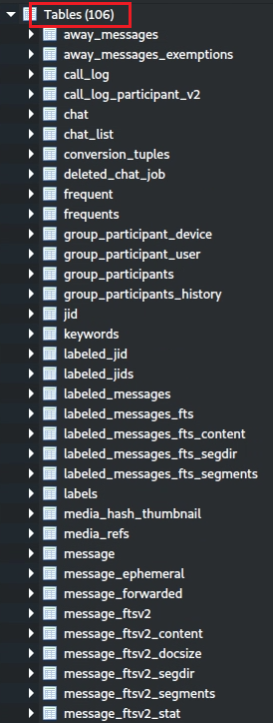
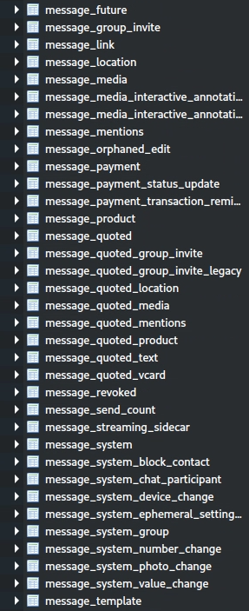
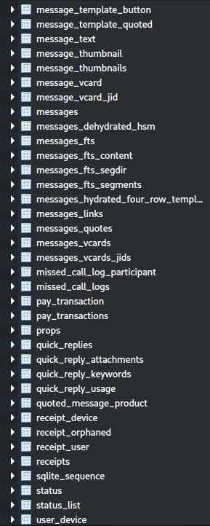
Attributes of msgstore.db

Slide 19
Most valuable tables in msgstore.db for digital forensics (1)
jid (and user_device, labeled_jids)
  Unique identifiers for users, groups, and other entities in WhatsApp
messages (and related tables: message_fts, message_quoted, message_system)
  Stores individual messages within WhatsApp conversations. Each row represents a single message, including its content (if accessible/ unencrypted), metadata, and references to the chat it belongs to. It is highly granular and focuses on the details of each message exchange.
chat (and chat_list)
  Stores metadata about entire conversations (or "chats"), whether they are one-on-one or group chats. Each row represents a single chat, summarizing its participants, last message, and other high-level details. It provides an overview of the conversation as a whole.
group_participants (and related tables)
  Reveals group membership, roles, and historical changes, which are keys for social network analysis and understanding group dynamics.

Slide 20
Most valuable attributes in msgstore.db for digital forensics (2)
message_location (and message_quoted_location)
  Stores location-sharing data, which is critical for geolocation analysis and establishing the user’s physical presence.
message_payment (and pay_transaction, pay_transactions)
  Contains payment transaction details, which are crucial for financial investigations, especially given the payment settings in com.whatsapp_preferences.xml.
call_log (and call_log_participant_v2, missed_call_logs)
  Provides call history, including participants, durations, and timestamps, which is useful for communication analysis.
message_media (and media_refs, media_hash_thumbnail)
  Links messages to media files, providing metadata and file paths for shared media, which can lead to further evidence (e.g., photos, videos).
Notes:
The image shows a list of tables within the `msgstore.db` database, which is the primary database used by WhatsApp to store messages, metadata, and related information. This database is critical for digital forensics because it contains a wealth of user data, including chat conversations, media metadata, and interaction details. The image lists 106 tables, many of which are related to messages, groups, payments, media, and other WhatsApp features.
Below is an analysis of the tables in `msgstore.db` to identify the most valuable attributes (or tables) for digital forensics, focusing on their potential to reveal user activity, communications, and metadata.
---
### Analysis of Tables in `msgstore.db` and Their Forensic Value
1. **chat (and related tables: chat_list)**
- **Description:** The `chat` table stores information about individual and group chats, such as chat IDs, participants, and metadata (e.g., last message, timestamps). The `chat_list` table likely provides a summary or index of chats for quick access.
- **Forensic Value: High**
- **Key Attributes:** Chat ID, participant JIDs (WhatsApp user IDs), last message timestamp, chat type (individual or group), and unread message count.
- **Why Valuable:** This table provides an overview of all conversations, including who the user was communicating with and when. It can help map the user’s social network and establish a timeline of communication.
2. **message (and related tables: message_fts*, message_quoted*, message_system*, message_template*, etc.)**
- **Description:** The `message` table is the core table for storing individual messages, including their content, sender/receiver, timestamps, and status (e.g., sent, delivered, read). Related tables like `message_fts*` (full-text search), `message_quoted*` (quoted messages), and `message_system*` (system messages, e.g., group changes) provide additional context.
- **Forensic Value: Very High**
- **Key Attributes:** Message ID, chat ID, sender JID, recipient JID, message content (if unencrypted), timestamp, status, message type (text, media, location, etc.), and quoted message ID.
- **Why Valuable:** This table contains the actual messages exchanged by the user, which are critical for reconstructing conversations. Even if message content is end-to-end encrypted, metadata (e.g., timestamps, sender/receiver) can still be extracted. Related tables like `message_quoted` can reveal quoted messages, and `message_system` can show group events (e.g., user added/removed).
3. **group_participants (and related tables: group_participant_user, group_participant_device, group_participants_history)**
- **Description:** These tables store information about group chats, including group members, their roles (e.g., admin), and historical changes to group membership.
- **Forensic Value: High**
- **Key Attributes:** Group ID, participant JID, role (admin/member), join timestamp, and leave timestamp (from `group_participants_history`).
- **Why Valuable:** These tables can reveal the user’s group affiliations, including who they interacted with in groups and when. The `group_participants_history` table can show changes over time, such as when users were added or removed, which is useful for social network analysis and timeline reconstruction.
4. **message_media (and related tables: media_hash_thumbnail, media_refs)**
- **Description:** The `message_media` table stores metadata about media files (e.g., images, videos, documents) shared in chats, such as file paths, sizes, and types. The `media_refs` table likely tracks references to media files, and `media_hash_thumbnail` may store hashes or thumbnails for media.
- **Forensic Value: High**
- **Key Attributes:** Message ID, file path, file size, media type (image, video, etc.), hash, thumbnail data, and timestamp.
- **Why Valuable:** This table links messages to their associated media files, allowing investigators to locate and analyze shared media. Hashes can be used to identify known files (e.g., for CSAM detection), and file paths can lead to the actual media files on the device.
5. **message_location (and related tables: message_quoted_location)**
- **Description:** These tables store location-sharing data, such as coordinates, place names, and timestamps of shared locations within chats.
- **Forensic Value: High**
- **Key Attributes:** Message ID, latitude, longitude, place name, timestamp, and zoom level.
- **Why Valuable:** Location data is critical for geolocation analysis. This table can reveal specific locations the user shared, which can help establish their physical presence at a given time. It can also corroborate the location data found in `com.whatsapp_preferences.xml` (e.g., coordinates 35.65854, -78.861786).
6. **message_payment (and related tables: message_payment_status_update, message_payment_transaction_reminder, pay_transaction, pay_transactions)**
- **Description:** These tables store payment-related data, such as transaction details, payment status, and reminders for WhatsApp Payments.
- **Forensic Value: High**
- **Key Attributes:** Transaction ID, message ID, sender JID, recipient JID, amount, currency, timestamp, and status.
- **Why Valuable:** If the user used WhatsApp Payments, these tables can reveal financial transactions, including amounts, recipients, and timestamps. This is critical for financial investigations, especially given the payment settings in `com.whatsapp_preferences.xml` (e.g., UPI transaction limit of 5000).
7. **call_log (and related tables: call_log_participant_v2, missed_call_log_participant, missed_call_logs)**
- **Description:** These tables store call-related data, such as call logs, participants, durations, and missed calls.
- **Forensic Value: High**
- **Key Attributes:** Call ID, caller JID, recipient JID, call type (voice/video), duration, timestamp, and status (answered/missed).
- **Why Valuable:** Call logs can reveal who the user communicated with via voice or video calls, along with the timing and duration of those calls. This is useful for establishing communication patterns and timelines.
8. **messages_links (and related tables: messages_quotes, messages_vcards, messages_vcards_jids)**
- **Description:** The `messages_links` table stores URLs shared in messages, while `messages_quotes` tracks quoted messages, and `messages_vcards` stores vCard (contact card) data.
- **Forensic Value: Moderate to High**
- **Key Attributes:** Message ID, URL (for `messages_links`), quoted message ID (for `messages_quotes`), vCard data, and associated JIDs (for `messages_vcards_jids`).
- **Why Valuable:** The `messages_links` table can reveal URLs shared by the user, which might lead to external content (e.g., websites, media). The `messages_quotes` table can provide context for conversations by linking to quoted messages, and `messages_vcards` can reveal shared contacts, including phone numbers.
9. **status (and related tables: status_list)**
- **Description:** These tables store WhatsApp Status updates, including the content, viewers, and timestamps.
- **Forensic Value: Moderate**
- **Key Attributes:** Status ID, JID, content, timestamp, and viewer JIDs.
- **Why Valuable:** Status updates can reveal what the user posted and who viewed it, providing insight into their social interactions and activity. This can also contribute to a timeline of events.
10. **jid (and related tables: labeled_jids, user_device)**
- **Description:** The `jid` table stores WhatsApp user IDs (JIDs), which are unique identifiers for users (e.g., phone numbers in the format `+1234567890@s.whatsapp.net`). The `labeled_jids` table may link JIDs to labels, and `user_device` may track devices associated with JIDs.
- **Forensic Value: High**
- **Key Attributes:** JID, phone number, device ID, and label (if applicable).
- **Why Valuable:** JIDs are essential for identifying users and linking them to messages, calls, and other activities. The `user_device` table can reveal devices linked to a JID, which is useful for multi-device investigations.
11. **frequent (and related tables: quick_replies, quick_reply_attachments, quick_reply_keywords, quick_reply_usage)**
- **Description:** These tables store frequently used messages, quick replies, and associated data, such as keywords and usage statistics.
- **Forensic Value: Moderate**
- **Key Attributes:** Quick reply ID, message content, keywords, and usage frequency.
- **Why Valuable:** These tables can reveal the user’s frequently used messages or responses, providing behavioral insights. They might also indicate business or automated interactions if quick replies are heavily used.
12. **props**
- **Description:** The `props` table likely stores app properties or configuration settings, similar to those in `com.whatsapp_preferences.xml`.
- **Forensic Value: Moderate**
- **Key Attributes:** Property name, value, and timestamp.
- **Why Valuable:** This table can provide additional context about the app’s configuration at the time of use, such as enabled features or settings that might affect data storage (e.g., auto-download settings).
---
### Most Valuable Attributes (Tables) in `msgstore.db` for Digital Forensics
Based on the analysis, the most valuable tables in `msgstore.db` for forensic analysis are:
1. **message (and related tables: message_fts*, message_quoted*, message_system*)**
- Contains the core message data, including content (if unencrypted), sender/receiver, timestamps, and message types. This is the most critical table for reconstructing conversations and communication history.
2. **chat (and chat_list)**
- Provides an overview of all chats, including participants and metadata, which is essential for mapping the user’s social network and communication patterns.
3. **group_participants (and related tables)**
- Reveals group membership, roles, and historical changes, which is key for social network analysis and understanding group dynamics.
4. **message_media (and media_refs, media_hash_thumbnail)**
- Links messages to media files, providing metadata and file paths for shared media, which can lead to further evidence (e.g., photos, videos).
5. **message_location (and message_quoted_location)**
- Stores location-sharing data, which is critical for geolocation analysis and establishing the user’s physical presence.
6. **message_payment (and pay_transaction, pay_transactions)**
- Contains payment transaction details, which are crucial for financial investigations, especially given the payment settings in `com.whatsapp_preferences.xml`.
7. **call_log (and call_log_participant_v2, missed_call_logs)**
- Provides call history, including participants, durations, and timestamps, which is useful for communication analysis.
8. **jid (and user_device, labeled_jids)**
- Maps JIDs to users and devices, which is essential for identifying communication partners and linked devices.
---
### Additional Notes
- **End-to-End Encryption:** WhatsApp messages are end-to-end encrypted, meaning the content in the `message` table may not be directly readable without the user’s private key. However, metadata (e.g., timestamps, sender/receiver JIDs) is still accessible and highly valuable for forensic analysis.
- **Cross-Referencing:** The tables in `msgstore.db` can be cross-referenced with other databases (e.g., `wa.db` for contacts, `location.db` for additional location data) to build a comprehensive picture of the user’s activities.
- **Timestamps:** Many tables (e.g., `message`, `call_log`, `message_location`) include timestamps, which are critical for establishing a timeline of events.
In summary, the `message`, `chat`, `group_participants`, `message_media`, `message_location`, `message_payment`, `call_log`, and `jid` tables are the most valuable for digital forensics in `msgstore.db`, as they provide direct access to messages, contacts, media, locations, payments, calls, and user identifiers. Tools like SQLite browsers can be used to query these tables and extract specific data for further analysis.

Slide 21
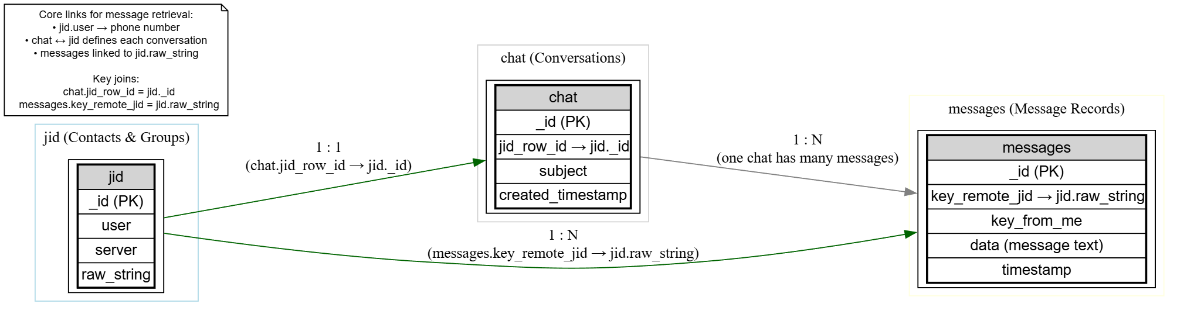
ER for retrieving conversations
Color | Represents | Example
🟩 Green | Explicit key relationships between tables (foreign key or direct reference). | chat.jid_row_id → jid._id
⚫ Gray/Black | Logical grouping or conceptual “contains” relation (no foreign key ) | chat → messages (one chat has many messages)
Notes:
digraph WhatsApp_DB_CoreRelations {
rankdir=LR;
node [shape=box, style=filled, fillcolor=white, fontname="Helvetica"];
// jid table
subgraph cluster_jid {
label="jid (Contacts & Groups)";
color=lightblue;
jid [label=<
<TABLE BORDER="1" CELLBORDER="1" CELLSPACING="0">
<TR><TD BGCOLOR="lightgray">jid</TD></TR>
<TR><TD>_id (PK)</TD></TR>
<TR><TD>user</TD></TR>
<TR><TD>server</TD></TR>
<TR><TD>raw_string</TD></TR>
</TABLE>
>];
}
// chat table
subgraph cluster_chat {
label="chat (Conversations)";
color=lightgray;
chat [label=<
<TABLE BORDER="1" CELLBORDER="1" CELLSPACING="0">
<TR><TD BGCOLOR="lightgray">chat</TD></TR>
<TR><TD>_id (PK)</TD></TR>
<TR><TD>jid_row_id → jid._id</TD></TR>
<TR><TD>subject</TD></TR>
<TR><TD>created_timestamp</TD></TR>
</TABLE>
>];
}
// messages table
subgraph cluster_messages {
label="messages (Message Records)";
color=lightyellow;
messages [label=<
<TABLE BORDER="1" CELLBORDER="1" CELLSPACING="0">
<TR><TD BGCOLOR="lightgray">messages</TD></TR>
<TR><TD>_id (PK)</TD></TR>
<TR><TD>key_remote_jid → jid.raw_string</TD></TR>
<TR><TD>key_from_me</TD></TR>
<TR><TD>data (message text)</TD></TR>
<TR><TD>timestamp</TD></TR>
</TABLE>
>];
}
// Relationships
jid -> chat [label="1 : 1\n(chat.jid_row_id → jid._id)", color=darkgreen];
jid -> messages [label="1 : N\n(messages.key_remote_jid → jid.raw_string)", color=darkgreen];
chat -> messages [label="1 : N\n(one chat has many messages)", color=gray];
// Legend
legend [shape=note, fontsize=10, label="Core links for message retrieval:\n• jid.user → phone number\n• chat ↔ jid defines each conversation\n• messages linked to jid.raw_string\n\nKey joins:\n chat.jid_row_id = jid._id\n messages.key_remote_jid = jid.raw_string"];
}

Slide 22
jid table in msgstore.db

Slide 23
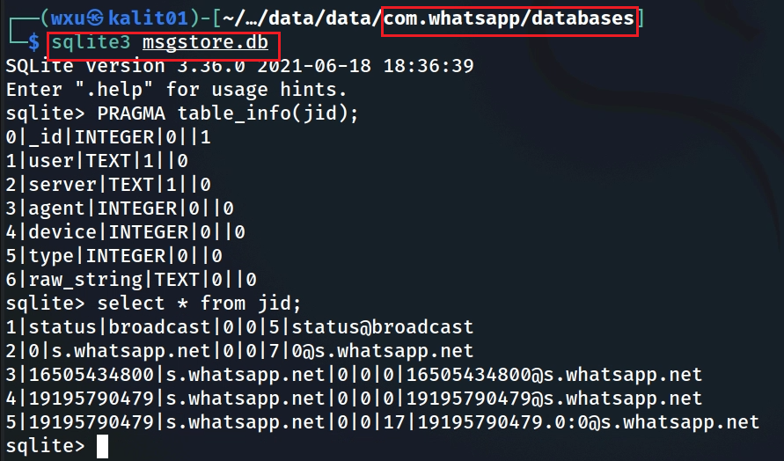
jid (Jabber ID) table
_id: Unique identifier for the JID entry.
user: The user part of the JID (e.g., a phone number or group ID).
server: The server part of the JID (e.g., s.whatsapp.net for users, g.us for groups).
agent: Likely indicates the type of agent (e.g., a bot, almost always 0).
device: Device number (used in multi-device WhatsApp). For example, 0 = main phone, 1 = linked device.
type: Indicates the type of JID (e.g., individual, group, broadcast).
raw_string: The full JID string (e.g., +16505434800@s.whatsapp.net).
Jabber was the original name for an open messaging protocol that later became an Internet standard called XMPP — the Extensible Messaging and Presence Protocol.
Notes:
The image shows the output of two SQLite commands executed on the `msgstore.db` database, which is part of WhatsApp's data storage system. The commands are:
1. `PRAGMA table_info(jid)`: This command retrieves the schema of the `jid` table, showing its columns, data types, and constraints.
2. `SELECT * FROM jid`: This command retrieves all rows from the `jid` table, showing sample data.
Let’s break down the `jid` table’s structure, its purpose, and its forensic significance in the context of WhatsApp’s database.
---
### **Schema of the `jid` Table**
The output of `PRAGMA table_info(jid)` provides the following schema for the `jid` table:
| **Column Name** | **Type** | **Not Null** | **Default Value** | **Primary Key** |
|-----------------|------------|--------------|-------------------|-----------------|
| `_id` | INTEGER | 1 | NULL | 1 |
| `user` | TEXT | 1 | NULL | 0 |
| `server` | TEXT | 1 | NULL | 0 |
| `agent` | INTEGER | 0 | NULL | 0 |
| `device` | INTEGER | 0 | NULL | 0 |
| `type` | INTEGER | 0 | NULL | 0 |
| `raw_string` | TEXT | 0 | NULL | 0 |
#### **Explanation of Each Column**
1. **_id (INTEGER, Primary Key, Not Null)**
- This is the unique identifier for each JID entry in the table. It’s an auto-incrementing integer that serves as the primary key.
- **Forensic Value:** The `_id` is used by other tables (e.g., `chat.jid_row_id`, `message.sender_jid_row_id`) to reference a specific JID, making it a critical link in the database.
2. **user (TEXT, Not Null)**
- This column stores the user part of the JID, which is typically the phone number for individual users (e.g., `+16505434800`) or a group ID for group chats (e.g., `16505434800-16505434800`).
- **Forensic Value:** This column helps identify the contact or group associated with the JID, though it needs to be combined with the `server` column to form the full JID.
3. **server (TEXT, Not Null)**
- This column stores the server part of the JID, which indicates the type of entity. For individual users, it’s typically `s.whatsapp.net`. For group chats, it’s `g.us`. For broadcast lists, it’s `broadcast`.
- **Forensic Value:** The `server` column helps distinguish between different types of JIDs (e.g., individual, group, broadcast), which is crucial for understanding the context of a chat.
4. **agent (INTEGER, Nullable)**
- This column likely indicates the type of agent associated with the JID (e.g., a bot or automated system). In the sample data, it’s `0` for all rows, suggesting it’s not used in this dataset.
- **Forensic Value:** Limited, unless investigating interactions with bots or automated systems.
5. **device (INTEGER, Nullable)**
- This column likely indicates the device ID for multi-device support (e.g., if the JID is associated with a specific device in WhatsApp’s multi-device feature). In the sample data, it’s `0` for all rows, suggesting multi-device data is not present.
- **Forensic Value:** Useful for multi-device investigations, but not relevant in this dataset.
6. **type (INTEGER, Nullable)**
- This column indicates the type of JID (e.g., individual, group, broadcast). In the sample data:
- `5` for `status@broadcast` (status broadcast list).
- `7` for group chats (e.g., `16505434800-16505434800@g.us`).
- `0` for individual users (e.g., `+16505434800@s.whatsapp.net`).
- **Forensic Value:** Helps categorize JIDs, which is useful for filtering chats (e.g., focusing on group chats vs. individual chats).
7. **raw_string (TEXT, Nullable)**
- This column stores the full JID string (e.g., `+16505434800@s.whatsapp.net`). In the sample data, it’s `NULL` for all rows, which explains the earlier error (`no such column: j.raw_string_jid`)—the column exists, but it’s named `raw_string` (not `raw_string_jid`), and it’s empty.
- **Forensic Value:** If populated, this column would be the most direct way to match JIDs with other tables (e.g., `messages.key_remote_jid`). Since it’s `NULL`, we need to construct the JID using `user` and `server`.
---
### **Sample Data from the `jid` Table**
The output of `SELECT * FROM jid` shows the following rows:
| **_id** | **user** | **server** | **agent** | **device** | **type** | **raw_string** |
|---------|-----------------------|--------------------|-----------|------------|----------|----------------|
| 1 | `status` | `broadcast` | 0 | 0 | 5 | NULL |
| 2 | `16505434800` | `s.whatsapp.net` | 0 | 0 | 0 | NULL |
| 3 | `16505434800-16505434800` | `g.us` | 0 | 0 | 7 | NULL |
| 4 | `191957790479` | `s.whatsapp.net` | 0 | 0 | 0 | NULL |
| 5 | `191957790479` | `0:0@s.whatsapp.net` | 0 | 0 | 17 | NULL |
#### **Analysis of Sample Data**
- **Row 1:** `_id = 1`, `user = "status"`, `server = "broadcast"`, `type = 5`
- This is the JID for the status broadcast list (`status@broadcast`), used for WhatsApp status updates.
- **Row 2:** `_id = 2`, `user = "16505434800"`, `server = "s.whatsapp.net"`, `type = 0`
- This is an individual user’s JID, representing a contact with the phone number `+16505434800`. The full JID is `+16505434800@s.whatsapp.net`.
- **Row 3:** `_id = 3`, `user = "16505434800-16505434800"`, `server = "g.us"`, `type = 7`
- This is a group chat JID, representing a group with the ID `16505434800-16505434800`. The full JID is `16505434800-16505434800@g.us`.
- **Row 4:** `_id = 4`, `user = "191957790479"`, `server = "s.whatsapp.net"`, `type = 0`
- Another individual user’s JID, representing a contact with the phone number `+191957790479`. The full JID is `+191957790479@s.whatsapp.net`.
- **Row 5:** `_id = 5`, `user = "191957790479"`, `server = "0:0@s.whatsapp.net"`, `type = 17`
- This appears to be a device-specific JID for the same user (`+191957790479`), possibly related to multi-device support. The `server` value `0:0@s.whatsapp.net` is unusual and might indicate a specific device or context.
#### **Key Observations**
- The `raw_string` column is `NULL` for all rows, meaning we can’t directly use it to match JIDs. Instead, we need to construct the full JID by combining `user` and `server` (e.g., `user@server`).
- The `type` column helps distinguish between different JID types:
- `0`: Individual user.
- `5`: Broadcast list (e.g., status updates).
- `7`: Group chat.
- `17`: Possibly a device-specific JID (related to multi-device support).
---
### **Purpose of the `jid` Table**
The `jid` table in WhatsApp’s `msgstore.db` database serves as a lookup table for JIDs (Jabber IDs), which are unique identifiers for users, groups, and other entities in WhatsApp. Its primary purposes are:
1. **Normalization:** Instead of storing the full JID string (e.g., `+16505434800@s.whatsapp.net`) repeatedly in other tables (e.g., `chat`, `message`), WhatsApp stores the JID in the `jid` table and references it using the `_id` (e.g., `chat.jid_row_id`, `message.sender_jid_row_id`). This reduces redundancy and improves database efficiency.
2. **JID Decomposition:** The `jid` table breaks down a JID into its components (`user`, `server`, `agent`, `device`, `type`), making it easier to query specific types of JIDs (e.g., group chats vs. individual users).
3. **Multi-Device Support:** Columns like `device` and `type` support WhatsApp’s multi-device feature, allowing the app to track JIDs associated with specific devices.
#### **Role in Connecting Tables**
- The `jid` table acts as a bridge between tables like `messages` and `chat`:
- The `messages` table uses `key_remote_jid` (a full JID string) to identify the chat.
- The `chat` table uses `jid_row_id` (an integer) to reference the `_id` in the `jid` table.
- To connect `messages` and `chat`, you need to match `messages.key_remote_jid` with the constructed JID from `jid` (e.g., `user@server`), then link to `chat.jid_row_id`.
---
### **Updated Query to Connect `messages` and `chat` Tables**
Now that we know the `jid` table’s schema, we can fix the query to connect the `messages` and `chat` tables. Since the `raw_string` column is `NULL`, we need to construct the full JID by concatenating the `user` and `server` columns (e.g., `user || '@' || server` in SQLite).
#### **Revised Query**
```sql
SELECT m.*
FROM messages m
JOIN jid j ON m.key_remote_jid = (j.user || '@' || j.server)
JOIN chat c ON c.jid_row_id = j._id
WHERE c._id = 1;
```
#### **Explanation of the Query**
- `SELECT m.*`: Selects all columns from the `messages` table (aliased as `m`).
- `FROM messages m`: Starts with the `messages` table.
- `JOIN jid j ON m.key_remote_jid = (j.user || '@' || j.server)`: Joins the `messages` table with the `jid` table by constructing the full JID from `j.user` and `j.server` (e.g., `+16505434800@s.whatsapp.net`) and matching it with `m.key_remote_jid`.
- `JOIN chat c ON c.jid_row_id = j._id`: Joins the `chat` table with the `jid` table by matching `c.jid_row_id` with `j._id`, linking the chat to its JID.
- `WHERE c._id = 1`: Filters the results to only include messages from the chat with `_id = 1`.
#### **Why This Works**
- The `jid` table’s `user` and `server` columns together form the full JID (e.g., `+16505434800@s.whatsapp.net`), which matches the `key_remote_jid` in the `messages` table.
- The `jid._id` links to `chat.jid_row_id`, allowing us to connect messages to their corresponding chats.
#### **Potential Issue**
- **JID Format Mismatch:** Some JIDs in `messages.key_remote_jid` might include additional components (e.g., device or agent information) that don’t match the simple `user@server` format. For example, a multi-device JID might look like `+191957790479:0@s.whatsapp.net`, but the `jid` table might only store `+191957790479@s.whatsapp.net`. In such cases, you may need to strip the device part from `key_remote_jid` or handle special cases separately.
---
### **Forensic Significance of the `jid` Table**
The `jid` table is a critical component of WhatsApp’s database for forensic analysis:
1. **Social Network Mapping:**
- The `user` and `server` columns allow you to identify contacts and groups involved in chats. For example:
- `+16505434800@s.whatsapp.net` is an individual contact.
- `16505434800-16505434800@g.us` is a group chat.
- You can cross-reference these JIDs with the `wa_contacts` table in `wa.db` to get more details about the contacts (e.g., phone numbers, display names).
2. **Chat Type Identification:**
- The `type` column helps distinguish between different types of chats:
- `type = 0`: Individual user.
- `type = 7`: Group chat.
- `type = 5`: Broadcast list (e.g., status updates).
- This is useful for filtering chats (e.g., focusing on group chats for social dynamics analysis).
3. **Multi-Device Analysis:**
- The `device` and `type` columns (e.g., `type = 17` for `+191957790479:0@s.whatsapp.net`) indicate multi-device usage, which can help track messages sent from specific devices.
4. **Timeline and Attribution:**
- By linking the `jid` table to the `messages` and `chat` tables, you can attribute messages to specific contacts or groups and build a timeline of communication.
5. **Data Normalization:**
- The `jid` table’s use of `_id` to reference JIDs in other tables (e.g., `chat.jid_row_id`) allows you to efficiently map messages to chats and contacts without duplicating JID strings, making queries more efficient.
---
### **Conclusion**
The `jid` table in `msgstore.db` is a lookup table that maps JIDs to their components (`user`, `server`, `agent`, `device`, `type`) and provides a unique `_id` for referencing JIDs in other tables. Its key columns are:
- `_id`: Links to other tables (e.g., `chat.jid_row_id`).
- `user` and `server`: Together form the full JID (e.g., `+16505434800@s.whatsapp.net`).
- `type`: Indicates the type of JID (e.g., individual, group, broadcast).
The `raw_string` column, which was expected to store the full JID, is `NULL` in your dataset, so we construct the JID using `user || '@' || server`. The updated query to connect the `messages` and `chat` tables is:
```sql
SELECT m.*
FROM messages m
JOIN jid j ON m.key_remote_jid = (j.user || '@' || j.server)
JOIN chat c ON c.jid_row_id = j._id
WHERE c._id = 1;
```
This query should now work without the `no such column: j.raw_string_jid` error, as it uses the correct columns (`user` and `server`) to construct the JID. For forensic analysis, the `jid` table is invaluable for mapping messages to chats, identifying contacts and groups, and understanding the structure of WhatsApp communications.

Slide 24
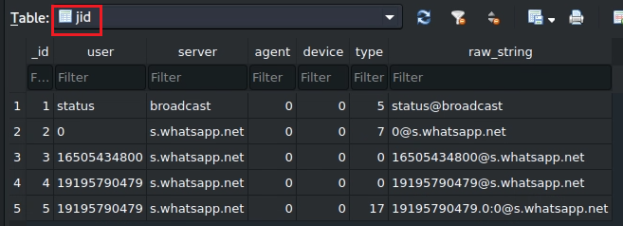
Sample rows example jid
_id | Meaning
1 | WhatsApp’s system broadcast JID for user statuses (stories). All “My Status” updates go through this channel.
2 | A special system JID, often representing internal metadata or a “null” sender in old versions. Not a real user.
3 | A normal WhatsApp contact (user with phone number +1-650-543-4800).
4 | Another normal WhatsApp contact, phone number +1-919-579-0479.
5 | A multi-device JID variant — same user but referencing a linked companion device (for example, WhatsApp Web or secondary device).
0 = normal user/contact
1 = group
2 = broadcast list
5 = system/status
7 = special system entry
17 = multi-device contact

Slide 25
messages table in msgstore.db

Slide 26
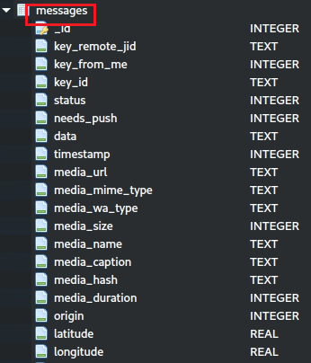
messages table
_id : Unique identifier for the message.
key_remote_jid: The raw_string in jid table (e.g., 1234567890@s.whatsapp.net).
key_from_me : Indicates if the message was sent by the user (1) or received (0).
key_id: A unique identifier for the message within the chat.
status : The status of the message (e.g., 0 = sent, 4 = delivered, 5 = read).
data : The message content (often encrypted).
timestamp: The timestamp of when the message was sent.
media_url: URL or file path for media (if applicable).
media_mime_type: MIME type of the media (e.g., image/jpeg).
media_wa_type: WhatsApp-specific media type (e.g., 0 = text, 1 = image).
media_size : Size of the media file.
media_name : Name of the media file.
media_caption : Caption for the media.
media_duration : Duration of the media (e.g., for audio or video).
origin: Indicates the origin of the message (e.g., forwarded).
latitude: Latitude for location messages.
longitude: Longitude for location messages.
Notes:
sqlitebrowser 'Pixel 3/data/data/com.whatsapp/databases/msgstore.db'

Slide 27
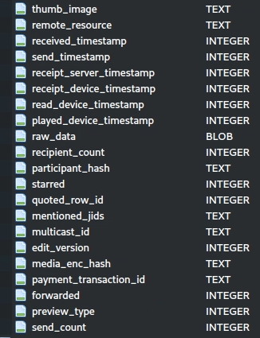
thumb_image : Thumbnail image data (often a blob).
remote_resource: JID of the sender in group chats.
received_timestamp: Timestamp of when the message was received.
send_timestamp: Timestamp of when the message was sent (possibly redundant with timestamp).
receipt_server_timestamp : Timestamp of server acknowledgment.
receipt_device_timestamp: Timestamp of device receipt.
read_device_timestamp: Timestamp of when the message was read on the device.
played_device_timestamp: Timestamp of when the media was played on the device.
raw_data: Raw data for the message (possibly unprocessed content).
recipient_count: Number of recipients (for broadcast messages).
participant_hash: Hash of participants (for group chats).
starred: Indicates if the message was starred by the user.
quoted_row_id: Links to the quoted message (if applicable).
mentioned_jids: JIDs mentioned in the message.
multicast_id: ID for multicast messages.
Notes:
sqlitebrowser 'Pixel 3/data/data/com.whatsapp/databases/msgstore.db'

Slide 28
Forensic implications of messages table
Timeline Reconstruction: The timestamp, received_timestamp, and receipt_server_timestamp attributes are critical for building a precise timeline of communication, which is often a cornerstone of forensic investigations.
Conversation Analysis: The key_from_me, and key_remote_jid attributes allow investigators to group messages by chat, identify participants, and reconstruct the flow of conversations.
Content Analysis: The text_data attribute (if decrypted) provides the raw message content, while message_type directs investigators to related tables (e.g., message_media for media messages, message_location for location data).
Behavioral Insights: The starred and status attributes reveal user behavior, such as which messages were important to them and whether messages were read by the recipient.

Slide 29
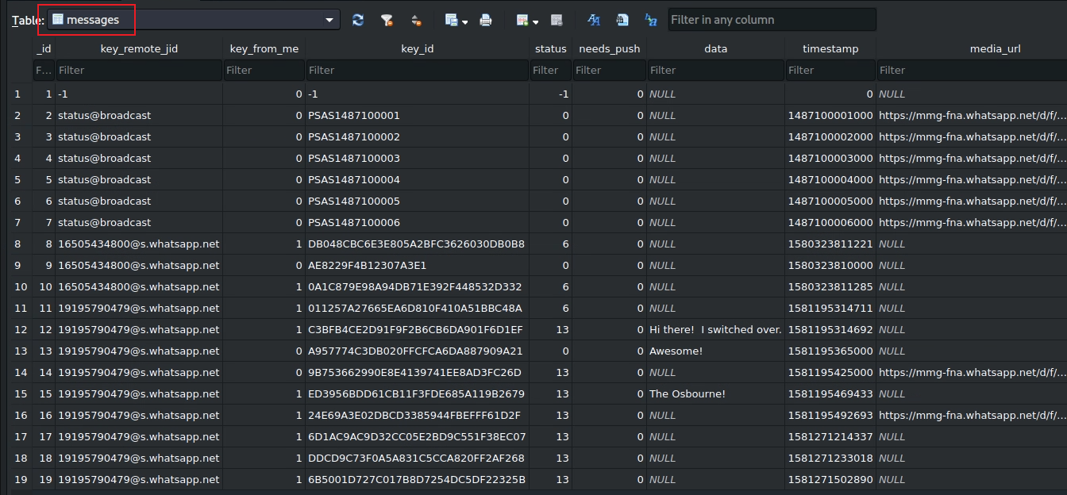

0=received
4=waiting on the server
5=received at the destination
6=control message
13=message opened by the recipient
message content
send/received timestamps
who
Notes:
other columns: https://blog.group-ib.com/whatsapp_forensic_artifacts

Slide 30
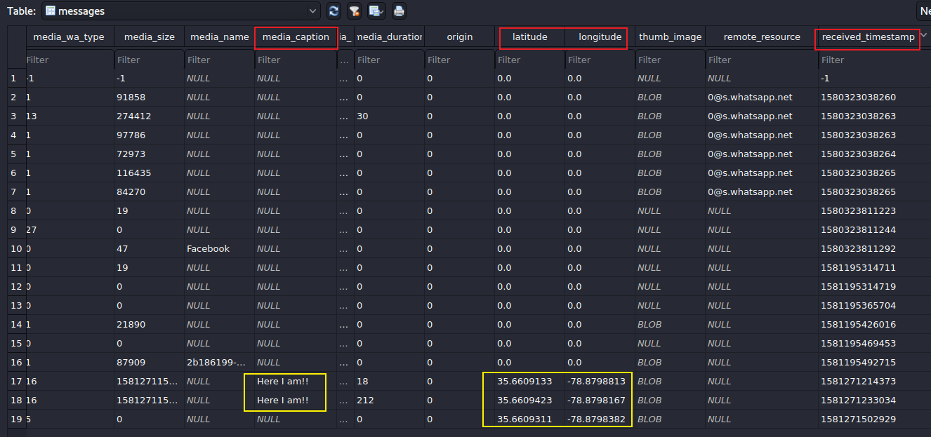




0: message
1: picture
5: static location
13: video
16: live location
used to find users’ actions (e.g., send pictures, videos, etc.)
Notes:
35.6609123, -78.8798813

Slide 31
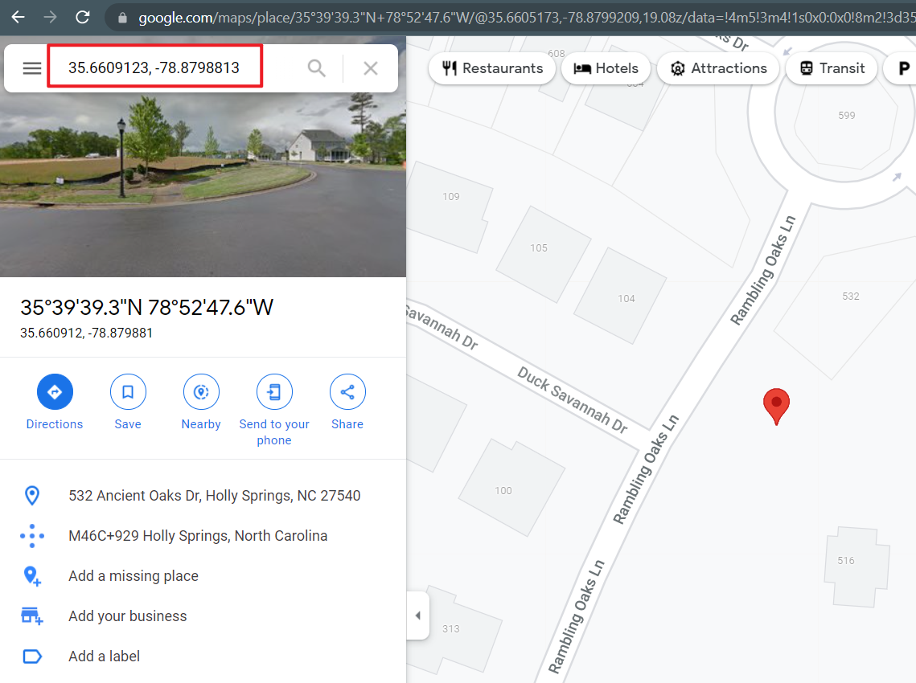
Notes:
https://www.google.com/maps/place/35%C2%B039'39.3%22N+78%C2%B052'47.6%22W/@35.6609133,-78.88207,17z/data=!3m1!4b1!4m5!3m4!1s0x0:0x0!8m2!3d35.6609133!4d-78.8798813

Slide 32
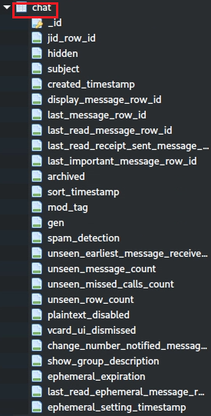
chat table
_id: Uniquely identifies each chat and links to other tables (e.g., message).
jid_row_id (int): Identifies the participants or group (link to jid._id), enabling social network analysis.
subject: Provides the group name (for group chats), giving context about the conversation.
created_timestamp: Shows when the chat was created, aiding timeline analysis.
last_message_row_id: Links to the most recent message, providing a snapshot of recent activity.
last_read_message_row_id: Indicates the last message the user read, showing their engagement.
last_read_receipt_sent_message_row_id: Shows the last message for which a read receipt was sent, useful for interaction analysis.
unseen_message_count: Reveals unread messages, indicating the user’s engagement with the chat.
unseen_missed_calls_count: Shows missed calls, highlighting missed communication attempts.
sort_timestamp: Indicates the most recent activity in the chat, critical for timeline analysis.
Notes:
The image shows the schema of the `chat` table from WhatsApp's `msgstore.db` database, which stores metadata about conversations (both one-on-one and group chats). This table is crucial for digital forensics as it provides an overview of the user’s chats, including participants, timestamps, and user preferences. Below, I’ll analyze the attributes shown in the image and list the most valuable ones for forensic analysis, explaining their significance.
---
### **Attributes in the `chat` Table (as shown in the image)**
The image lists the following attributes in the `chat` table:
- `_id`: Unique identifier for the chat.
- `jid_row_id`: Links to the JID (WhatsApp user ID) of the chat participant or group (references the `jid` table).
- `hidden`: Indicates whether the chat is hidden (e.g., for temporary or system chats).
- `subject`: The name or subject of the chat (for group chats, this is the group name).
- `created_timestamp`: The timestamp of when the chat was created.
- `display_message_row_id`: The ID of the message currently displayed in the chat (links to the `message` table).
- `last_message_row_id`: The ID of the most recent message in the chat (links to the `message` table).
- `last_read_message_row_id`: The ID of the last message marked as read by the user.
- `last_read_receipt_sent_message_row_id`: The ID of the last message for which a read receipt was sent.
- `last_important_message_row_id`: The ID of the last "important" message (e.g., a starred or significant message).
- `archived`: Indicates whether the chat is archived.
- `sort_timestamp`: A timestamp used for sorting chats (often the same as the last message timestamp).
- `mod_tag`: A tag used for internal modification tracking.
- `gen`: Likely a generation or version number for the chat (used internally by WhatsApp).
- `spam_detection`: Indicates whether the chat is flagged as spam.
- `unseen_earliest_message_received_time`: The timestamp of the earliest unseen message.
- `unseen_message_count`: The number of unseen messages in the chat.
- `unseen_missed_calls_count`: The number of unseen missed calls in the chat.
- `unseen_row_count`: The number of unseen rows (messages or events) in the chat.
- `plaintext_disabled`: Indicates whether plaintext storage is disabled (related to encryption settings).
- `vcard_ui_dismissed`: Indicates whether the vCard UI was dismissed (e.g., for shared contacts).
- `change_number_notified_message_row_id`: The ID of the message notifying a phone number change.
- `show_group_description`: Indicates whether the group description is shown (for group chats).
- `ephemeral_expiration`: The expiration time for ephemeral messages (if enabled).
- `last_read_ephemeral_message_row_id`: The ID of the last read ephemeral message.
- `ephemeral_setting_timestamp`: The timestamp of when the ephemeral message setting was applied.
---
### **Most Valuable Attributes in the `chat` Table for Digital Forensics**
Here’s a list of the most valuable attributes from the `chat` table for forensic analysis, based on the schema provided, along with their significance:
1. **_id**
- **Forensic Value: High**
- **Why Valuable:** This is the primary key for the chat, uniquely identifying each conversation in the table. It’s essential for linking to other tables (e.g., the `message` table via `chat_row_id`) and for tracking specific chats during analysis. For example, the `_id` can be used to find all messages in a chat by querying the `message` table.
2. **jid_row_id**
- **Forensic Value: Very High**
- **Why Valuable:** This attribute links to the `jid` table, which contains the WhatsApp user ID (JID) of the chat participant (e.g., `+1234567890@s.whatsapp.net`) or the group JID for group chats. It’s critical for identifying the participants in a conversation, enabling social network analysis, and mapping the user’s contacts. For group chats, it can be cross-referenced with the `group_participants` table to identify all members.
3. **subject**
- **Forensic Value: High**
- **Why Valuable:** For group chats, this attribute stores the group name (e.g., "Family Group"). It provides context about the chat’s purpose or participants, which can be useful for understanding the nature of the conversation. For one-on-one chats, this might be empty or reflect the contact’s name as set by the user.
4. **created_timestamp**
- **Forensic Value: High**
- **Why Valuable:** This timestamp indicates when the chat was created (in milliseconds since the Unix epoch). It helps establish the start of a conversation, which is crucial for building a timeline of communication. For example, a `created_timestamp` of 1581692436133 converts to Feb 14, 2020, 15:40:36 UTC, showing when the chat began.
5. **last_message_row_id**
- **Forensic Value: High**
- **Why Valuable:** This attribute links to the most recent message in the chat (via the `message` table). It allows investigators to quickly access the latest message in a conversation, which can provide a snapshot of recent activity. It’s also useful for cross-referencing with the `message` table to analyze the content and timestamp of the last message.
6. **last_read_message_row_id**
- **Forensic Value: Moderate to High**
- **Why Valuable:** This attribute indicates the last message the user has read (links to the `message` table). It can reveal how far the user has progressed in the conversation and whether they’ve seen critical messages, which is useful for understanding their engagement and awareness of the chat’s content.
7. **last_read_receipt_sent_message_row_id**
- **Forensic Value: Moderate to High**
- **Why Valuable:** This attribute shows the last message for which a read receipt was sent to the other party. It can help determine when the user last interacted with the chat and whether the other party knows the user has seen their messages, which can be relevant for behavioral analysis.
8. **unseen_message_count**
- **Forensic Value: Moderate**
- **Why Valuable:** This attribute indicates the number of unread messages in the chat. It provides insight into the user’s engagement with the conversation—e.g., a high `unseen_message_count` might suggest the user ignored the chat, while a count of 0 indicates they’ve read all messages. This can help prioritize chats for further investigation.
9. **unseen_missed_calls_count**
- **Forensic Value: Moderate**
- **Why Valuable:** This attribute shows the number of missed calls in the chat that the user hasn’t seen. It can reveal missed communication attempts, which might be significant in understanding the user’s availability or relationships (e.g., repeated missed calls from a specific contact might indicate urgency).
10. **sort_timestamp**
- **Forensic Value: High**
- **Why Valuable:** This timestamp is used to sort chats in the WhatsApp UI, typically reflecting the timestamp of the last message or significant event in the chat. It provides a quick way to determine the most recent activity in the chat, which is essential for timeline analysis and identifying active conversations.
11. **archived**
- **Forensic Value: Moderate**
- **Why Valuable:** This boolean (0 or 1) indicates whether the chat is archived (1) or not (0). Archived chats are often less frequently accessed by the user, which can provide behavioral insights—e.g., the user might have archived a chat to hide it from their main view, potentially indicating it contains sensitive information.
12. **ephemeral_expiration** and **ephemeral_setting_timestamp**
- **Forensic Value: Moderate to High**
- **Why Valuable:** These attributes relate to WhatsApp’s ephemeral (disappearing) messages feature. `ephemeral_expiration` indicates the duration after which messages disappear (e.g., 24 hours, 7 days), and `ephemeral_setting_timestamp` shows when this setting was applied. These are valuable for understanding whether the user enabled disappearing messages, which might suggest an intent to hide communication. If messages have already disappeared, this can complicate the investigation but still provides context about the user’s privacy practices.
13. **change_number_notified_message_row_id**
- **Forensic Value: Moderate**
- **Why Valuable:** This attribute links to a message notifying a phone number change (e.g., if a contact changed their number). It can help track changes in user identities, which is useful for attribution and continuity in communication analysis (e.g., linking an old number to a new one).
---
### **Less Valuable Attributes (but Still Relevant)**
- **hidden:** Indicates if the chat is hidden (e.g., for temporary or system chats). While useful for identifying non-standard chats, most user conversations are not hidden.
- **display_message_row_id:** The message currently displayed in the chat UI. This is more relevant to the app’s state at the time of extraction and less critical for forensics.
- **last_important_message_row_id:** Links to the last "important" message (e.g., starred). While useful, it’s less critical than the last message or last read message.
- **mod_tag, gen:** Internal tags used by WhatsApp for tracking modifications or versions. These are more technical and less directly relevant to forensics.
- **spam_detection:** Indicates if the chat is flagged as spam. This might provide context but is not a primary focus unless investigating spam-related activity.
- **unseen_earliest_message_received_time:** The timestamp of the earliest unseen message. It’s useful for timeline analysis but secondary to `unseen_message_count`.
- **unseen_row_count:** The number of unseen rows (messages or events). It’s similar to `unseen_message_count` but less specific.
- **plaintext_disabled:** Indicates if plaintext storage is disabled (related to encryption). This is more technical and less directly useful unless investigating encryption settings.
- **vcard_ui_dismissed:** Indicates if the vCard UI was dismissed. This is a minor UI-related detail with limited forensic value.
- **show_group_description:** Indicates if the group description is shown. This is more relevant to group chat UI settings than forensic analysis.
- **last_read_ephemeral_message_row_id:** Links to the last read ephemeral message. This is useful only if ephemeral messages are a focus of the investigation.
---
### **Summary of Most Valuable Attributes**
The most valuable attributes in the `chat` table for digital forensics, based on the schema provided, are:
1. **_id:** Uniquely identifies each chat and links to other tables (e.g., `message`).
2. **jid_row_id:** Identifies the participants or group, enabling social network analysis.
3. **subject:** Provides the group name (for group chats), giving context about the conversation.
4. **created_timestamp:** Shows when the chat was created, aiding timeline analysis.
5. **last_message_row_id:** Links to the most recent message, providing a snapshot of recent activity.
6. **last_read_message_row_id:** Indicates the last message the user read, showing their engagement.
7. **last_read_receipt_sent_message_row_id:** Shows the last message for which a read receipt was sent, useful for interaction analysis.
8. **unseen_message_count:** Reveals unread messages, indicating the user’s engagement with the chat.
9. **unseen_missed_calls_count:** Shows missed calls, highlighting missed communication attempts.
10. **sort_timestamp:** Indicates the most recent activity in the chat, critical for timeline analysis.
11. **archived:** Indicates if the chat is archived, providing behavioral insights.
12. **ephemeral_expiration** and **ephemeral_setting_timestamp:** Reveal the use of disappearing messages, suggesting privacy concerns.
13. **change_number_notified_message_row_id:** Tracks phone number changes, aiding user attribution.
---
### **Forensic Implications**
- **Social Network Mapping:** The `jid_row_id` and `subject` attributes are key for identifying participants and understanding the context of the chat (e.g., a group named "Work Team" vs. "Family Group").
- **Timeline Reconstruction:** The `created_timestamp`, `sort_timestamp`, and `last_message_row_id` attributes help build a timeline of when the chat started and its most recent activity, which can be cross-referenced with the `message` table for detailed message timestamps.
- **Behavioral Analysis:** Attributes like `unseen_message_count`, `unseen_missed_calls_count`, `archived`, and `last_read_message_row_id` provide insights into the user’s engagement with the chat—e.g., which chats they prioritized, ignored, or archived.
- **Privacy Practices:** The `ephemeral_expiration` and `ephemeral_setting_timestamp` attributes indicate whether the user enabled disappearing messages, which might suggest an intent to hide communication.
- **Identity Tracking:** The `change_number_notified_message_row_id` can help track changes in phone numbers, which is useful for maintaining continuity in user identification.
In summary, these attributes collectively enable a high-level analysis of WhatsApp conversations, providing insights into the user’s social network, communication timeline, and behavioral patterns. The `chat` table serves as a starting point for forensic investigations, guiding investigators to specific chats and linking to the `message` table for detailed message analysis.

Slide 33
Forensic implications of chat table
Social Network Mapping: The jid_row_id (int) and subject attributes are key for identifying participants and understanding the context of the chat (e.g., a group named "Work Team" vs. "Family Group").
Timeline Reconstruction: The created_timestamp, sort_timestamp, and last_message_row_id attributes help build a timeline of when the chat started and its most recent activity, which can be cross-referenced with the message table for detailed message timestamps.
Behavioral Analysis: Attributes like unseen_message_count, unseen_missed_calls_count, archived, and last_read_message_row_id provide insights into the user’s engagement with the chat—e.g., which chats they prioritized, ignored, or archived

Slide 34
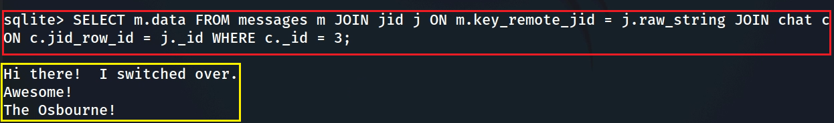



jid, messages, chat tables work together
chat
_id | jid_row_id
messages
key_remote_jid
jid
_id | raw_string
19195790479@s.whatsapp.net
19195790479@s.whatsapp.net
Goal: retrieve all messages from the messages table that belong to the chat (_id = 3). It does this by:
  Joining the messages table with the jid (raw_string) table to map each message’s key_remote_jid to a JID entry.
  Joining the jid table with the chat table to link the JID to a specific chat via jid_row_id.
  Filtering the results to only include messages from the chat with _id = 3.
Notes:
SELECT m.data FROM messages m JOIN jid j ON m.key_remote_jid = j.raw_string JOIN chat c ON c.jid_row_id = j._id WHERE c._id = 3;

Slide 35
wa.db (whatapp database)

Slide 36
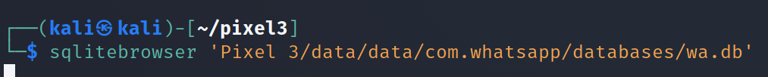
wa.db database
Contains a full list of the WhatsApp user's contacts
  phone numbers (blocked numbers, groups, etc.)
  display names,
  other information mentioned upon registering in WhatsApp
Show all tables in wa.db
Notes:
Cmd: sqlitebrowser 'Pixel 3/data/data/com.whatsapp/databases/wa.db'

Slide 37
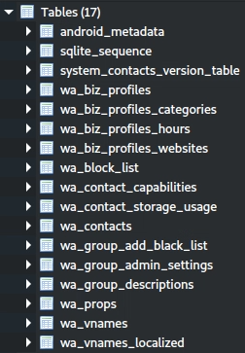
Valuable tables in wa.db
wa_contacts: Contains detailed contact information (JID, phone number, display name, status, blocked status), critical for mapping the user’s social network and cross-referencing with msgstore.db.
wa_group_admin_settings: Stores group settings (e.g., admin-only messaging, ephemeral messages), revealing group dynamics and privacy preferences.
wa_group_descriptions: Provides group descriptions and metadata (e.g., who set the description, when), offering context about group purpose and activity.
wa_block_list: Lists blocked contacts, indicating potential conflicts or privacy concerns.
wa_biz_profiles: Contains business profile details (e.g., location, description), useful for investigating business interactions and geolocation.

Slide 38
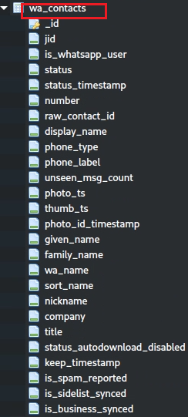
Valuable attributes in wa_contacts table
_id: Uniquely identifies each contact and links to other tables.
jid: The WhatsApp JID, critical for linking to messages and mapping the social network.
is_whatsapp_user: Filters contacts to focus on WhatsApp users.
status: The contact’s “About” / profile status text, e.g. “Hey there! I am using WhatsApp.”
status_timestamp: Shows when the status was updated, aiding timeline analysis.
number: The contact’s phone number, essential for real-world identity attribution.
display_name: The user-assigned name, revealing how the user identifies the contact.
given_name and family_name: Structured names for confirming the contact’s identity.
wa_name: The contact’s self-assigned WhatsApp name, useful for identity verification.
unseen_msg_count: Indicates unread messages, showing user engagement.
photo_ts and thumb_ts: Timestamps for profile photo updates, useful for activity tracking.
is_spam_reported: Indicates if the contact was reported as spam, revealing potential issues.
is_business_synced: Identifies business contacts, linking to wa_biz_profiles.
Notes:
The image shows the schema of the `wa_contacts` table from WhatsApp's `wa.db` database, which is a critical table for storing contact information. This table is highly valuable for digital forensics as it contains detailed metadata about the user’s contacts, including their WhatsApp JIDs, phone numbers, names, and interaction details. Below, I’ll analyze the columns shown in the image and list the most valuable ones for forensic analysis, explaining their significance.
---
### **Columns in the `wa_contacts` Table (as shown in the image)**
The image lists the following columns in the `wa_contacts` table, along with their data types:
- `_id` (INTEGER): Unique identifier for the contact.
- `jid` (TEXT): The WhatsApp JID (e.g., `+1234567890@s.whatsapp.net`).
- `is_whatsapp_user` (BOOLEAN): Indicates if the contact is a WhatsApp user (1 = yes, 0 = no).
- `status` (TEXT): The contact’s status message.
- `status_timestamp` (INTEGER): The timestamp of when the status was last updated.
- `number` (TEXT): The contact’s phone number.
- `raw_contact_id` (INTEGER): Links to the system’s raw contact ID (from the device’s contact database).
- `display_name` (TEXT): The display name of the contact.
- `phone_type` (INTEGER): The type of phone number (e.g., mobile, home).
- `phone_label` (TEXT): A label for the phone number (e.g., "Work").
- `unseen_msg_count` (INTEGER): The number of unseen messages from this contact.
- `photo_ts` (INTEGER): Timestamp of the contact’s profile photo.
- `thumb_ts` (INTEGER): Timestamp of the contact’s profile photo thumbnail.
- `photo_id_timestamp` (INTEGER): Timestamp of the contact’s photo ID.
- `given_name` (TEXT): The contact’s first name.
- `family_name` (TEXT): The contact’s last name.
- `wa_name` (TEXT): The name set by the contact in WhatsApp.
- `sort_name` (TEXT): The name used for sorting (e.g., in the contact list).
- `nickname` (TEXT): The contact’s nickname.
- `company` (TEXT): The contact’s company name.
- `title` (TEXT): The contact’s job title.
- `status_autodownload_disabled` (INTEGER): Indicates if status autodownload is disabled for this contact.
- `keep_timestamp` (INTEGER): Timestamp for keeping certain data (e.g., status).
- `is_spam_reported` (INTEGER): Indicates if the contact was reported as spam.
- `is_sidelist_synced` (BOOLEAN): Indicates if the contact is synced with the sidelist.
- `is_business_synced` (BOOLEAN): Indicates if the contact’s business profile is synced.
---
### **Most Valuable Columns in the `wa_contacts` Table for Digital Forensics**
Here’s a list of the most valuable columns from the `wa_contacts` table for forensic analysis, based on the schema provided, along with their significance:
1. **_id (INTEGER)**
- **Forensic Value: High**
- **Why Valuable:** This is the primary key for the contact, uniquely identifying each contact in the table. It’s essential for linking to other tables (e.g., `wa_contact_capabilities`, `wa_contact_storage_usage`) and for tracking specific contacts during analysis. For example, the `_id` can be used to find associated capabilities or storage usage for a contact.
2. **jid (TEXT)**
- **Forensic Value: Very High**
- **Why Valuable:** The `jid` (e.g., `+1234567890@s.whatsapp.net`) is the WhatsApp user ID for the contact. It’s critical for:
- Linking the contact to messages in the `msgstore.db` database (e.g., matching with `key_remote_jid` or `sender_jid_row_id` in the `message` table).
- Identifying the contact in group chats (e.g., in `wa_group_admin_settings` or `group_participants` tables).
- Mapping the user’s social network by identifying who they communicate with.
- **Use Case:** Cross-referencing with `msgstore.db` to analyze communication history with a specific contact.
3. **is_whatsapp_user (BOOLEAN)**
- **Forensic Value: High**
- **Why Valuable:** This boolean (1 = yes, 0 = no) indicates whether the contact is a WhatsApp user. It helps filter contacts to focus on those the user can communicate with via WhatsApp, narrowing down the scope of the investigation to relevant individuals.
- **Use Case:** Identifying which contacts are part of the user’s WhatsApp network, excluding non-WhatsApp contacts.
4. **status (TEXT)**
- **Forensic Value: Moderate to High**
- **Why Valuable:** This column stores the contact’s status message (e.g., "Busy", "Available"). It can provide insights into the contact’s state or intentions at a given time, which might be relevant for understanding their behavior or context during communication.
- **Use Case:** Analyzing a contact’s status to infer their availability or mood at the time of communication.
5. **status_timestamp (INTEGER)**
- **Forensic Value: High**
- **Why Valuable:** This timestamp (in milliseconds since Unix epoch) indicates when the contact’s status was last updated. It’s useful for timeline analysis, as it shows when the contact was active on WhatsApp and can help correlate their status changes with communication events in `msgstore.db`.
- **Use Case:** Building a timeline of contact activity, especially when cross-referenced with message timestamps.
6. **number (TEXT)**
- **Forensic Value: Very High**
- **Why Valuable:** This column stores the contact’s phone number (e.g., `+1234567890`). It’s critical for:
- Identifying the contact’s real-world identity (phone numbers can be linked to individuals).
- Cross-referencing with other data sources (e.g., call logs, SMS records).
- Verifying the `jid`, as the JID is typically derived from the phone number (e.g., `+1234567890@s.whatsapp.net`).
- **Use Case:** Attributing a WhatsApp JID to a real phone number, enabling broader identity mapping.
7. **display_name (TEXT)**
- **Forensic Value: High**
- **Why Valuable:** This column stores the display name of the contact as set by the user (e.g., "John Doe"). It provides a human-readable identifier for the contact, which can help investigators understand how the user refers to the contact (e.g., "Mom" vs. "John Smith").
- **Use Case:** Identifying contacts by their user-assigned names, which can reveal relationships (e.g., "Boss", "Best Friend").
8. **given_name (TEXT) and family_name (TEXT)**
- **Forensic Value: Moderate to High**
- **Why Valuable:** These columns store the contact’s first name (`given_name`) and last name (`family_name`), providing a structured breakdown of the contact’s name. They can help confirm the contact’s identity, especially when combined with `number` and `display_name`.
- **Use Case:** Verifying the contact’s identity and distinguishing between contacts with similar names.
9. **wa_name (TEXT)**
- **Forensic Value: Moderate to High**
- **Why Valuable:** This column stores the name set by the contact in WhatsApp (e.g., their profile name). It can differ from the `display_name` (set by the user) and provides insight into how the contact presents themselves on WhatsApp.
- **Use Case:** Comparing `wa_name` with `display_name` to understand naming discrepancies and confirm identities.
10. **unseen_msg_count (INTEGER)**
- **Forensic Value: Moderate**
- **Why Valuable:** This column indicates the number of unseen messages from the contact. It provides behavioral insights into the user’s engagement with the contact—e.g., a high `unseen_msg_count` might suggest the user is ignoring the contact, while a count of 0 indicates they’ve read all messages.
- **Use Case:** Prioritizing contacts for further investigation based on the user’s interaction patterns.
11. **photo_ts (INTEGER) and thumb_ts (INTEGER)**
- **Forensic Value: Moderate**
- **Why Valuable:** These columns store timestamps for the contact’s profile photo (`photo_ts`) and thumbnail (`thumb_ts`). They indicate when the contact last updated their profile photo, which can be useful for timeline analysis and detecting recent activity.
- **Use Case:** Correlating profile photo updates with communication events to infer contact activity.
12. **is_spam_reported (INTEGER)**
- **Forensic Value: Moderate**
- **Why Valuable:** This boolean (1 = yes, 0 = no) indicates whether the user reported the contact as spam. It can reveal potential issues with the contact (e.g., unwanted messages) and provide behavioral insights into the user’s interactions.
- **Use Case:** Identifying problematic contacts and understanding the user’s response to spam.
13. **is_business_synced (BOOLEAN)**
- **Forensic Value: Moderate**
- **Why Valuable:** This boolean (1 = yes, 0 = no) indicates whether the contact’s business profile is synced (e.g., if they are a WhatsApp business account). It can help identify business contacts, which can be cross-referenced with the `wa_biz_profiles` table for more details.
- **Use Case:** Investigating business-related communications and identifying commercial interactions.
---
### **Less Valuable Columns (but Still Relevant)**
- **raw_contact_id (INTEGER):** Links to the device’s contact database. It’s useful for cross-referencing with system contacts but less critical for WhatsApp-specific analysis.
- **phone_type (INTEGER) and phone_label (TEXT):** Provide details about the phone number type (e.g., mobile, home) and label (e.g., "Work"). They add context but are secondary to the phone number itself.
- **photo_id_timestamp (INTEGER):** Timestamp for the contact’s photo ID. It’s similar to `photo_ts` but less commonly used.
- **sort_name (TEXT):** The name used for sorting in the contact list. It’s useful for UI purposes but not critical for forensics.
- **nickname (TEXT), company (TEXT), title (TEXT):** Provide additional details about the contact (e.g., nickname, company name, job title). They can add context but are less critical than core identifiers like `jid` or `number`.
- **status_autodownload_disabled (INTEGER):** Indicates if status autodownload is disabled for the contact. It’s a minor setting with limited forensic value.
- **keep_timestamp (INTEGER):** Timestamp for keeping certain data (e.g., status). It’s more technical and less directly useful.
- **is_sidelist_synced (BOOLEAN):** Indicates if the contact is synced with the sidelist (a WhatsApp-specific list). It’s more technical and less relevant for most investigations.
---
### **Summary of Most Valuable Columns**
The most valuable columns in the `wa_contacts` table for digital forensics, based on the schema provided, are:
1. **_id:** Uniquely identifies each contact and links to other tables.
2. **jid:** The WhatsApp JID, critical for linking to messages and mapping the social network.
3. **is_whatsapp_user:** Filters contacts to focus on WhatsApp users.
4. **status:** Provides the contact’s status message, offering behavioral context.
5. **status_timestamp:** Shows when the status was updated, aiding timeline analysis.
6. **number:** The contact’s phone number, essential for real-world identity attribution.
7. **display_name:** The user-assigned name, revealing how the user identifies the contact.
8. **given_name and family_name:** Structured names for confirming the contact’s identity.
9. **wa_name:** The contact’s self-assigned WhatsApp name, useful for identity verification.
10. **unseen_msg_count:** Indicates unread messages, showing user engagement.
11. **photo_ts and thumb_ts:** Timestamps for profile photo updates, useful for activity tracking.
12. **is_spam_reported:** Indicates if the contact was reported as spam, revealing potential issues.
13. **is_business_synced:** Identifies business contacts, linking to `wa_biz_profiles`.
---
### **Forensic Implications**
- **Social Network Mapping:** Columns like `jid`, `number`, `display_name`, `given_name`, `family_name`, and `wa_name` are key for identifying contacts and mapping the user’s social network, especially when cross-referenced with `msgstore.db`.
- **Timeline Analysis:** `status_timestamp`, `photo_ts`, and `thumb_ts` help build a timeline of contact activity, such as when they updated their status or profile photo.
- **Behavioral Insights:** `unseen_msg_count` and `is_spam_reported` provide insights into the user’s engagement with the contact and any issues (e.g., ignoring messages, reporting spam).
- **Business Investigations:** `is_business_synced` flags business contacts, which can be further explored in the `wa_biz_profiles` table for commercial interactions.
In summary, the `jid`, `number`, `display_name`, `status`, `status_timestamp`, and `unseen_msg_count` columns are among the most valuable in `wa_contacts`, as they provide direct access to contact identities, communication links, and user behavior, making this table a cornerstone for forensic analysis of WhatsApp contacts.

Slide 39
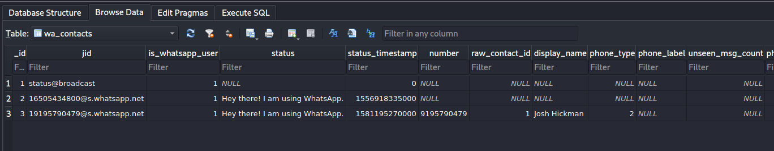
contains ’1’ if the contact corresponds to an actual WhatsApp user, ’0’ otherwise
WhatsApp ID of the contact (a string structured as
’x@s.whatsapp.net’, where ’x’ is the phone number of the
contact)
Status set timestamp. Unix millisecond epoch time (13 digits)
phone number type:
2 = mobile,1 = home, 3 = work, etc.
profile status
name of contact
This means: WhatsApp knows this JID exists (you’ve had some interaction or it’s in a chat), but that number is not saved in the phone’s Contacts app. So WhatsApp only stores the JID; it does not copy the phone number into the number column because there is no linked Android contact (raw_contact_id is NULL).
Notes:
https://arxiv.org/pdf/1507.07739.pdf

Slide 40
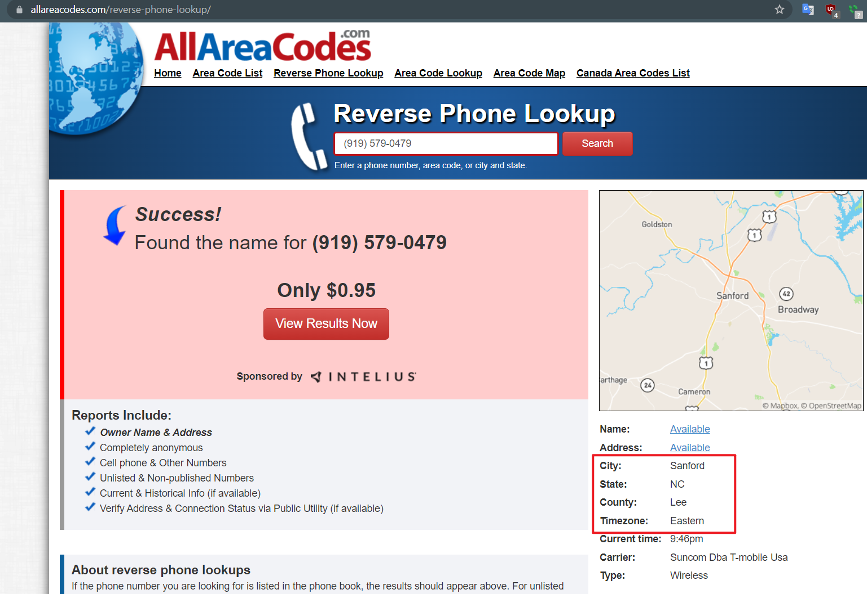
Notes:
https://www.allareacodes.com/919
(919) 579-0479

Slide 41
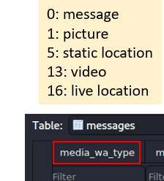

Can you reconstruct the timeline?
Are timestamps one hour off?

Slide 42
To summarize
Dig into databases (msgstore.db & wa.db) to fetch information such as messages, contacts, etc.
Find the phone number associated with WhatsApp
Questions: Use SQL to reconstruct the timeline

Slide 43
Homework (Snapshot)
Similar approach

Slide 44

Snapchat
Snapchat opens right to the camera, so you can send a Snap in seconds! Just take a photo or video, add a caption, and send it to your best friends and family. Express yourself with Filters, Lenses, Bitmojis, and all kinds of fun effects.
Evidence types
  SNAP: camera
  CHAT : messages
  STORIES: friends' Stories, news, shows
  SPOTLIGHT: best of Snapchat!
  SNAP MAP: map
  MEMORIES: look back on Snaps
  FRIENDSHIP PROFILE: friends’ info
Notes:
https://play.google.com/store/apps/details?id=com.snapchat.android

Slide 45
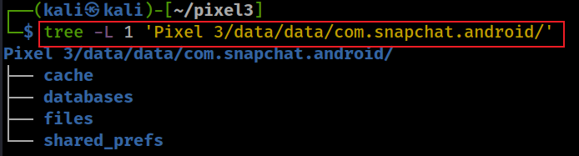
Snapchat level 1 file structure
Notes:
tree -L 1 'Pixel 3/data/data/com.snapchat.android/'

Slide 46
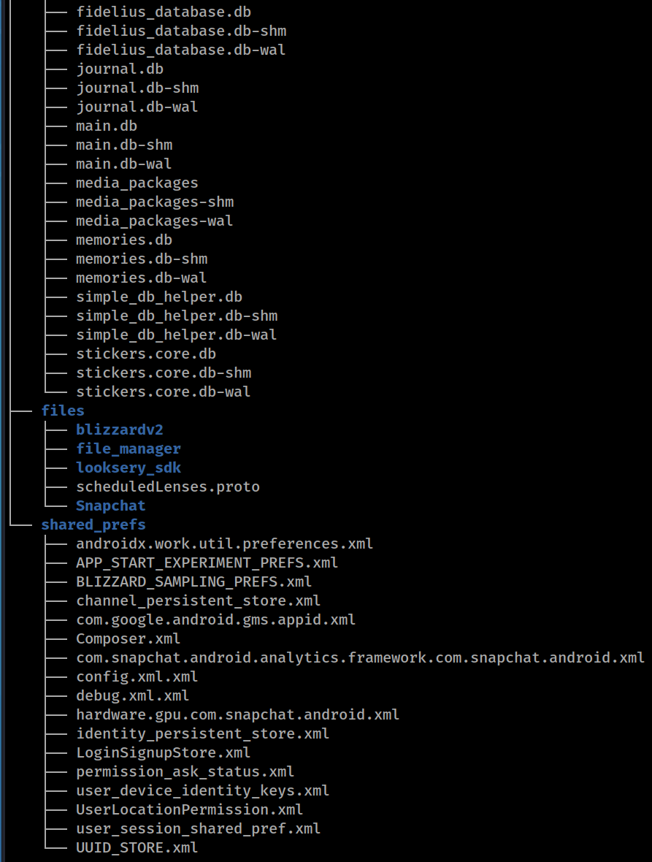
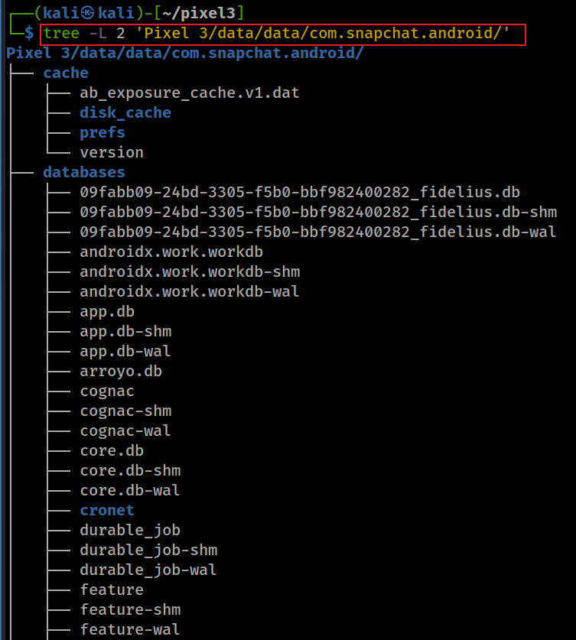
Snapchat level 2 file structure
Notes:
tree -L 2 'Pixel 3/data/data/com.snapchat.android/'

Slide 47
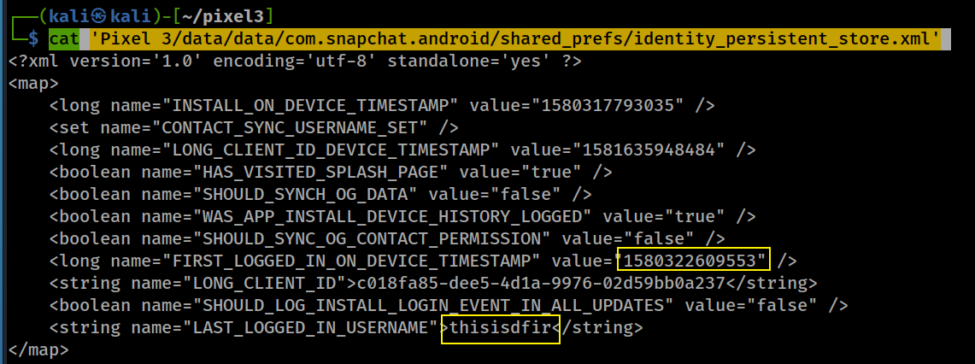
Who was the last logged in snapchat? data/data/com.snapchat.android/shared_prefs/identity_persistent_store.xml

Slide 48
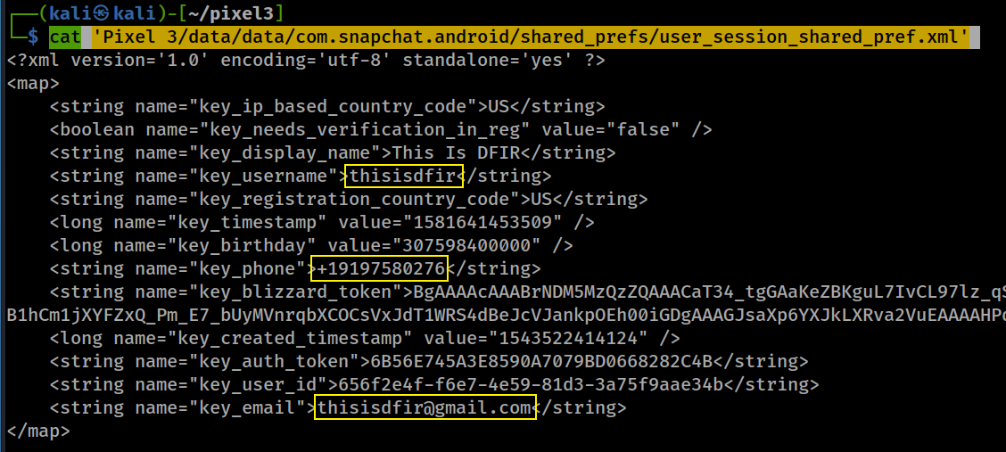
What is email/phone number of snapchat? data/data/com.snapchat.android/shared_prefs/user_session_shared_pref.xml
Notes:
cat 'Pixel 3/data/data/com.snapchat.android/shared_prefs/user_session_shared_pref.xml'

