Slide 1
Android Rooting

Slide 2
Overview
Rooting concept
ROMs (Android OS images)
Booting modes
Steps to root Android
  Using adb, Fastboot, and Magisk
  Using odin, TWRP, and Magisk

Slide 3
Rooting concept

Slide 4

What is Android rooting?
Android OS uses Linux permissions
  file ownership and root vs. normal users
Android OS users by default have normal user accounts
  remove a standard Linux function, e.g., rm -rf , su (switch user)
  can’t uninstall system applications
  can’t install low-level system binaries
  can’t revoke permissions installed apps require
Rooting is the process of gaining “root access” to a device.
  gaining superuser privilege
  adding a standard Linux function that was removed
  the same as the Administrator user on Windows.
  after rooting, you can grant specific applications to do almost anything

Slide 5

Root method 1: System root (up to Android 4.3)
Two Requirements
  The process (daemon) that handles su requests for root access has to run as soon as you turn on your phone.
  This process (named su daemon) needs special permissions so it can work as intended.
How root works theoretically?
  Modify su daemon = modify/add files in the phone’s /system folder
  The modified daemon with permissions will handle su request, e.g.., SuperSU
This method worked fine until around Android Marshmallow
  When Google strengthened security
Notes:
https://www.howtogeek.com/249162/what-is-systemless-root-on-android-and-why-is-it-better/
note: Exploiting one or more security bugs in the firmware of the device can change daemon permission

Slide 6
System root tool: SuperSU
It changes the system files and adds new files to the system partition on the phone.
It does not have modules built-in, but having root allows you to use other frameworks like Xposed to install mods.
It is closed source.

Slide 7





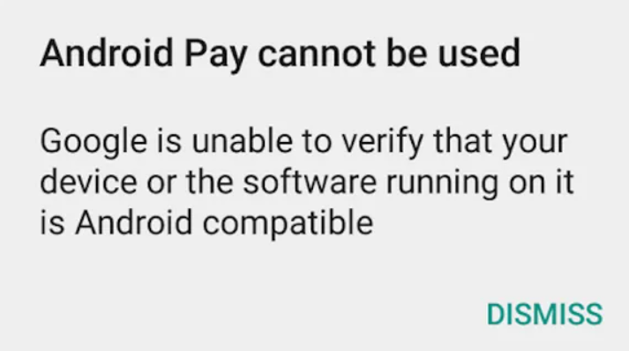
Problem of system root
Google strengthened the security since Android 5
  add SafetyNet security services
Google SafetyNet that monitors the system
  Help apps against security threats
    including device tampering, bad URLs, potentially harmful apps, and fake users.
  Modify the system partition sends up a red flag to apps that try to detect root.
Impacts of SaftyNet when rooting
  Will block certain apps from working if tampering is detected.
  Can’t use Google Pay, banking apps, or Netflix with SuperSU.
  Can’t get any over-the-air (OTA) updates once the system has been modified.
/system changed?
no
yes
Notes:
https://www.xda-developers.com/magisk-vs-supersu/
https://developer.android.com/training/safetynet

Slide 8
Root method 2: Systemless root
a layer/mask added by a modified boot image
Systemless root doesn’t trigger SafetyNet
  it doesn't modify the system partition
  it modifies the boot image
The modifications are virtually overlayed (mask) on top of the original files.
  When something requests a system file, the modified version is sent in its place.
  But since all the system files are intact, SafetyNet can be tricked into thinking everything is normal.
  Google Pay, banking apps, or Netflix can still work on a rooted phone.
return
check

Slide 9

Systemless root: Magisk
Systemless root is what you need
  Unless you can build Android for your phone
  However, it doesn’t work on devices with locked OEM/bootloaders by default (there are workaround)
Magisk is the best magic mask to alter the system.
  patch boot.img
  Open source

Slide 10
Magisk and Magisk Manager
Magisk Manager will control all the rooting privileges and the installations from the Android device.
Magisk Manager is also a repository for modules.
  These modules are installable mods that can do really cool things.
  Some of the best mods include Active Edge customizations (squeeze your phone to launch Google Assistant ), emoji replacements, RAM management fixes, Camera2API enabler, and a bunch more.
Note: Magisk v22.0 and Magisk Manager have been merged

Slide 11
ROMs/Android OS images

Slide 12
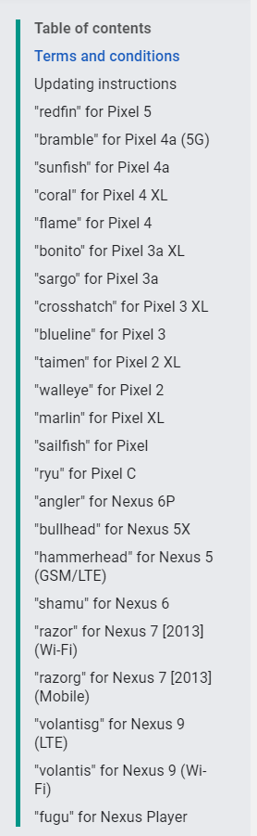
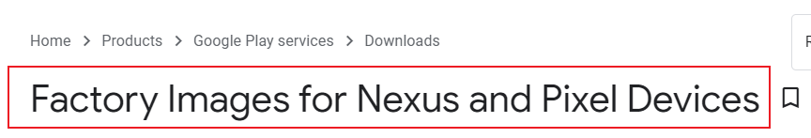
What is ROM, stock ROM, custom ROM?
ROM (Read-Only-Memory)
  Often refers to a chip on the motherboard.
  A firmware can flashed to a ROM
  now refer to an Android OS image, like Windows OS disk image
Installing/Flash ROM
  Erasing/overwriting old Android OS with new ones to alter the behaviour of Android and the device.
Stock ROM
  is a factory image (the ROM that's on the phone when it leaves the factory)
  sometimes you can download a stock ROM from the phone's manufacturer
https://developers.google.com/android/images
https://androidmtk.com/download-samsung-stock-rom

Slide 13
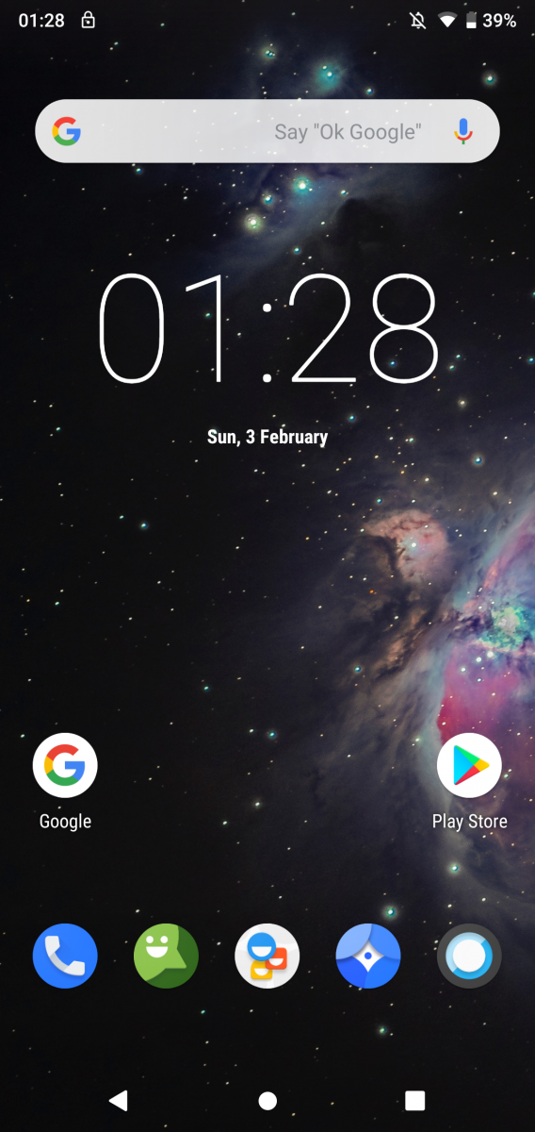
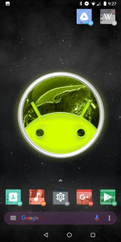
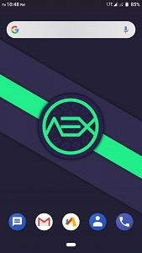
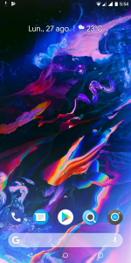
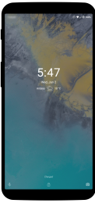
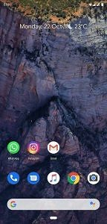
Custom ROM
A modification of a pure distribution of Android OS
  by manufacturers, carriers, or other developers
Changes include
  improve performance
  change home screens
  change background services
  modify default software
You have to root devices
  to install custom ROMs
You have to unlock bootloader
  to root devices
AOSP Extended
LineageOS
OmniROM
Paranoid Android
Remix OS
Pixel Experience
Notes:
https://www.xda-developers.com/the-most-popular-custom-roms-on-xda/

Slide 14
Booting Modes

Slide 15
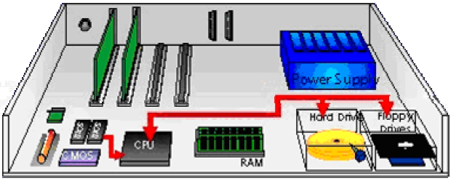
Bootloader
Normal booting
Power on
BIOS/UEFI
Bootloader
Kernel
Windows OS
Master Boot Record
change the device to boot from
Android OS
Android Bootloader
can be locked by manufactory or operator
Notes:
https://source.android.com/devices/bootloader#:~:text=A%20bootloader%20is%20a%20vendor,binding%20its%20root%20of%20trust.

Slide 16
Power on => secure boot ROM
What is secure boot ROM
  a very small program baked-in to the processor
Security functions
  verifies the next component’s integrity, e.g., public/private key scheme
  ensures the next component it loads is trusted, verified software.
loading function
  load Android bootloader
  bootloader is signed with the phone manufacturer’s private key
Notes:
https://www.sitepoint.com/things-know-android-boot-recovery-images/

Slide 17
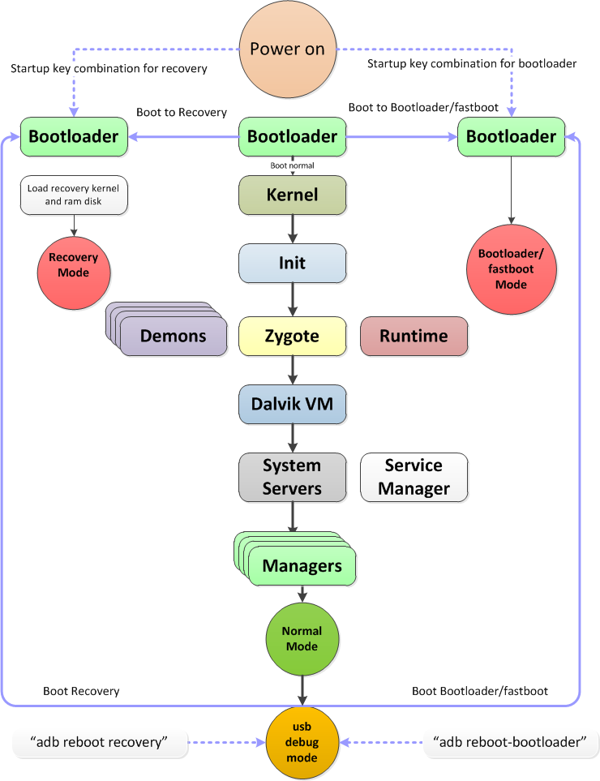
Android Bootloader
https://tektab.com/2015/10/31/android-bootloaderfastboot-mode-and-recovery-mode-explained/
Decides what mode to load
  if is not locked (via security exploit, or manufactory allows)
USB debug mode
  After normal boot (or system boot)
Recovery model =PC recovery
Bootloader model (download/fastboot/flash)
  provide an interface for the user to interact with
  allow to flash new images to partitions, e.g., system, radio, recovery, etc.
Notes:
https://source.android.com/devices/bootloader#:~:text=A%20bootloader%20is%20a%20vendor,binding%20its%20root%20of%20trust.
https://www.quora.com/What-is-the-difference-between-the-BIOS-and-a-boot-loader

Slide 18
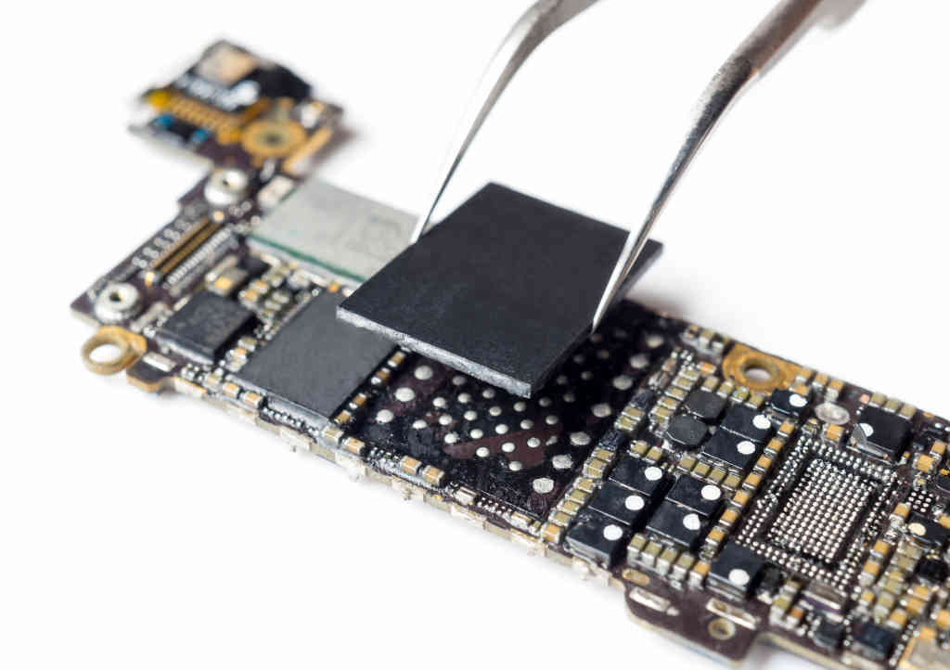
Android normal boot (1)
Load a boot image from non-volatile memory (usually NAND flash, similar to SSD but smaller) into volatile memory (RAM) and run it.
Boot image is located on the same SSD on device as rest of Android OS
  start executing code from the start of the first partition of SSD

Slide 19
Android normal boot (2)
Responsible for bringing up the kernel on a device.
  a vendor-proprietary image
Serves as a security checkpoint
  Initialize the Trusted Execution Environment
  Verifies the integrity of the boot and recovery partitions before moving execution to the kernel, and displays boot state warnings
Some device manufacturers create multipart bootloaders and then combine them into a single bootloader.img file;
  at flash time, the bootloader extracts and flashes all individual bootloaders
Normal boot leads to USB debug mode
  then we can use Android Debug Bridge (adb)
Notes:
https://source.android.com/devices/bootloader#:~:text=A%20bootloader%20is%20a%20vendor,binding%20its%20root%20of%20trust.

Slide 20
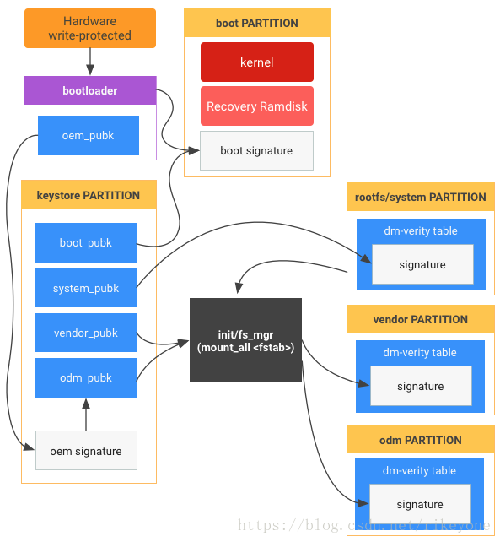
Bootloader operations in details (optional)
The bootloader loads first and initializes memory.
  If A/B updates are used, the bootloader determines the current slot to boot. (Boot from C: or D: in Windows?)
The bootloader determines if recovery mode should be booted.
The bootloader loads the boot image/partition, which contains the kernel and ramdisk images.
The bootloader loads the kernel into memory as a self-executable compressed binary. The kernel then decompresses itself and starts executing into memory.
The bootloader loads init, either from the ramdisk partition (on older devices) or from the system partition (on newer devices).
From the system partition, init launches and mounts all other partitions (such as vendor, oem, and odm), and then starts executing code to start the device.
Notes:
https://edk2-docs.gitbook.io/understanding-the-uefi-secure-boot-chain/additional_secure_boot_chain_implementations/android_verified_boot

Slide 21
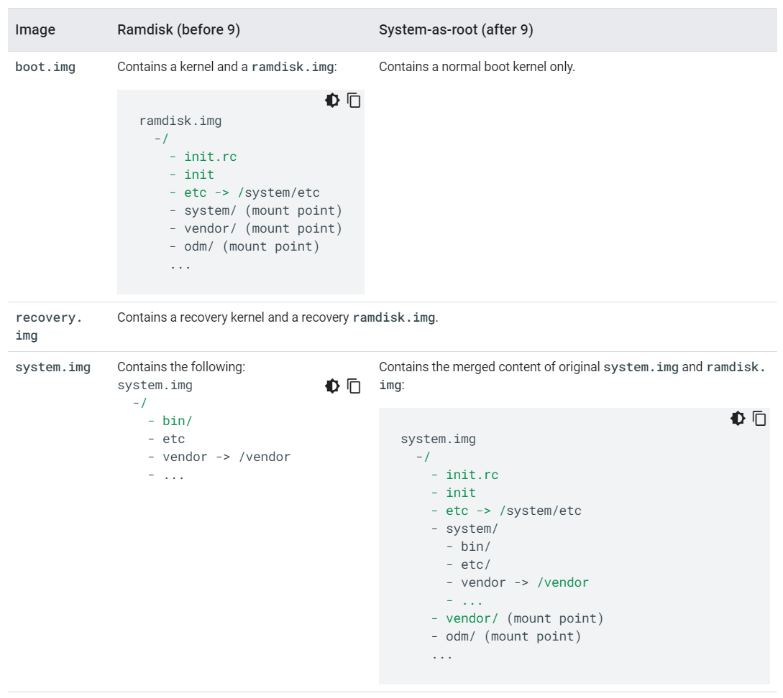
image partition differences for non-A/B devices before and after Android 9
ramdisk.img only contains /init and a few config files. It is used to start init which will mount the rest of the system images properly and run the init procedure.
Notes:
https://source.android.com/devices/bootloader/partitions/system-as-root

Slide 22
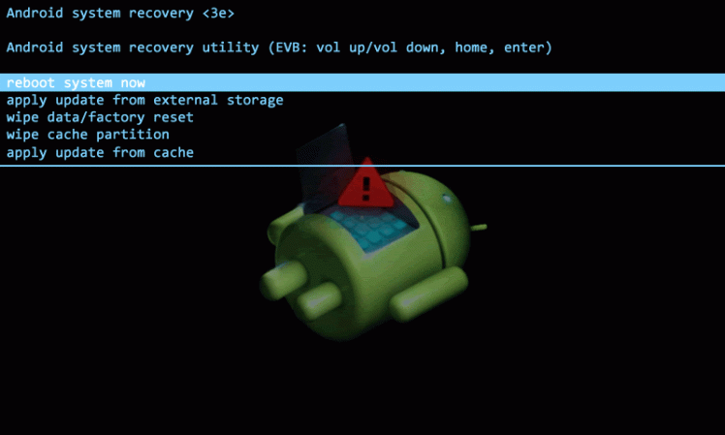
Android boot to recovery model
Recovery software
  used to restore the device to factory default settings,
  update its operating system, and
  perform other diagnostic tasks
  pressing device-specific buttons or adb after normal boot
Stock Recovery
  a recovery environment preinstalled in all Android devices
Method to boot to the recovery system
  pressing device-specific buttons
  use adb command that boots your device to recovery mode (see next slide for adb).
Notes:
https://techratst.wordpress.com/2016/08/03/android-custom-recovery-explained/

Slide 23
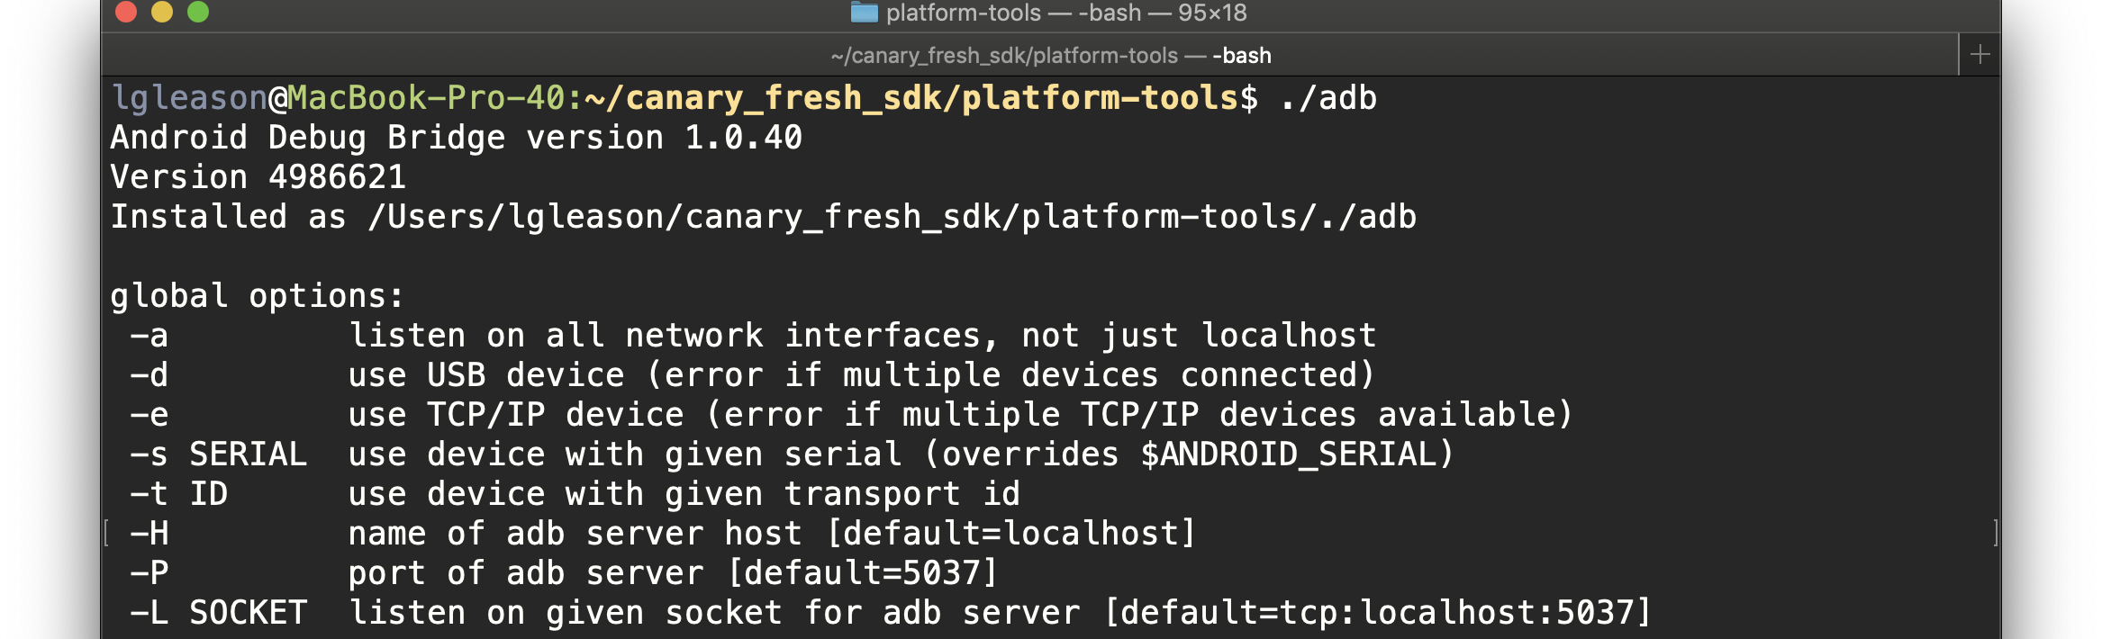
Android Debug Bridge (adb)
//test the connectivity
adb devices
//get into recovery mode
adb reboot recovery
//get into fastboot mode
adb reboot-bootloader
adb is a versatile command-line tool that lets you communicate with a device.
adb facilitates a variety of device actions
  installing and debugging apps
adb provides access to a Unix shell that you can use to run a variety of commands on a device.
  e.g., fastboot, manipulate the flash partitions
adb is included in the Android SDK Platform-Tools package
Notes:
https://developer.android.com/studio/command-line/adb#:~:text=Android%20Debug%20Bridge%20(adb)%20is,of%20commands%20on%20a%20device.
https://www.raywenderlich.com/621437-android-debug-bridge-adb-beyond-the-basics

Slide 24
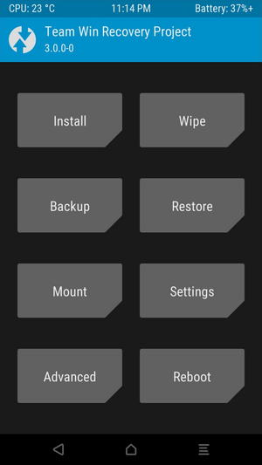
Customize Recovery
Problems of stock recovery
  limited functions, can not install third-party ROMs
A custom recovery
  is a third-party recovery software.
Flashing custom recovery software to your device means
  replaces the stock recovery with a third-party, customized recovery environment
Popular Customize Recovery software
  Team Win Recovery Project (TWRP)

Slide 25
What is Team Win Recovery Project (TWRP)?
TWRP is an open-source Customize Recovery project.
  allows users to install third-party firmware (similar custom BIOS)
  can back up the current system which are functions often unsupported by stock recovery images
  provides a touchscreen-enabled interface
Often installed before flashing, installing, or rooting Android devices
  Some custom ROMs come with TWRP as the default recovery image.
Install TWRP
  downloading a version made specifically for the device, and then
  using a tool such as fastboot, Odin.
Notes:
https://twrp.me/about/
https://en.wikipedia.org/wiki/Team_Win_Recovery_Project

Slide 26
Android boot to Fastboot mode
Fastboot is a program you can run on a computer to communicate with it.
  used to manipulate the flash partitions of the Android developer phone
  can unlock bootloaders
  can boot the phone using a kernel image or root filesystem image which reside on the host machine rather than in the phone flash.
Fastboot is three different things with the same name
  A protocol for communication between your phone hardware and a computer,
  software that runs on the phone when in fastboot mode, and
  the executable file on the computer you use to make them talk to each other.
Notes:
https://elinux.org/Android_Fastboot

Slide 27
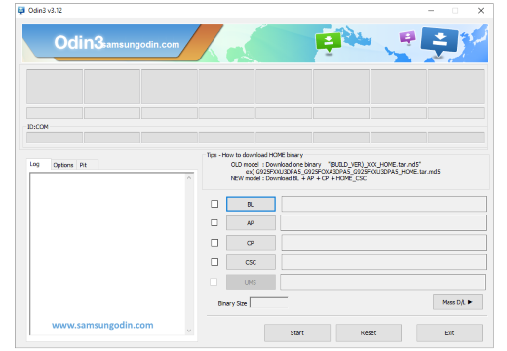
Odin (firmware flashing software)
Odin is a utility software developed and used by Samsung internally.
Key features
  Flash Stock ROM
  Flash Custom ROM
  Flash Recovery File (TWRP)
  Flash Kernels ( .tar/.zip/.img)
  Flash Root Package (MD5 and .tar files)
Notes:
https://samsungodin.com/

Slide 28
Steps to root Android
Using adb, Fastboot, and Magisk
https://www.youtube.com/watch?v=sPvnmgon89U
Notes:
https://www.youtube.com/watch?v=sPvnmgon89U
https://maowdroid.squabbi.com/2020/how-to-root-a-google-pixel-on-android-11/#htoc-f

Slide 29
Four Steps
Unlocking OEM – Turning on a switch that allows us to run “fastboot” commands to unlock the bootloader
Unlocking Bootloader – That allows us to install custom recovery on android device.
Installing Custom Recovery (like TWRP) – Custom Recovery allows us to flash third-party images, which the default recovery doesn’t allow (for example Magisk, Viper4android etc.).
Flashing Magisk – Magisk is a suite of open-source tools for customizing fundamental parts of Android which includes “root”.

Slide 30
What is OEM unlocking?
Manufacturers of the device prevent users from accidentally messing up their device.
  using a software switch (OEM lock) to lock bootloader
  using a bootloader lock to lock fastboot/recovery models
Other differences between OEM and bootloader locks
  has to turn off OEM unlock first
    then unlock bootloader
  Factory reset doesn’t have the switch setting
In some devices, you may not find the OEM unlock option. In that case, just proceed with unlocking bootloader.
  fix the missing OEM Unlock button
Notes:
https://www.xda-developers.com/fix-missing-oem-unlock-samsung-galaxy-s9-samsung-galaxy-s8-samsung-galaxy-note-8/

Slide 31
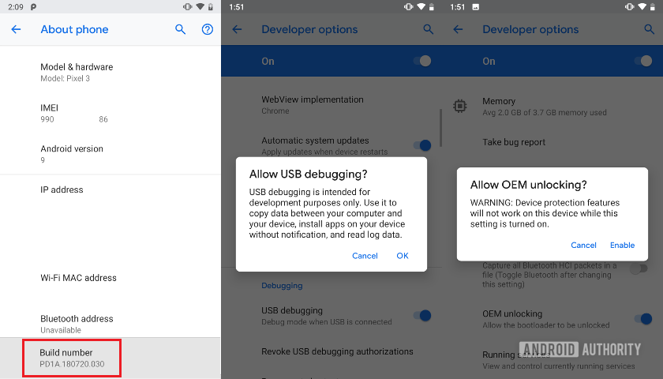
Enable OEM unlocking
Settings > System> About phone and tapping on Build number seven times.
Settings > System> Developer options, check the box next to USB debugging and OEM Unlocking
Notes:
https://www.androidauthority.com/unlock-pixel-3-bootloader-915961/

Slide 32
Prepare unlock the bootloader
What is ADB and Fastboot?
Download Required Software
Install software
Connect to device
Boot to Fastboot mode
Unlock the bootloader

Slide 33
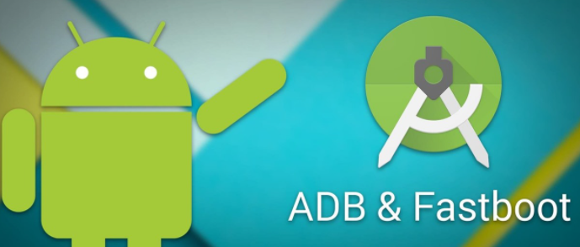
What is ADB and Fastboot?
ADB and Fastboot are utilities that unlock access to the Android system while your phone is connected to a desktop computer via a USB cable.
Normally use ADB when Android is running.
  It enables you to access system folders, or tweak hidden settings, which are otherwise off-limits to users.
  can copy system files to and from the device using ADB, and there's also a sideload function that can be used to install system updates.
Fastboot works when Android device is booted into "Fastboot mode"
  enables to access all device's partitions, include Android system, data partition, the boot partition
Notes:
https://android.gadgethacks.com/how-to/android-basics-install-adb-fastboot-mac-linux-windows-0164225/

Slide 34


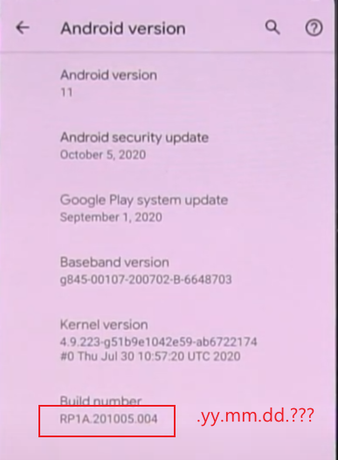
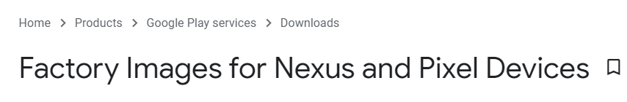
Download Required Software
Google USB Driver
SDK Platform Tools
  ADB and Fastboot
Google Factory Image
Check Android build

Slide 35
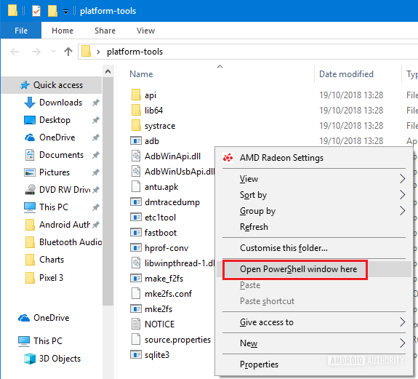
Install software
Install Google USB Drivers
Extract SDK Platform Tools
Open cmd in platform-tools folder
Extract boot.img from Factory Image

Slide 36
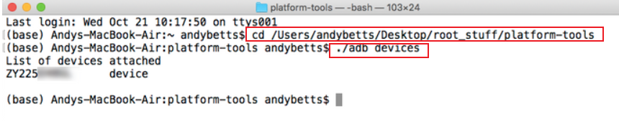
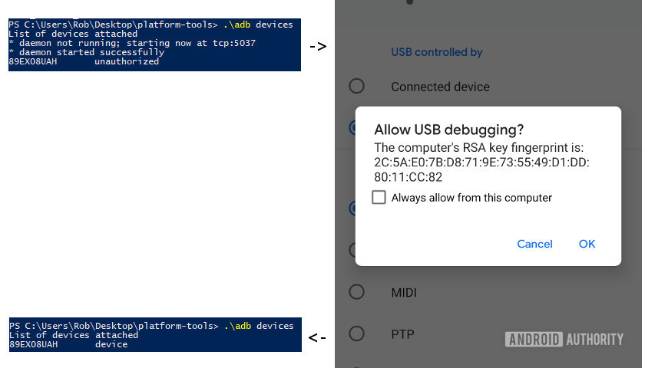
Connect to device
Mac
Windows

Slide 37
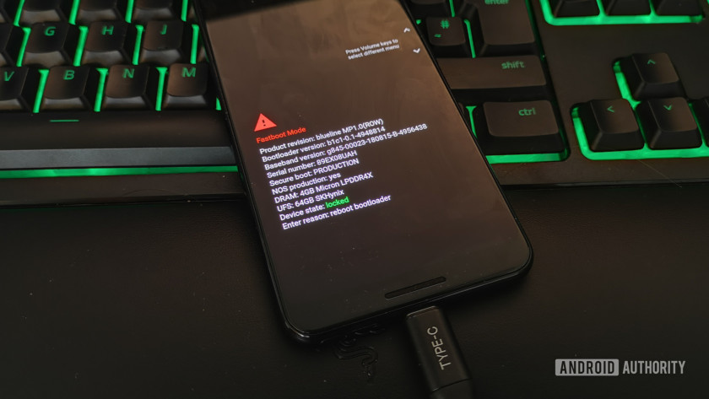
Boot the phone into the bootloader/fastboot using command adb reboot bootloader

Slide 38
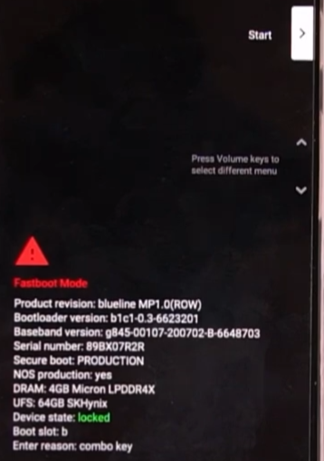
Alternative (manual boot to fastboot )
restart device
when the screen freezes or turns black
  hold the volume down
Notes:
https://tektab.com/2015/10/31/android-bootloaderfastboot-mode-and-recovery-mode-explained/
https://www.makeuseof.com/tag/use-adb-fastboot-android/

Slide 39
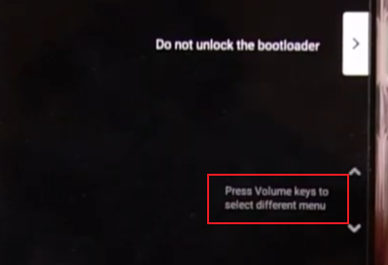
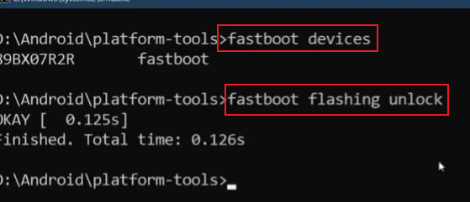
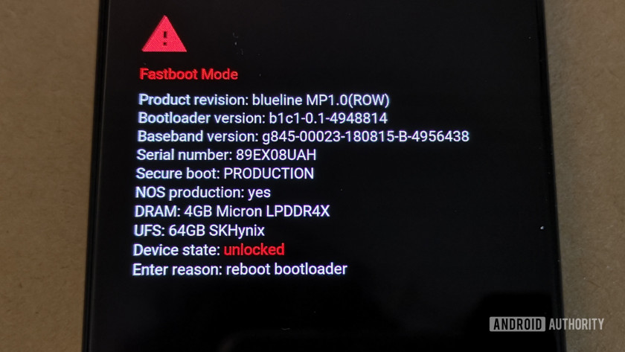
Unlock the bootloader

Slide 40
Reboot using fastboot reboot
Unlock the bootloader usually includes a factory-reset
You may want to backup and retore data
  adb backup –apk –shared –all –f /path/to/backup.adb
  adb restore /path/to/backup.adb

Slide 41
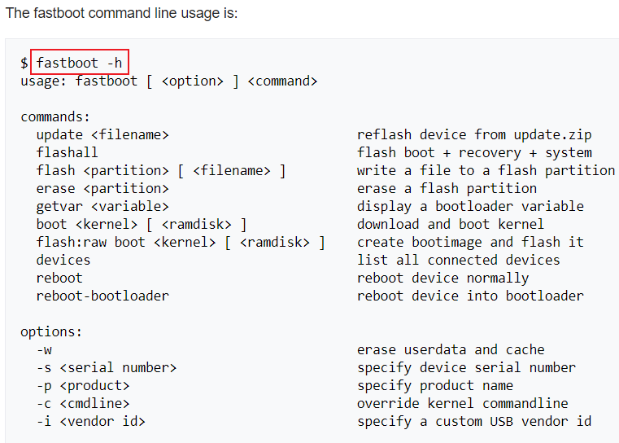

Slide 42
Things You Can Do With ADB and Fastboot
adb pull [path to file] [path to folder] This copies a file stored anywhere on your phone, and saves it to a specified folder on your computer.
adb push [path to file] [path to folder] The opposite of pull; send a file (boot.img) from your desktop to your phone.
adb install [path to file] Installs an APK app on your phone. This is of most use to app developers.
adb uninstall [package name] Uninstalls an app. You need to enter the full package name—usually something along the lines of com.devname.appname—instead of the common app name.
adb sideload [path to update.zip] Sideloads an update.zip firmware update. This one runs via the custom recovery on your phone. Useful if you can't wait for an update to get pushed to your device.

Slide 43
Things You Can Do With ADB and Fastboot
fastboot oem unlock (lollipop-) OR fastboot flashing unlock Which command you should use depends on which version of Android you're running. From Android 6 onwards you also need to enable OEM unlocking in Developer Options. Unlocking the bootloader this way wipes your phone completely.
fastboot flash recovery [filename.img] Installs a custom recovery, such as TWRP, on your device. For ease of use, we suggest changing the recovery filename to something easy—twrp.img, for instance—and moving it into the platform-tools folder.
fastboot -w Completely wipes your phone in preparation for flashing a custom ROM.
fastboot update [path to rom.zip] Flashes a custom ROM. A useful option if you haven't rooted your phone.

Slide 44
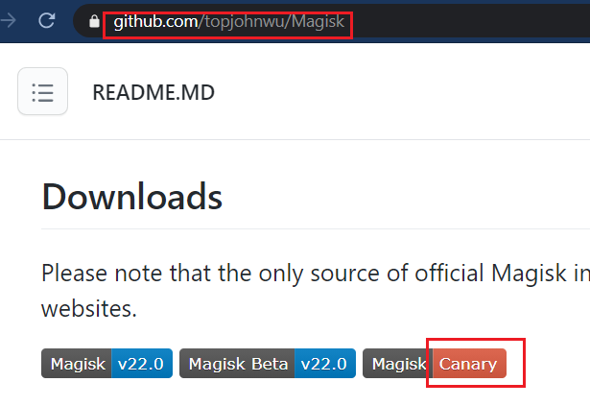
Downloading Magisk Manager
Prepare
  Enable Developer Options
  Disable automatic system updates
  Enable USB debugging
Download Canary version from Pixel 3 device

Slide 45
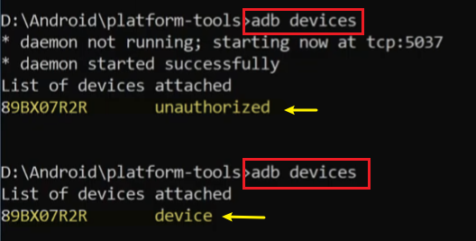
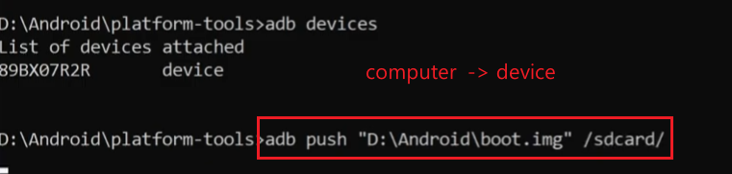
Copy boot.img to your phone

Slide 46
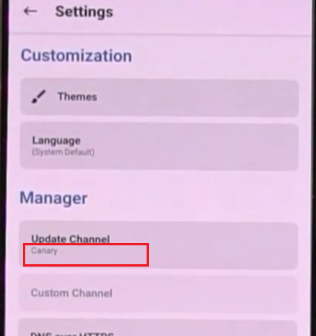
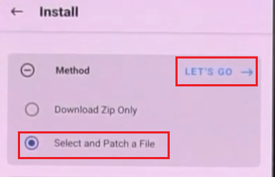
Patch the stock boot.img with Magisk
Open Magisk manager
Patch boot.img
  Flash Magisk onto boot.img
  Save the new version of boot.img to device download folder
  Name of the new image to magisk_patched.img

Slide 47
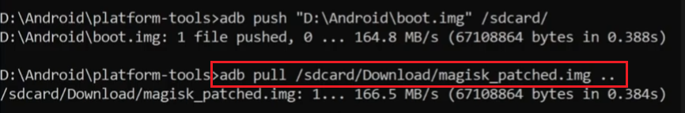
Copy magisk_patched.img back to our PC
Notes:
adb pull /sdcard/Download/magisk_patched.img ..

Slide 48
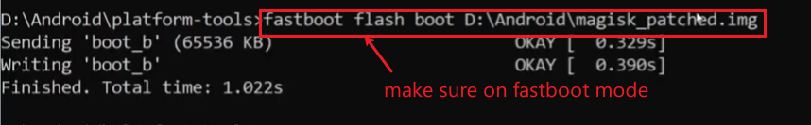
Flash patched image to device boot
flash the patched image to boot partition
now you can boot normally
//changes in Magisk 22.0
//Magisk “Manager” now add a short string of random characters to the end the patched imag
//The old command to pull with the original filename format:
adb pull /sdcard/Download/magisk_patched.img ..
//The NEW command to pull with the updated filename format:
adb pull /sdcard/Download/magisk_patched_Xwvb3.img ..
Notes:
https://maowdroid.squabbi.com/2021/rooting-with-magisk-v22-0-amendment/

Slide 49
Configuring Magisk via Magisk Manager
SafetyNet not passing on stock install
Enable Magisk Hide
Hide Magisk Manager
SafetyNet passes now!

Slide 50
Summary
System Mode
adb push
boot.img moved to SD card
Magisk flashed/patch boot.img
Unlock Fastboot OME/bootloader
install Magisk Manager
Magisk manager
adb pull
fastboot flashing unlock
Patched boot.img extracted to PC
Fastboot Mode
fastboot flashing boot
adb reboot bootloader
Rooted
OEM Unlocked
Notes:
https://android.gadgethacks.com/how-to/complete-guide-flashing-factory-images-android-using-fastboot-0175277/

Slide 51
Steps to root Android
Using odin, TWRP, and Magisk
https://www.youtube.com/watch?v=BOfv0F12gSI
Notes:
https://www.youtube.com/watch?v=BOfv0F12gSI

Slide 52
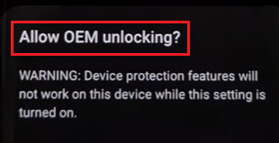


Basic steps (1)
OEM unlocking
Download TWRP and odin
Flash TWRP using odin
  In fastboot mode
Reboot TWRP
  in recovery mode
Download no-verity-opt-encryp
  to bypass OEM security check
  Device Mapper Variety is a security mechanism used by OEMs in their devices to restrict the actions of rootkits so that a device can not be modified.
Install no-verity-opt-encrypt
  using TWRP
Notes:
https://www.androidinfotech.com/no-verity-opt-encrypt-versions/

Slide 53

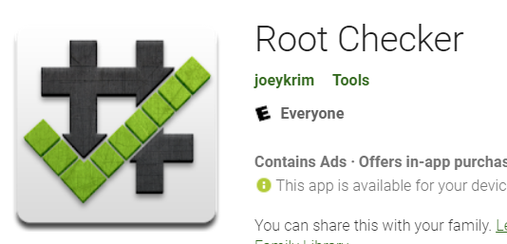
Basic steps (2)
Reboot TWRP
Reboot to System mode
Download Magsik to phone
Install Magisk using TWRP
  in recovery mode
Using rootcheck to check if a device is rooted

Slide 54
Summary
System Mode
Magisk Moved to SD card
no-verity-opt-encrypt installed
TWRP
Recovery Mode
TWRP
Magisk flashed
OEM Unlocked
Recovery/TWRP Image Flashed
Rooted
Fastboot Mode
odbin
Notes:
https://android.gadgethacks.com/how-to/complete-guide-flashing-factory-images-android-using-fastboot-0175277/

