Slide 1
Rhino Hunting – Illegal Possession Investigation
File Recovering
https://www.cfreds.nist.gov/dfrws/Rhino_Hunt.html
Notes:
https://www.youtube.com/watch?v=6G3qm60dfA8&ab_channel=PrashantThombre

Slide 2
Background
The city of New Orleans passed a law in 2004 making possession of nine or more unique rhinoceros images a serious crime.
The network administrator at the University of New Orleans recently alerted police when his instance of RHINOVORE flagged illegal rhino traffic.
Evidence in the case includes
  Three network traces (log files)
  USB key seized from one of the University’s labs (DD image).

Slide 3
Prerequisites

Slide 4
Prerequisites
Kali installation (separate slides)
The Sleuth Kit tutorial (separate slides)
Illegal content warning

Slide 5

Warning illegal content
The lab contains illegal images. Shred all photos after finishing the lab using the following command!
shred -vzn 3 file_to_be_removed
-v: show progress
-z: overwrite with zeros
-n: overwrite n times

Slide 6
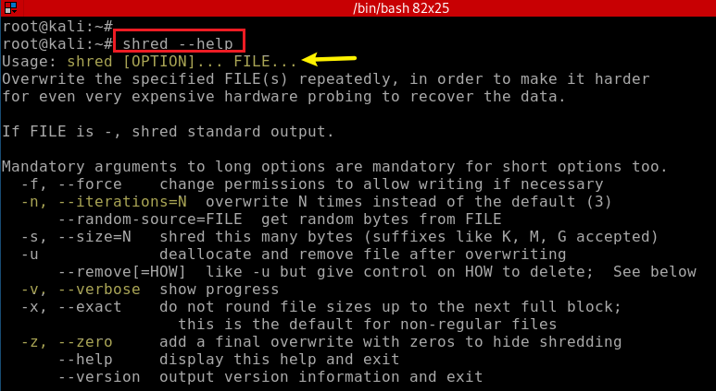
How to shred a text file?
Show shred command help

Slide 7
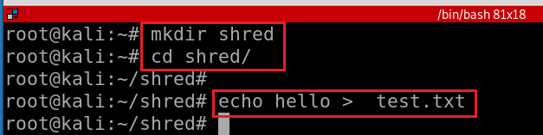
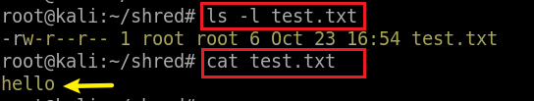
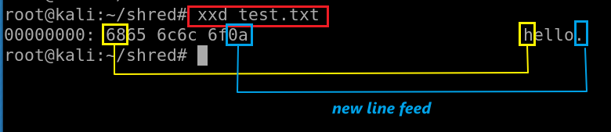
Create a test.txt under the folder
Verify test.txt and note the size of the file is 6
Show test.txt in Hex
Also try xxd –b test.txt
5 characters with LF

Slide 8
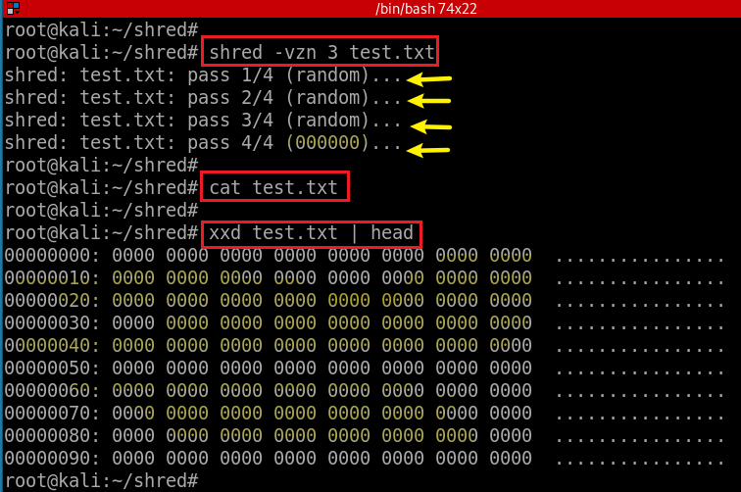
Randomly shift the content of the file three times and overwrite it with zero
shred -vzn 3 file_to_be_removed
-v: show progress
-z: overwrite with zeros
-n: overwrite n times
View the overwritten content (up to 9F)

Slide 9
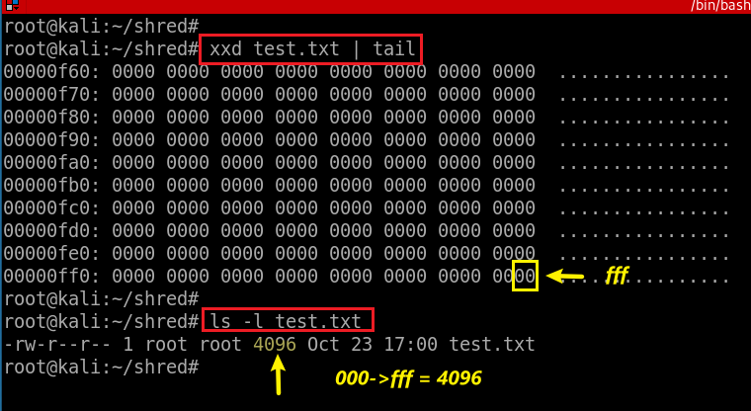
View the overwritten content in Hex
Observe the size of test.txt

Slide 10
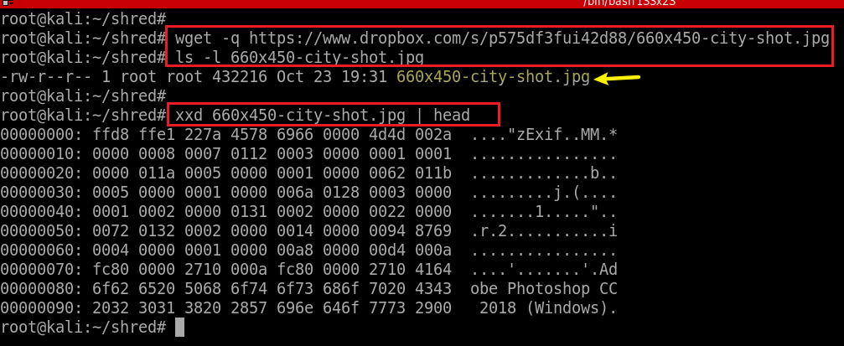
How to shred an image file?
-q: quit mode
Download an image online
Verify the size (432216)
head : output the first 10 lines by default
Show photo in Hex
Notes:
wget- q https://www.dropbox.com/s/p575df3fui42d88/660x450-city-shot.jpg

Slide 11
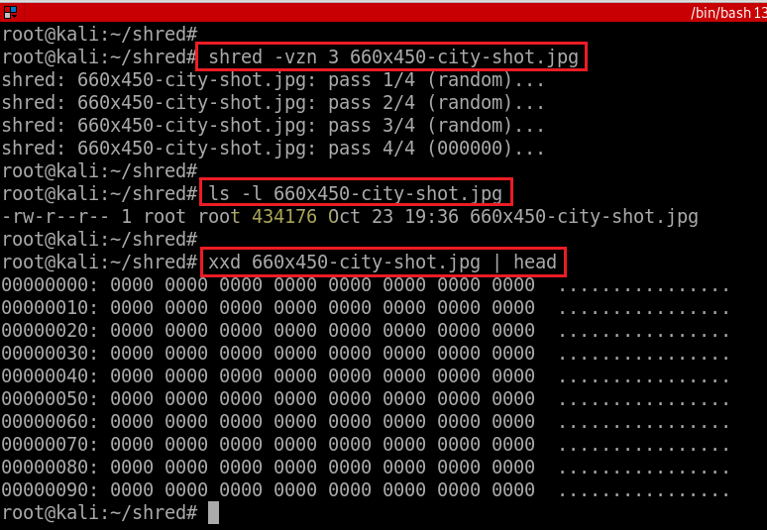
Observe the size

Slide 12
Get A Case Study DD Image

Slide 13
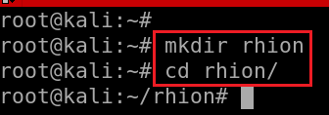
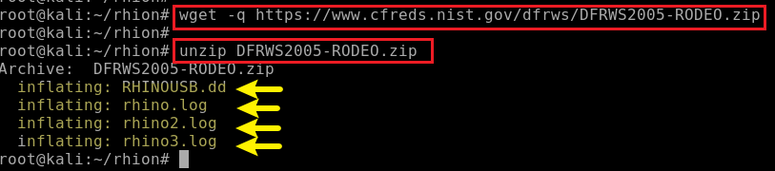
Create a working folder
Download DD image and unzip it
https://raw.githubusercontent.com/frankwxu/digital-forensics-lab/main/Illegal_Possession_Images/USB_image/DFRWS2005-RODEO.zip
Notes:
wget -q https://raw.githubusercontent.com/frankwxu/digital-forensics-lab/main/Illegal_Possession_Images/USB_image/DFRWS2005-RODEO.zip
wget https://www.cfreds.nist.gov/dfrws/DFRWS2005-RODEO.zip (not working)

Slide 14
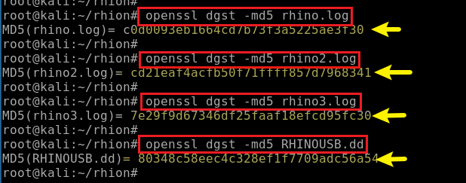
Verify MD5 hashes

Slide 15
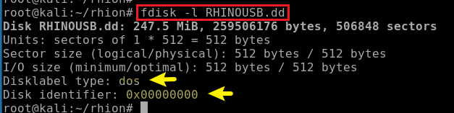
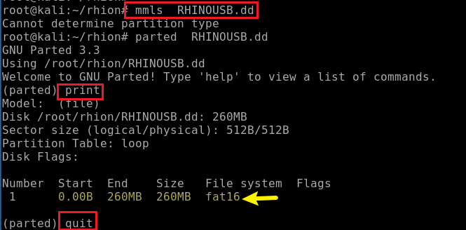
View partitions using fdisk
fdisk command can view, create, delete, change, resize, copy and move partitions on a hard drive
Displays the layout of a disk, including the unallocated spaces.
media management ls (mmls): Can show unallocated sectors so it can be used to search for hidden data

Slide 16
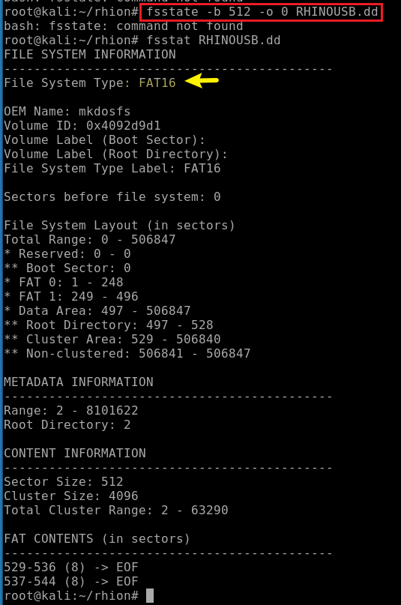
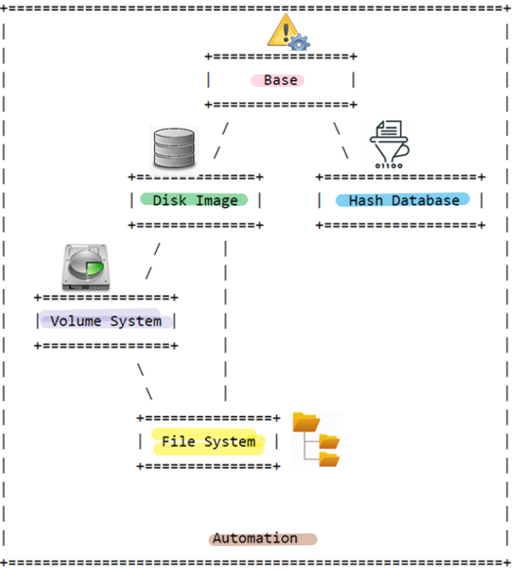
fsstat: Shows file system details and statistics including layout, sizes, and labels.
-b: block size (default is 512)
-o: image offset

Slide 17
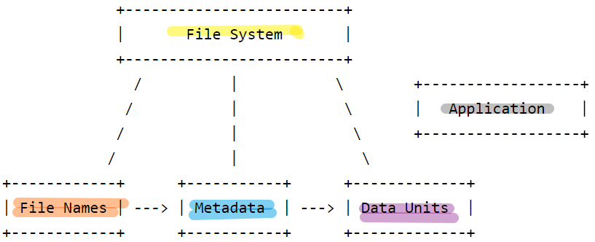
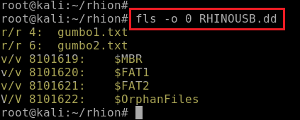
Sleuthkit: List file and directory names in a disk image.
Orphan files are deleted files that still have file metadata in the file system, but that cannot be accessed from the root directory.
r/r 4: gumbo1.txt
File Type
r: Regular file
d: Directory
v: Virtual file/directory (created for convenience)
Metadata Address
Address (inode number) that store file metadata
File Name
Notes:
http://www.sleuthkit.org/sleuthkit/man/
https://people.cs.umass.edu/~liberato/courses/2017-spring-compsci365/assignments/09-istat-fat16/

Slide 18
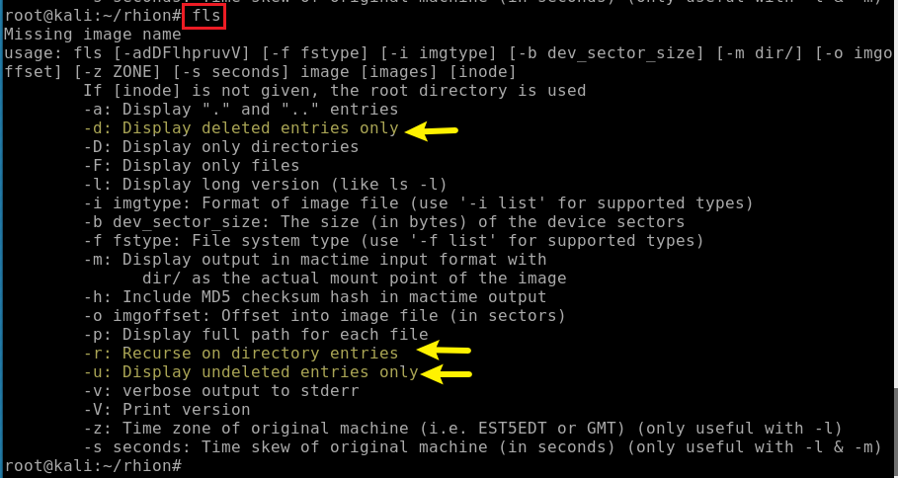

Slide 19


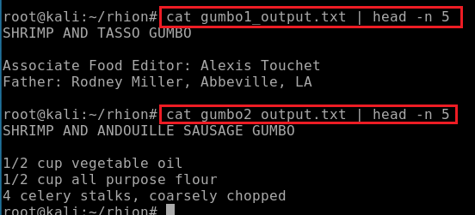
Extract the data units of a file, which is specified by its meta data address (instead of the file name).
Verify the extracted file names
Verify the content of the files
Could not find anything in two .txt files

Slide 20
Recover Rhino Images from DD

Slide 21
What is PhotoRec?
A free and open-source utility software for data recovery
  Shipped with TestDisk
Designed to recover lost files from various digital camera memory
  hard disk and CD-ROM.
Can recover the files with more than 480 file extensions
  possible to add custom file signature to detect less known files
Use data carving techniques
  reassembling computer files from fragments in the absence of filesystem metadata
Compatible with
  DOS (either real or in a Windows 9x DOS box) , Microsoft Windows: NT4, 2000, XP, 2003, 2008, 2016, Vista, Windows 7, Windows 8, Windows 8.1, Windows 10, Linux, FreeBSD, NetBSD, OpenBSD, SunOS, macOS, ARM
Notes:
https://en.wikipedia.org/wiki/PhotoRec

Slide 22
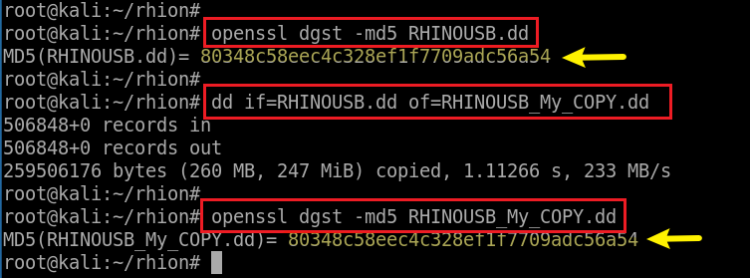
Make a copy of the DD avoid corrupt the original DD image
Verify both DD images are the same
Notes:
https://www.ubuntupit.com/top-15-linux-data-recovery-tools-the-professionals-choice/

Slide 23
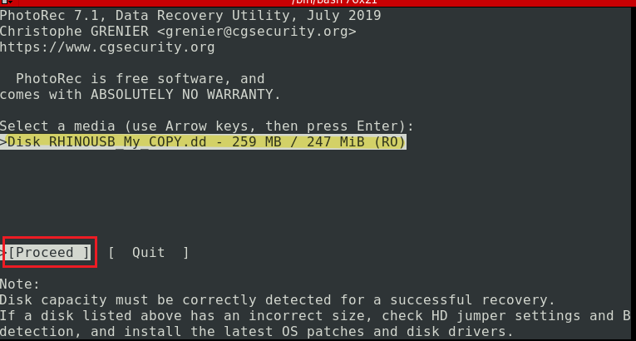
Start recover photos from our DD image
Choose a media
Notes:
photorec RHINOUSB.dd

Slide 24
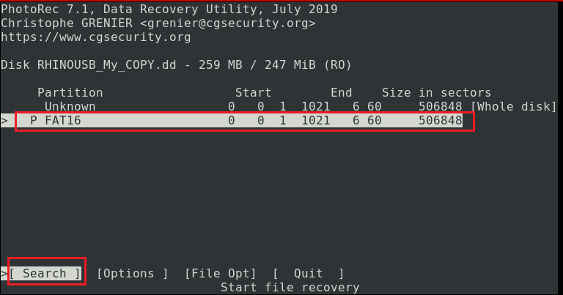
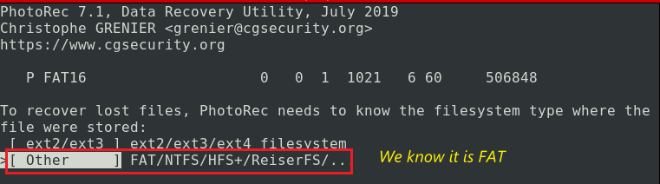
The file system is FAT16
Start searching
It is FAT16

Slide 25
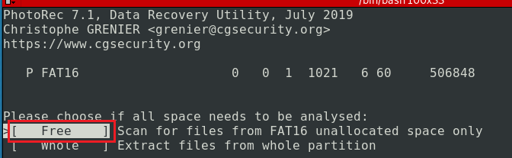
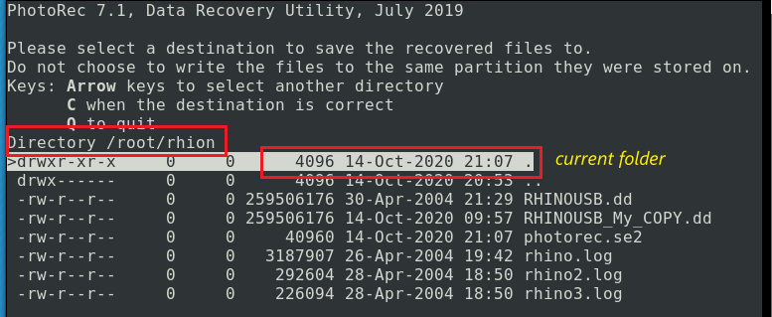
Pick free we know the USB it is not corrupted
Free: : from the unallocated space only (available for ext2/ext3/ext4, FAT12/FAT16/FAT32 and NTFS). With this option only deleted files are recovered.
Whole: from the whole partition (useful if the filesystem is corrupted)
Save recovered files to the current directory

Slide 26
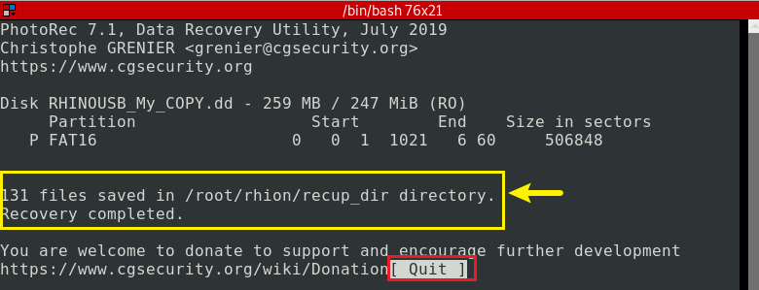
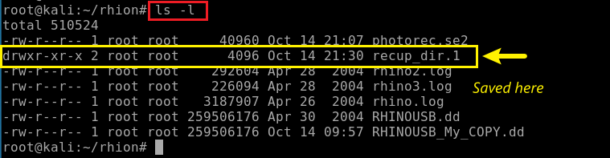
# of files are recovered and saved in a folder
Verify if the folder exsits

Slide 27
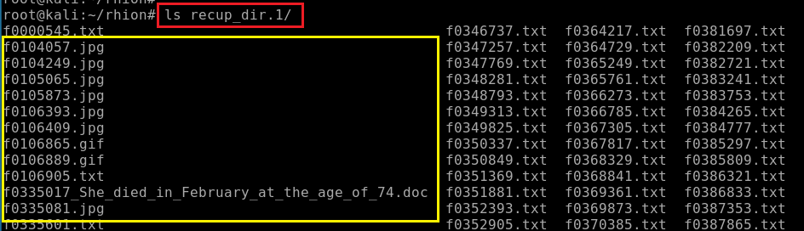
List all recovered files

Slide 28

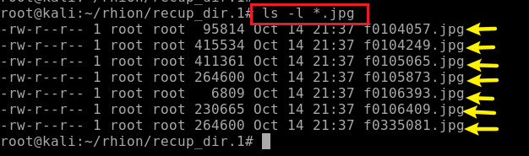
Navigate to the folder where the recovered files were saved
List all .jpg
Show one retrieved .jpg photo

Slide 29
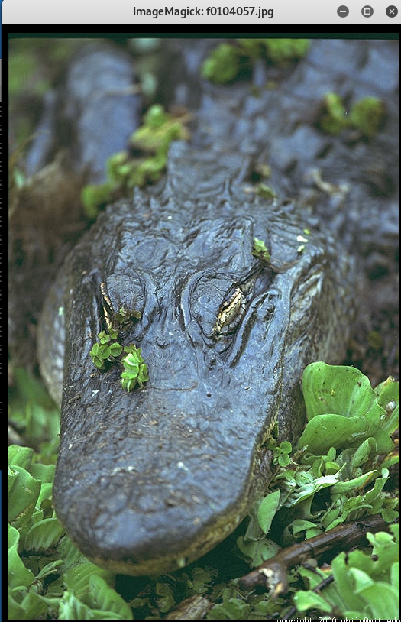

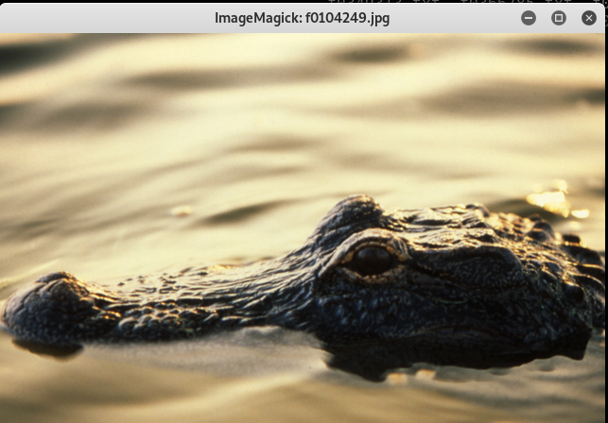
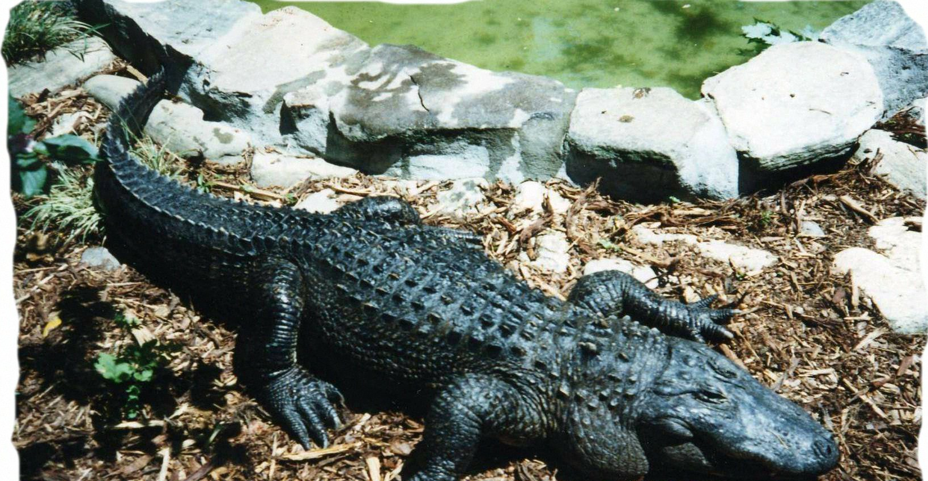
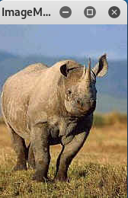
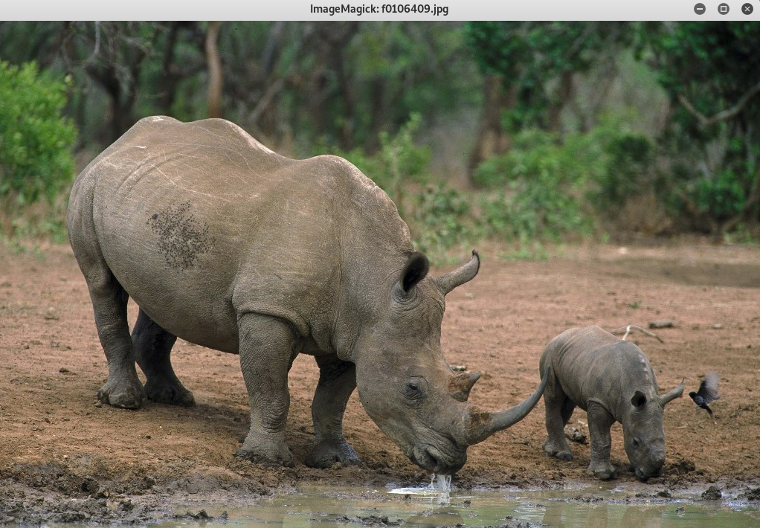
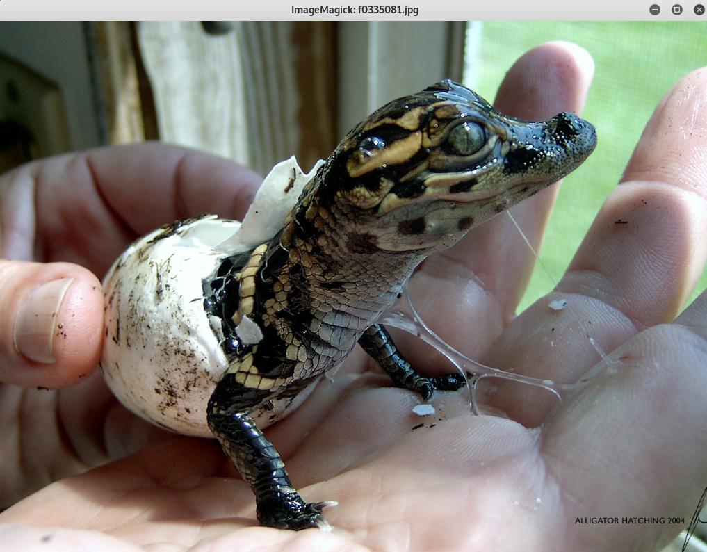


All retrieved .jpg photos
6bd0e9bd4fb4a738f9ca4c351a853281
4d37a1033450b8cc96ffd1564829d321
ee67d8bef72f9b63fa93dc9ea1bb833a
1
2
ca03f2eed3db06a82a8a31b3a3defa24
f1bbcd31cd33badc65ca3d1d781f57fa
ed870202082ea4fd8f5488533a561b35
f1bbcd31cd33badc65ca3d1d781f57fa

Slide 30
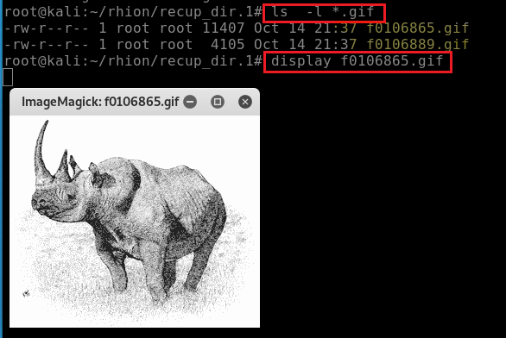
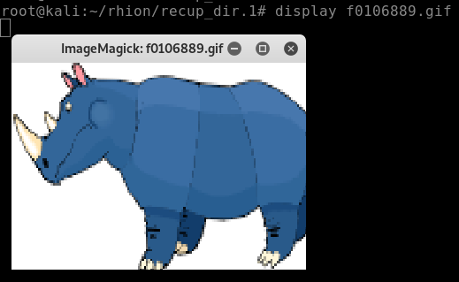
All retrieved.gif photos
4
3
76610b7bdb85e5f65e96df3f7e417a74
d03dc23d4ec39e4d16da3c46d2932d62

Slide 31
Evidence
What evidence help you make conclusion that
  a suspect deleted rhino images?
Four recovered images
  contain rhino images
Images are recovered using tool
  PhotoRec7.1

Slide 32
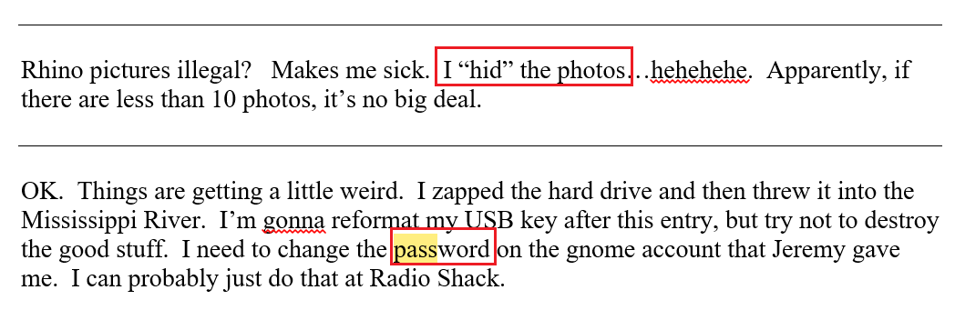
What happened to the hard drive and USB?

Slide 33
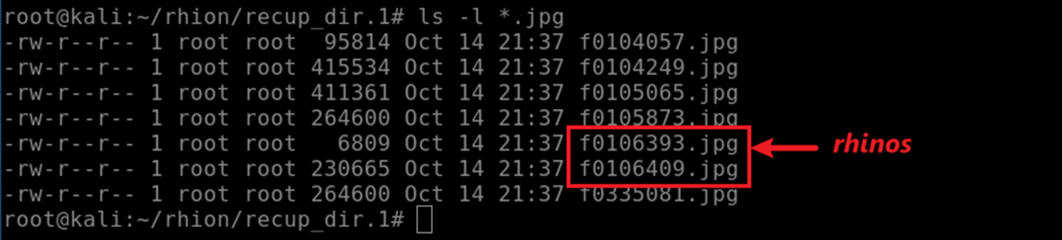

Progress so far
Two rhinos
  7 .jpg (2 rhinos)
  2 .gif (2 rhinos)
May have clues for rest photos
  1 .doc
  124 .txt
We are searching for nine or more unique rhinoceros images. Where are the rest of photos?

