Slide 1


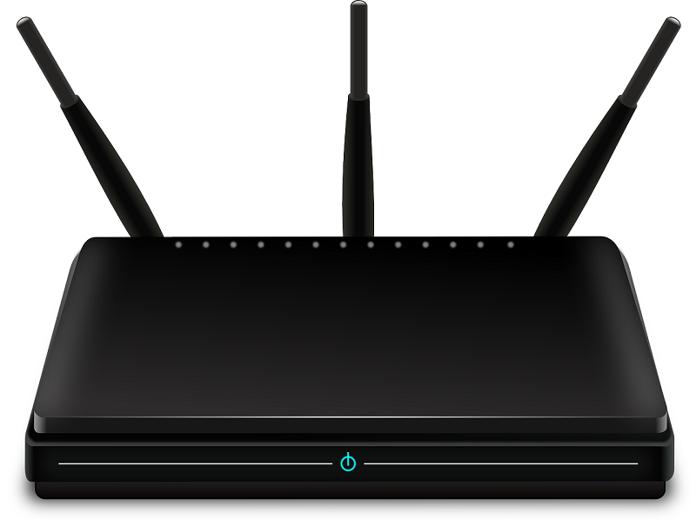

Decrypt Wireless Packets
Traffic files: https://github.com/frankwxu/digital-forensics-lab/tree/main/Illegal_Possession_Images/lab_files/wlan_decrypt
Notes:
https://github.com/ctfs/write-ups-2015/tree/master/codegate-ctf-2015/programming/good-crypto
https://www.mathyvanhoef.com/2015/03/codegate-2015-goodcrypto-advanced-wep.html

Slide 2
Overview
Decrypt traffic
  Find the security key
  Decrypt traffics using a security key
    wlan packets saved in .pcap
  Extract files from packets
Crack wifi password
  IEEE 802.11 and Motivation
  What is Wired Equivalent Privacy?

Slide 3
Decrypt traffics
Date credits: CodeGate General Capture the flag challenge (CTF) 2015

Slide 4
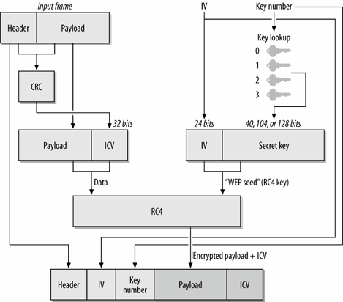





Goal: only use a secret key (IV unknown) to decrypt encrypted payload
Problem with Stream Cipher
Consider two packets with the same IV ⇒ Same keystream b
c1 = p1 ⊕ k; c2 = p2 ⊕ k
  ⇒ c1 ⊕ c2=p1 ⊕ p2
two packets with the same IV
  ⇒ XOR = Difference in plain text
50% chance of using the same IV in 4823 packets.
Recovered ICV matches ⇒ Plain text is correct
Possible to recover all 2²⁴ keystreams in a few hours
Notes:
https://www.cse.wustl.edu/~jain/cse571-09/ftp/l_19wls.pdf

Slide 5


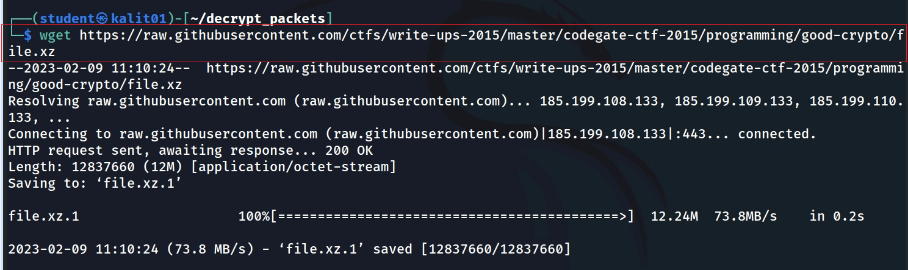
Create a working space
Download a traffic file
Notes:
wget https://raw.githubusercontent.com/ctfs/write-ups-2015/master/codegate-ctf-2015/programming/good-crypto/file.xz

Slide 6
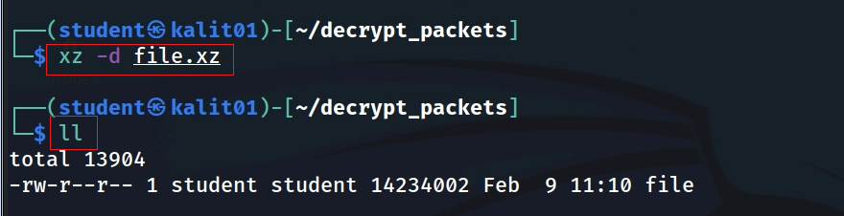
Unzip the file
Capture the flag challenge
CodeGate General CTF 2015

Slide 7
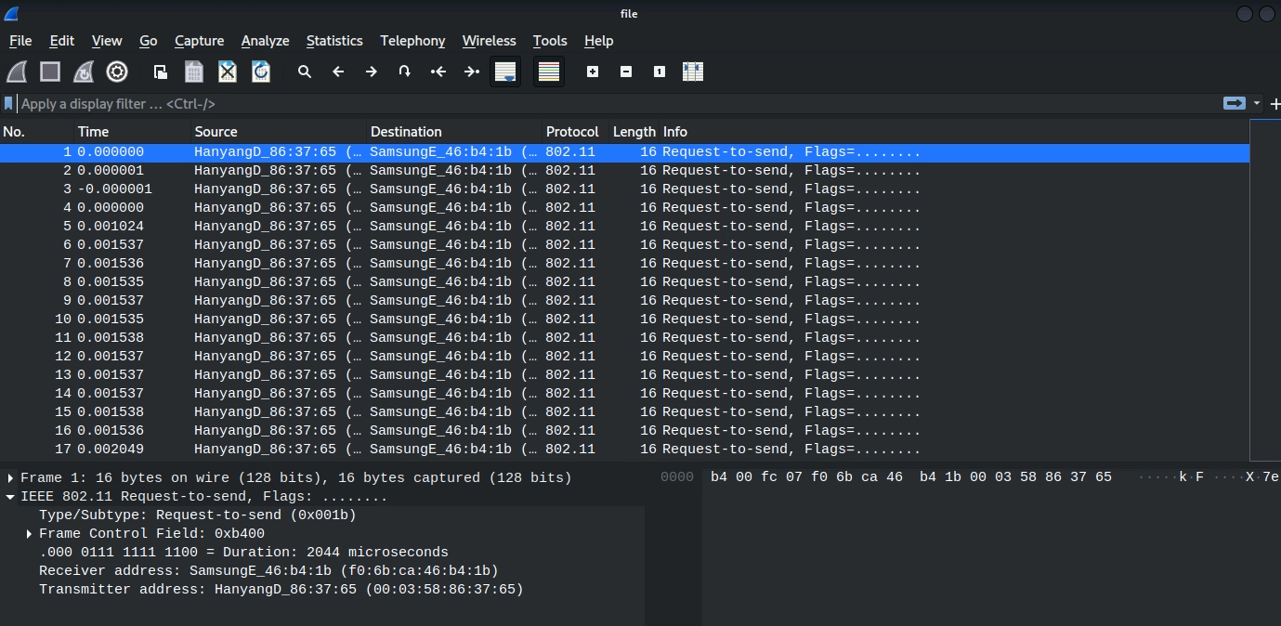
Show the encrypted traffic
Notes:
https://www.vnsecurity.net/ctf%20-%20clgt%20crew/2015/03/16/codegate-good-crypto.html

Slide 8
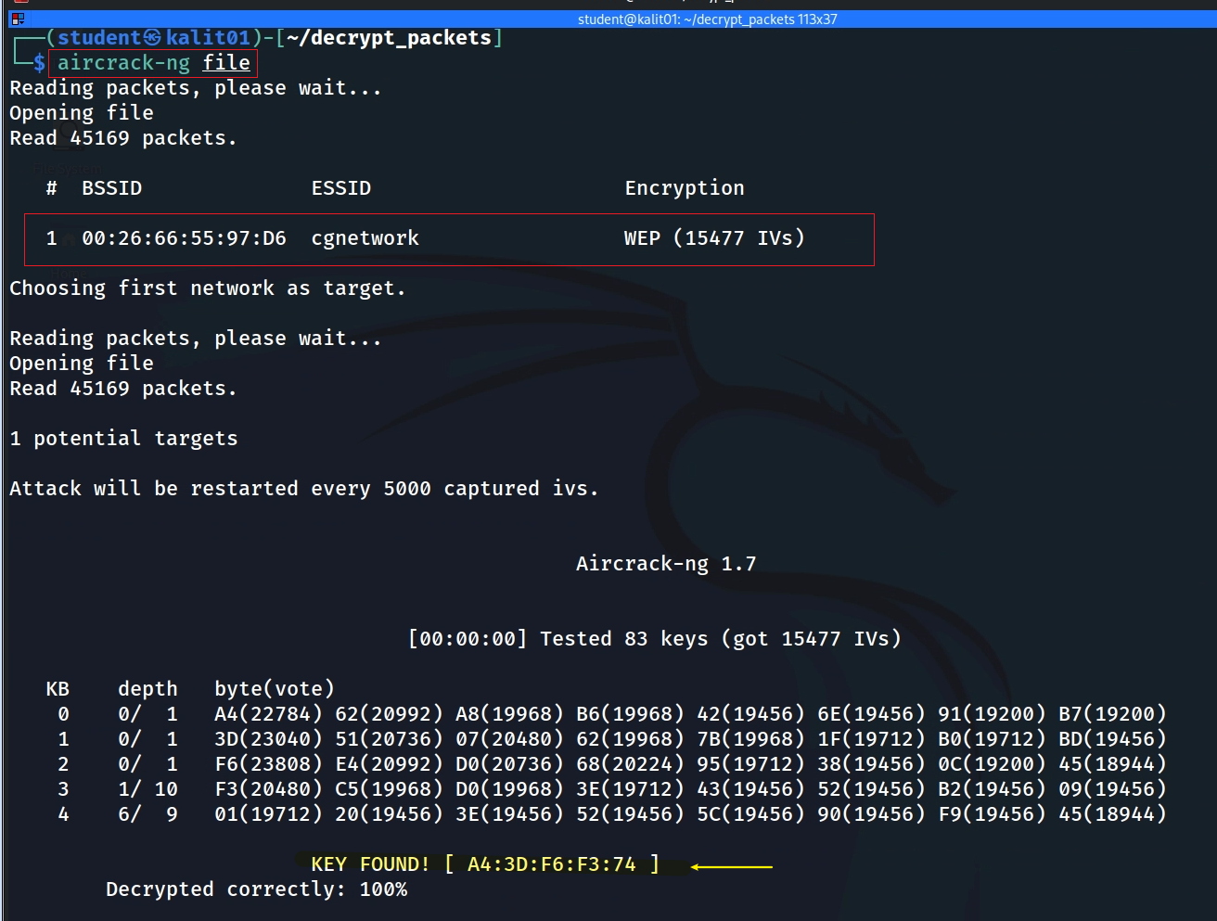
Find key
key length 40 bits
Notes:
sudo apt install aircrack-ng
aircrack-ng file

Slide 9
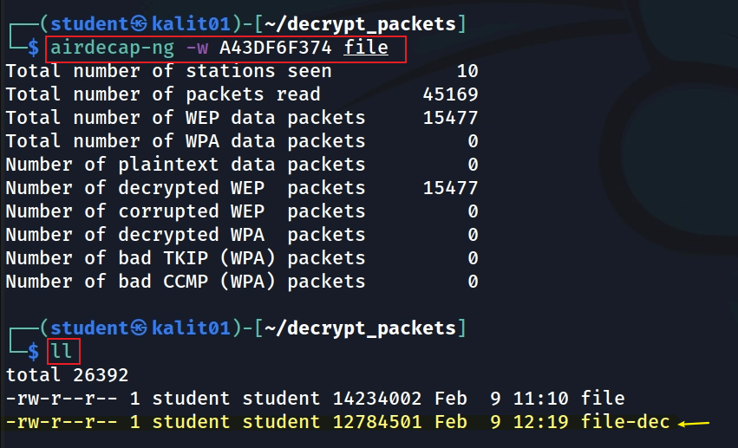
Decrypts traffic with the key
Notes:
airdecap-ng -w A43DF6F374 file

Slide 10

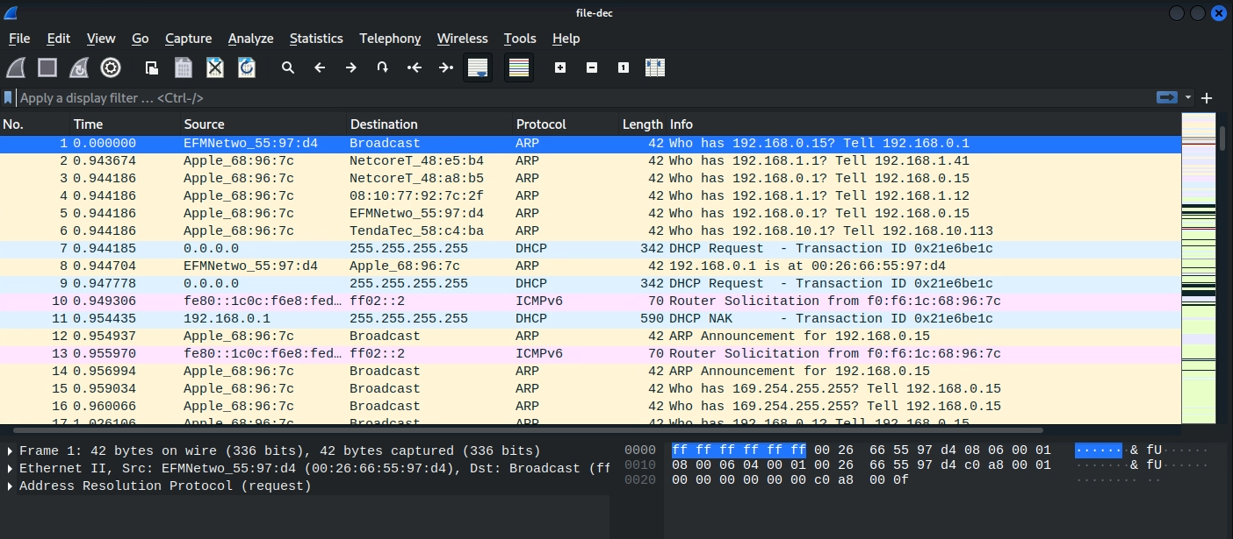

Slide 11
Extract files from packets

Slide 12
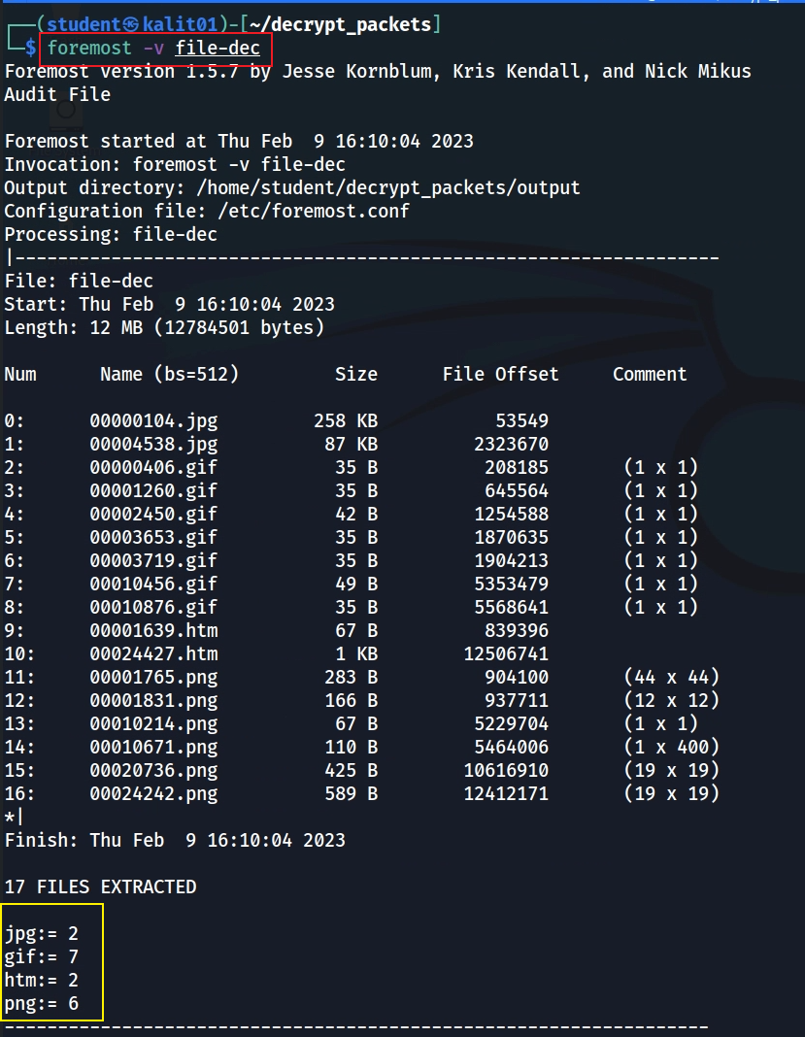
Carving files from traffic
"Foremost" is a popular open-source forensic tool used for data recovery on the Linux operating system

Slide 13
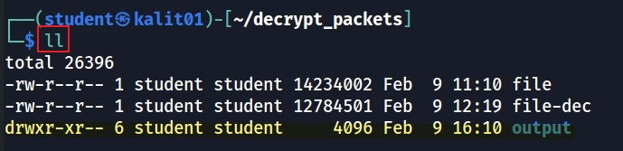

Show extracted files
Notes:
http://www.blackhat.com/presentations/bh-usa-01/TimNewsham/bh-usa-01-Tim-Newsham.ppt

Slide 14
Crack wifi password

Slide 15
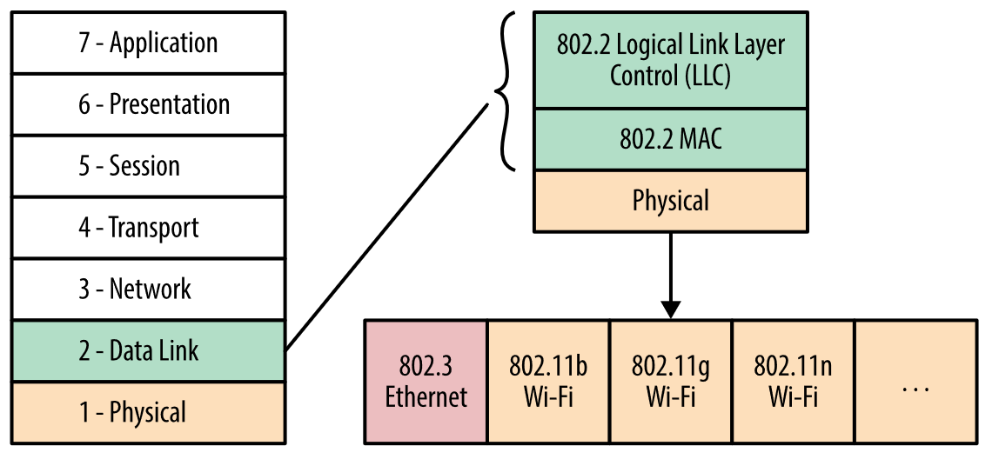
Where does 802.11 fit in the OSI Model?
(Ethernet) and 802.11 (WiFi) data and physical layers
https://hpbn.co/wifi/
Notes:
https://microchipdeveloper.com/wifi:80211-osi

Slide 16
IEEE 802.11
802.11 data frame
Header | Payload | Trailer(ICV)
ICV: Integrity Check Value = cyclic redundancy check (CRC) value
ICV = CRC(Header+ Payload)
802.11 is a set of standards for wireless networking that defines how wireless devices communicate with each other.
The 802.11 standards define the format of data frames, which are the units of data that are transmitted between devices.
There are several types of 802.11 frames, including management frames, control frames, and data frames.
  Management frames: manage the wireless network, such as establishing and maintaining a connection, authenticating devices, and to configure the network.
  Control frames: control the flow of data on the network, such as requesting or acknowledging the transmission of data.
  Data frames: transmit data between devices on the network.

Slide 17
IEEE 802.11 Supports Encryption Protocols
Encryption Protocols
  Wired Equivalent Privacy (WEP),
  Wi-Fi Protected Access (WPA), and
  Wi-Fi Protected Access II (WPA2).
These protocols use various methods to encrypt the data transmitted in 802.11 frames
  symmetric key encryption,
  public key encryption, and
  message authentication codes.
Users can choose to use encryption or not
  depends on the configuration of the network and the security needs of its users.

Slide 18
Wired Equivalent Privacy (WEP)
It is an outdated security protocol used to protect wireless local area networks (WLANs).
It was one of the first security standards developed for wireless networks and was intended to provide a level of security comparable to that of a wired network.
WEP is stream cipher using RC4 to generate a keystream
WEP key length -64/128/256 bits
  128-bit WEP remains one of the most common implementations

Slide 19


RC4 Algorithm
Plaintext
RC4 Keystream Generator
Keystream
RC4 Key
XOR
Ciphertext
RC4 Key
RC4 Keystream Generator
Keystream
XOR
Plaintext

Slide 20
RC4 Keystream Generator
Initialization/key scheduling
  The key is used to initialize a 256-byte state array (S) with the values 0 to 255.
  The state array is then shuffled based on the key.
Keystream generation
  At each step, the generator uses two index variables, i and j, to generate a keystream byte.
    The i-th and j-th elements of the state array are swapped, and
    the sum of i and the j-th element is used to determine the next keystream byte.
  This process is repeated until enough keystream bytes have been generated to encrypt the plaintext.

Slide 21
# Harry Sauers
# rc4.py
# demo of RC4 encryption algorithm
def key_scheduling(key): | def stream_generation(sched):
sched = [i for i in range(0, 256)] | stream = []
 | i = 0
i = 0 | j = 0
for j in range(0, 256): | while True:
i = (i + sched[j] + key[j % len(key)]) % 256 | i = (1 + i) % 256
 | j = (sched[i] + j) % 256
tmp = sched[j]
sched[j] = sched[i] | tmp = sched[j]
sched[i] = tmp | sched[j] = sched[i]
 | sched[i] = tmp
return sched | yield sched[(sched[i] + sched[j]) % 256]
Notes:
https://gist.github.com/hsauers5/491f9dde975f1eaa97103427eda50071

Slide 22
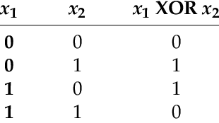

XOR stream cipher
Unencrypted 802.11 data frame
1010 | 1100 | … | … | 1110 | 0101
keystream
1110 | 0100 | … | … | 1000 | 1001
RC4
=
802.11 WEP data frame
0100 | 1000 | … | … | 0110 | 1100

Slide 23



WEP also allows for multiple keys to be stored and used at the same time.
  Specifically, WEP allows for four different keys to be stored simultaneously, and the user can switch between the keys at any time.
This allows for greater flexibility in managing the security of a wireless network.
https://flylib.com/books/en/2.519.1/wep_cryptographic_operations.html

Slide 24
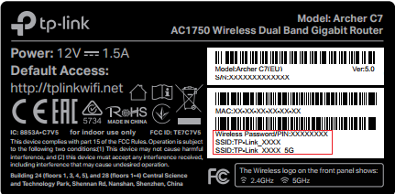

Generated by a cryptographically secure random number generator
Ensure that the same key is not used for multiple transmissions.
64-bit WEP (WEP-40)
Initialization Vector (IV) (24 bits) | Secret Key (40 bits)
Unencrypted 802.11 data frame
Header | Payload | ICV
seed
Keystream
RC4
generated from password
=
802.11 WEP data frame
Header | IV | Key# | Payload | ICV
Multiple keys will be generated, Key# specifies the key that should be used to encrypt and decrypt the data in the frame (8 bits)

Slide 25
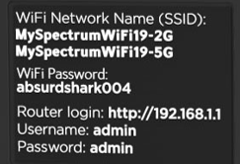
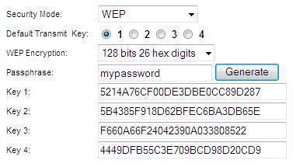
Secret Key Management
128-bit WEP
WEP 104: 13 ASCII characters (0–9, a–z, A–Z)
5 ASCII characters (0–9, a–z, A–Z)
Secret keys are generated with a passphrase/password
  one passphrase generates multiple keys
Multiple keys provide additional security
  if an attacker were to capture and crack one key, other keys would still be in use
Keys are manually distributed
Every device on the network uses one key to encrypt every transmitted packet
  an eavesdropper could intercept the WEP encryption and find the key.
Notes:
https://www.tech-faq.com/wep-key-passphrase.html

Slide 26
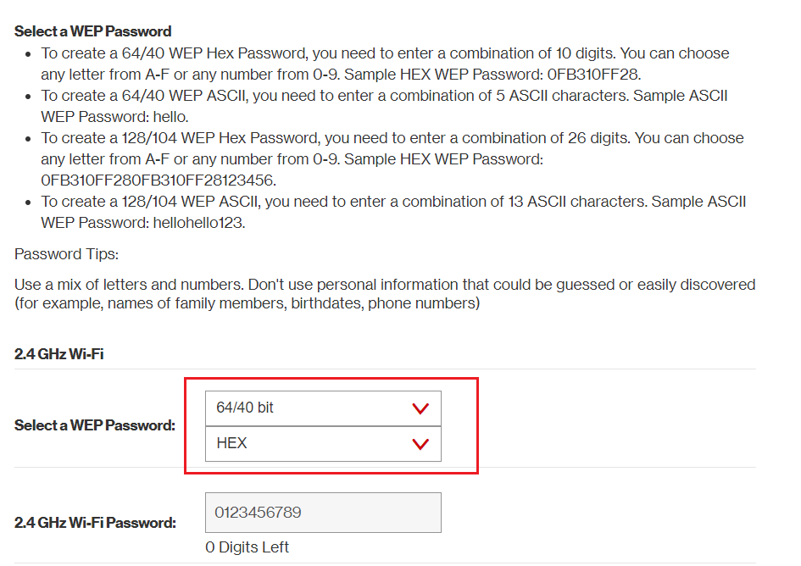

Slide 27
How Are WEP-40 Secret Keys Generated?
32 bits
?
34
a4
a9
27
M
y
P
ee
3d
7b
f7
a
s
s
p
ab
f6
35
59
key 1
h
r
a
s
32-bit PRNG
20 iterations
seed
12
f3
a3
98
a4
3d
f6
f3
74
e
Pseudo Random Number generator (PRNG)
62
74
f3
7f
6a
8e
a3
59
32 bits (little endian)
key 2
. . .
key 3
key 4
Seeding: ASCII string mapped to 32-bits
PRNG: Generate 32-bits key candidates
http://www.blackhat.com/presentations/bh-usa-01/TimNewsham/bh-usa-01-Tim-Newsham.ppt
Notes:
http://alumni.cs.ucr.edu/~nsoracco/tomsnetworking-wepcracking.pdf

Slide 28
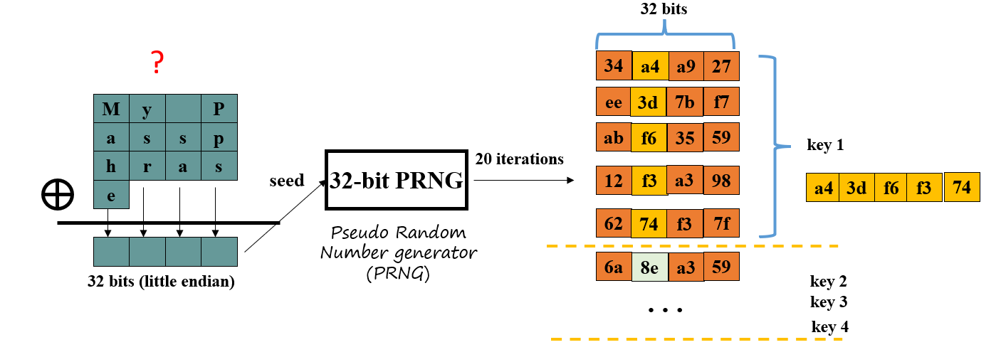



How to find password
40 Bits Security key
Seed
Wifi Password

Slide 29
WEP-40 Secret Keys Generator has a security problem
WEP-40 security key should have 40-bits of entropy
Key entropy is reduced in several ways
  seed entropy reduced
  PRNG entropy reduced

Slide 30
Seeding problem – reduced seed entropy (32-28 bits)
M
y
P
XOR operation guarantees produce four zero bits
  Input is ASCII. High bit of each character is always zero
XOR of these high bits is also zero
  Only seeds 00:00:00:00 through 7f:7f:7f:7f can occur (entropy is reduced to 28 bits =32-4)
a
s
s
p
h
r
a
s
e
a 32-bit seed
M | 0 | 1001101
a | 0 | 1100001
h | 0 | 1101000
e | 0 | 1100101
 | 0

Slide 31
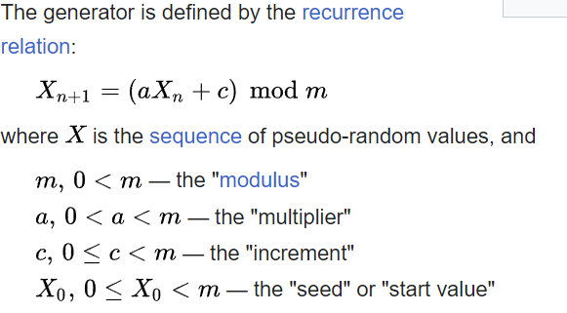
PRNG problem: Reduced PRNG Entropy (32-24 bits)
34
a4
a9
27
PRNG is a Linear congruential generator
ee
3d
7b
f7
ab
f6
35
59
key 1
32-bit PRNG
5 iterations
12
f3
a3
98
a4
3d
f6
f3
74
62
74
f3
7f
m=2²⁴
Why not using m=2³²
Because the most significant byte of the outputs is not used, which is equivalent to generating only 24-bits words at each iteration.
Only seeds 00:00:00:00 through 00:ff:ff:ff (24 bits) may result in unique keys!
https://en.wikipedia.org/wiki/Linear_congruential_generator
Notes:
https://en.wikipedia.org/wiki/Linear_congruential_generator

Slide 32



Find a seed
a4
3d
?
32-bit PRNG
5 iterations
x₀=seed (We want to figure it out)
a=0x000343fd (how do we know, next slide)
c=0x269ec3 (how do we know)
m=0x00FFFFFF (2²⁴)
f6
f3
74
we know
Approach: Generate 5 candidate keys, x₁, x₂, x₃, x₄, x₅, their second most significant bytes must match the secret keys. The x1 is the seed

Slide 33
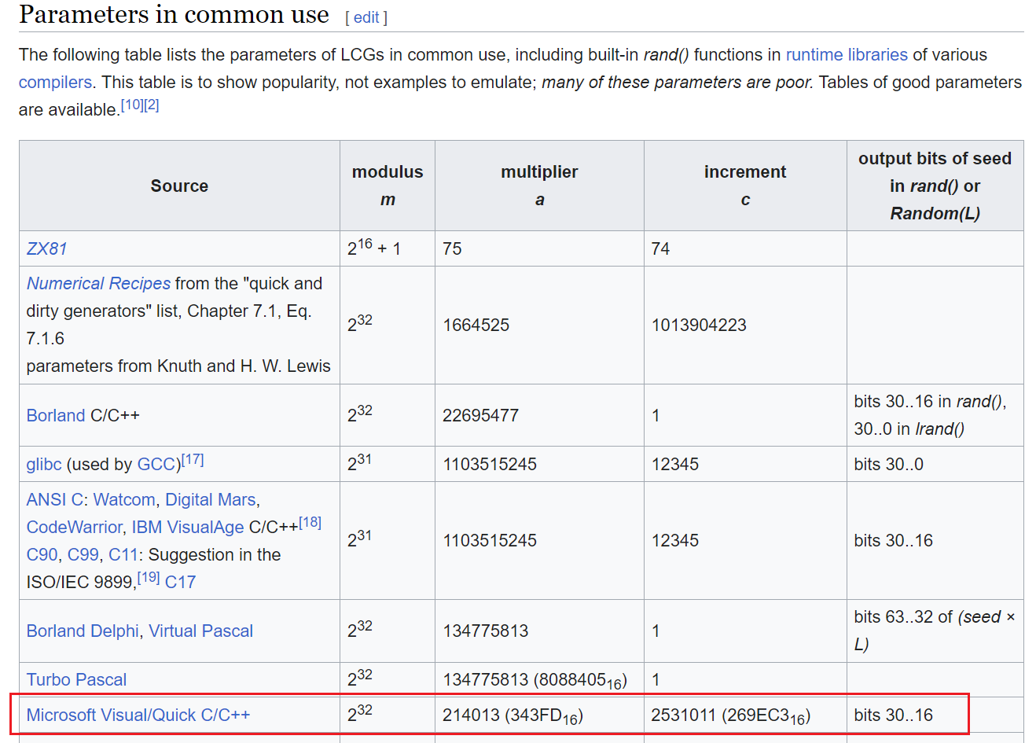
Notes:
https://en.wikipedia.org/wiki/Linear_congruential_generator

Slide 34
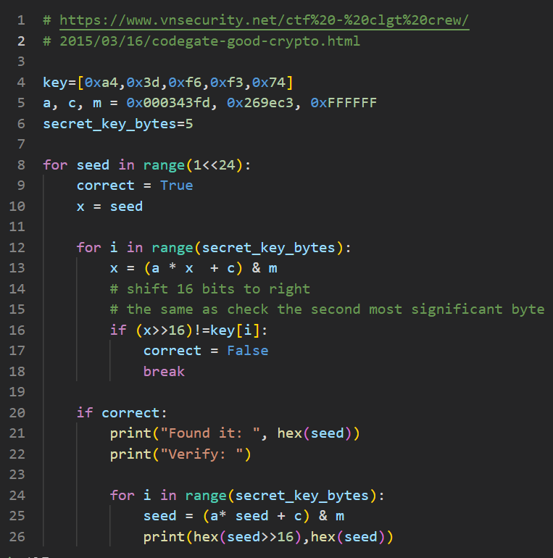
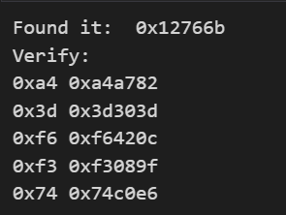




Password Position
0
1
2
3
We know the password = [A-Za-z]+
4
5
6
7
8
9
10
11
12
6b
76
12
??
32 bits seed
32 bits (little endian)
https://raw.githubusercontent.com/frankwxu/digital-forensics-lab/main/Illegal_Possession_Images/lab_files/wlan_decrypt/findseed.py
Notes:
key=[0xa4,0x3d,0xf6,0xf3,0x74]
a, c, m = 0x000343fd, 0x269ec3, 0xFFFFFF
secret_key_bytes=5
for seed in range(1<<24):
correct = True
x = seed
for i in range(secret_key_bytes):
x = (a * x + c) & m
# shift 16 bits to right
# the same as check the second most significant byte
if (x>>16)!=key[i]:
correct = False
break
if correct:
print("Found it: ", hex(seed))
print("Verify: ")
for i in range(secret_key_bytes):
seed = (a* seed + c) & m
print(hex(seed>>16),hex(seed))

Slide 35
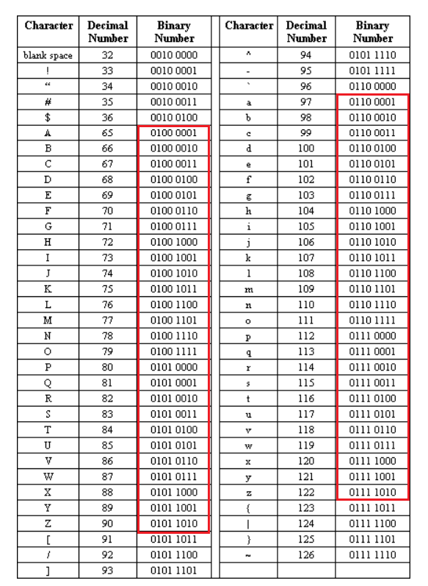



How long is the passphrase?
Position
0
1
2
3
4
5
6
7
8
9
10
11
12
6b
76
12
??
32 bits (little endian)
0x12=0001,0010 can only be generated by an even number of [A-Za-z] characters. Why?
If generated by an odd number of [A-Aa-z], 0 should be 1.
Possible passphrase char ends at (include) 9, 17, 25, etc,
How about 0x76 = 0111,0101
even #
 | 9
 | 17
 | 25
 | …
Notes:
https://www.intel.com/content/dam/www/program/education/us/en/documents/the-journery-inside/digital/tji-digital-info-handout4.pdf

Slide 36

The length of the passphrase is 10
We only need to brute-force 8 characters.
  All possibility combinations = 52⁸
0
1
2
3
Can be any two characters
4
5
6
7
8
9
6b
76
12
??
The hash of the 10-character needs to match the hint provided in the game 0xff7b948953ac.

Slide 37
Information for cracking passphrase
We know the 40-bit secret key.
  It can be computed by capturing and analyzing WEP packets
  We will demonstrate it later
We know the seed of the secret key
The passphrase consists of all lowercase
  Analyzing the seed
We know the hash code of the passphrase 0xff7b948953ac
  it is provided by CTF
a4
3d
f6
f3
74
6b
76
12
??

Slide 38
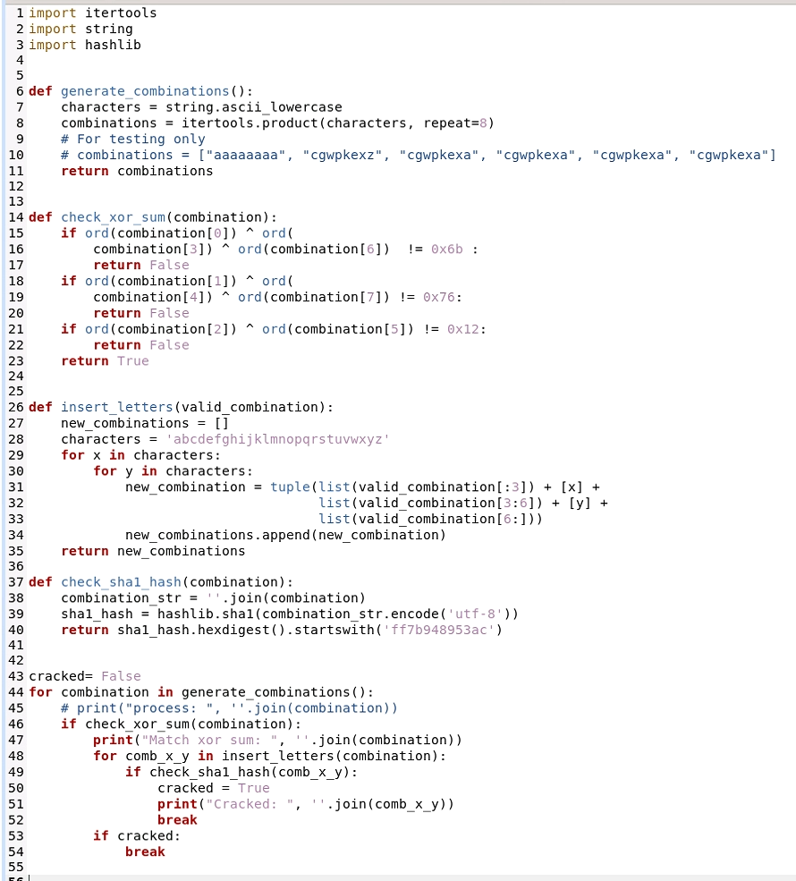


0
1
2
3
4
5
6
7
8
9
6b
76
12
??

Slide 39
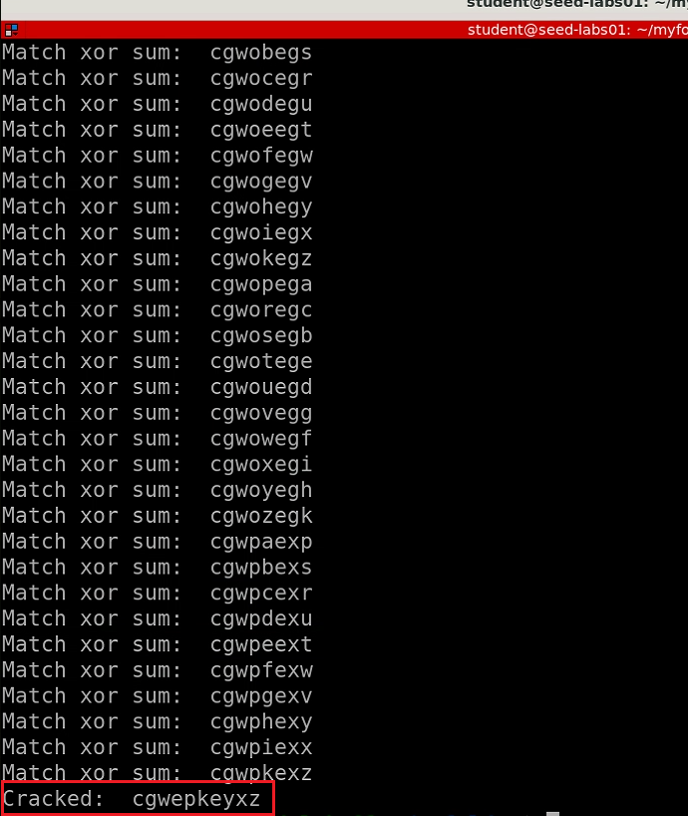
wget https://raw.githubusercontent.com/frankwxu/digital-forensics-lab/main/Illegal_Possession_Images/lab_files/wlan_decrypt/crackWEP40_noGPU_Improved_v1.py
python crackWEP40_noGPU_Improved_v1.py

Slide 40
Assignment
What are the IP addresses of the host and server?
What are the Mac addresses?
Can you manually extract pictures and HTML pages?
What is the password of the router?

Slide 41
To do
It seems Wireshark can crack 40-bit secret key

Slide 42
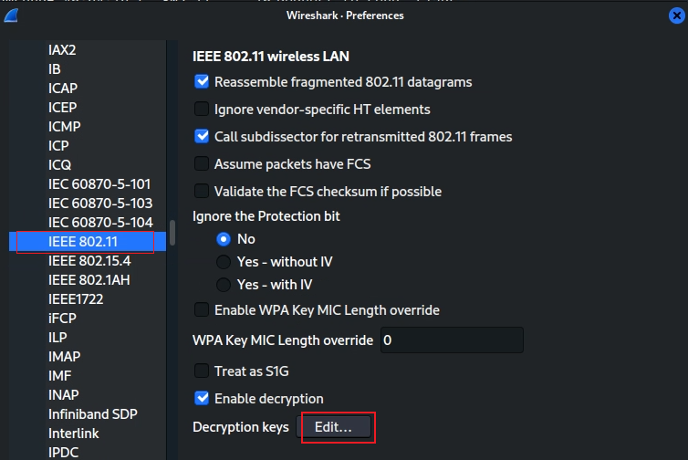
Decrypt using Wireshark is not working, not sure why

Slide 43
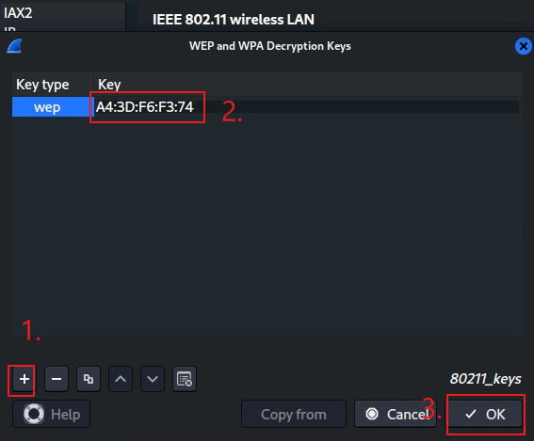
Notes:
A4:3D:F6:F3:74

