Slide 1
P2P Data Leakage
(File Signature)
Malcolm Hayward
University of Baltimore
Forensic Science – Cyber Investigations

Slide 2
Previous Presentations
0. Lab Setup
1. Disk Image and Partitions
2. Registry and File Directory
3. MFT Timeline
4. USN Journal Timeline
5. uTorrent Log File

Slide 3
Objectives
Locate the .mp3 files on the system.
Verify if the .mp3 files are the same as the ones the company owns.
Check both files to verify the company’s claim of one file having a binary signature.

Slide 4
12. Are the .mp3 files the same as the files the company has?
Tools Used:
  Hexedit
  Icat
  MD5deep
  SHA1deep
  Hashdeep (alternatively)
  MD5sum (optional)
  SHA1sum (optional)
These tools will compare the MD5 and/or SHA1 hash of the disk image to the MD5 and/or SHA1 hash in the ‘hash_reference.txt’ file.
GUI Tools to consider for hex editing: Ghex, Bless
GUI Tool to consider for hashing: GTKHash

Slide 5
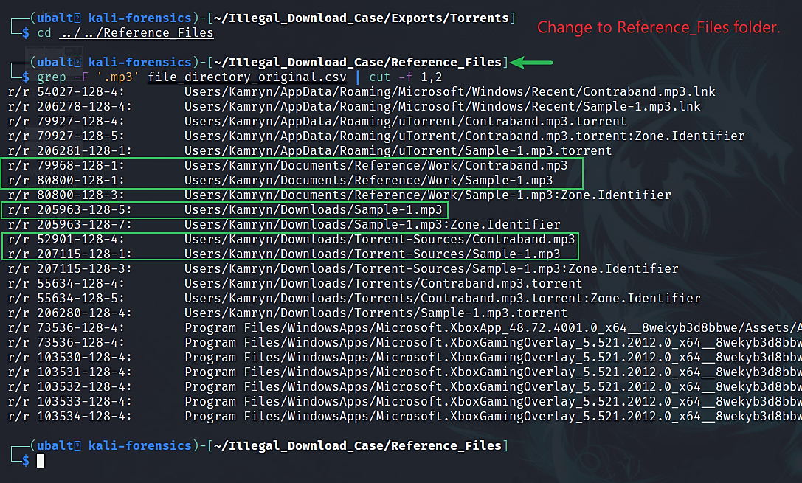
Use grep to search for the .mp3 files.

Slide 6
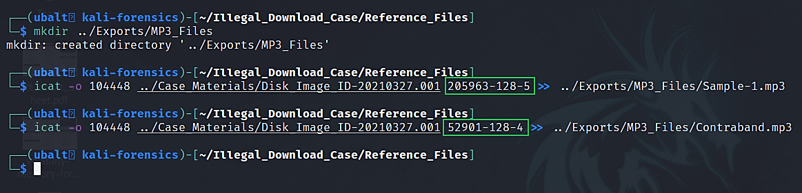
Use icat to extract the .mp3 files.

Slide 7
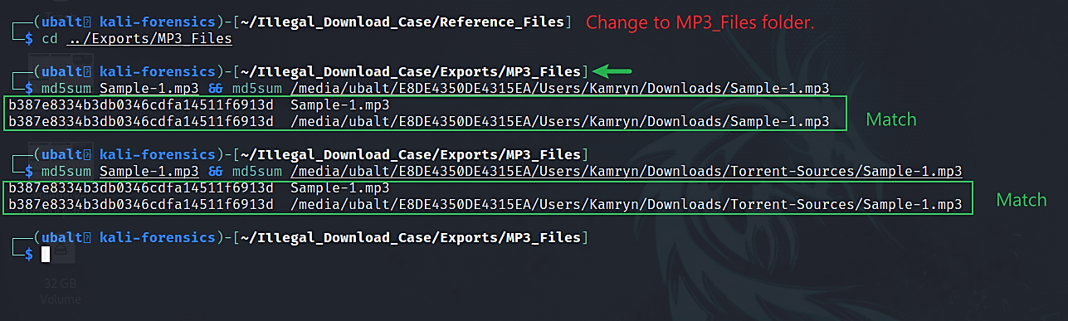
Verify that you have genuine copies.
Note: You are encouraged to also verify the SHA1 hash.

Slide 8
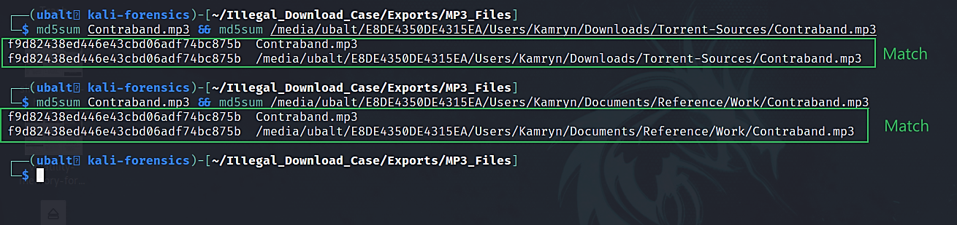
Verify that you have genuine copies.
Note: You are encouraged to also verify the SHA1 hash.

Slide 9
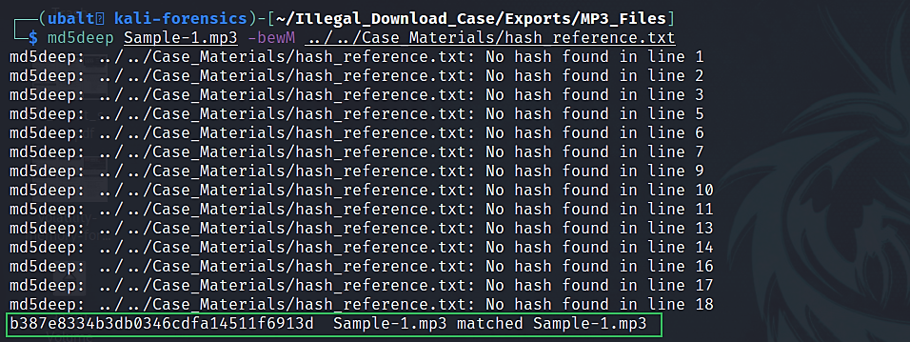
Use MD5deep to compare the MD5 hash to the one we were given in hash_reference.txt.
Note: You are encouraged to also verify the SHA1 hash.

Slide 10
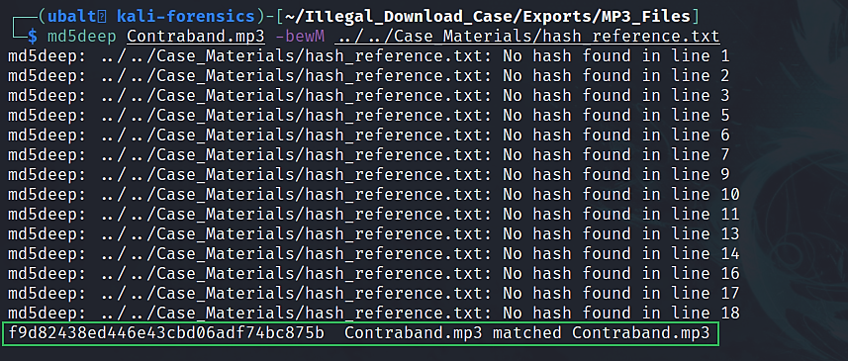
Use MD5deep to compare the MD5 hash to the one we were given in hash_reference.txt.
Note: You are encouraged to also verify the SHA1 hash.

Slide 11
How to use exiftool.
Exiftool allows you to read the metadata of files.
The command –
  exiftool <file>
    Replace ‘<file>’ with the file to be read.

Slide 12
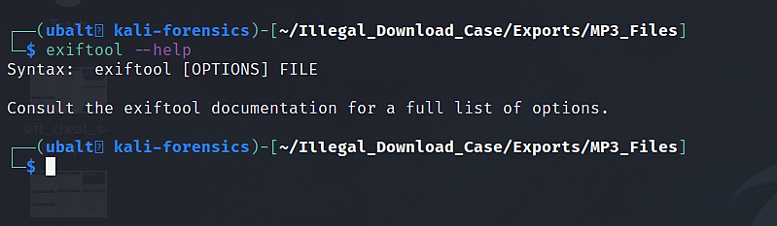
How to get help for exiftool.

Slide 13
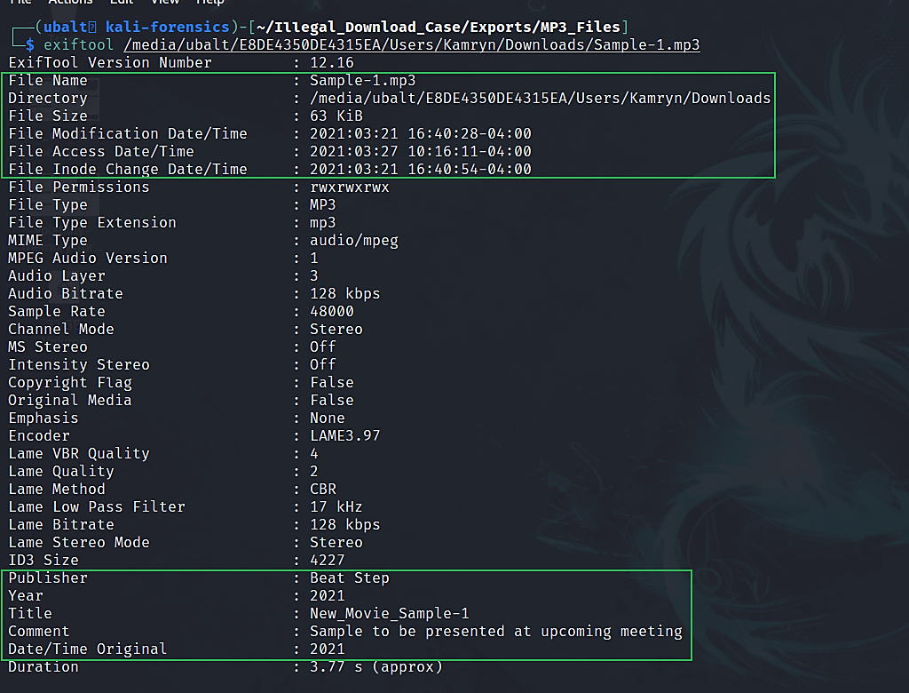
Use exiftool to see the metadata of the .mp3 files.

Slide 14
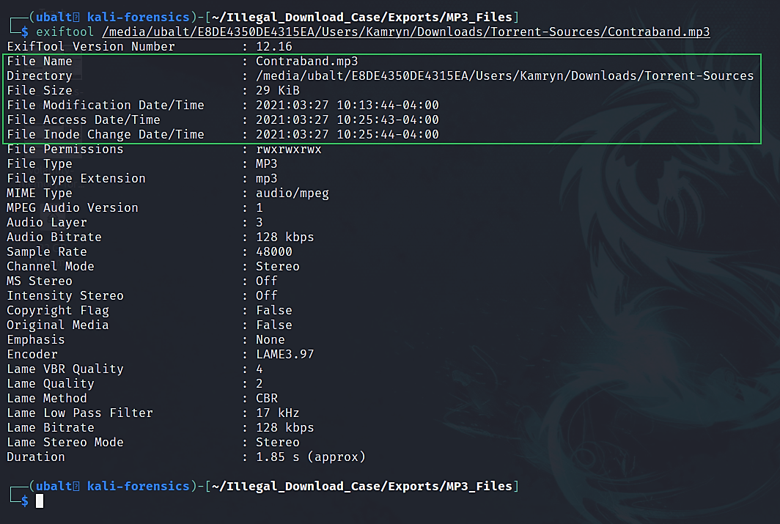
Use exiftool to see the metadata of the source files.
direct manipulation of the file times counts as modification of the inode, which will bump the ctime to the current clock time.
  because timestamps are saved in inode
you can change the inode without changing the file contents
Notes:
The field st_atime is changed by file accesses, for example, by execve(2), mknod(2), pipe(2), utime(2) and read(2) (of more than zero bytes). Other routines, like mmap(2), may or may not update st_atime.
The field st_mtime is changed by file modifications, for example, by mknod(2), truncate(2), utime(2) and write(2) (of more than zero bytes). More‐ over, st_mtime of a directory is changed by the creation or deletion of files in that directory. The st_mtime field is not changed for changes in owner, group, hard link count, or mode.
The field st_ctime is changed by writing or by setting inode information (i.e., owner, group, link count, mode, etc.).
https://unix.stackexchange.com/questions/132660/whats-the-difference-between-modification-date-and-inodes-modification-date

Slide 15
How to use strings.
Strings will output printable characters from a file.
This is a very powerful tool that can be ran against any file that has printable characters in them.
Command –
  strings -t x -f *
The ‘-t x’ argument will print the offset in hexadecimal format.
  The manual for strings will show you what ‘d’ and ‘o’ stand for.
The ‘-f’ argument will print the name of the file next to the string that is found. Since we are using it with the grep command, the file name will be printed next to each match.

Slide 16
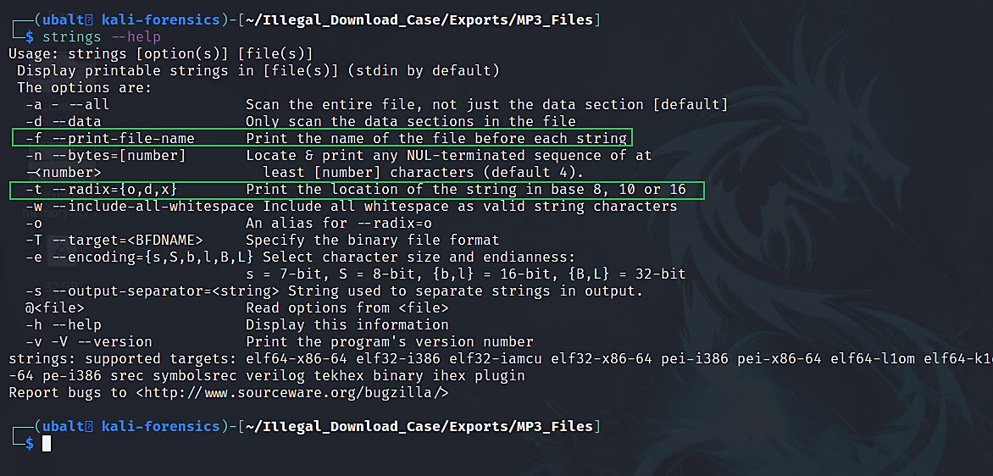
How to get help for strings.

Slide 17
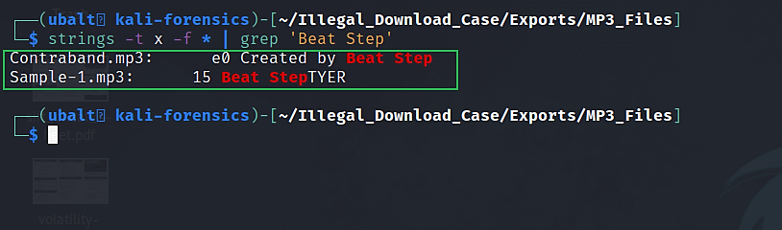
Use strings to find out which file has the binary signature.
‘e0’ and ‘15’ are the offsets where these strings are located. You can verify this information by opening these files in a hex editor.

Slide 18
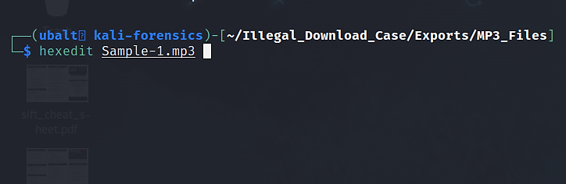
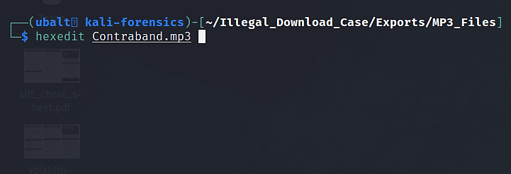
Use hexedit to verify the output of strings.

Slide 19
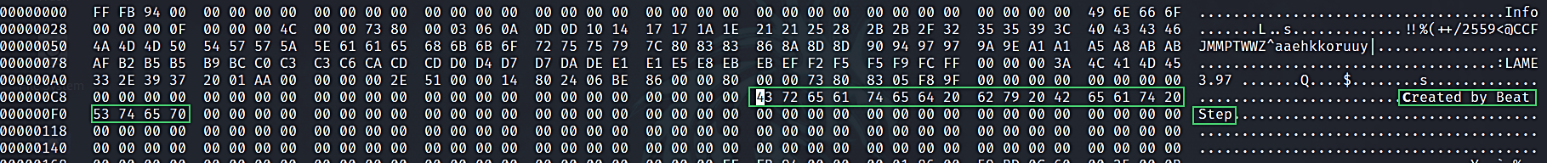
A command line interface will open:
For Contraband.mp3:
At the bottom left corner, you should find:
The strings output says this entry was to be found at offset E0. This shows that strings was correct.

Slide 20
A command line interface will open:
For Sample.mp3:
At the bottom left corner, you should find:
The strings output says this entry was to be found at offset 15. This shows that strings was correct.

Slide 21
What this means for the investigation.
Both files match the names and the hash code given to us by the company.
Sample.mp3 shows that the author is Beat Step. However, it does not have a binary signature.
Contraband.mp3 has a binary signature.
This verifies the information given to us by the company: Contraband.mp3 is the copyrighted file that contains the binary signature.
We will look at the emails and web history to figure out how Kamryn acquired these files.

Slide 22
Alternate Ways of Answering the Question
Hashdeep can do what MD5/SHA1deep did; however:
  You must generate the hashes using hashdeep itself before you can compare hashes. Hashdeep will not accept the format used by md5/sha1sum, which is the format the ‘hash_reference.txt’ uses.
  The command input is different from MD5deep and SHA1deep and requires more input flags to get the same result; therefore, hashdeep is the more difficult option.
Both md5sum and sha1sum will generate their respective hashes, and then you would compare them to the hashes given in <location of the hashes>.
GTKhash is a GUI program that will calculate both hashes, and then you would compare them to the hashes given in <location of the hashes>.
  Think of GTKhash as being ‘HashCalc’ for Linux.
Ghex and Bless are GUI hex editors you can use on Linux. Use these if you are not comfortable using a hex editor in the terminal.
  Note: You may prefer Ghex since it’s more stable than Bless.

Slide 23
Next Presentation
Emails

