Slide 1
iOS 13 Cellebrite Investigation

Slide 2
Overview
What is Cellebrite Physical Analyzer
Loading image into Cellebrite Physical Analyzer
Examining data with Cellebrite Physical Analyzer
Reporting with Cellebrite Physical Analyzer
  Review Reports

Slide 3
What is Cellebrite Physical Analyzer
Notes:
https://cellebrite.com/en/physical-analyzer/

Slide 4
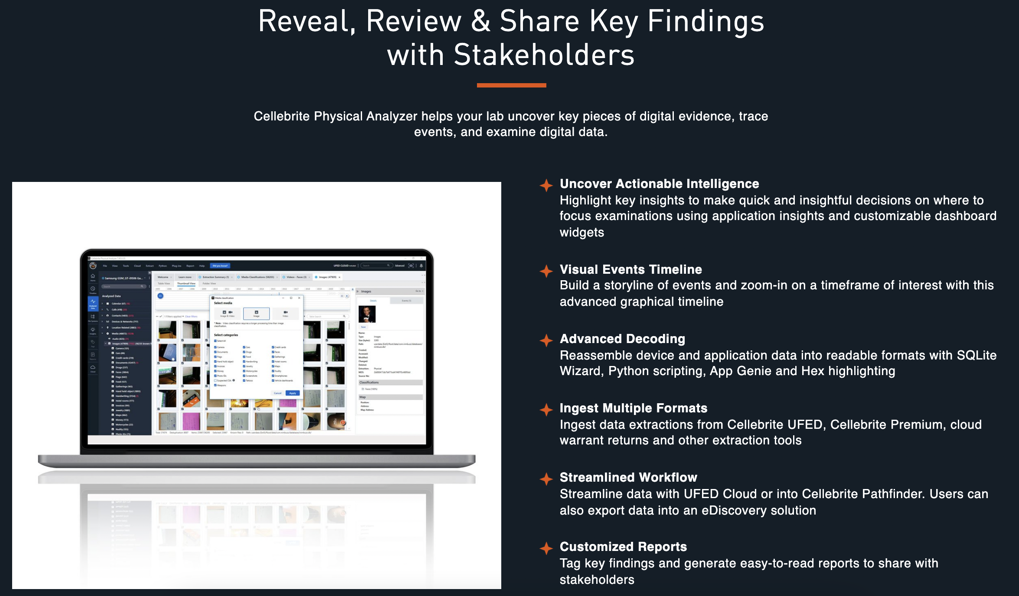

Slide 5
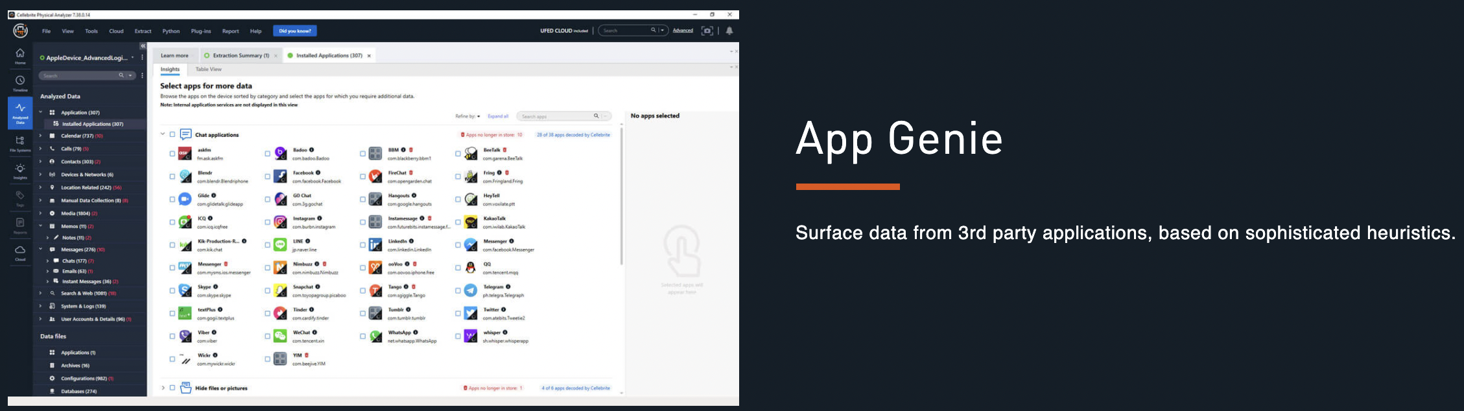
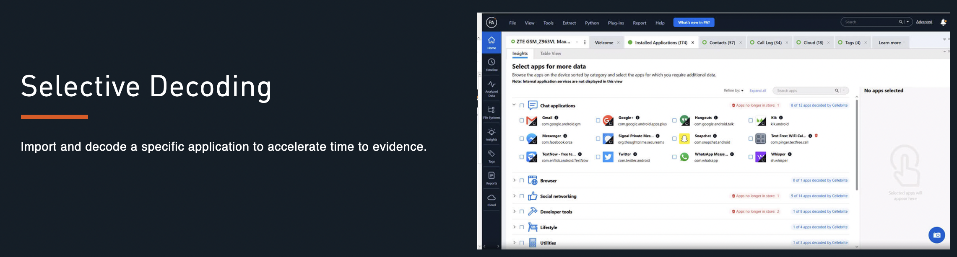

Slide 6
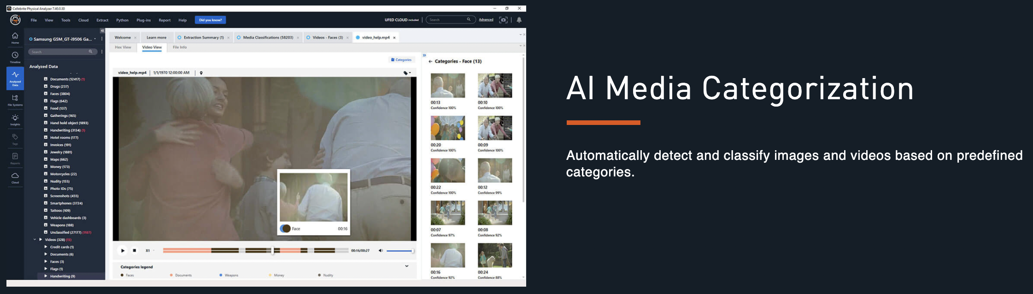
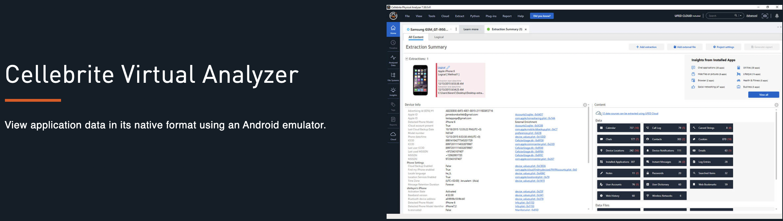

Slide 7
Loading Image into Cellebrite Physical Analyzer
Notes:
https://cellebrite.com/en/physical-analyzer/

Slide 8
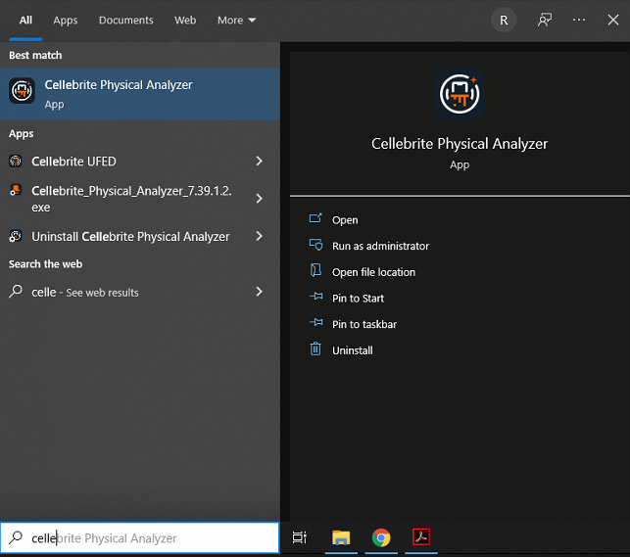
Open up Cellebrite Physical Analyzer

Slide 9
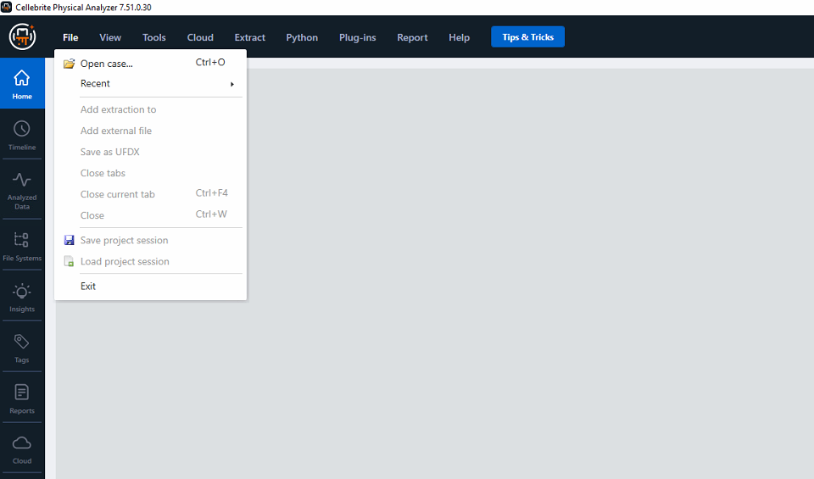
Once the program opens, Click on File and select open case.

Slide 10
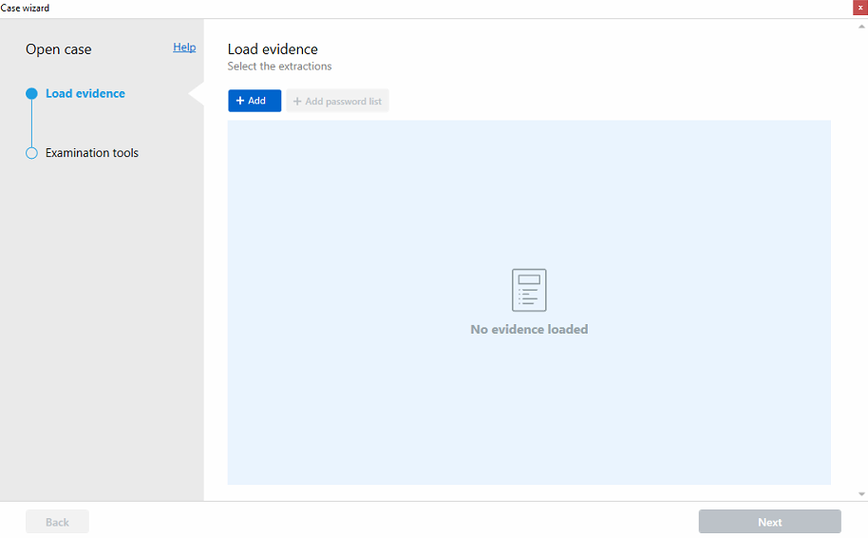
The Case Wizard window will open - Select +Add button

Slide 11
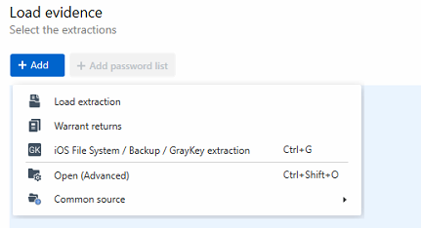
Select iOS File System / Backup / GrayKey extraction

Slide 12
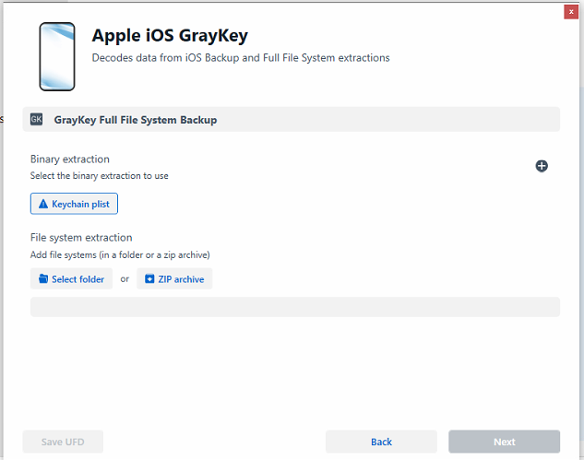
Point Case Wizard to the Backup Folder by selecting the Select Folder button

Slide 13
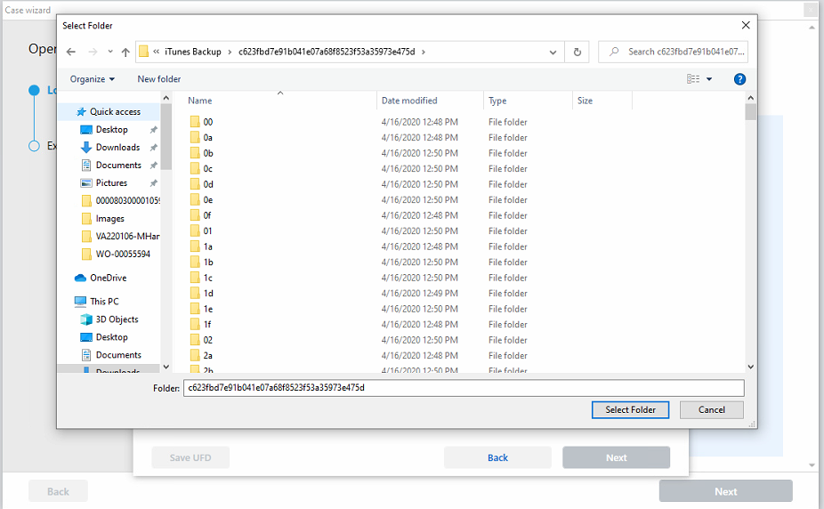
Point at top level folder for iTunes backup

Slide 14
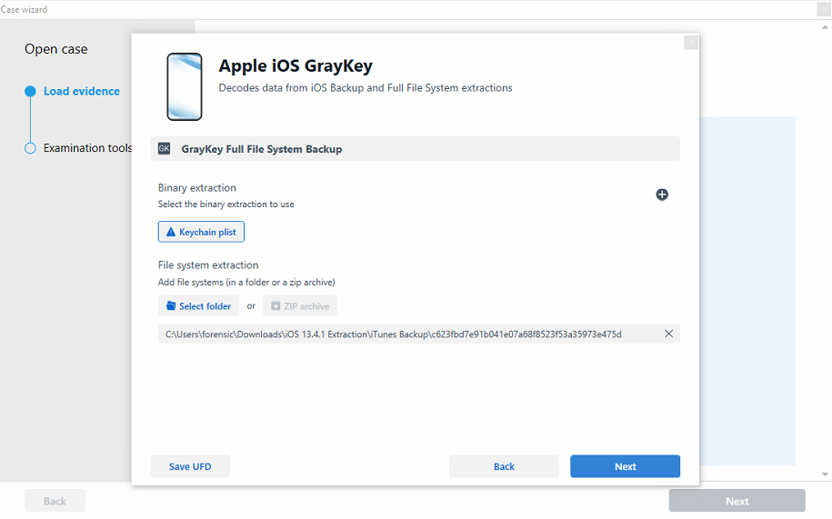
Once the iTunes Backup folder is selected hit Next

Slide 15
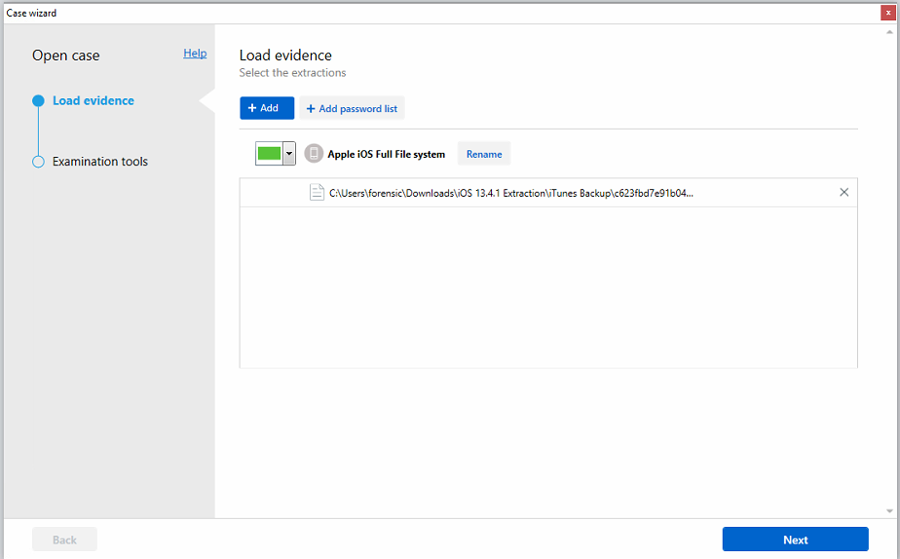
Confirmation screen, hit Next to continue

Slide 16
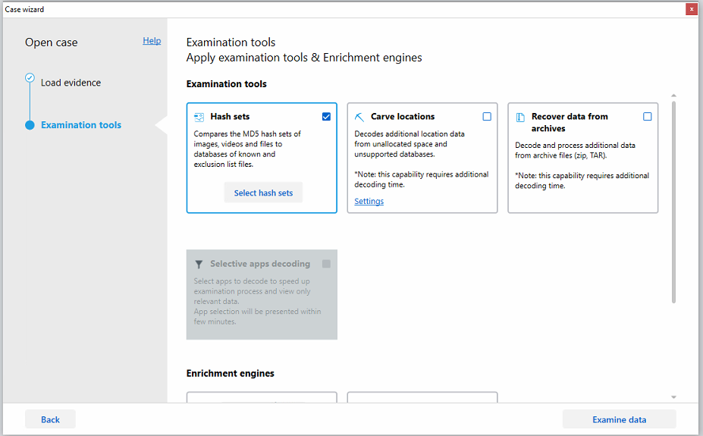
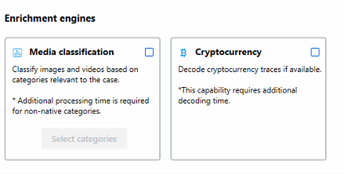
Select optional examination tools and enrichment engines.
Hash sets is on by default.
Hit Examine Data to continue.

Slide 17
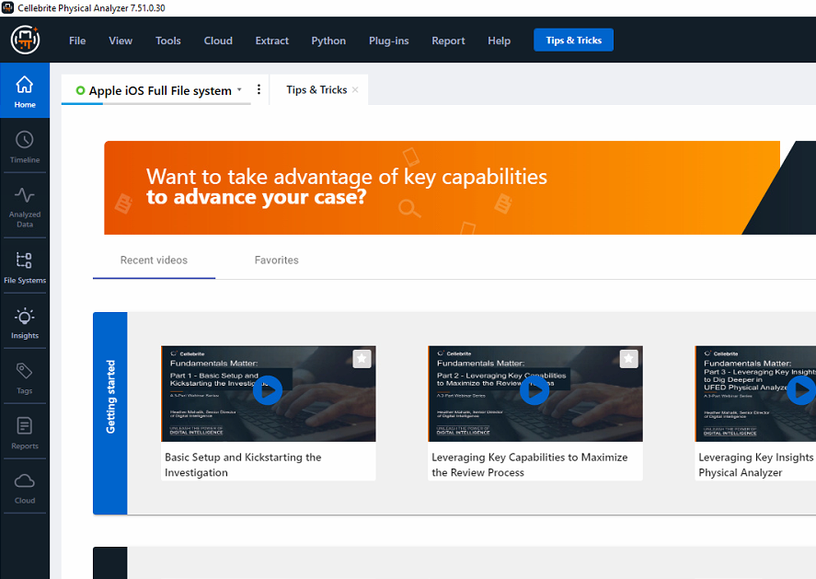
Cellebrite will begin to parse the image, progress bar is in the upper left
Depending on the size of the Image, this may take minutes up to hours.

Slide 18
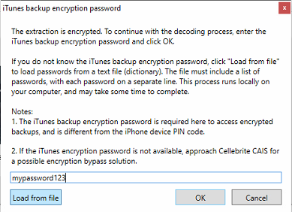
Cellebrite will detect the Image is encrypted and prompt you to enter the password
Enter the password found in the image creation pdf documentation that came along with the image and hit OK

Slide 19
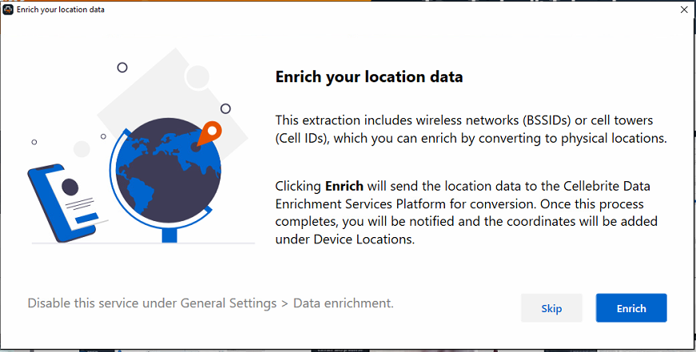
Cellebrite will continue parsing the image until it reaches this optional message:
Select Enrich to continue

Slide 20
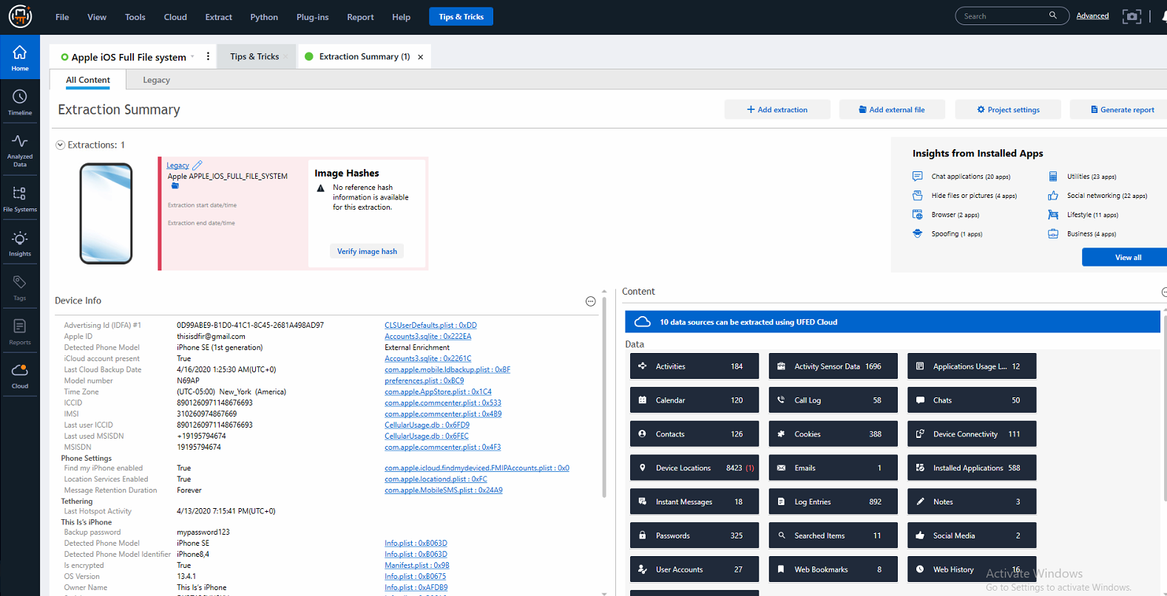
Once the phone is fully parsed, the home screen will look like this:
The Extraction Summary page contains device info.
A good place to start is by looking at this page.

Slide 21
Examining data with Cellebrite Physical Analyzer
Notes:
https://cellebrite.com/en/physical-analyzer/

Slide 22
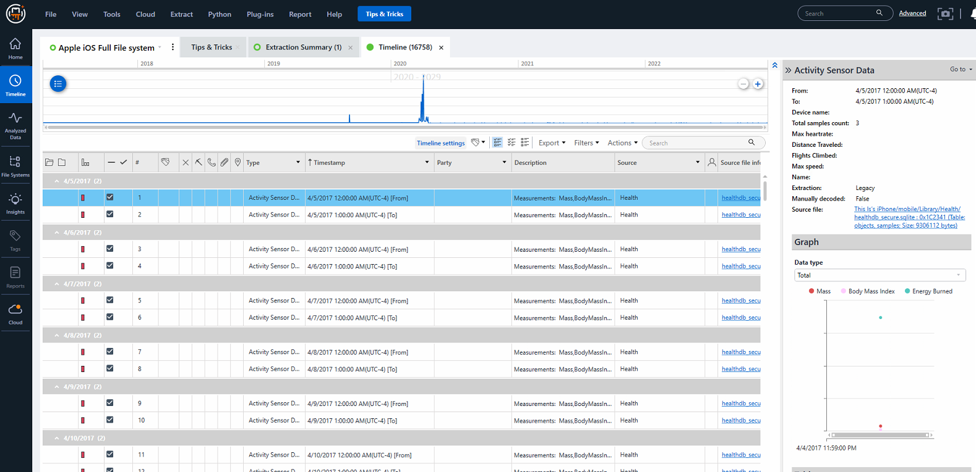
Timeline: List of events day by day
Click the Timeline icon to view.

Slide 23
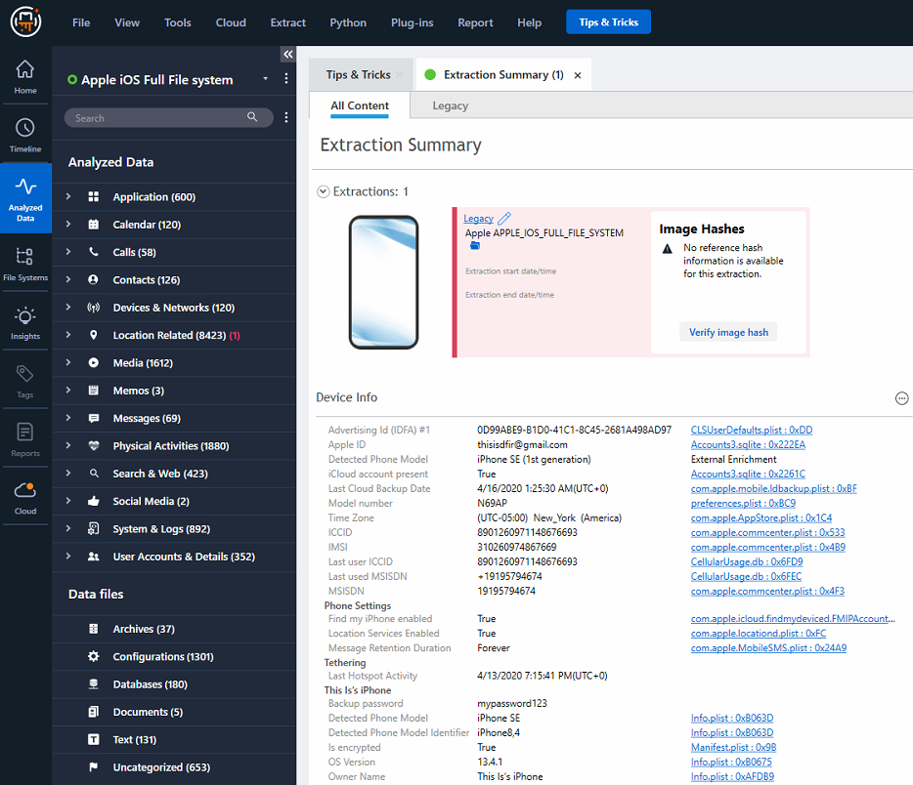
Analyzed Data Tab
Breakdown of data categories
Click on the Analyzed Data to view all categories

Slide 24
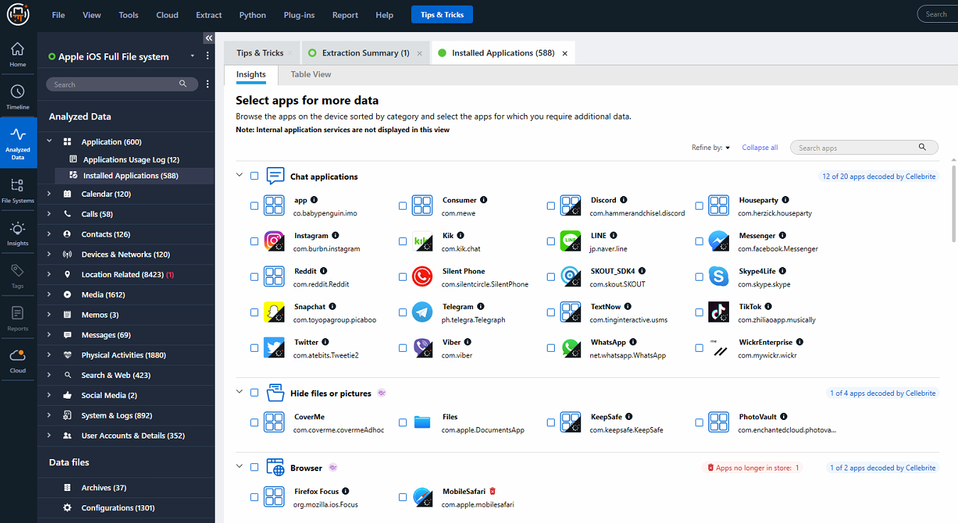
Applications – List of Application Usage logs and Installed Applications

Slide 25
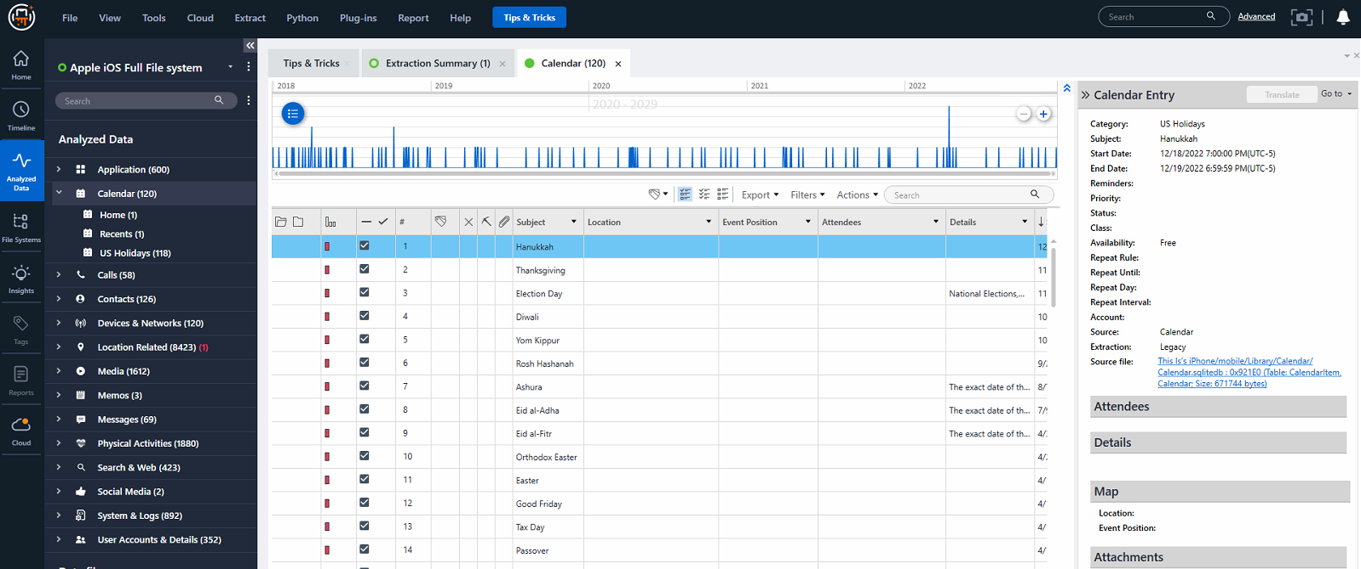
Calendar – List of all calendar entries

Slide 26
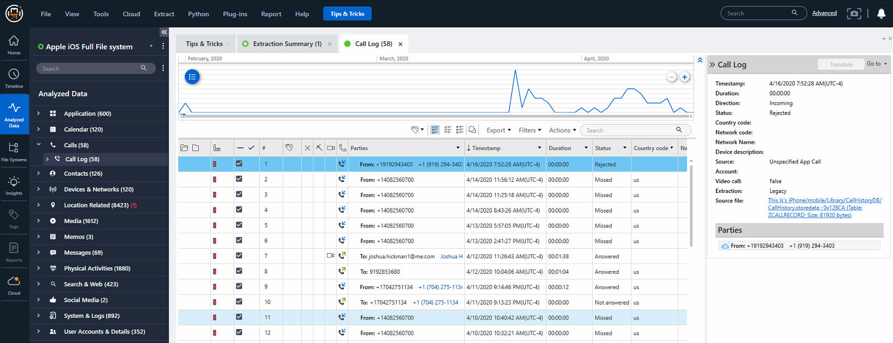
Call log – list of received calls and outgoing calls

Slide 27
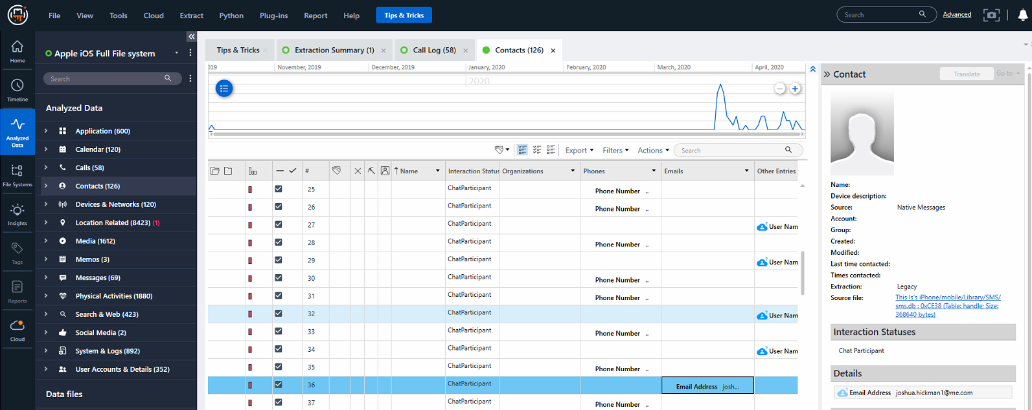
Contacts – List of all contacts (includes 3rd party applications)

Slide 28
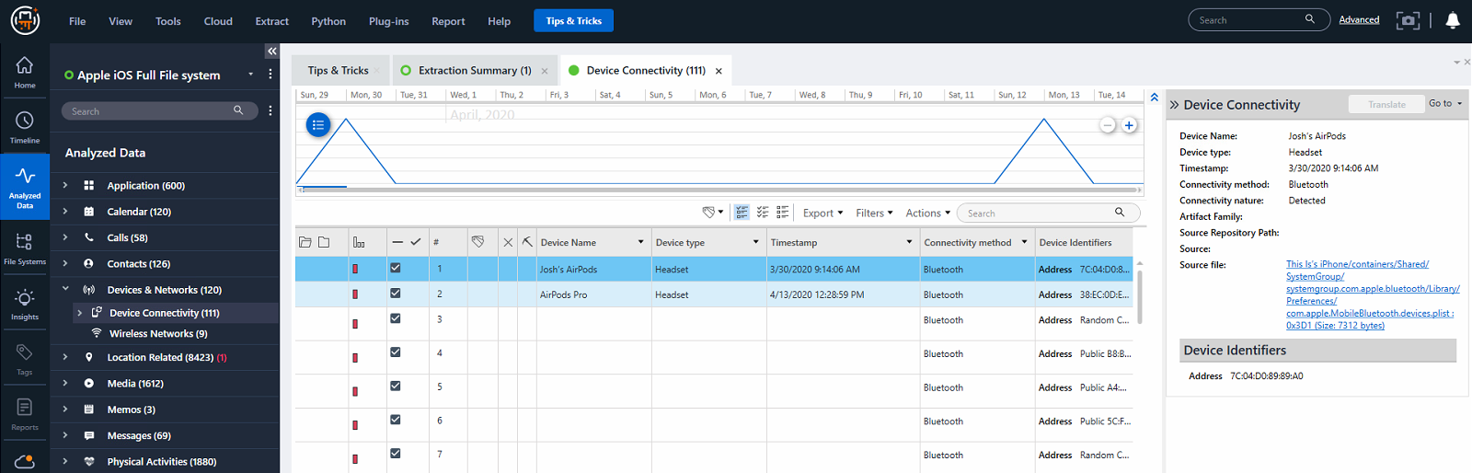
Device tab – List of all devices connected via Bluetooth & WiFi

Slide 29
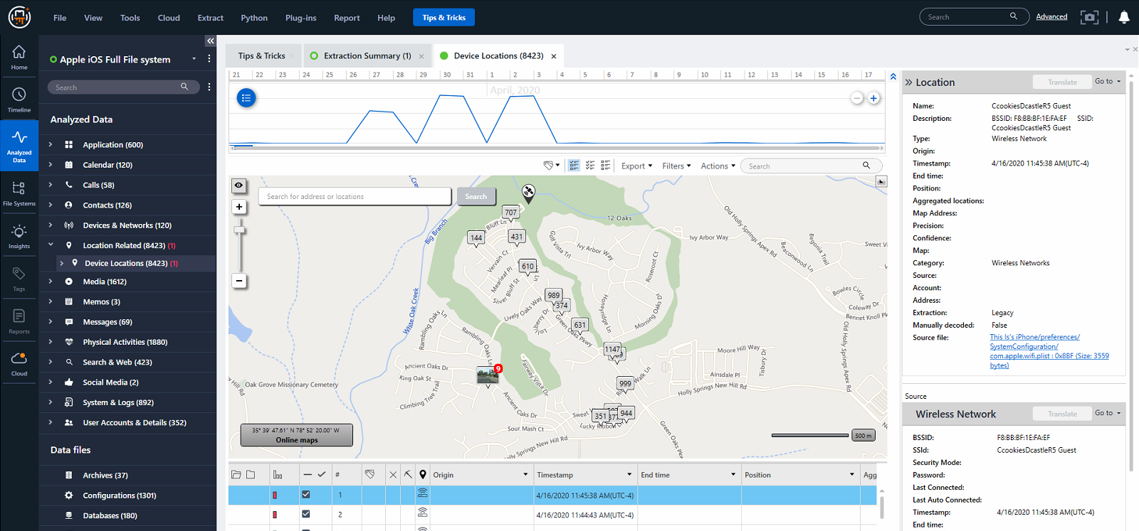
Device locations – List of all BSSID locations

Slide 30
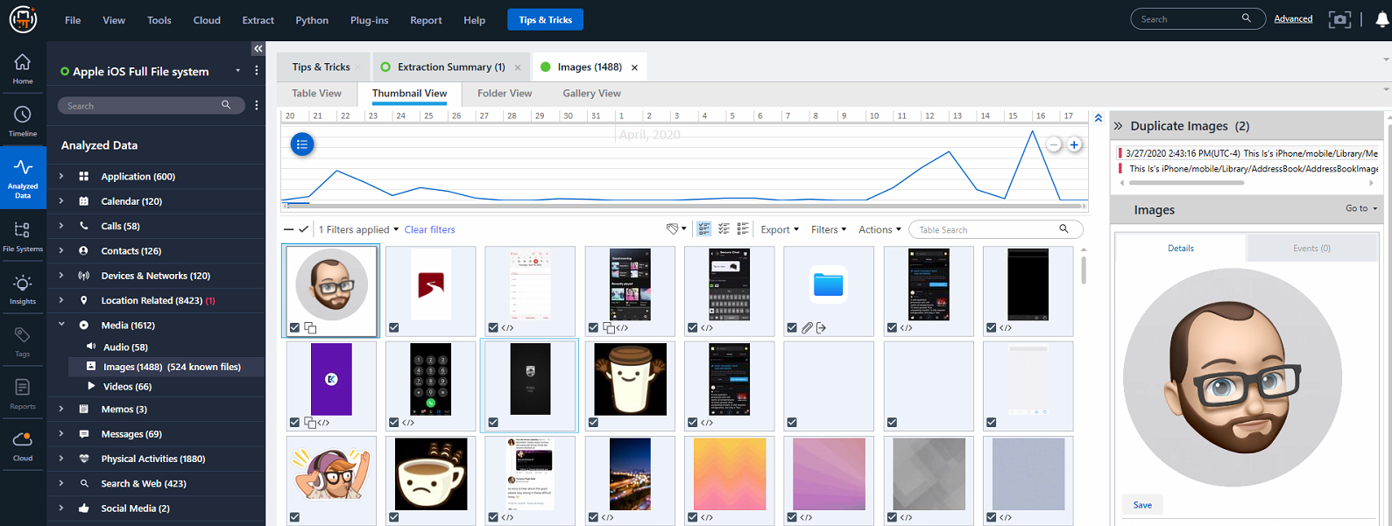
Media – Audio, Photos, & Videos across entire device

Slide 31
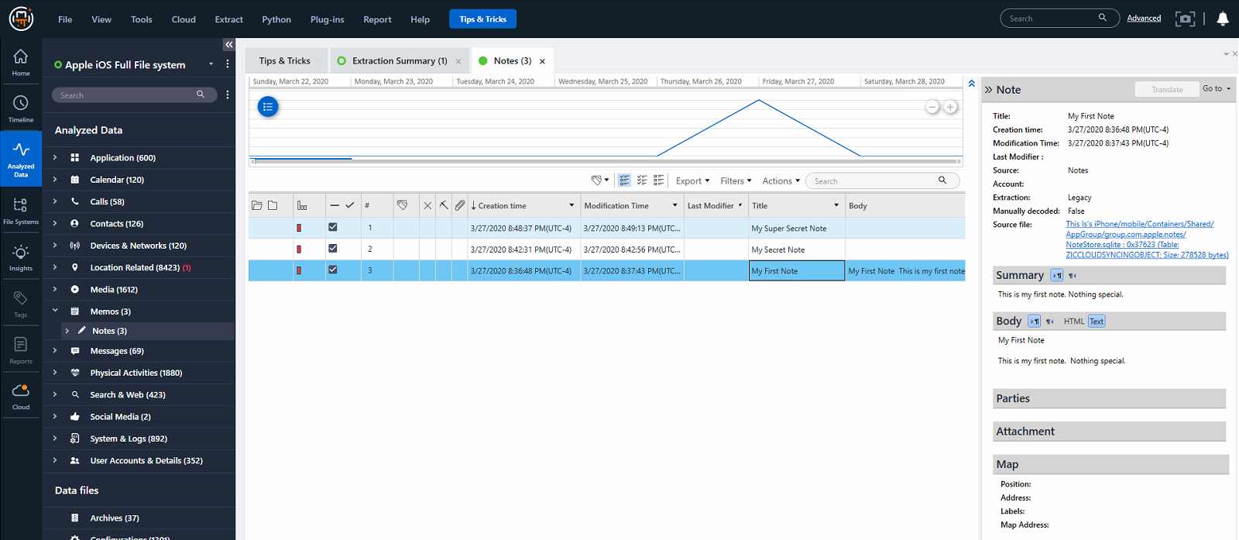
Memos – List of notes on device

Slide 32
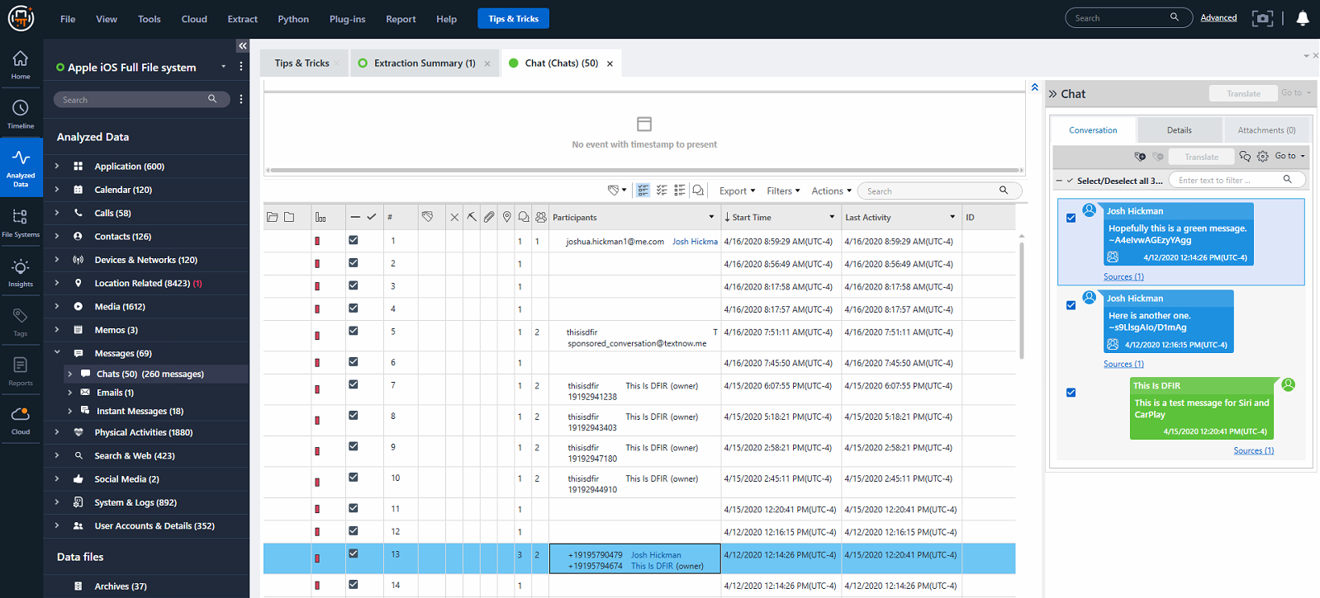
Messages – List of all Messages on device (Includes 3rd Party Applications)

Slide 33
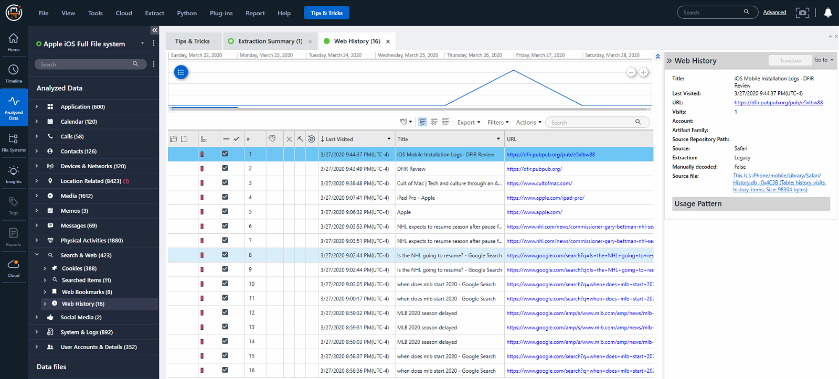
Search & Web – List of Searches and Web History

Slide 34
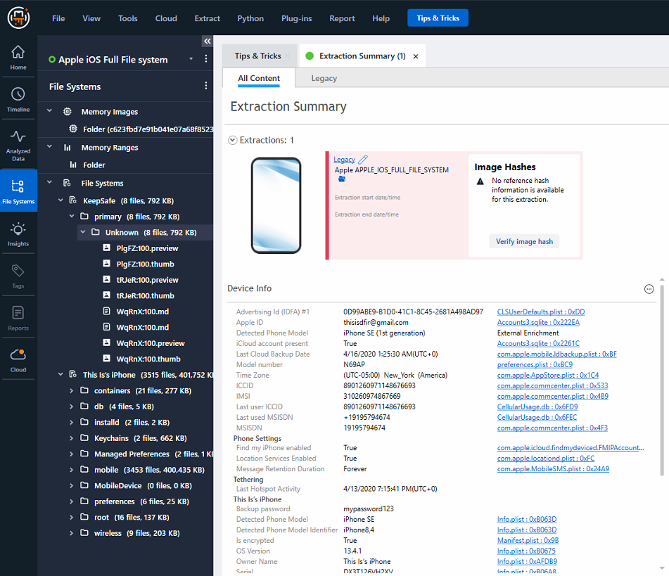
File Systems – View Databases with Built in SQL viewer
Also, browse through the captured file system.
Since this is an iTunes backup, the file system is limited

Slide 35
Creating reports with Cellebrite Physical Analyzer
Notes:
https://cellebrite.com/en/physical-analyzer/

Slide 36
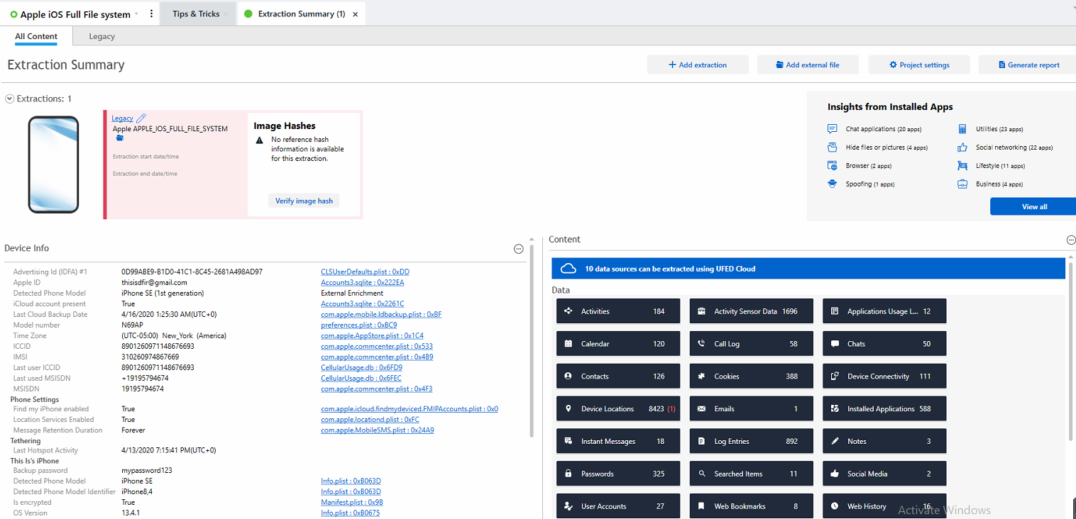
Select Generate Report button in upper right

Slide 37
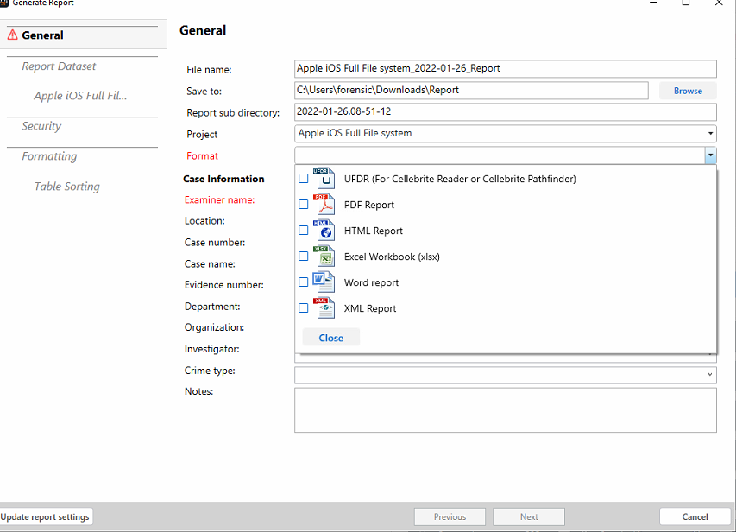
Report Creation Wizard
Set the File name of the report
Select location to save
Select Format(s)

Slide 38
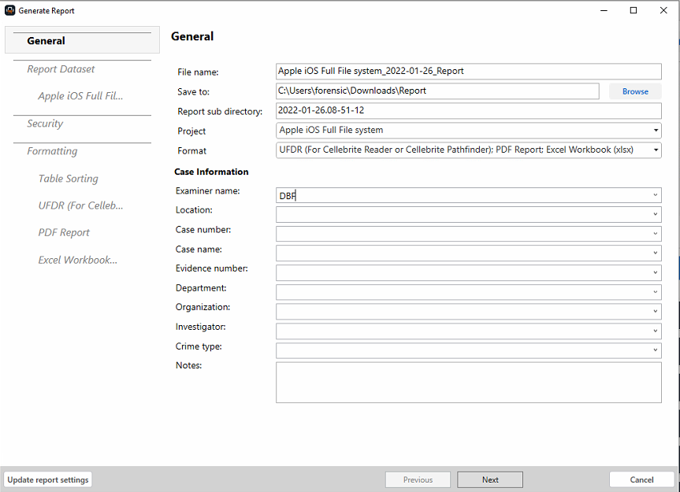
Once all mandatory fields are filled select Next

Slide 39
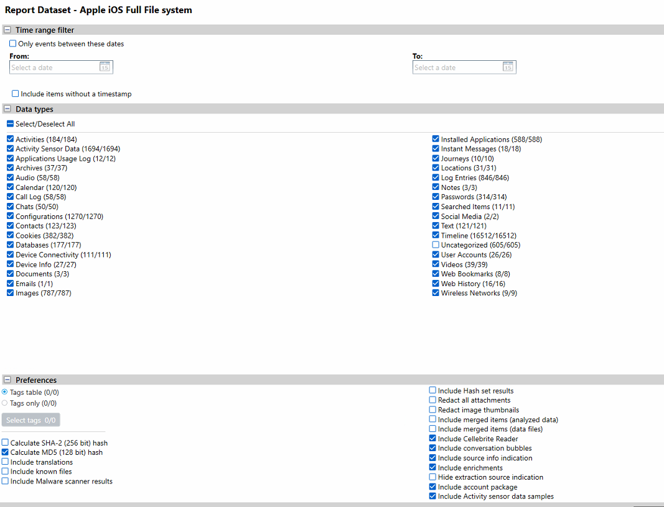
Select data types to be included in reports (This is the default reporting by Cellebrite)
Select Finish and the reports will begin to generate.
Depending on the amount of data this usually takes hours to days.

Slide 40
  Review Reports
Notes:
https://cellebrite.com/en/physical-analyzer/

Slide 41
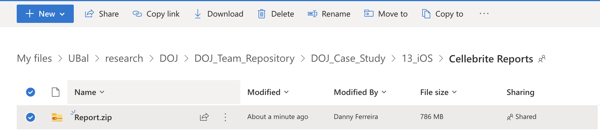

Download the Zipped Report from OneDrive
Extract the Zip

Slide 42
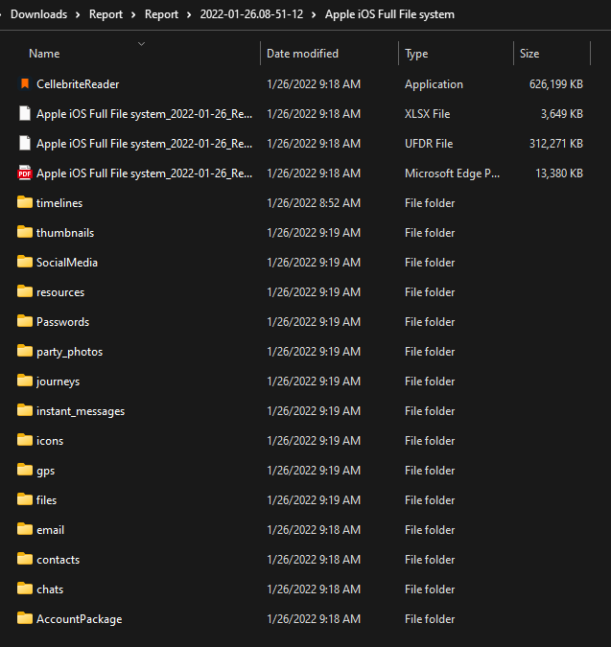
Report Package
Included in this report package is an Excel, PDF, and UFDR Report. UFDRs are Cellebrite Reader Reports which look and function like Cellebrite PA.
The folders are source data. They are hyperlinked to reports, they must remain in the same folders for the Report hyperlinks to work.
Launch the CellebriteReader Program to view UFDR.

Slide 43
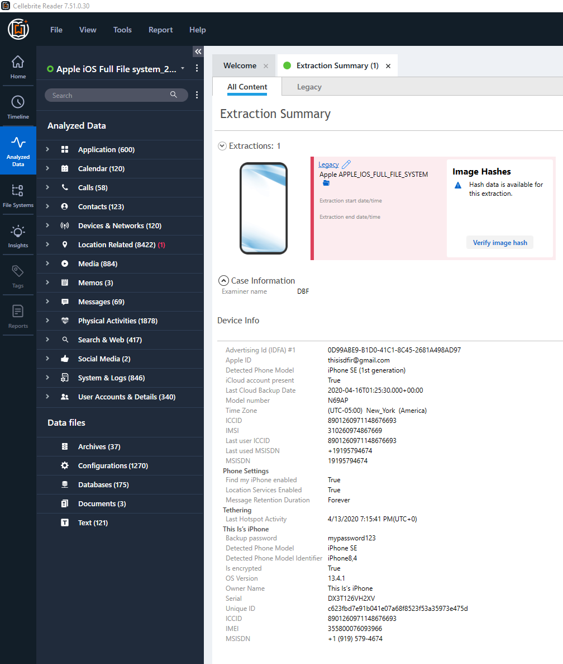
Once UFDR report opens. It will look and function exactly like Cellebrite PA.
Poke around and have fun.

