Slide 1
Photos Investigation
iOS 13
Notes:
https://digitalcorpora.s3.amazonaws.com/corpora/mobile/android_10/Non-Cellebrite%20Extraction/Pixel%203.zip

Slide 2
Overview
Introduction to Photos App
Introduction to Photos database
Scenario Questions
Summary

Slide 3
Introduction to Photos App
Introduction to Photos App

Slide 4

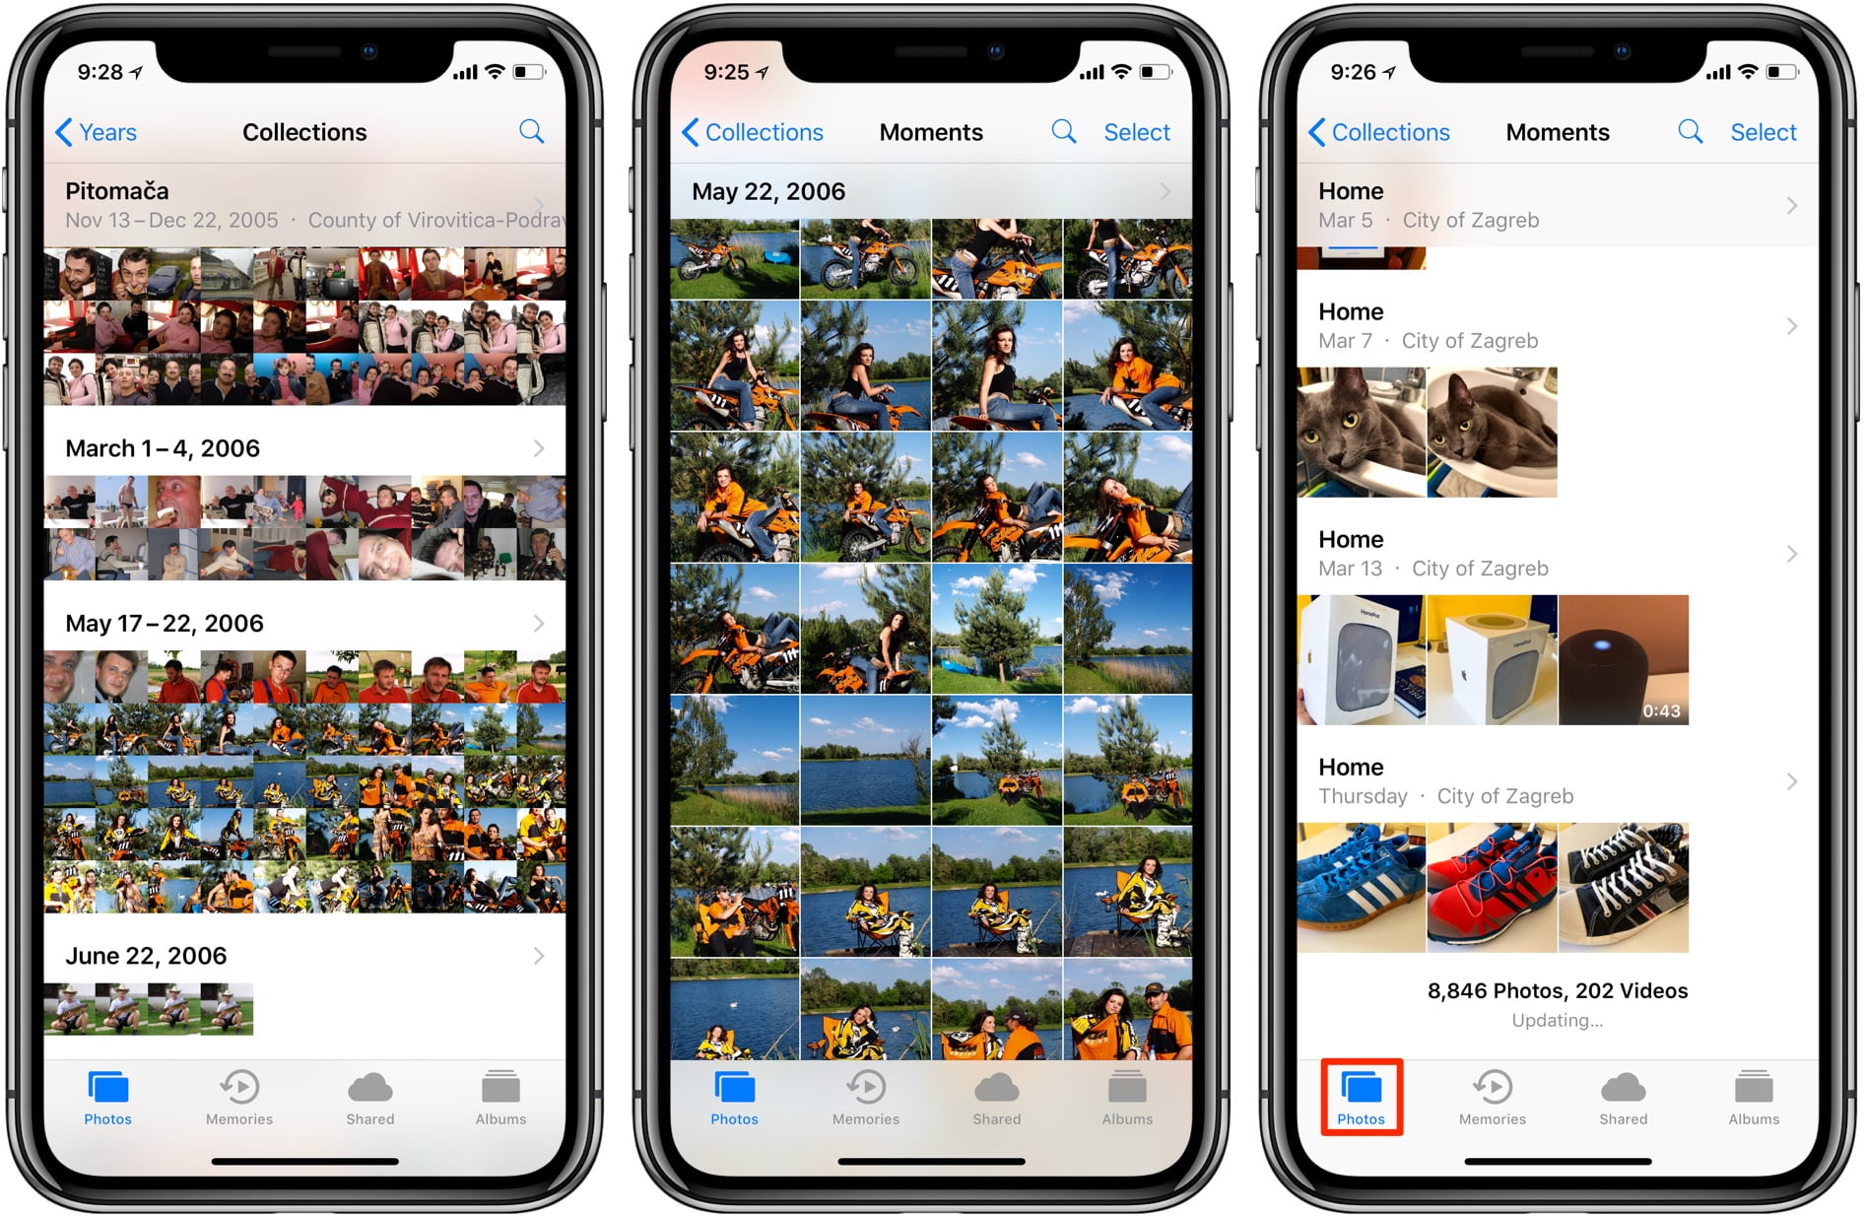
What is Photos?
The Photos app is where all the photos you take and save with your iOS devices live.

Slide 5
Where does the evidence come from?
What is a photo?
  A photo is a picture taken by a camera, digital camera or smartphone that can produce a hard copy or a digital copy
  Photo information usually get stored in databases
Generated by taken and saved Photos
  Location data
  Timestamps
  Filename and sizes

Slide 6
Introduction to Photos database

Slide 7
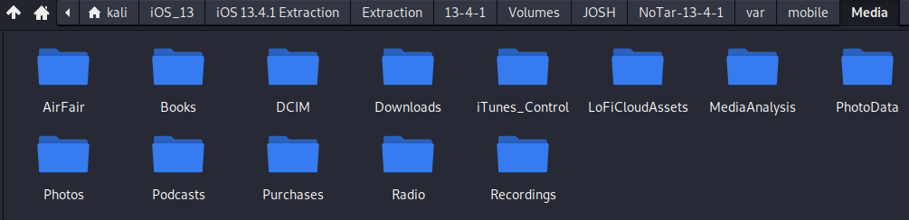
Find the location where photos are stored
Located at ~/var/mobile/Media
Photo storage in loose file format
Location of Photos Database

Slide 8
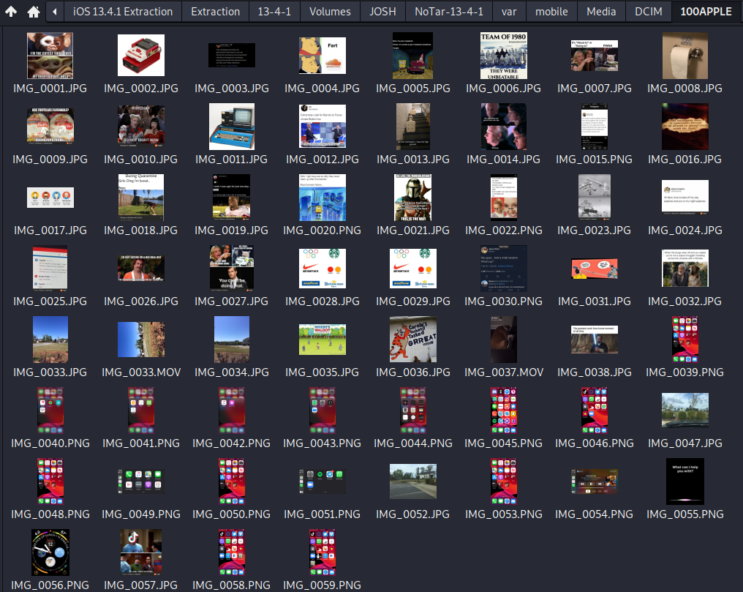
DCIM Folder
This is what the Photos app appears to the user.
Photos in chronological order.
Either saved photos or taken with the camera are stored here.

Slide 9
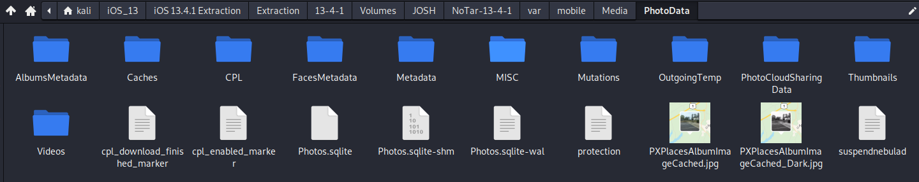
Find the database where photo data is stored.
Right click on Photos.sqlite and open with DB Browser for SQLite
Notes:
Cmd: sqlitebrowser 'Pixel 3/data/data/com.google.android.apps.photos/databases/gphotos-1.db'

Slide 10
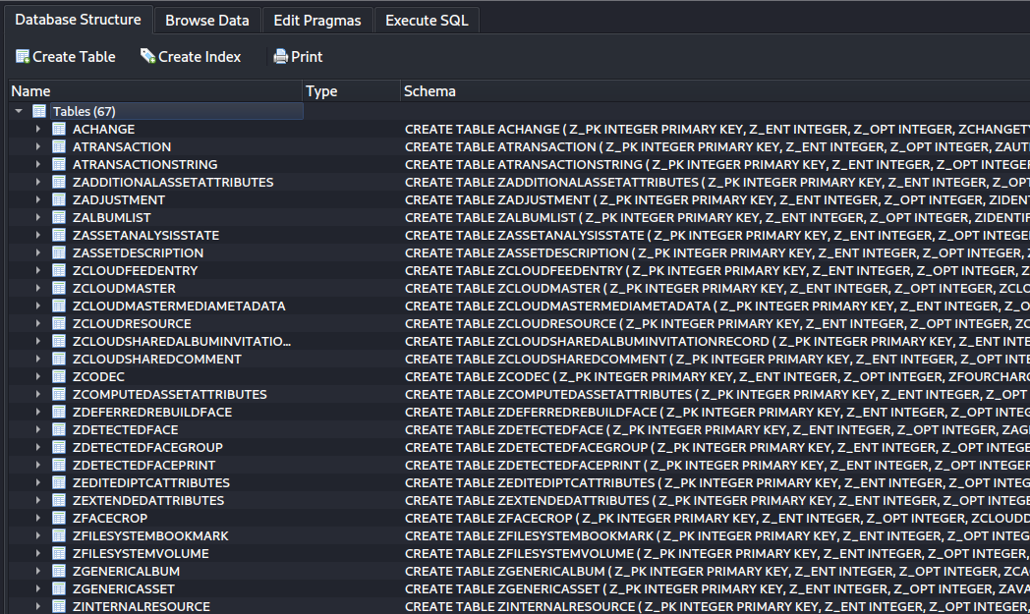
Determine tables to investigate
There are a lot of tables in the database; the 2 most important are ZADDITIONALASSETATTRIBUTES & ZGENERICASSET
Feel free to explore other tables as iOS stores a lot of information just based on photos.

Slide 11
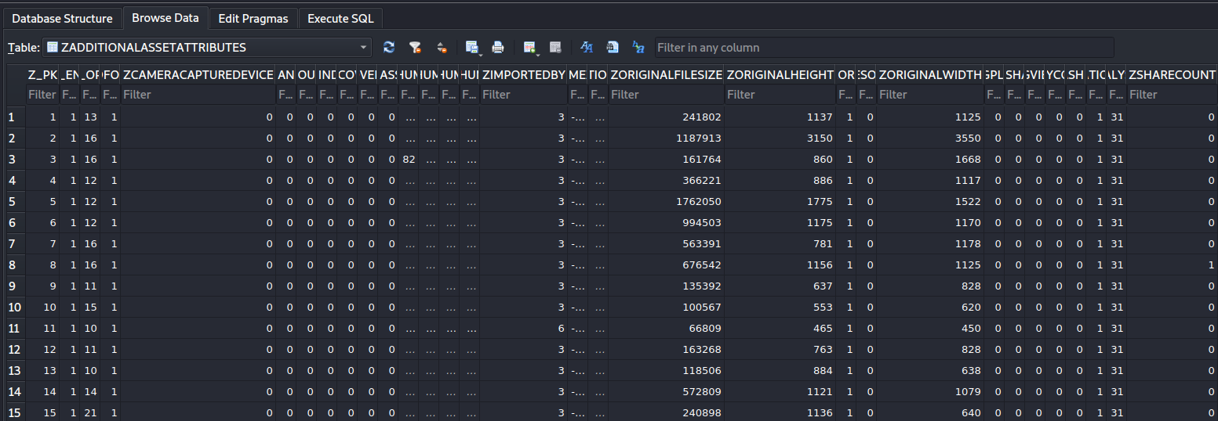
Investigating ZADDITIONALASSETATTRIBUTES
Imported by:
0 = Is related to .MOV files.
1 = Captured via native Back facing camera
2 = Captured via native Front facing camera
3 = Third Party Application
6 = Facebook/Instagram
9 = Saved from outside source (SMS, Safari)
# of times photo was shared; messages, third party applications, etc.
Taken by camera
0=False
1=True
File size (in bytes), height & width (in pixels)

Slide 12
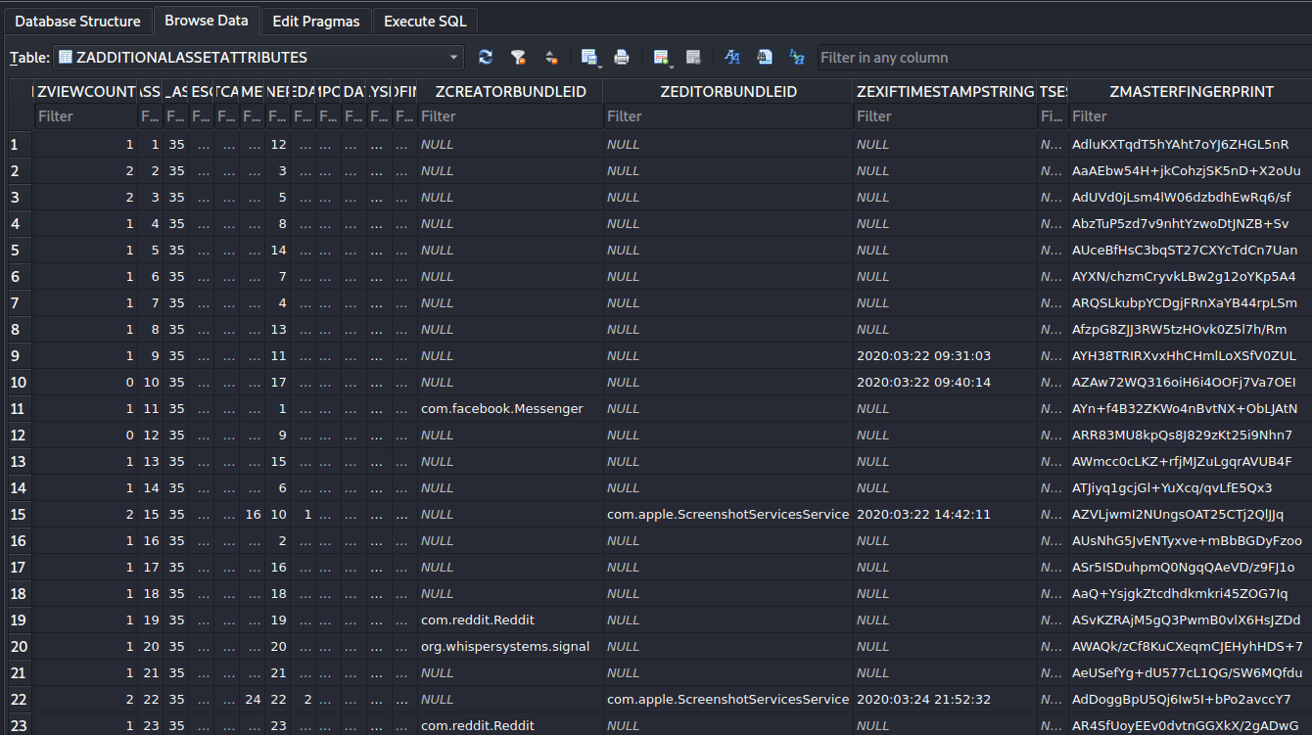
Investigating ZADDITIONALASSETATTRIBUTES (2)
Screenshotted and edited with screenshot service
Masterfingerprint = Apple’s way of hashing photos
Bundle ID where photo was saved from.
EXIF timestamp
How many times photo was viewed in App

Slide 13
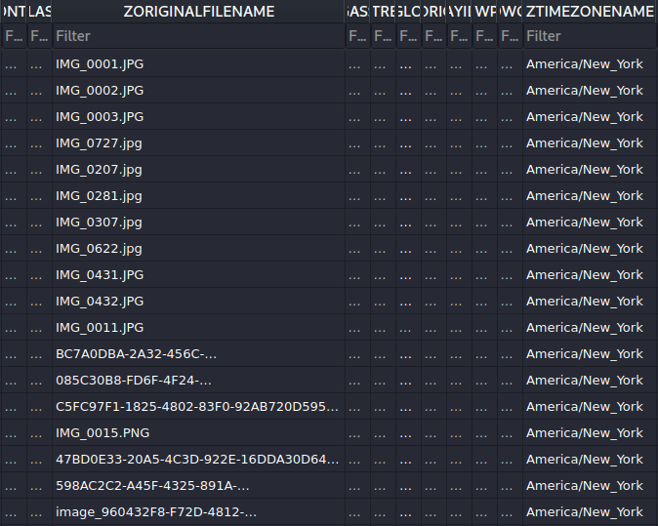
Investigating ZADDITIONALASSETATTRIBUTES (3)
Original Filename
Set Timezone

Slide 14
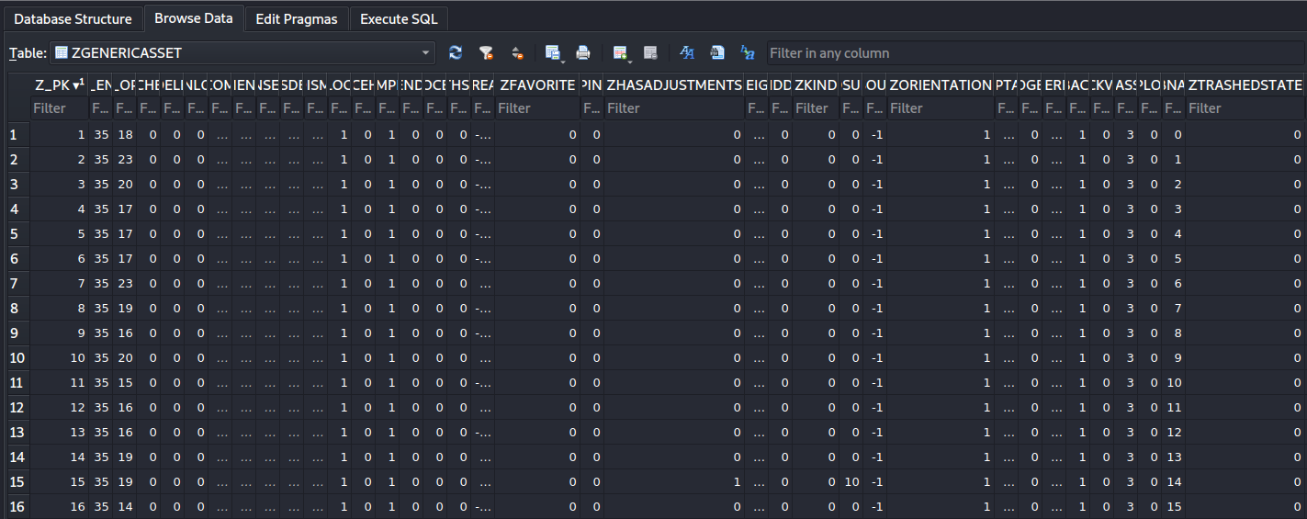
Investigating ZGENERICASSET
Media Orientation
1=Horizontal
6=Vertical
Chronological numbering of photos. Correlates with IMG_0001 from DCIM folder
Marked as Favorite?
0=False
1=True=Moved to Favorite Album
Was photo edited in app?
0=False
1=True
File type
0=Picture
1=Video
Trashed State
0=False
1=True=Deleted

Slide 15
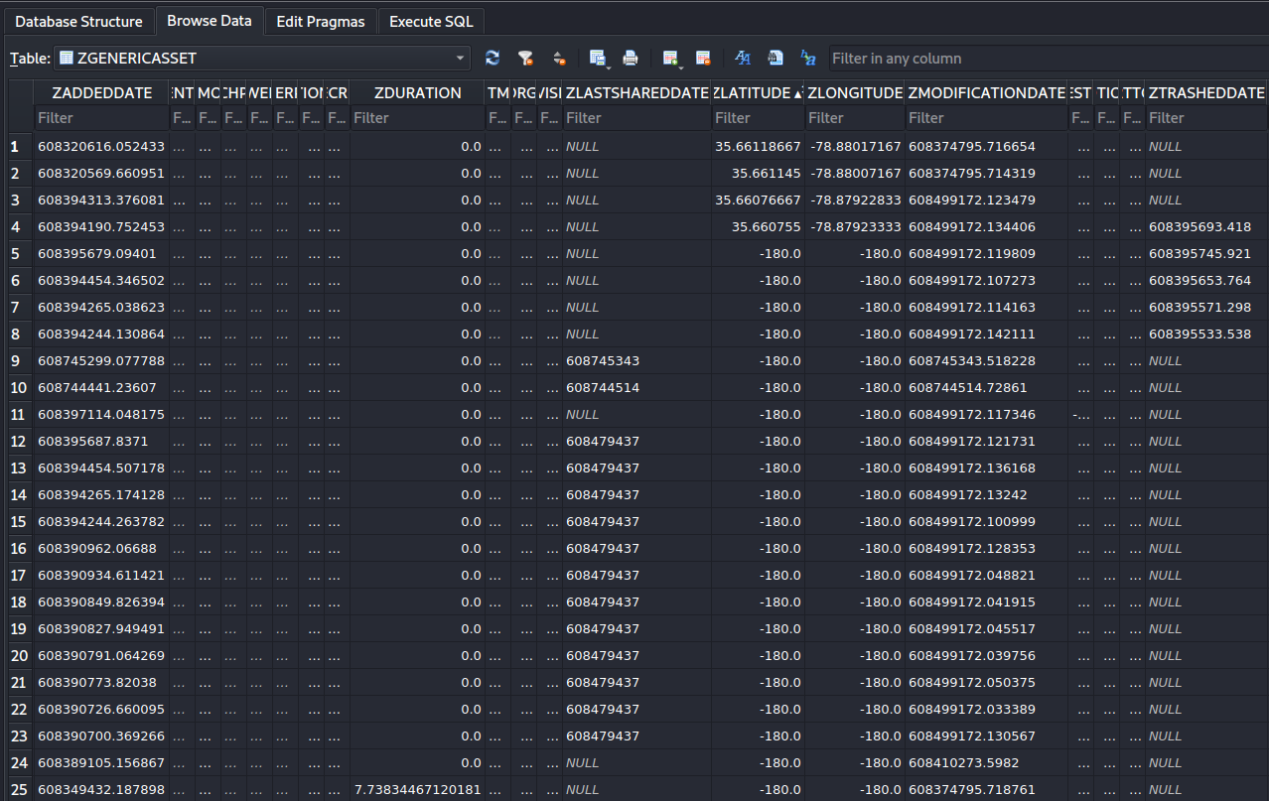
Investigating ZGENERICASSET (2)
Latitude & Longitude Coordinates
Timestamp when photo was deleted
Photo modified timestamp
Timestamp when media was last shared
Duration in seconds (if video)
Date added to Photos timestamp

Slide 16
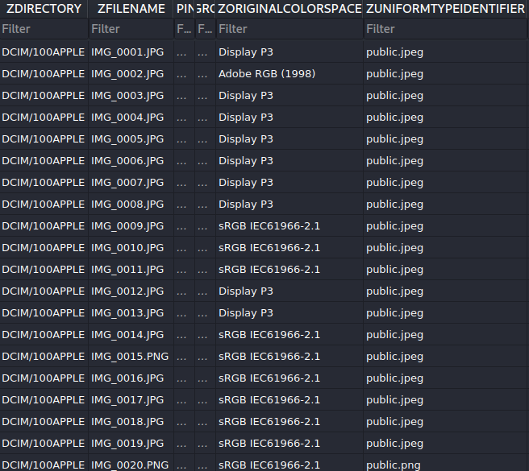
Investigating ZGENERICASSET (3)
Extension (JPEG, PNG, or MOV)
File name (Chronological)
Directory photo is stored in

Slide 17
Photos scenario
Photos and videos are saved in suspect's phone, and we need to determine how many?
Head to the DCIM Folder to find out.
60 items total
  58 Photos
  2 Videos

Slide 18
Forensic scenario questions related to photos
What kind of photos are saved and at what time?
What is location data of photos?
Where did the suspect download the photos from if they weren’t taken with the camera?

Slide 19
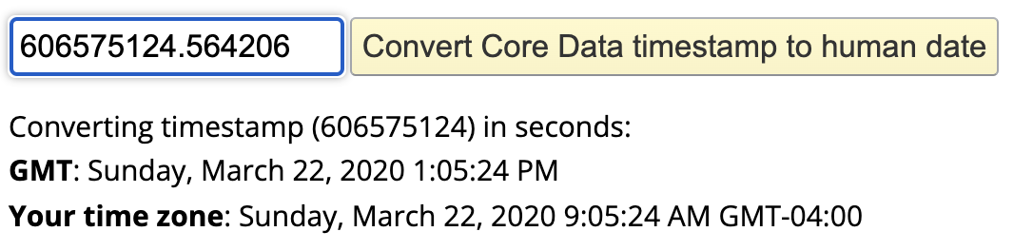
A. What kind of photos are saved and at what time?
Step 1: Head to the Photos.sqlite; ZGENERICASSET table and select any photo.
Step 2: Navigate to the ZADDEDDATE column
  In this instance IMG_0001 has an added date of 606575124.564206
IMG_0001 Was added to the user’s camera roll on Sunday March 22, 2020 at 1:05:24pm GMT
Notes:
https://www.epochconverter.com/coredata

Slide 20

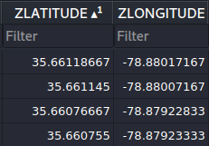
B. What is location data of photos?
Inside the Photos.sqlite; ZGENERICASSET table look for & filter on the ZLATITUDE & ZLONGITUDE columns.
  In this instance only 4 photos have location data:
IMGs 0034, 0033, 0052, & 0047.
To convert Coordinates head to:
  https://www.gps-coordinates.net/

Slide 21
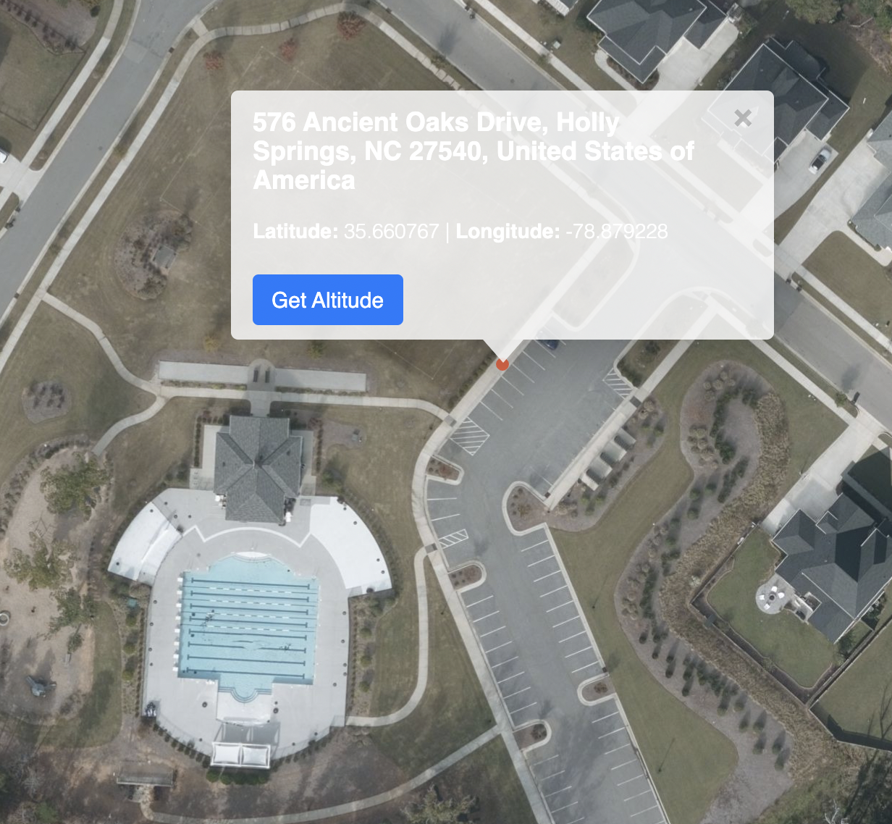
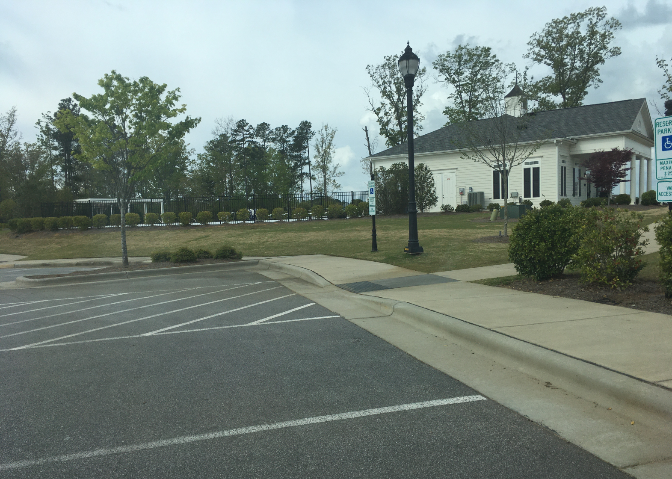
B. What is location data of photos? (2)
IMG_0052 as an example:
Latitude 35.66076667 Longitude -78.87922833

Slide 22


C. Where did the suspect download the photos from if they weren’t taken with the camera?
Head to the Photos.sqlite + ZADDITIONALASSETATTRIBUTES table and look for the ZCREATORBUNDLEID column.
The following 16 images were saved from 3rd party applications

Slide 23
To summarize
Understand the photos application.
Locate the photos application directory.
Look at the photo application database and important tables.
Apply information to scenario.

